Slide 1
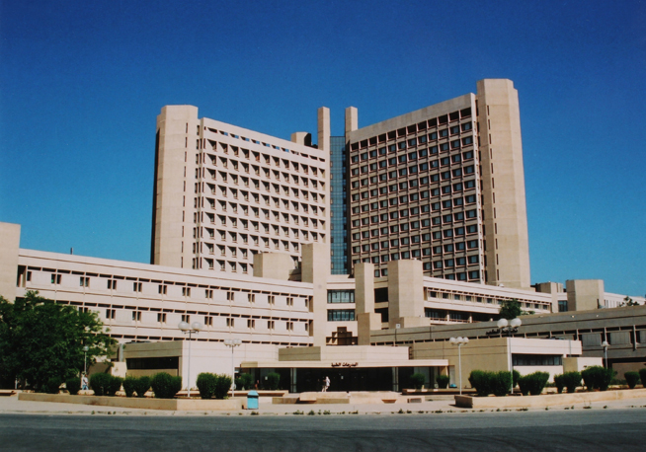
Redab Ahmad Alkhataybeh / MD
Former Neurosurgeon at King Abdallah University Hospital
Master degree in Medicine at Jordan University of Science & Technology
Certified Neurosurgeon at Jordan Medical Council‎
FEBNS / European Board of Neurological Surgery
International Member in AANS / Member in ACNS/YNS
Faculty of medicine committee / Hashemite University

Slide 2
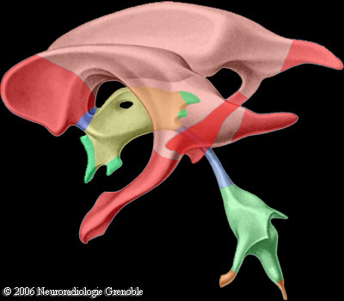

Slide 3
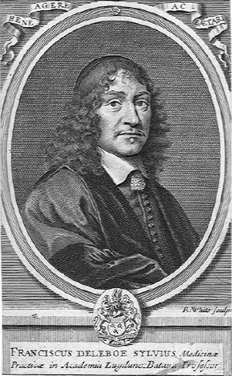
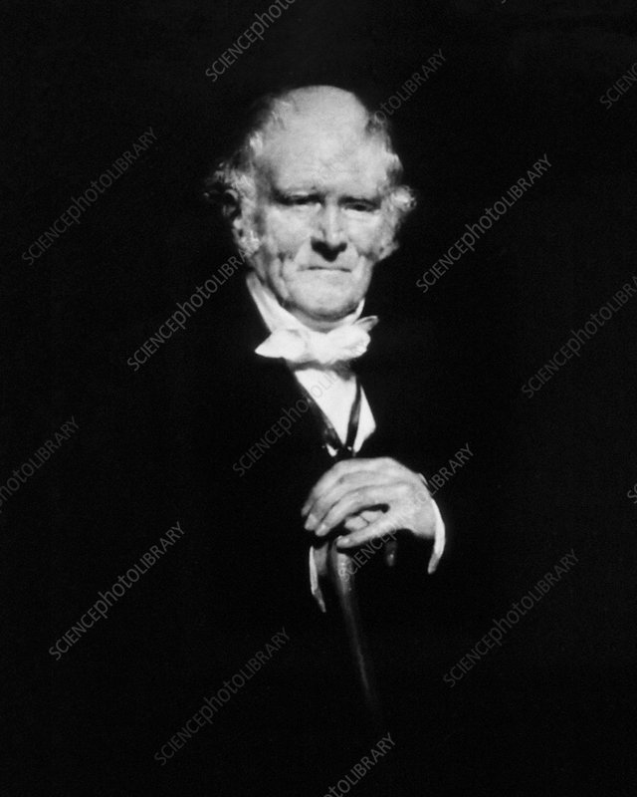
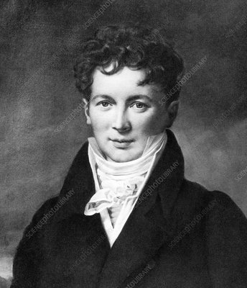
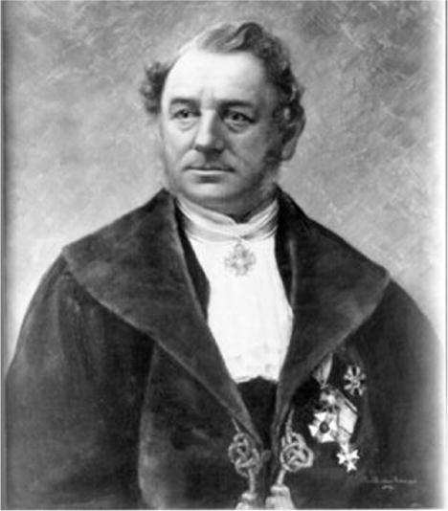
Interventricular foramen of Monro
Cerebral aqueduct (aqueduct of Sylvius)
Median aperture …. Foramen of Magendie
Lateral aperture …. Foramen of Luscka

Slide 4
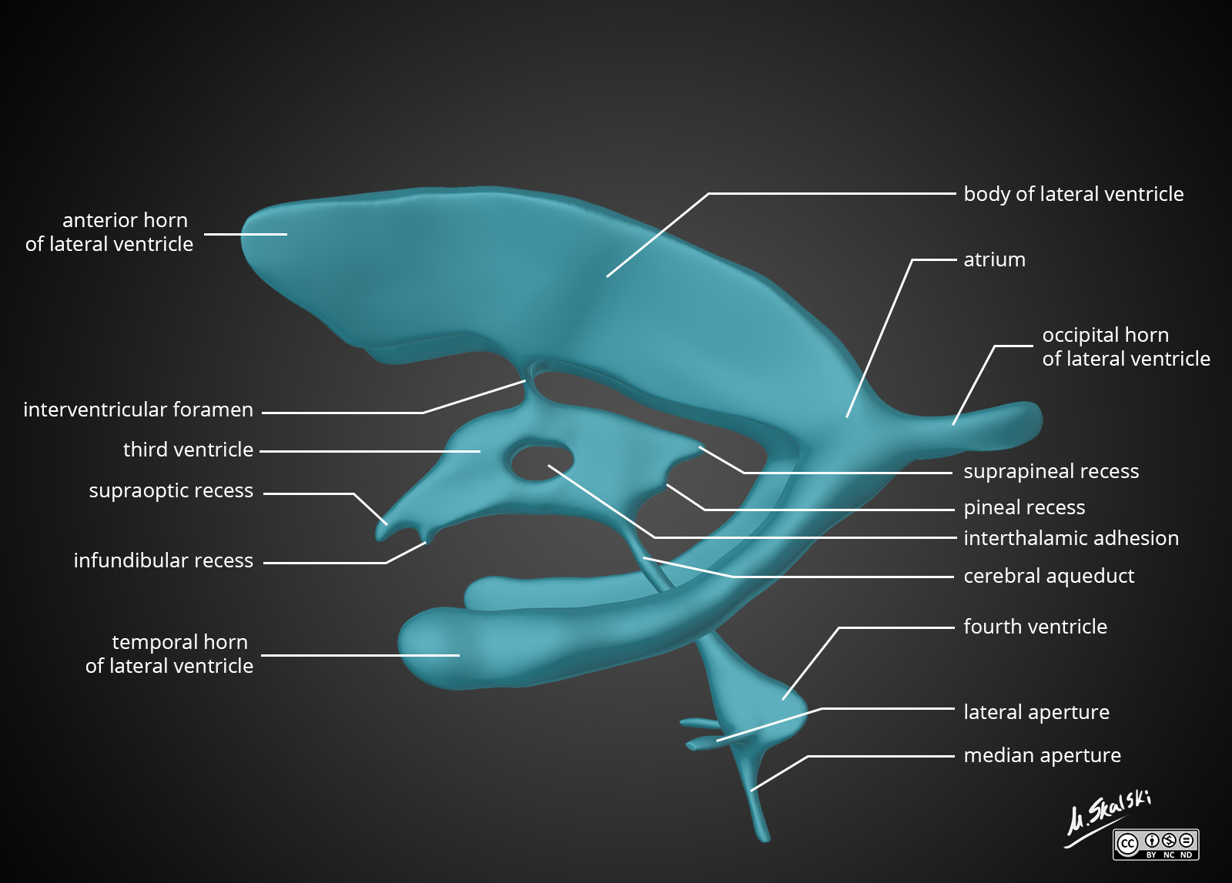

Slide 5
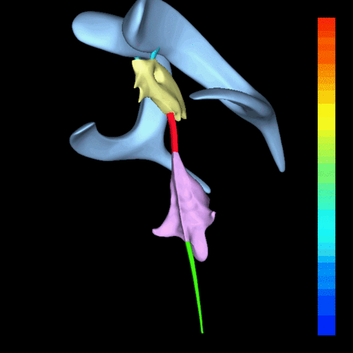

Slide 6
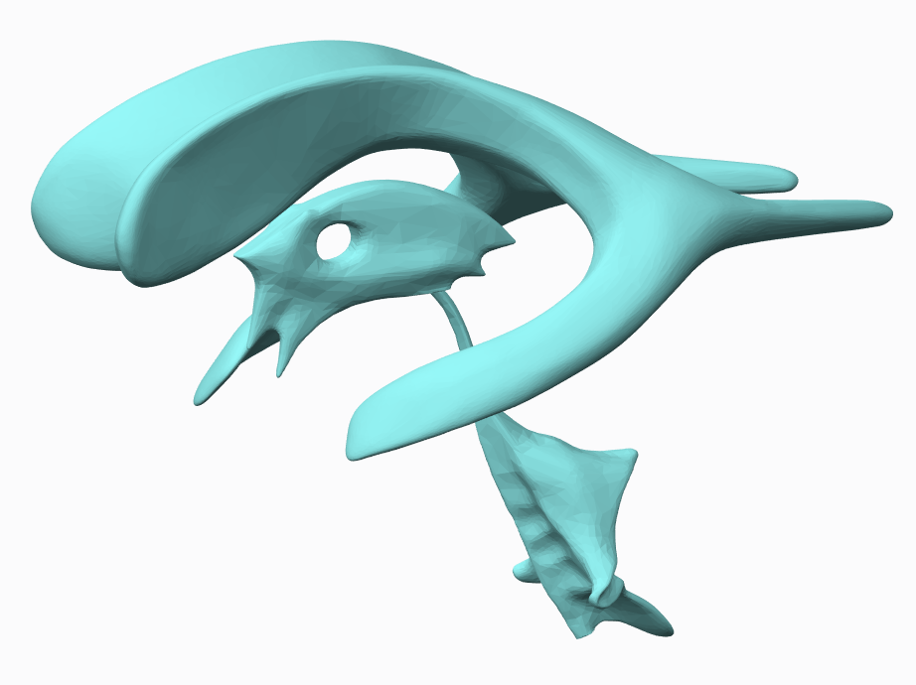

Slide 8
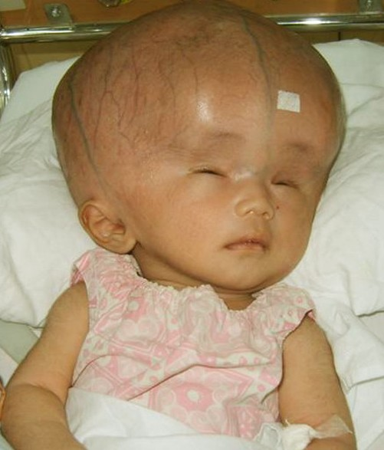
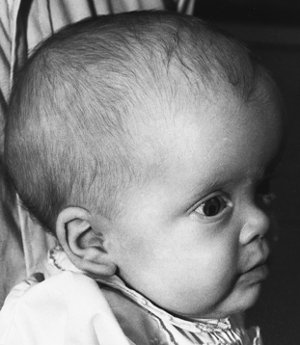
Hydrocephalus

Slide 9
Hydrocephalus
An abnormal accumulation of CSF within the ventricles of the brain.
Impaired Reabsorption: Two main functional subdivisions:
1. Obstructive (AKA non-communicating): block proximal to the arachnoid
granulations. On CT or MRI: enlargement of ventricles proximal to block
2. Communicating (AKA non-obstructive): defect in CSF reabsorption distal
to the arachnoid granulation
CSF overproduction: rare. As with some choroid plexus papillomas

Slide 10
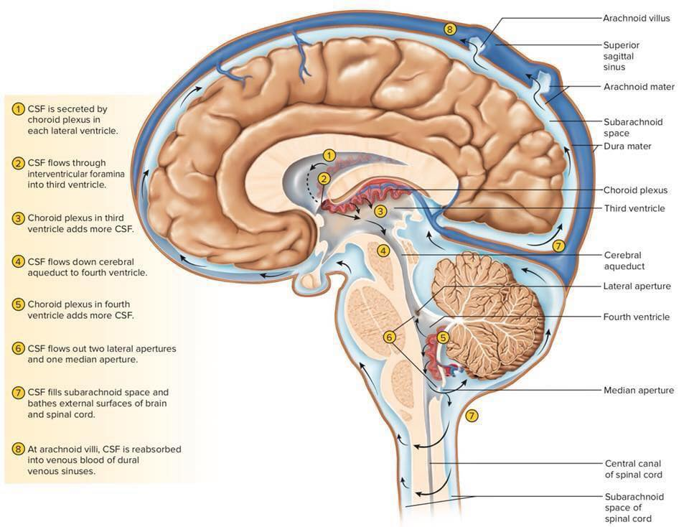

Slide 11
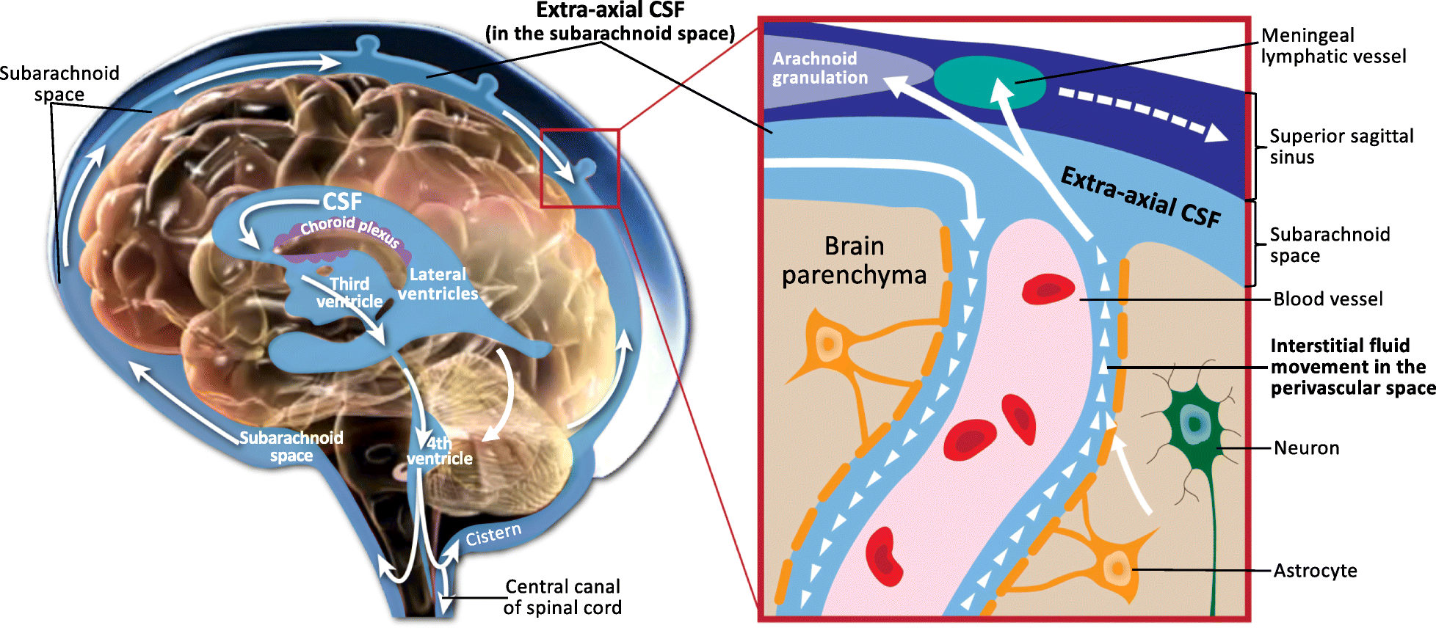

Slide 13
Diagnostic criteria :
Size of both temporal horns (TH) is ≥ 2mm in width
OR
both TH are ≥ 2 mm + the ratio FH/ ID > 0.5
suggestive features :
“Mickey Mouse” ventricles
3rd ventricle should normally be slit-like
periventricular low density on CT ….. (seepage)
Evans ratio >> ratio of FH to maximal biparietal diameter (BPD) measured in the same CT slice: > 0.3
sagittal MRI >>> thinning of the corpus callosum and/or upward bowing of the corpus callosum

Slide 14
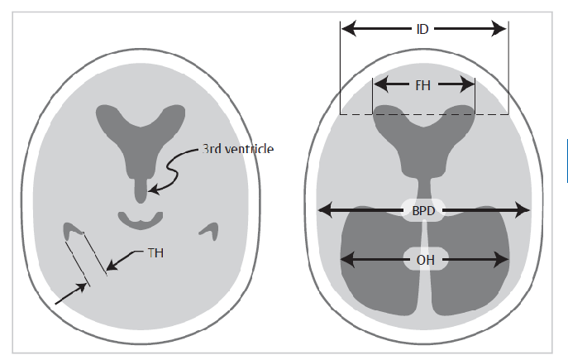

Slide 15
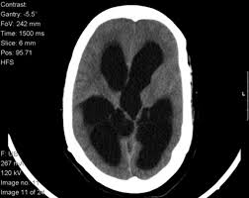

Slide 17
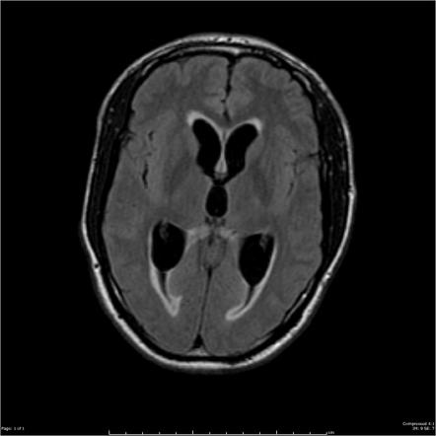
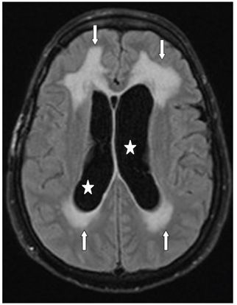

Slide 18
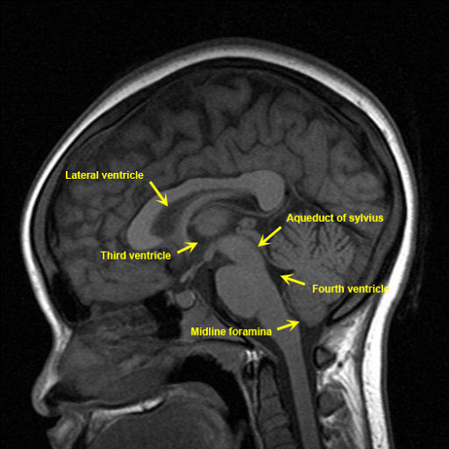

Slide 19
Etiologies
Congenital:
Chiari Type 2 malformation and/or myelomeningocele.
Chiari Type 1 malformation: may occur with 4th ventricle outlet obstruction.
primary aqueductal stenosis (usually in infancy, rarely in adulthood).

Slide 20
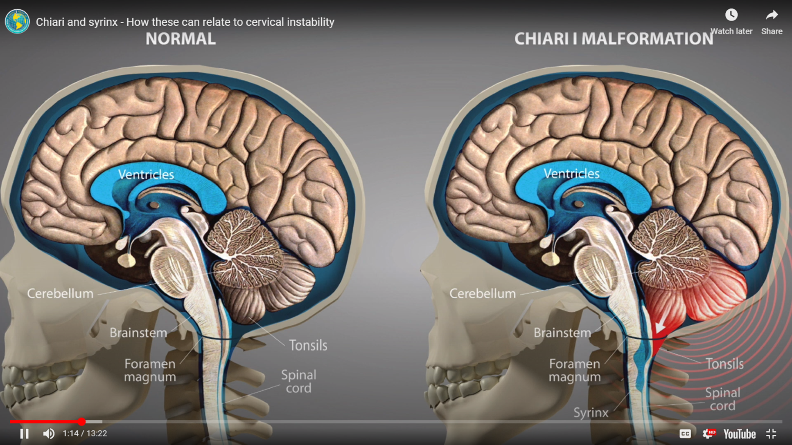

Slide 21
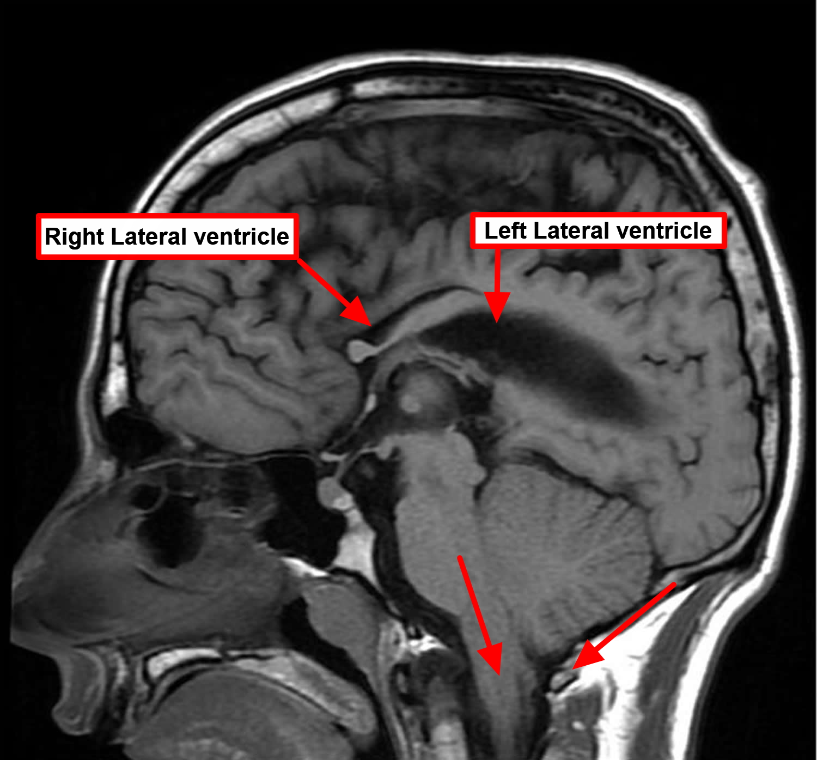
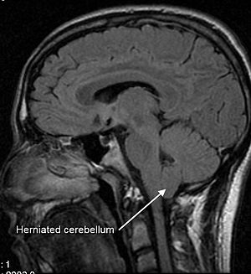
Chari malformation type II Chiari malformation Type I

Slide 22
2. Acquired :
infectious (the most common cause of communicating HCP).
post-hemorrhagic (2nd most common cause of communicating
Secondary to masses : vascular malformation, medulloblastoma,
colloid cyst, Pituitary tumor
Post-op >>> 20% of pediatric patients >>> permanent HCP
(requiring shunt) following p-fossa tumor removal.

Slide 23
Signs and symptoms
Symptoms are those of increased ICP:
Headache
Irritability …. Nausea & Vomitting.
Parinaud’s syndrome ?!
6th nerve (abducens) palsy:
Notes:
French ophthalmologist and neurologist,

Slide 24
Signs and symptoms
head circumference (OFC)
Bulged Anterior Fontanelle
Engorgement of scalp veins: due to reversal of flow
Macewen’s sign: ?!
Splaying of cranial sutures
Notes:
1848 – 1924) was a Scottish surgeon. He was a pioneer in modern brain surgery, considered the father of neurosurgery and contributed to the development of bone graft surgery.

Slide 25
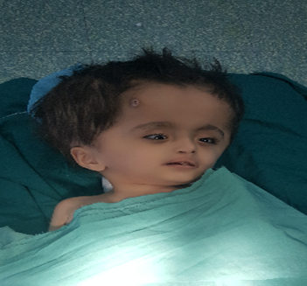
dilated scalp veins
Large HC

Slide 26
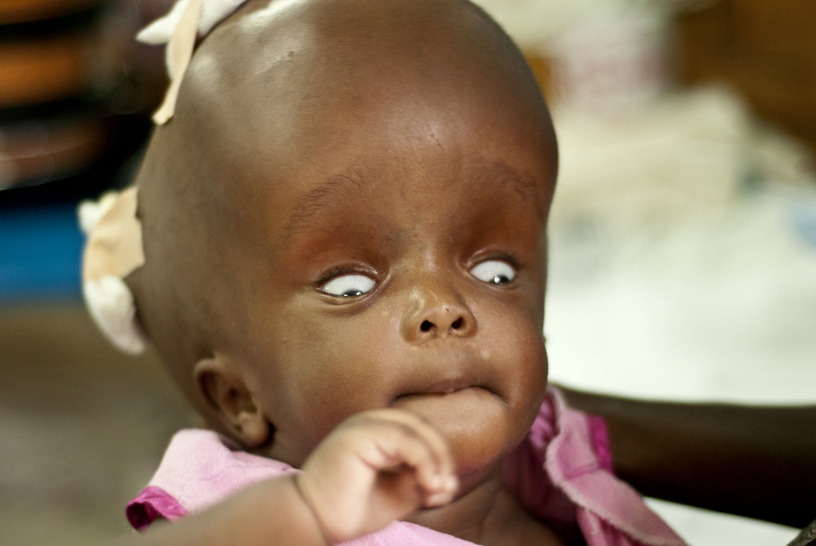
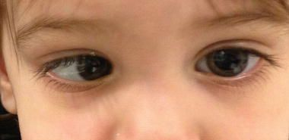
Sunset eyes
Abducent palsy

Slide 27
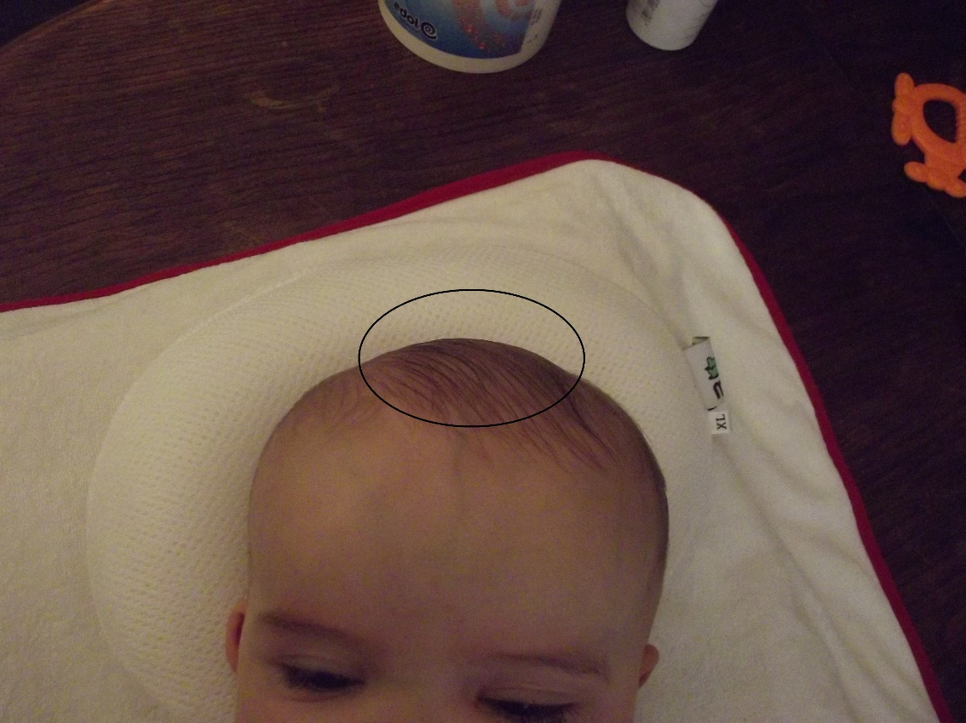
Bulged Anterior Fontanelle

Slide 28
“He who devoted himself to surgery must be versed in the science of anatomy.”

Slide 29
Treatment
Surgical options :
Endoscopic third ventriculostomy (ETV)
Shunting: VP shunt, VA shunt.
Eliminating the obstruction:

Slide 30
Shunts
Ventricular-peritoneal (VP) shunt
Ventricular-atrial(VA) shunt “vascular shunt >>
in abdominal abnormalities :
extensive abdominal surgery
peritonitis
morbid obesity
in preemies >>> NEC and may not tolerate VP shunt.

Slide 31
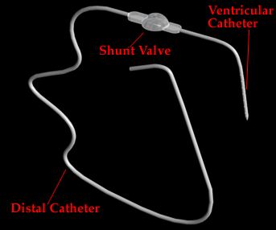

Slide 33
Shunt complications
1. Obstruction: the most common cause of shunt malfunction.
a) proximal: ventricular catheter (the most common site)
b) valve mechanism
c) distal:
2. Disconnection
3. Infection:
4. hardware erosion through skin
5. seizures
6. overshunting.

Slide 34
ETV:
Indications :
Obstructive HCP.
Option in : shunt obstruction.
Contra-indications:
1) communicating HCP

Slide 36
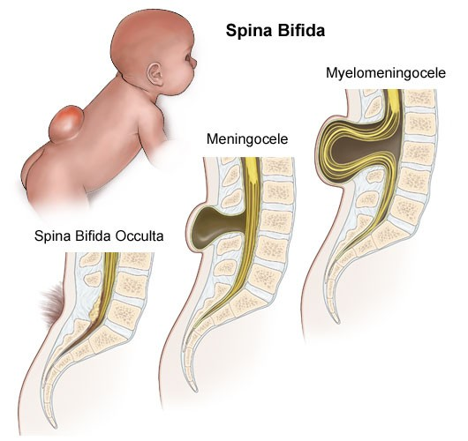
Spina Bifida

Slide 37
Types :
Spina bifida occulta (SBO) :
Congenital absence of a spinous process and variable amounts of
lamina. No visible exposure of meninges or neural tissue.
Spina bifida aperta :
Meningocele >> Congenital defect in vertebral arches with cystic distension of meninges, but no abnormality of neural tissue.
Myelomeningocele >> Congenital defect in vertebral arches with cystic dilatation of meninges + abnormality of neural tissue.

Slide 38
Spina bifida occulta (SBO).
found in 5-10 % of population.
The defect may be palpable, with cutaneous manifestations.
Incidental finding.
Occasionally >> associated with diastematomyelia,
tethered cord, lipoma, or dermoid tumor.

Slide 39
Myelomeningocele (MM)
Incidence >> is 1–2/1000 live births
(0.1– 0.2%).
Risk factors :
previous birth with MM
family history
Folic acid deficiency
Maternal H. pylori infection

Slide 40
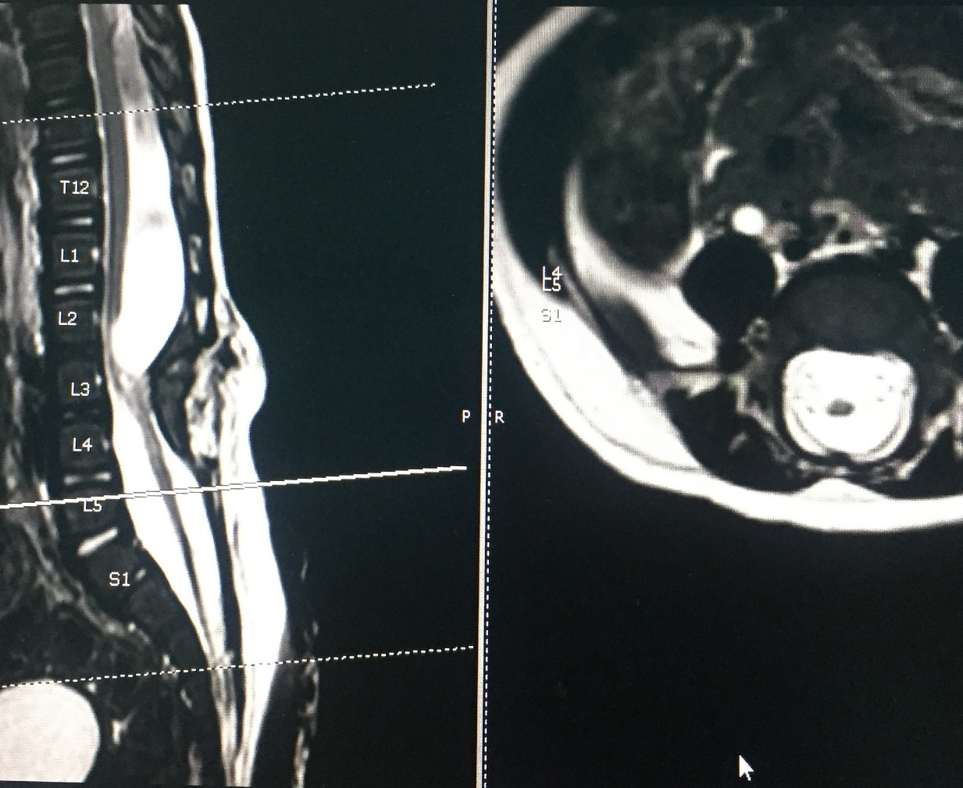
Notes:
Tethered cord at L5 level. splitting by bony spur at L3, with re-joining at L5….. hydromyelia of the two hemicords. Findings (diastomatomyelia)…cystic lesion posterior to the spinal cord, at L1-2 displacing the cord anteriorly….an oval shaped intra-dural extra-medullary fatty lesion at conus medullaris displacing it posteriorly from L5-S3 levels representing intra-dural lipoma.

Slide 41
MM and HCP
Hydrocephalus (HCP) develops >>> 65–85% of MM
5–10% of MM >> clinically overt HCP at birth.
Almost all MMC have >>> Chiari type II

Slide 42
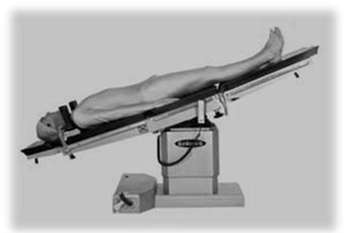
Management :
Initial approach :
Cover with saline soaked gauze
Give IV antibiotics
Keep in Trendelenburg position
Surgical repair :
within 36-28 hours of birth….. > 48 hrs >>> infx ?
Shunting within 3 days …. unless overt HCP

Slide 43
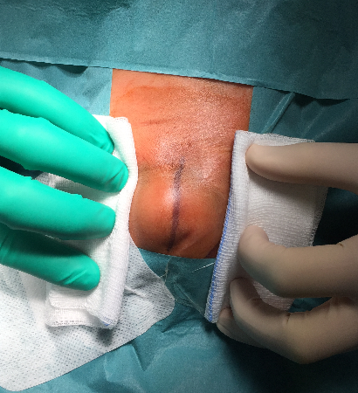
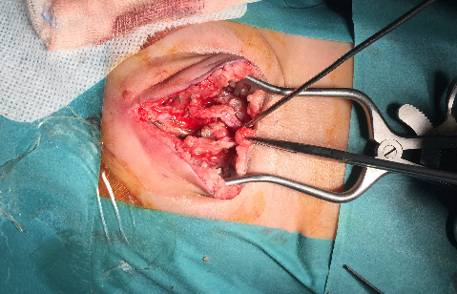

Slide 44
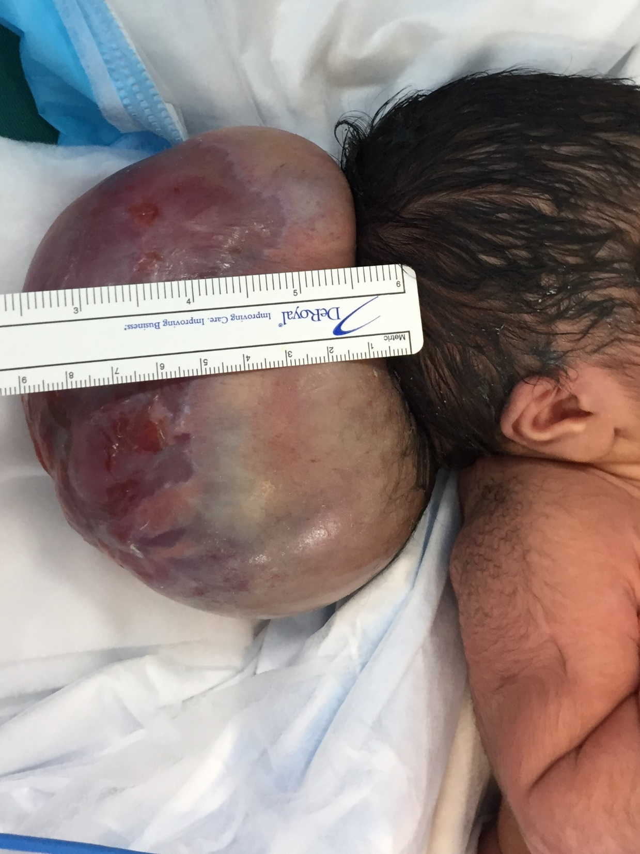
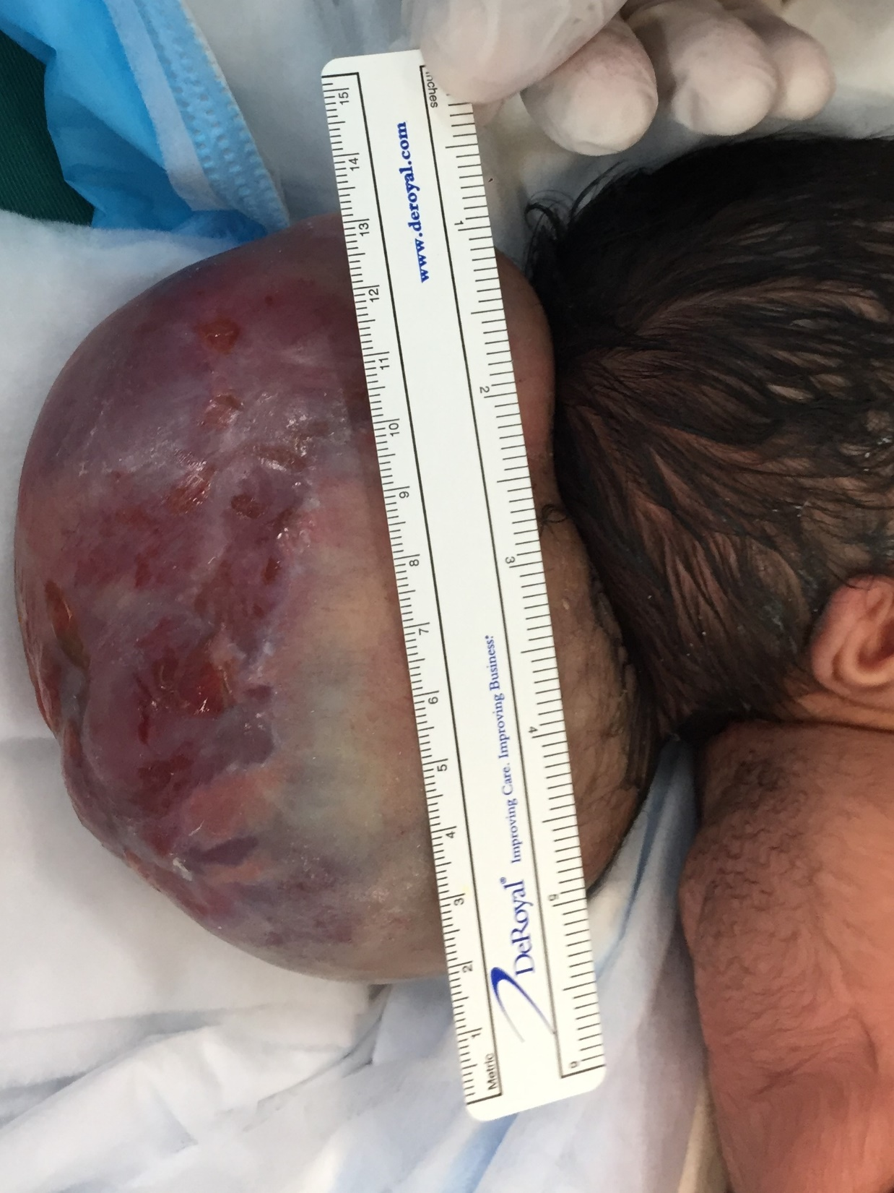

Slide 45
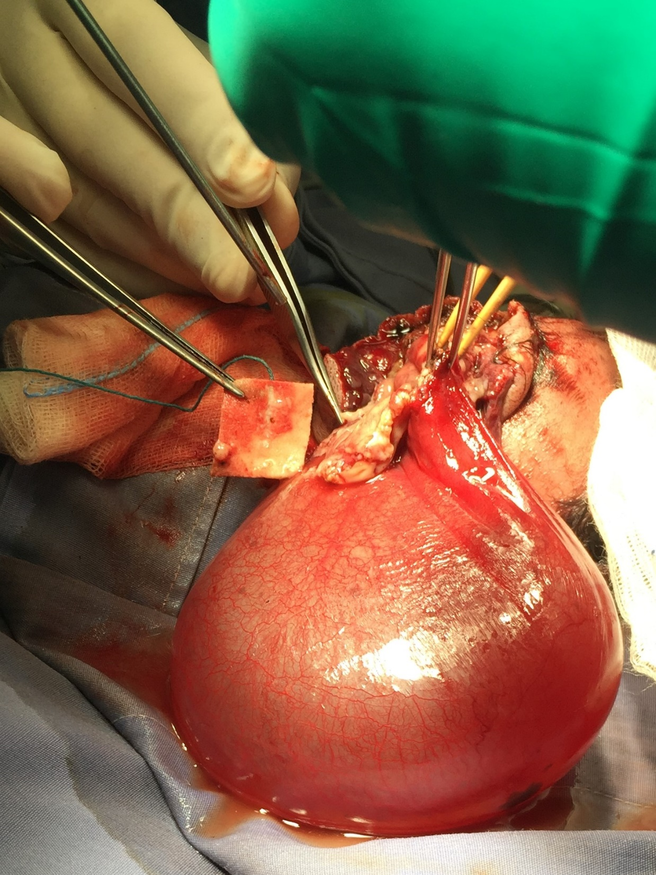
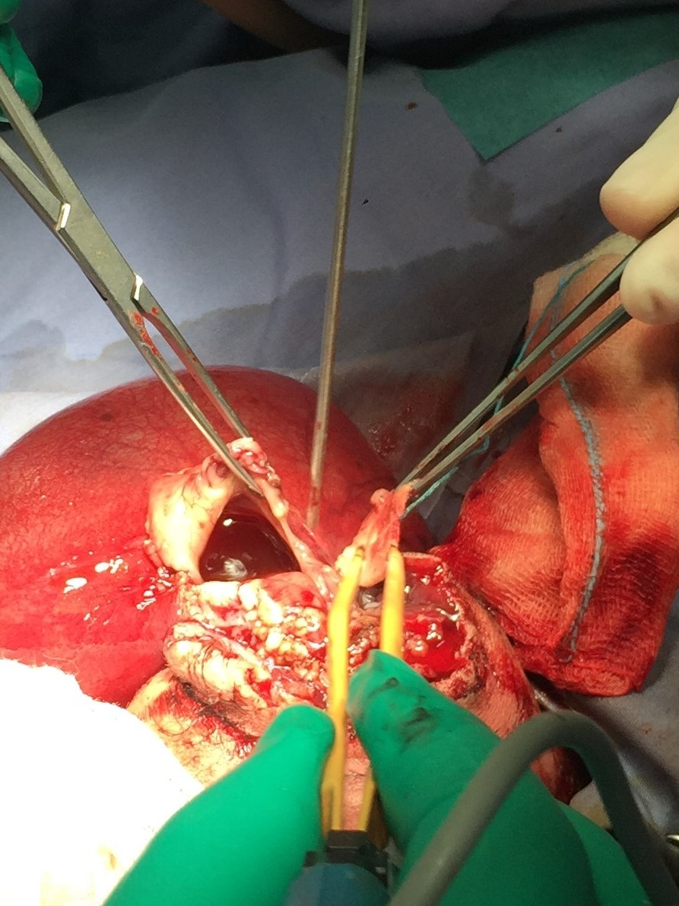

Slide 46
Good Luck

