Slide 1


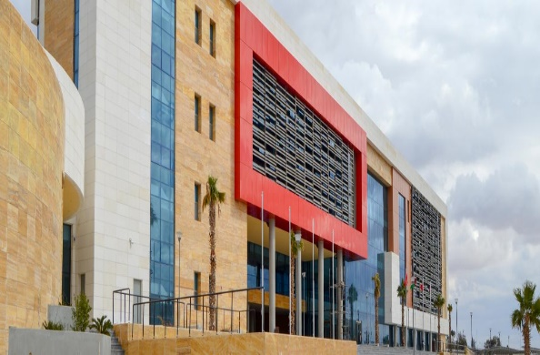

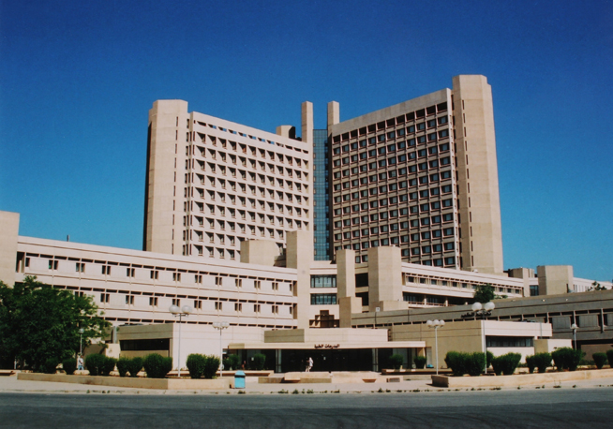


Redab Ahmad Alkhataybeh / MD
Former Neurosurgeon at King Abdallah University Hospital
Master degree in Medicine at Jordan University of Science & Technology
Certified Neurosurgeon at Jordan Medical Council‎
FEBNS / European Board of Neurological Surgery
International Member in AANS / Member in ACNS/YNS
Faculty of medicine committee / Hashemite University

Slide 2
Degenerative Disc Disease (DDD)
Cervical Myelopathy

Slide 5
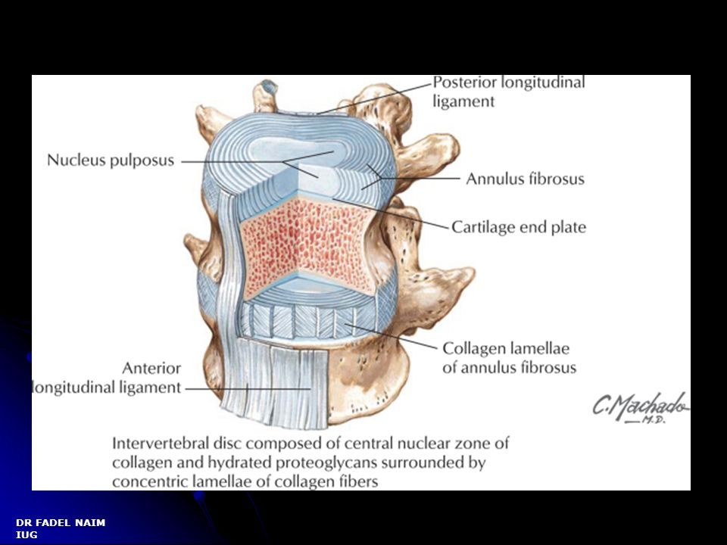
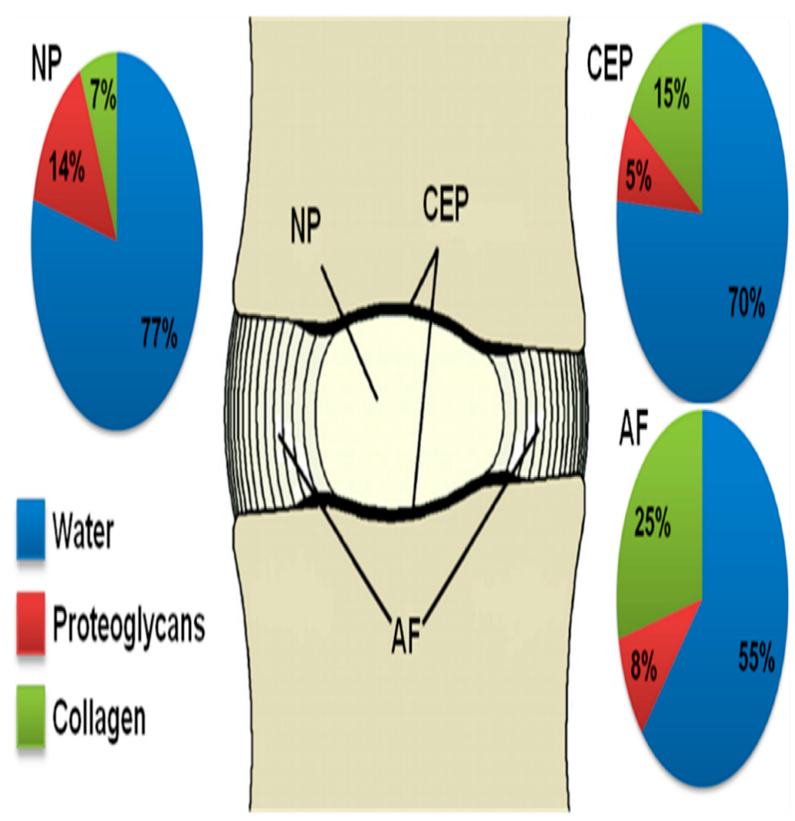
Molecular composition on the IVD

Slide 6
Degenerative Disc Disease
Aging process
Progressive dehydration of the nucleus pulposus and loss of disk volume
Degenerative tear in the annulus with herniation of the nucleus pulposus through this tear.
Present with L.B.P and L.O.M

Slide 7
Epidemiology
Low-Back Pain
The most common cause of disability for < 45 yrs of age
3rd most common reason to seek medical attention
60–90% >> lifetime prevalence
1% of patients will have nerve-root symptoms.
1–3% have lumbar disc herniation.

Slide 8
Pathophysiology
Three Phases:
Phase I >> circumferential tears or fissures in the outer annulus, coalesce to form radial tears.
Phase II >> Internal disk disruption (IDD), loss of disk-space height
Phase III >> further disk resorption, fibrosis, narrowing, endplate destruction and osteophyte formation

Slide 9
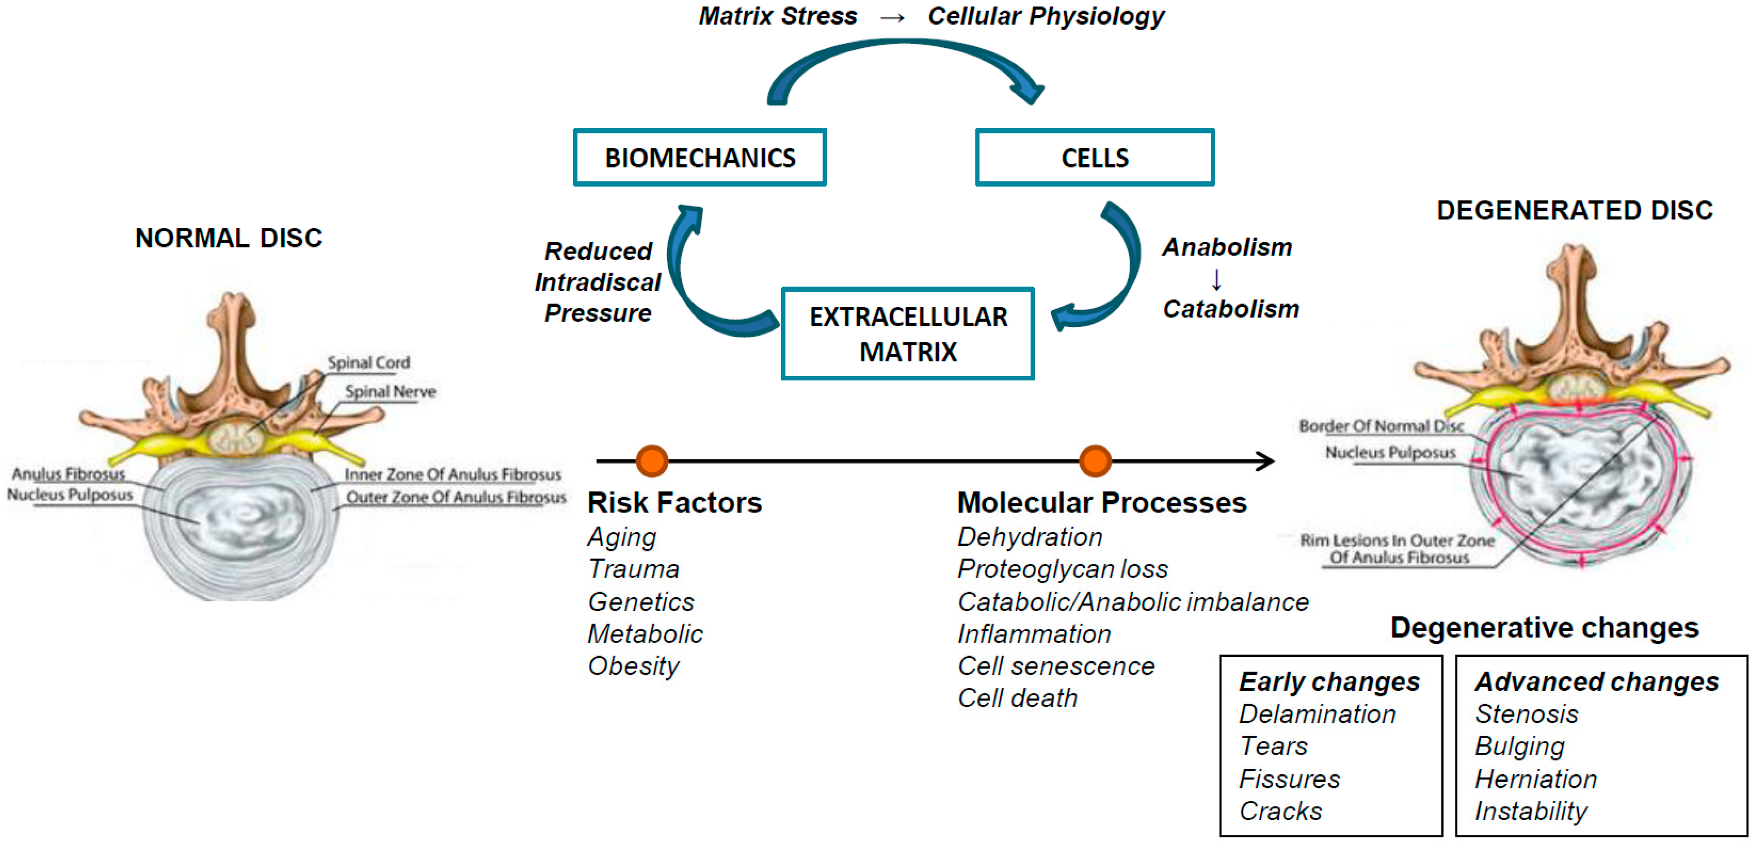

Slide 10
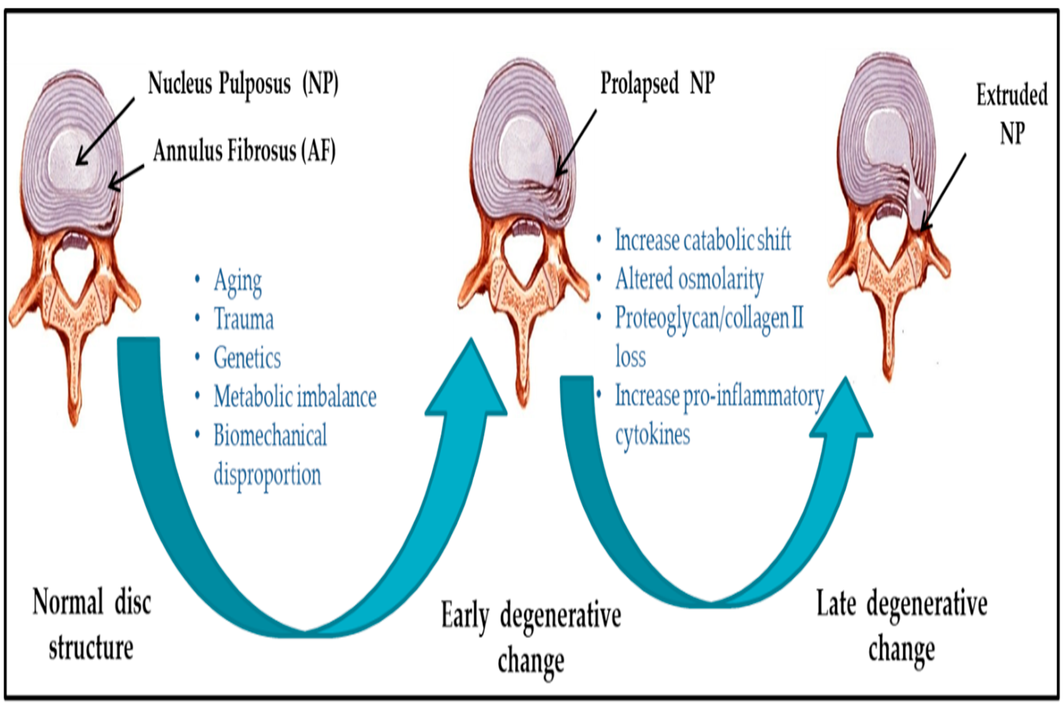

Slide 11
Nomenclature
Term | Discerption
Annualr tears | breaks through fibers extend radially, transversely, or concentrically
DDD | desiccation, fibrosis, narrowing of the disc, diffuse bulging of the annulus beyond the disc space
Disc Bulge | generalized displacement of disc material (as > 50% or 180°) beyond the peripheral limits
Disc Herniation | focal: < 25% of the disc circumference
 | broad-based: 25–50% of the disc circumference
 | Protrusion : Base > Apex
 | Extrusion : Apex > Base
 | Sequestered : Free Fragment
 | Migrated : Fragment displaced but still attached

Slide 12
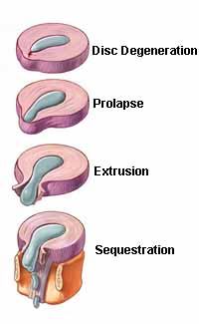
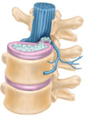
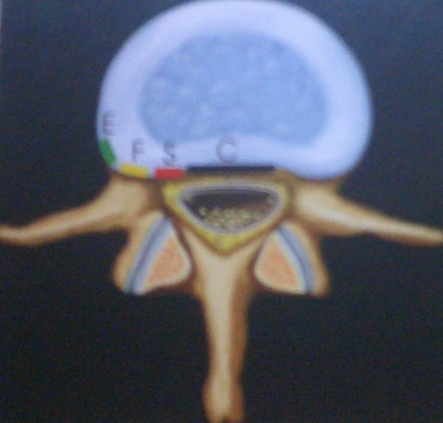

Slide 13
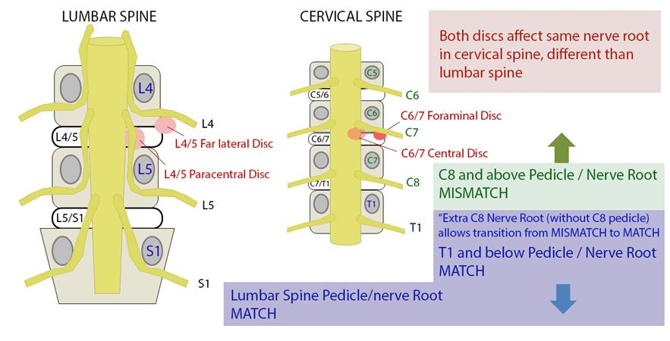

Slide 14
Pathophysiology
 | L3-L4 | L4-L5 | L5-S1
Compressed root | L4 | L5 | S1
% | 5-10% | 40-45% | 40-45%
Reflex affected | Knee | - | Ankle jerk
Motor | Q. Femoris (knee ex) | EHL & tibialis (foot drop) | Gastrocnemius (plantarflexion)
Sensory | M. maleolus | Dorsum of foot | L. maleolus

Slide 15
Clinical Presentation
LBP +/- radiculopathy
Pain exacerbated with physical stress and relieved with bed rest
Differentiate mechanical (non-specific) LBP from serious spinal conditions (radiculopathy or cauda equina syndrome caused by PID, tumors, infections…..)

Slide 16
Clinical Presentation / History
Mechanical low back pain >> “musculoskeletal” ,result from strain of the paraspinal muscles and/or ligaments, irritation of facet joints
Radiculopathy >> Dysfunction of a nerve root >> pain/ dermatomal sensory disturbances, weakness nerve root, and hypoactive reflexes
Sciatica >> Pain along the course of the sciatic nerve, usually resulting from root compromise

Slide 17
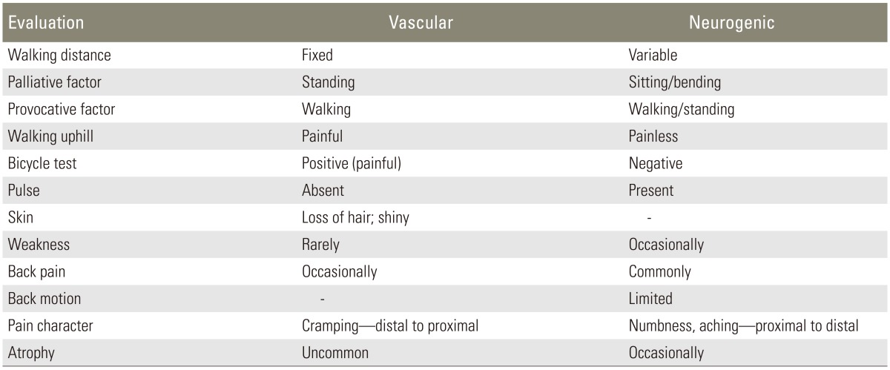
Clinical Presentation / History

Slide 18
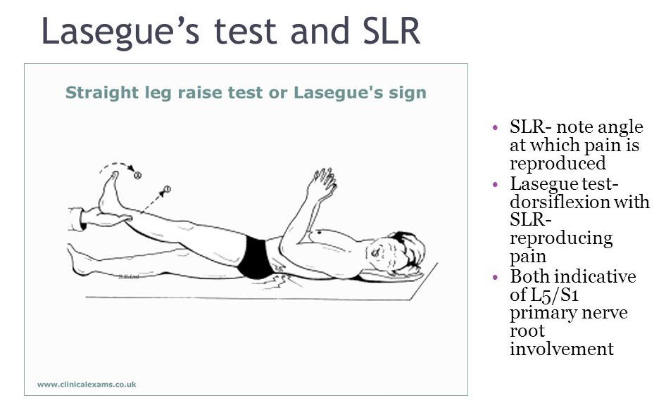
Clinical Presentation / Exam
Notes:
French physician that released over one hundred scientific papers. He became recognized in the mid-19th century from his work in the fields of psychiatry and neurology.[

Slide 19
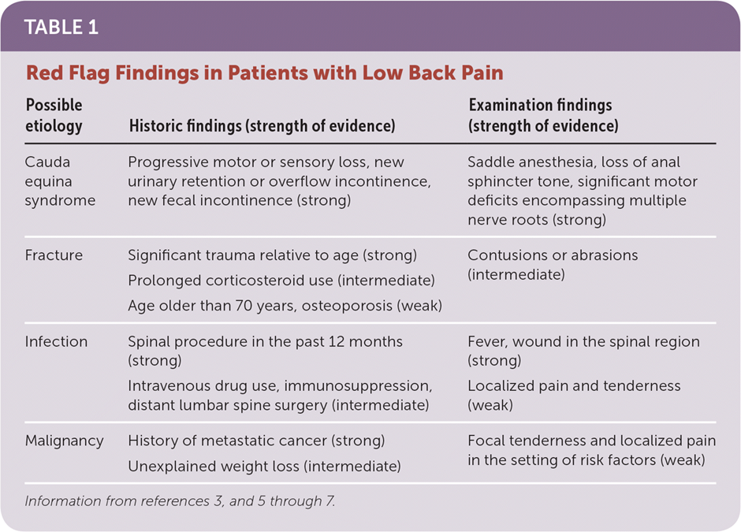

Slide 20
Investigation / MRI
Imaging
a- MRI
b- CT
c- X-RAY
d- Bone densitometry
Blood tests
a- CBC
b- CRP
c- ESR

Slide 21
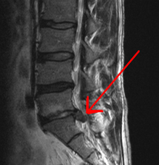
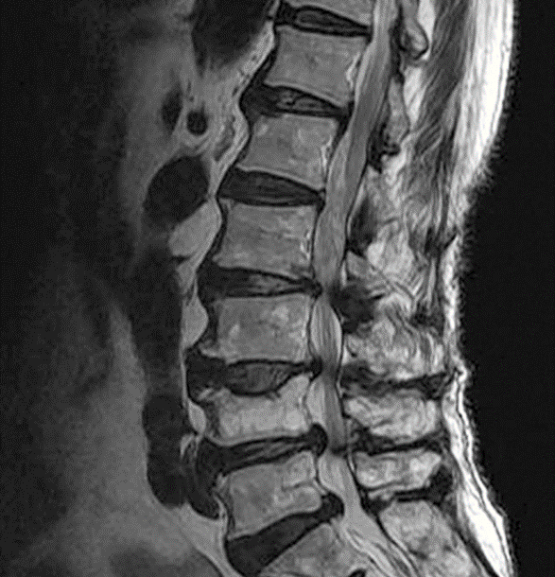

Slide 22
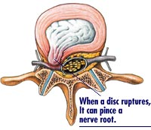
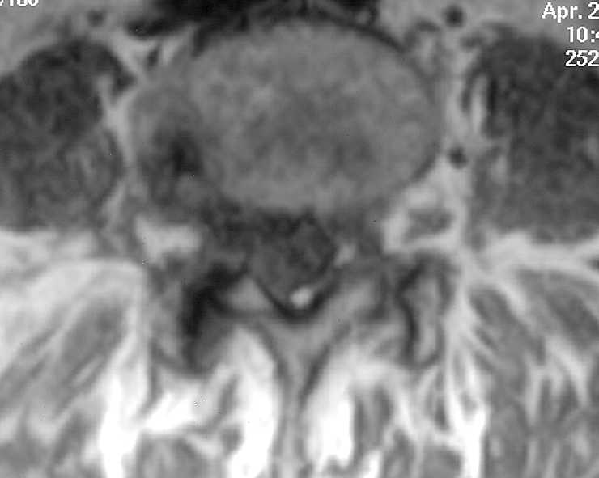

Slide 23
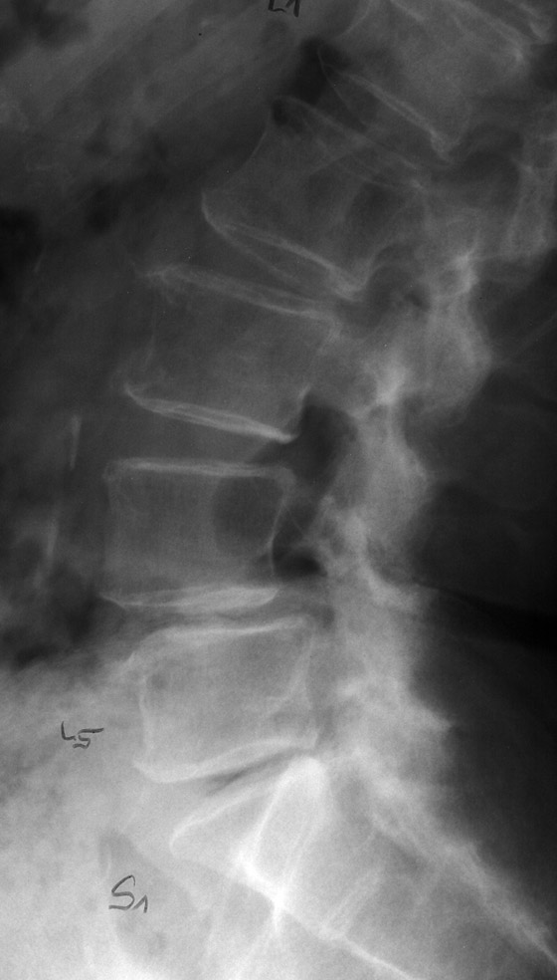
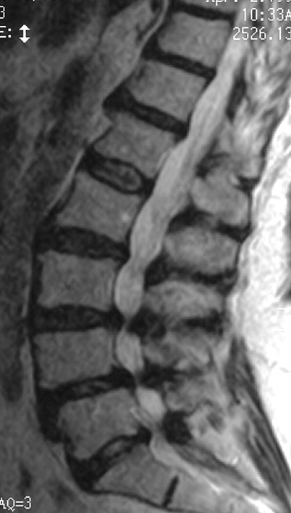

Slide 24
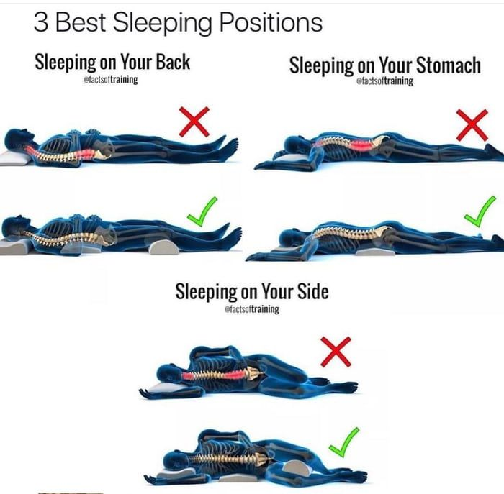
Management
Conservative treatment
Bed rest
Analgesia
Muscle relaxants
Life style modification
Regular PTH
Education
Epidural injections

Slide 25
Management
Surgical treatment/ Absolute
Significant weakness
Progressive neuro deficit
Bowel or bladder dysfunction
Surgical treatment/ Relative
Persistent Pain despite rest
Progressive pain sx
Recurrent attacks of sever pain

Slide 26


You are taller in the morning and… in space?

Slide 27
Cervical spondylotic Myelopathy
Congenital spinal stenosis
Focal stenosis due to disc degeneration (cervical bar)
Hypertrophy of structures
Subluxation
Altered mobility
Telescoping of laminae
Alteration of lordotic curvature

Slide 28
Cervical spondylosis:
Hypertrophy of any of the following
a) dura
b) articular facets
c) ligaments
  ● increased stenosis in extension is more than with flexion >>posterior inbuckling of ligamentum flavum
  ● PLL >> ossification (OPLL) May be segmental or diffuse. Often adherent to dura
  ● ossification of the ligamentum flavum

Slide 29
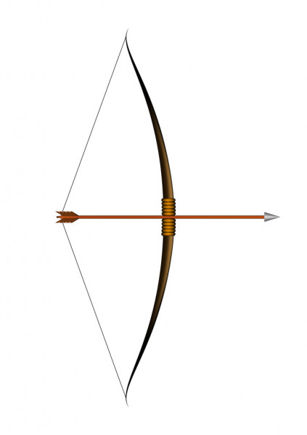
Cervical spondylosis:
Alteration of the normal lordotic curvature
Reduction of lordosis: including
  straightening
  reversed lordosis (kyphosis): “bowstringing” of the spinal cord
  Exaggerated lordosis (hyperlordosis):

Slide 30
Pathophysiology
Direct cord compression between osteophytic bars and hypertrophy or infolding of the ligamentum flavum
Ischemia due to compression of vascular structures >> (arterial deprivation +/- venous stasis)

Slide 31
Pathophysiology
Repeated local cord trauma by normal movements in the presence of protruded discs
cephalad/caudad movement with flexion extension
anterior/posterior traction on the cord by dentate ligaments & nerve roots
  ● increased stenosis is more common in extension
  ● unstable segments may sublux

Slide 32
Pathophysiology
Histologically:
Degeneration of the central grey matter
Degeneration of the posterior columns above the lesion
Demyelination in the lateral columns below the lesion.
Anterior spinal tracts are relatively spared.
Atrophic changes in the ventral and dorsal roots
Neurophagia of anterior horn cells.

Slide 33

Humans and giraffes have the same amount of vertebrae in the neck

Slide 34
Clinical presentation
Myeloradiculopathy: some combination of
  Radiculopathy: nerve root compression
  Spinal cord compression >> myelopathy. Some stereotypical syndromes

Slide 35
Clinical presentation
pain and paresthesias in the head, neck and shoulders with little or no suggestion of radiculopathy nor abnormal physical findings.
  This group is the most difficult to diagnose and treat
  often requires a good physician-patient relationship to decide if surgical treatment should be undertaken

Slide 36
Clinical presentation
CSM >> the most common in patients > 55 yrs of age.
CSM is rare in patients <40 years of age.
(CSM) develops in almost all patients with ≥30% narrowing of the cross-sectional area of the cervical spinal canal

Slide 37
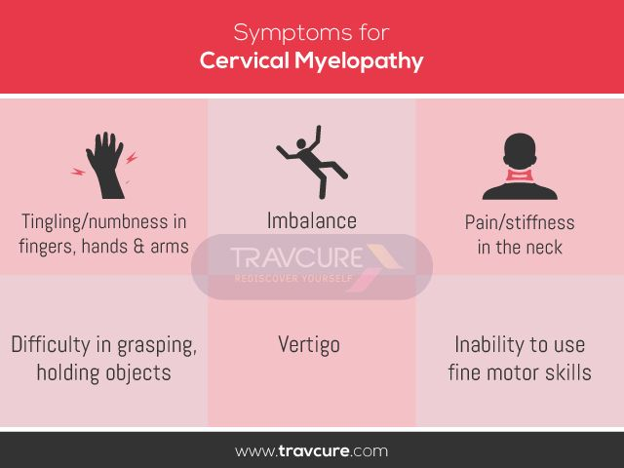

Slide 38
Clinical presentation
Gait disturbance, often with LE weakness or stiffness, is a common early finding in CSM.
Ataxia may result from spinocerebellar tract compression. Early on >> diffculty running.
Cervical pain and mechanical signs are uncommon in cases of pure myelopathy.

Slide 39
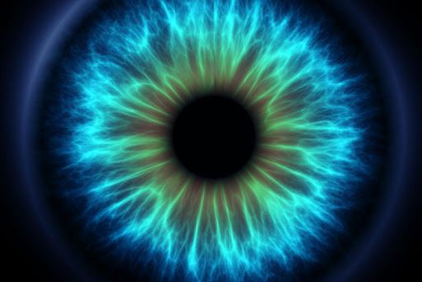
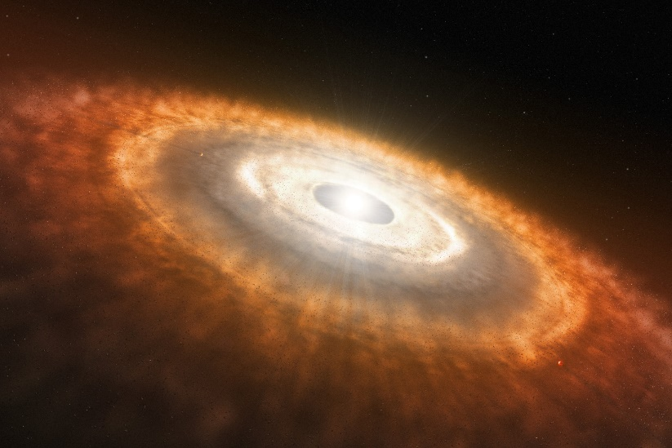
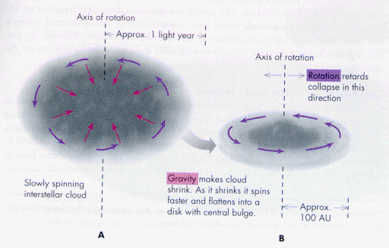

Slide 40
Motor symptoms
Findings are due to cord (UMN) +/- root (LMN) compression.
The earliest motor findings >> weakness in the triceps and hand intrinsics. (wasting of the hand muscles)
Clumsiness with fine motor skills is common.
Proximal weakness of the LE +/- Spasticity.

Slide 41
Sensory symptoms
minimal, often not radicular in distribution.
A sensory level >> levels below the area of cord compression.
LEs exhibit loss of vibratory sense (in as many as 82%),
Compression of the spinocerebellar tract >> diffculty running.
Lhermitte’s sign is rare

Slide 42
Reflexes
In 72–87% >> hyperactive at a varying distance below the level of stenosis.
Clonus, Babinski’s sign, or Hoffman’s sign may also be present.
Dynamic Hoffman’s sign may be more sensitive ?
94% of asymptomatic with +ve Hoffman’s >> significant spinal cord compression on MRI.
Notes:
Babinski’s 1886/ French-Polish professor of neurology.

Slide 43
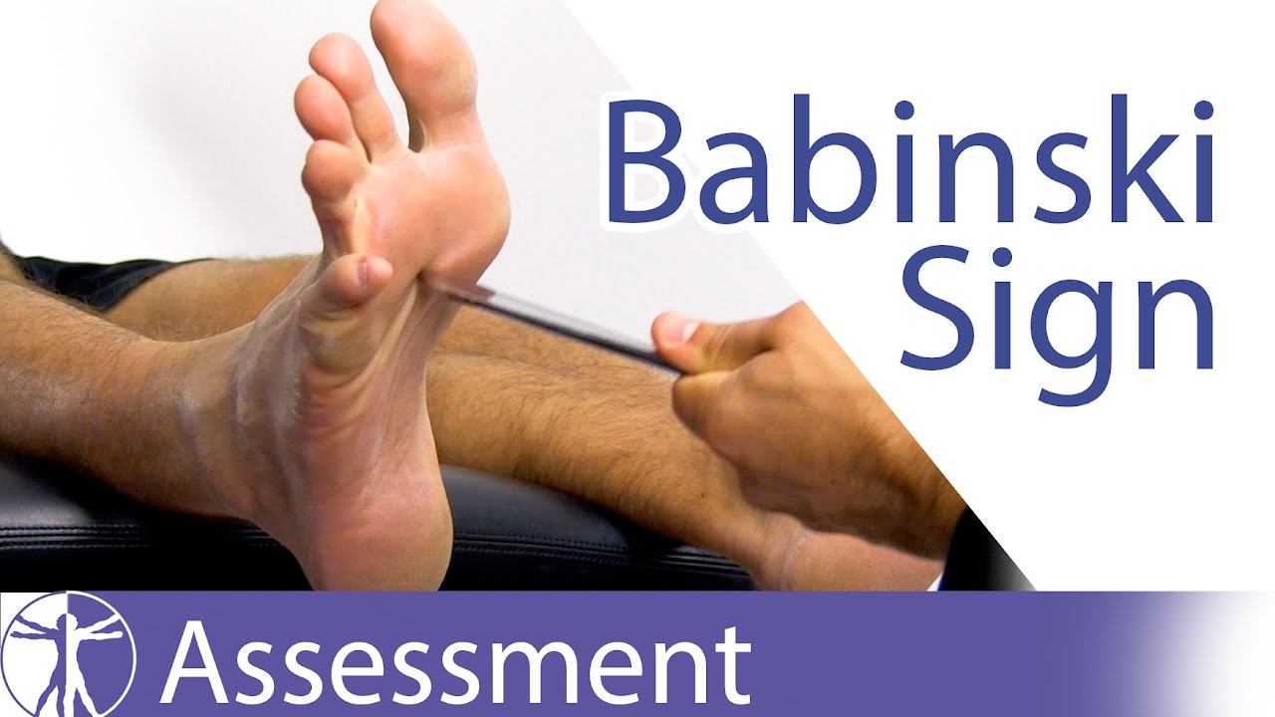
Notes:
Joseph Jules François Félix Babinski was a French-Polish professor of neurology. He is best known for his 1896 description of the Babinski sign, a pathological plantar reflex

Slide 44
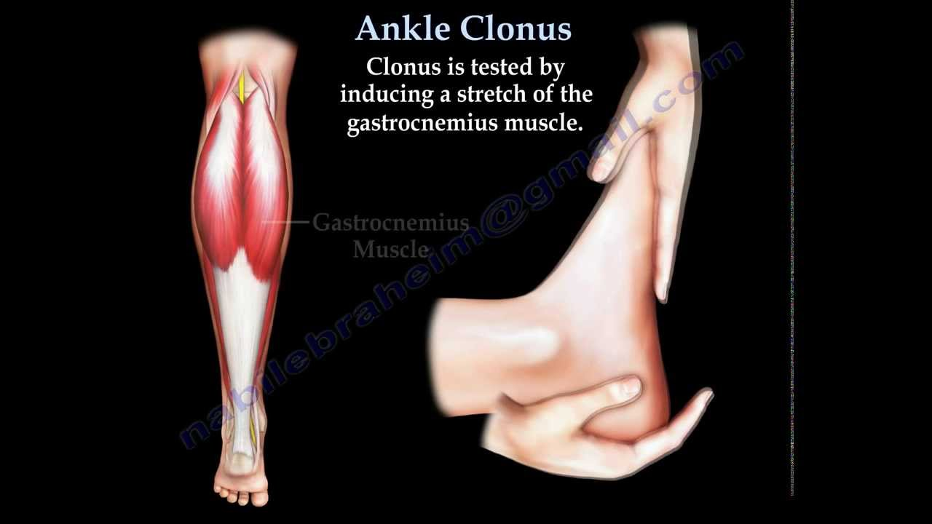

Slide 45
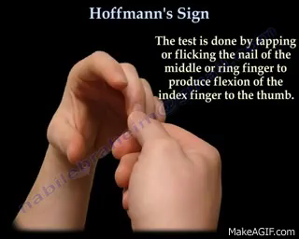
Notes:
Hoffman >> German neurologist….. (1857-1919)

Slide 46
Sphincter symptoms
Urinary urgency and frequency are common
?? also protean in the aging population.
Urinary incontinence is rare.
Anal sphincter disturbances are uncommon.

Slide 47
Clinical syndromes
Transverse lesion syndrome
Motor system syndrome
Central cord syndrome
Brown-Séquard syndrome
Brachialgia and cord syndrome

Slide 48
Natural history
The time course of symptoms is highly variable and unpredictable.
≈ 75% of cases of CSM >> progression in a stepwise fashion (1/3) or gradually in (2/3).

Slide 49
Differential diagnosis
ALS
Multiple Sclerosis (MS): spinal cord demyelination
remissions and exacerbations are common
patients are younger
Herniated cervical disc (soft disc):
  patients are younger
  Course is more rapid

Slide 50
Differential diagnosis
Subacute combined system disease:
  abnormal vitamin B12 level
  macrocyic anemia
Hereditary spastic paraplegia:
  family history is key.
  Diagnosis of exclusion
Spontaneous intracranial hypotension

Slide 51
MRI Imaging :
Shows intrinsic cord abnormalities:
Rules out Dxx (Chiari malformation,tumor…).
Bony structures and calcified ligaments are poorly imaged.
  These shortcoming are overcome with CT bone windows.

Slide 52
MRI Imaging :
Findings of poor outcome
multilevel T2WI hyperintensity within the cord
single level T2WI hyperintensity with T1WI hypointensity
spinal cord atrophy (transverse area <45 mm2)

Slide 53
MRI Imaging :
reduced (TASC) at the level of maximum compression.
“banana” shaped cord on axial images
Narrowing is not specific for CSM: ≈ 26% of asymptomatic individuals >64 years of age have spinal cord compression on MRI
“snake eyes” (AKA “owl’s eyes”) within the cord on axial T2WI >> cystic necrosis of the cord >> poor outcome

Slide 54
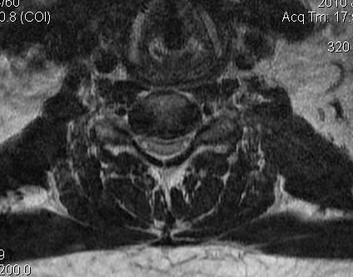
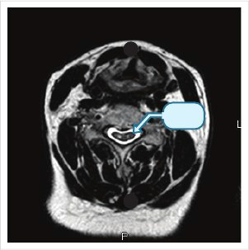

Slide 55
Management
Conservative management
bed rest
prolonged immobilization with rigid bracing
modified activity to eliminate “high-risk” activities
anti-inflammatory medications.
Surgical treatment

