Slide 1
Septic Arthritis
Dr. Monther Gharaibeh

Slide 2
Definition and Epidemiology
Inflammation of the joint secondary to a pyogenic microorganism
- Incidence: 5/ 100.000
- 50% < 2 y old
- M:F= 2:1
- Location:
Infancy Hip most common (35%)
Adults Knee (50%)
IVDU: SIJ & SCJ

Slide 3
Pathogens
Microbiology by Organism
Group B streptococcus | most common in neonates with community-acquired infection exposed during transvaginal delivery
Staph aureus | most common in children over 2 years of age gram-positive cocci in clusters most common in nosocomial infections of neonates
Neisseria gonorrhoeae | still the most common organism in adolescents gram negative diplococci, negative Gram stain a majority of the time patients usually have a preceding migratory polyarthralgia, multiple joint involvement, and small red papules may treat with large doses of penicillin alone and usually does not require surgical debridement.
Group A beta-hemolytic streptococcus | most common organism following varicella infection
HACEK organisms | Haemophilus, Actinobacillus, Cardiobacterium, Eikenella, and Kingella fastidious incidence of septic arthritis caused by H influenzae has markedly decreased since the advent of its vaccine

Slide 4
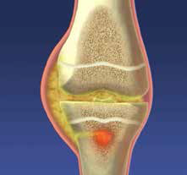
Pathophysiology
Hematogenous route
Exogenous route
Contiguous
80% RTI
Skin Penetration
Osteomyelitis
Hip
Shoulder
Ankle
Elbow
NOT the Knee

Slide 5
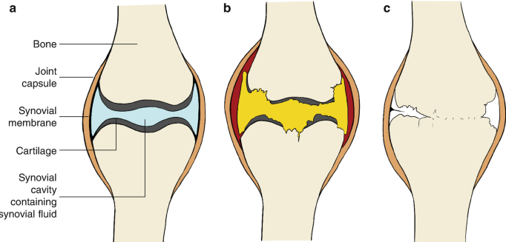

Slide 6
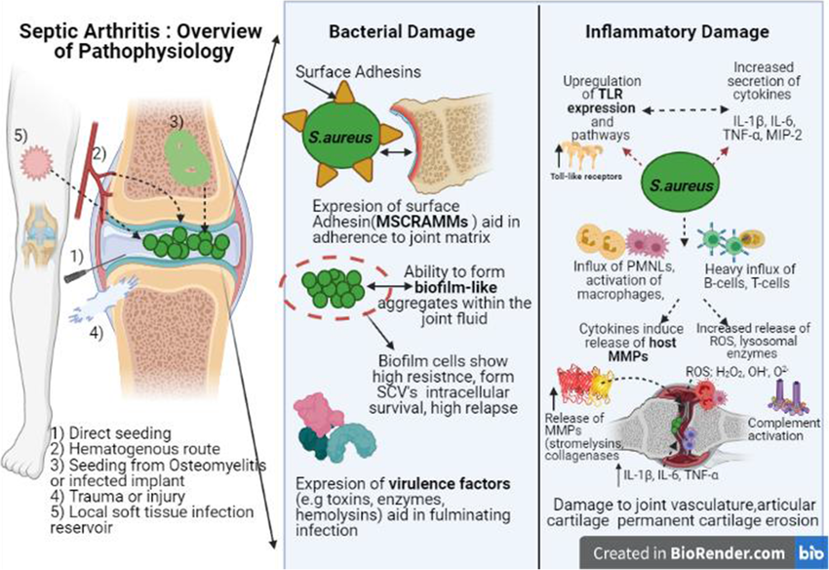
Urgent Issue

Slide 7
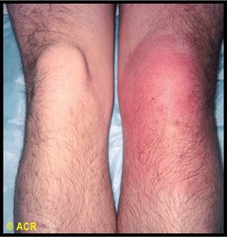
Presentation
Symptoms
acute onset of pain
presents more acutely than osteomyelitis
systemic symptoms
often associated with fever and other systemic symptoms causing toxic appearance
limp or refusal to bear weight
Physical exam
High grade fever
Ill looking patient
inspection and palpation
localized swelling
effusion, tenderness, and warmth

Slide 8
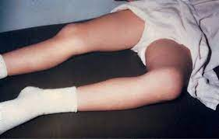
Presentation
hip rests in a position of flexion, abduction, and external rotation (FABER)
hip capsular volume is maximized with flexion, abduction, and external rotation and is the position of comfort for hip septic arthritis
range of motion
severe pain with passive motion
severe pain with logrolling of the hip
unwillingness to move joint (pseudoparalysis)

Slide 9
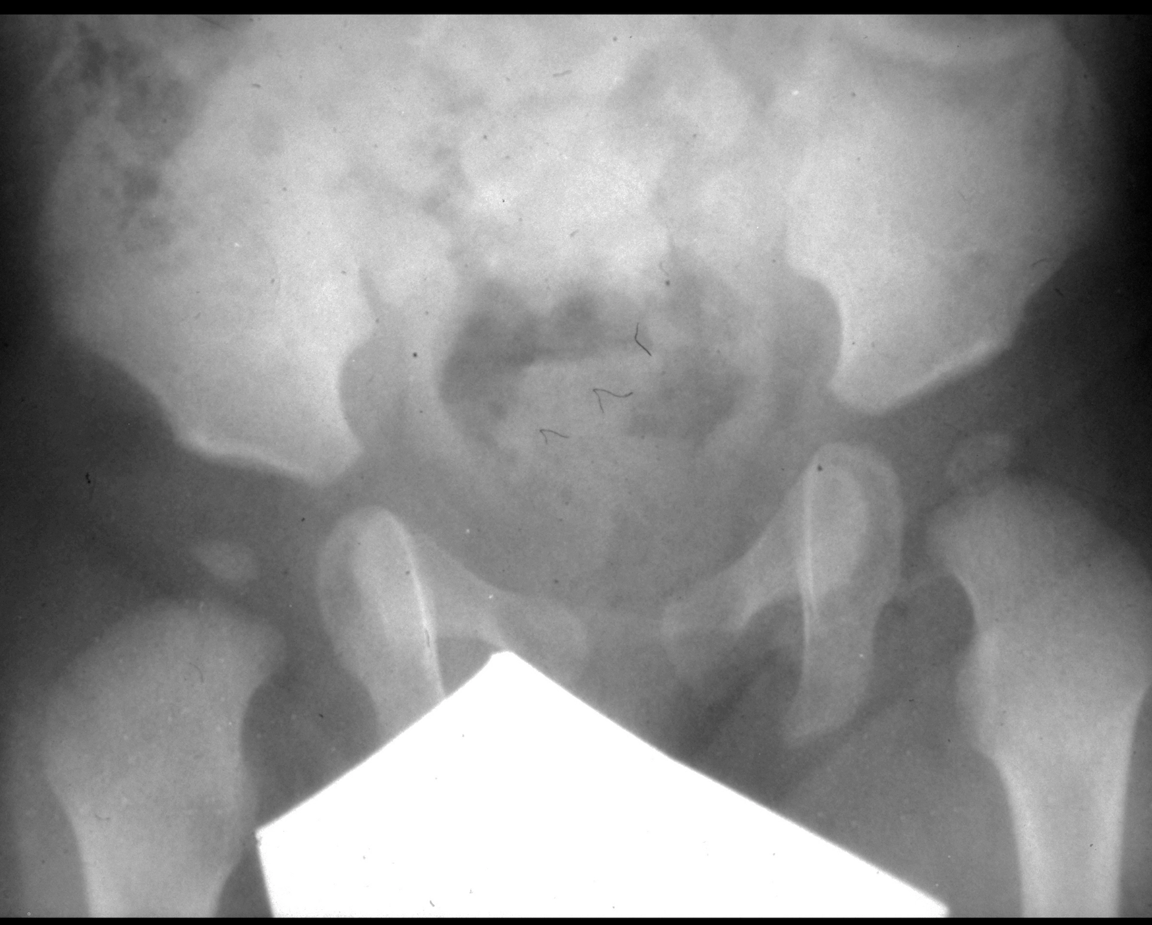
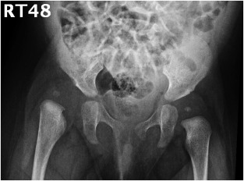
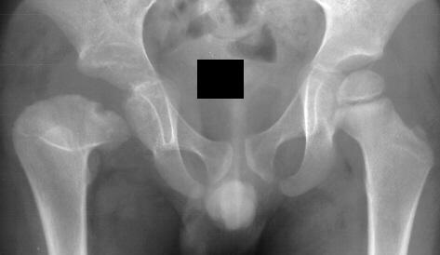
Imaging
Radiographs
AP and frog-leg lateral pelvic x-rays, if hips can be put in frog leg position.
may be normal, especially in early stages of disease
widening of the joint space
in infants, prior to ossification of the femoral head, widening of joint space can be seen by lateral displacement of the proximal femur
subluxation
dislocation
bone lesions

Slide 10
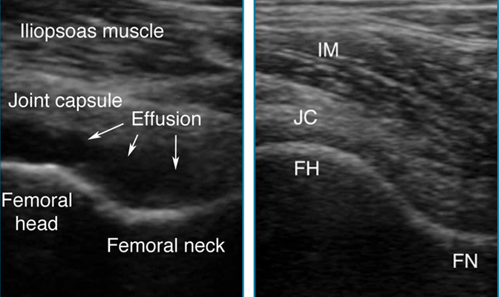
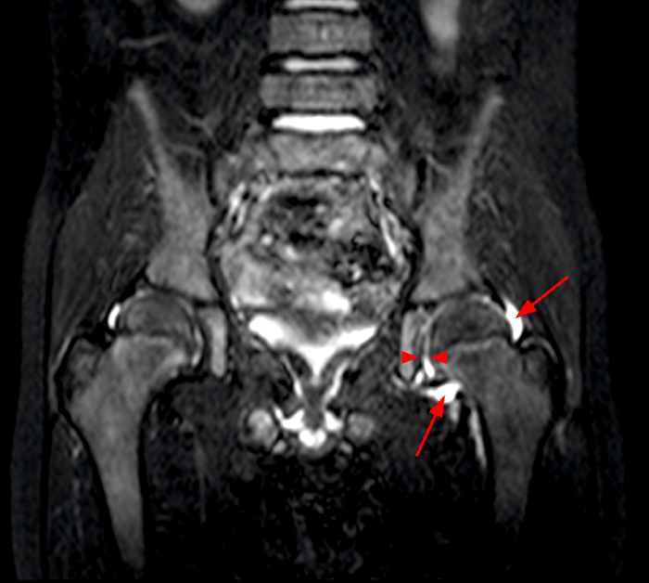
Imaging
Ultrasound
In neonates, ultrasound both hips if any septic joint is found, signs and symptoms of infection are muted in neonates, and a missed infection can be catastrophic.
For US guide aspiration
MRI
identifies a joint effusion and possible adjacent osseous involvement which can guide operative treatment

Slide 11
Labs
Serum labs
WBC: elevated in 30-60% of patients with a left shift in 60%
neonates may have leukopenia
ESR >30 mm/hr
CRP > 3 mg/dl
may rise as soon as 6-8 hours after injury or infection
yields a 74% probability of septic arthritis
order of sensitivity of above criteria
fever > CRP > ESR > refusal to bear weight > WBC

Slide 12
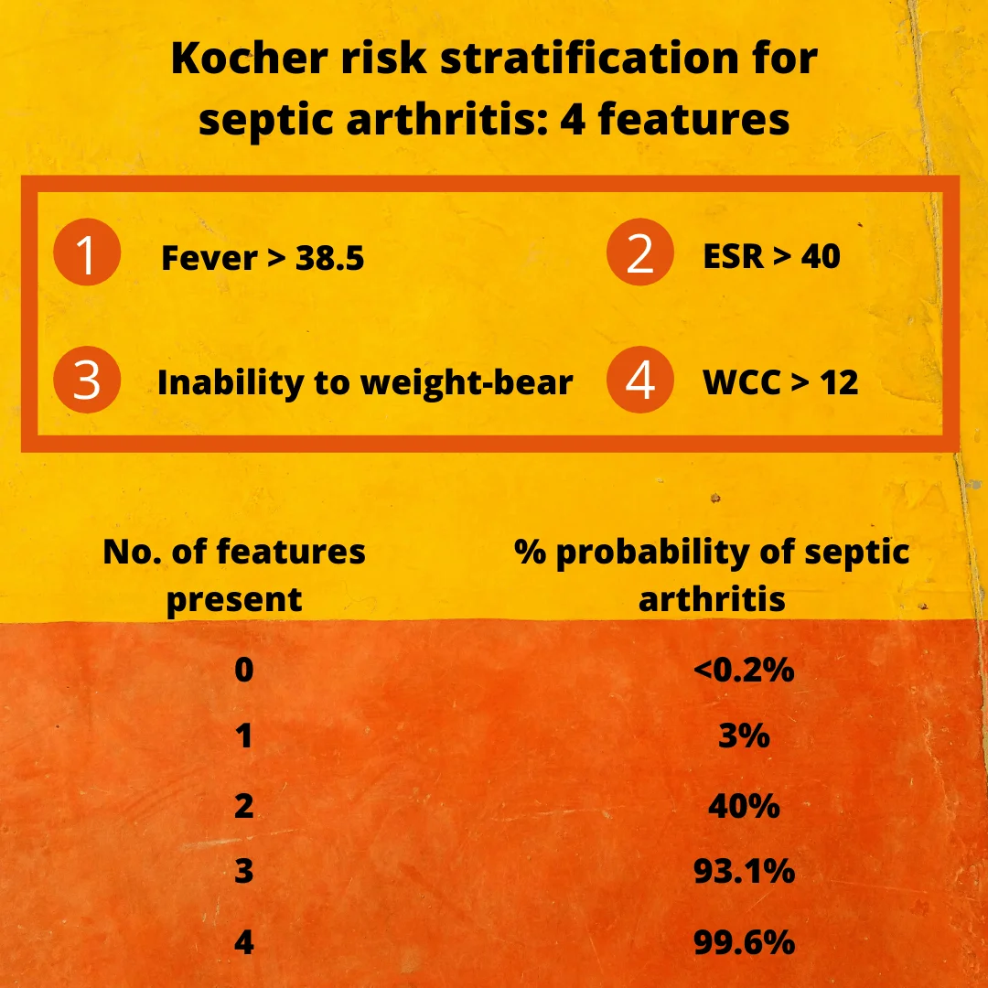

Slide 13
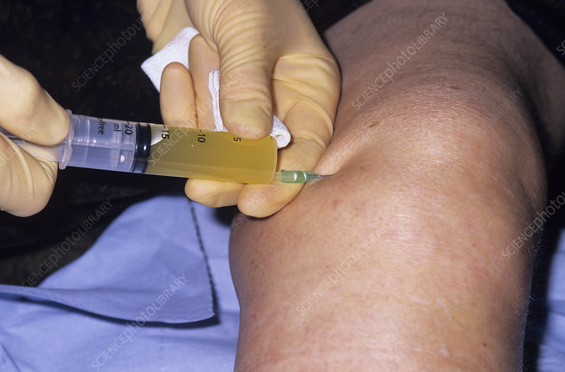
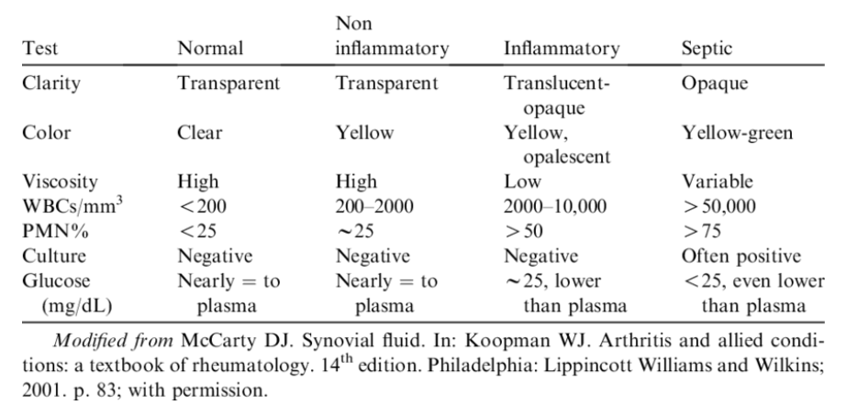
Joint Aspiration
Assists in diagnosis and management
helps guide antibiotic selection when organism identified (50% of the time)
proceed with surgical drainage if pus is aspirated
Technique
large bore needle utilized to aspirate the subperiosteal and intraosseous spaces under fluoroscopic or CT-guidance
Start antibiotics after aspiration

Slide 14
Management
Septic Hip Irrigation and Debridement
Arthrotomy is performed to remove all purulent fluid and to irrigate the joint
Take synovial culture
Intra-articular drain placement is recommended
Antibiotics
Empiric IV antibiotics are started after samples are sent for culture
Oce cultures return follow with IV antibiotics targeting pathogens
Convert to PO antibiotics once the clinical picture improves and definitive sensitivities are obtained
Current recommendation is a 2-7 day course of culture-specific IV antibiotics followed by a 2-3 week course of oral antibiotics

Slide 15
Septic Arthritis Antibiotic Treatment
Age | Organism | Antibiotics
< 3 months | group B streptococci, s. aureus, and gram-negative bacilli | 1st generation cephalosporin
3 months to 5 years | S. aureus, Kingella, S. pneumoniae, group A streptococci, H. influenzae | 2nd or 3rd generation cephalosporinKingella shown to be resistant to vancomycin and clindamycin
5-12 yrs | S. aureus | 1st generation cephalosporin
12-18 yrs | N. gonorrhoeae, S. aureus | 2nd or 3rd generation cephalosporin

