Slide 1

Osteomyelitis
Dr. Monther Gharaibeh

Slide 2
Definition
Acute or chronic inflammation of the bone, bone marrow and its surrounding structures secondary to infection.
Osteomyelitis is classified according to:
Duration: Acute, subacute, and chronic
Mechanism (route) of infection: Hematogenous vs. exogenous
Host response: Pyogenic vs. granulomatous

Slide 3
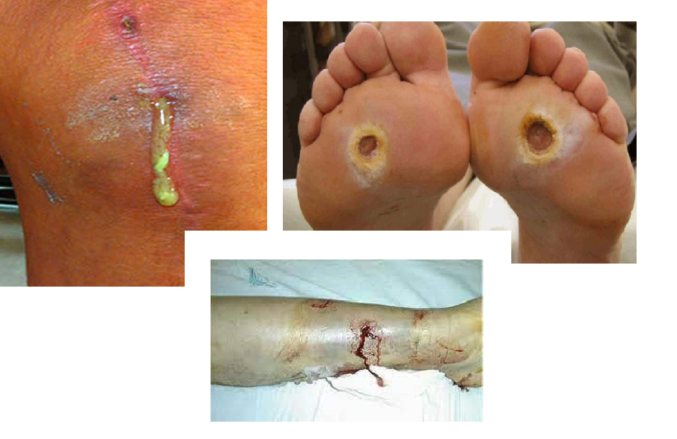
Route of infection
Hematogenous (endogenous osteomyelitis): caused by hematogenous dissemination of a pathogen. (involves episode of bacteremia)
Exogenous osteomyelitis: caused by a spread of bacteria (typically multiple organisms) from the surrounding environment.
Post-traumatic: infection following deep injury (penetrating injury, open fractures, severe soft tissue injury.
Contiguous: spread of infection from adjacent tissue as:
  Secondary to infected foot ulcer in diabetic patients.
  Iatrogenic (e.g., postoperative infection of a prosthetic joint implant)
Source infection organism enters bloodstream infiltrates the bone marrow localized systemic reaction.

Slide 4
Epidemiology
 | Pediatrics | Adults

Slide 5
Epidemiology
 | Pediatrics | Adults
Incidence | 13/100.000 <13 y old | 90/100.000

Slide 6
Epidemiology
 | Pediatrics | Adults
Incidence | 13/100.000 <13 y old | 90/100.000
Demographics | . mean age 6.6 years . 2.5 times more common in boys | . <20 , > 50 . Equal among sexes

Slide 7
Epidemiology
 | Pediatrics | Adults
Incidence | 13/100.000 <13 y old | 90/100.000
Demographics | . mean age 6.6 years . 2.5 times more common in boys | . <20 , > 50 . Equal among sexes
Anatomic location | Metaphysis | . Spine and ribs in dialysis patients . Medial or lateral clavicle in IV drug abusers . Foot and decubitus ulcers in diabetics

Slide 8
Epidemiology
 | Pediatrics | Adults
Incidence | 13/100.000 <13 y old | 90/100.000
Demographics | . mean age 6.6 years . 2.5 times more common in boys | . <20 , > 50 . Equal among sexes
Anatomic location | Metaphysis | . Spine and ribs in dialysis patients . Medial or lateral clavicle in IV drug abusers . Foot and decubitus ulcers in diabetics
Risk factors | . Diabetes mellitus . Hemoglobinopathy . JRA . Chronic renal disease . Immune compromise . Varicella infection | . Recent trauma or surgery . Immunocompromised patients . llicit IV drug use . Poor vascular supply . DM . Peripheral neuropathy

Slide 9
Causative Micro-organisms
Unusual Osteomyelitis Organism Table
Salmonella | Sickle cell anemia patients (S. aureus is still most common)
Pseudomonas | IV drug use with AC or SC joint infection or puncture wound through rubber soled shoes
Bartonella | HIV/AIDS patient following cat scratch or bite
Fungal osteomyelitis | Immunosuppressed, long-term IV medications, or parenteral nutrition
Tuberculosis | Manifestations include Potts disease
Osteomyelitis Organism Table
Newborns (younger than 4 mo) | S. aureus, Enterobacter species, group A and B Streptococcus species
Children (aged 4 mo to 4 y) | S. aureus, group A Streptococcus species, Kingella kingae, and Enterobacter species
Children, adolescents (aged 4 y to adult) | S. aureus (80%), group A Streptococcus species, H. influenzae, and Enterobacter species
Adult | S. aureus and occasionally Enterobacter or Streptococcus species

Slide 10
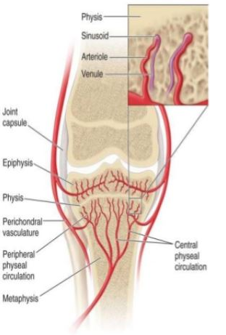
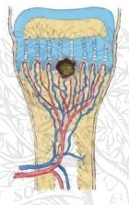
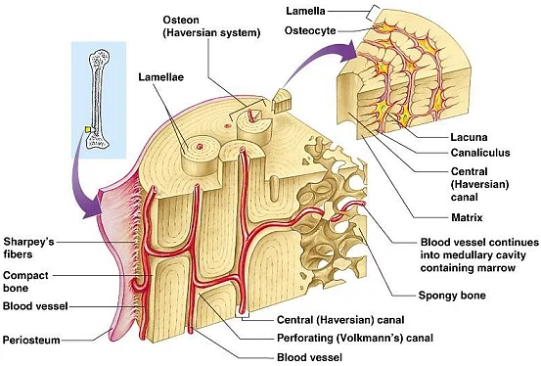
Pathophysiology
Transmission and metaphysis stasis
Increased intra-osseous pressure
Acute inflammatory response
Venous stasis and thrombosis
Infection seeding

Slide 11
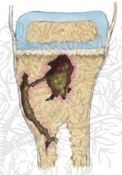
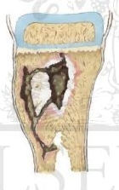
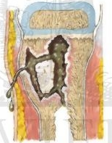
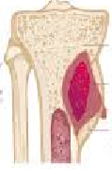
Vertical seeding
. Toward epiphysis ( neonatal septic arthritis)
. Toward diaphysis
Horizontal seeding
. Toward periosteum (sub periosteal abscess)
. Exceeds periosteum ( sinus tract, septic arthritis
Intraosseous effect
. Bone necrosis (Sequestrum)
. Bone lysis (Brodie’s abscess)
. Involucrum ( new bone formation)

Slide 12
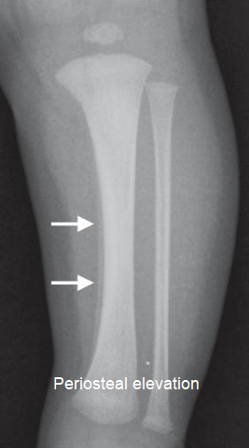
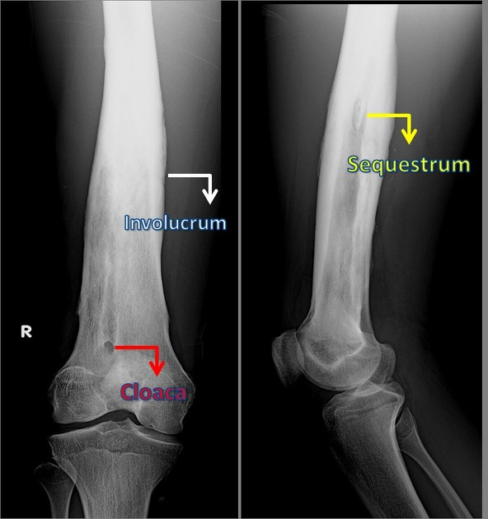
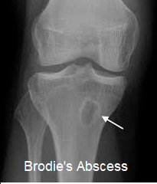

Slide 13
Necrotic bone tissue (Sequestrum) is surround by a rim, or shell of new healthy bone (involucrum)

Slide 14
Clinical Presentation of acute OM
Physical exam
inspection & palpation
edematous, warm, swollen, tender limb
evaluate for point tenderness
range of motion: restricted motion due to pain
Pseudoparalysis
History
limb pain
recent local infection or trauma
ask about prior antibiotic use, as it may mask symptoms
Symptoms
limp or refusal to bear weight
generally not toxic appearing
+/- fever

Slide 15
Differential Diagnosis
DDx | Findings
Cellulitis | Superficial erythema, edema, lymphangitis
Sickle crisis | Moderate to sever pain, possible salmonella OM
Rheumatic fever | Gradual onset, polyarticular, responds to NSAID
Septic arthritis | **************

Slide 16
Investigations
Laboratory studies
CBC: thrombocytosis, possible leukocytosis
Inflammatory markers:
  Elevated CRP: indicator for treatment response
  ESR (sensitive but not specific)
  Procalcitonin: differentiate bacterial from viral inefction
Blood cultures: positive in half of the patients (50%)
Purulent wounds/sinuses: Consider culture of purulent material
  Bone aspiration in equivocal cases

Slide 17
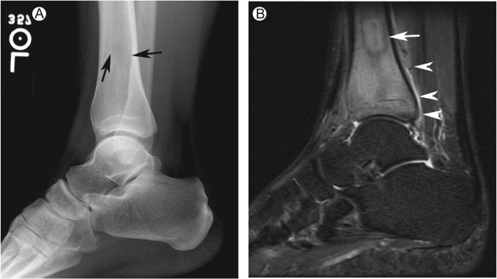
Imaging
Conventional Radiographs
early films may be normal or show loss of soft tissue planes and soft tissue edema
new periosteal bone formation (5-7 days)
osteolysis (10-14 days)
late films (1-2 weeks) show metaphyseal rarefaction (reduction in metaphyseal bone density) or possible abscess
CT
Demonstrate late bone changes or abscesses

Slide 18
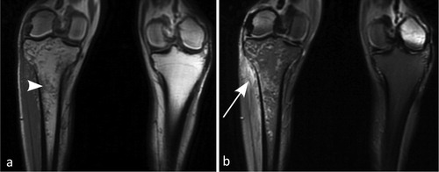
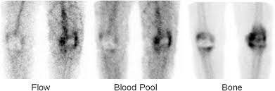
Imaging
MRI
Abscesses and early marrow and soft tissue edema
T1 signal decreased
T1 with gadolinium signal increased
T2 signal increased
88% to 100% sensitivity, sensitivity increased by Gadolinium contrast
Bone scan
technetium-99m can localize the focus of infection and show a multifocal infection
92% sensitivity
a cold bone scan may be associated with more aggressive infections

Slide 19
Treatment
AAA (Antibiotic, Analgesia, Antipyretics)
Surgical Drainage
Follow up

Slide 20
Antibiotic therapy
Start with empiric therapy:
  generally, nafcillin or oxacillin, unless high local prevalence of MRSA (then use clindamycin or vancomycin)
  gram stain shows gram-negative bacilli - add a third generation cephalosporin
convert to organism-specific antibiotics if organism identified
Duration
typically treat with IV antibiotics for 6-8 weeks
Differentiate between septic arthritis & osteomyelitis:
Osteomyelitis: Start with antibiotics, if no response, drainage is required then surgical intention (debridement of necrotic bone and tissue).
Septic arthritis: Evacuation of purulent material from the joint (therapeutic arthrocentesis (drainage)) and systemic antibiotics are the mainstays of treatment in septic arthritis. empirical antibiotics are started then changed according to culture results.

Slide 21
Surgical Drainage
Indications
  Deep or subperiosteal abscess
  Failure to respond to antibiotics after 48 hours
  chronic infection
send tissue for culture and pathology to rule out neoplasm
close wound over drains or pack and return to OR in two to three days
Apply cast for comfort and remove after 3-4 weeks
  Acute Osteomyelitis:
  Drainage
  Bone drilling
  Subacute and chronic osteomyelitis
  Debridement of necrotic and infected bone

Slide 22
Subacute Osteomyelitis
> 2 weeks of partially treated OM
Insidious onset
Mild symptoms, lack of systemic reaction
Due to:
a)Organism being less virulent OR
b)Patient more resistant OR
c)Both
Staph. Aureus: is the most common organism

Slide 23
Clinical features
Frequently asymptomatic or mild symptoms :
Localized Pain (several weeks/ months)
Limping
swelling & local tenderness
Muscle wasting
Body temperature usually normal (no fever)

Slide 24
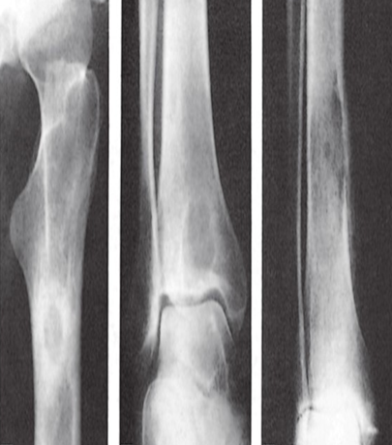
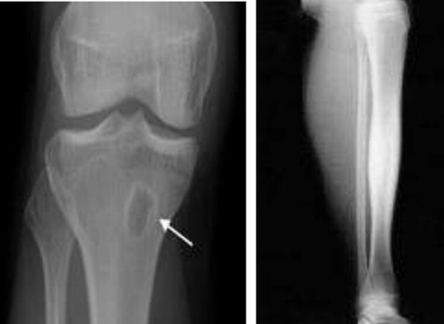
KEEP IN MIND

Slide 25
Chronic OM
Severe persistent, incapacitating bone infection
Staph aureus is the most common MO
Usually mixed infection
Staph. Epidermidis and coagulase negative staph with surgical implants

Slide 26
Pathogenesis
Inadequate treatment of acute osteomyelitis /
Foreign implant/
Open fracture
Persistent infection in bone leads to increase in the intramedullary pressure due to inflammatory exudates (pus)
Stripping the periosteum
Biofilm on surgical implants
Inflammatory process continues with time together with persistent infection by staphylococcus aureus

Slide 27
Pathogenesis (contd.)
vascular thrombosis
Bone necrosis (sequestrum formation)
New bone formation occur (involucrum)
Multiple openings appear in this involucrum, through which exudates and debris from the sequestrum pass through the sinuses (sinus formation)

Slide 28
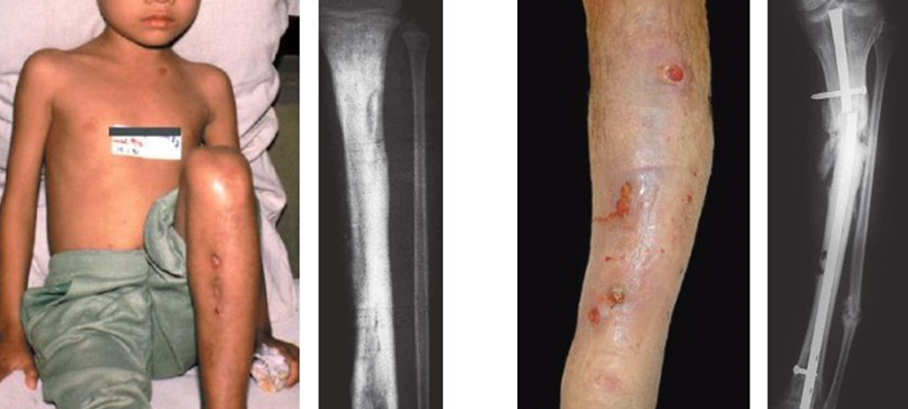

Slide 29
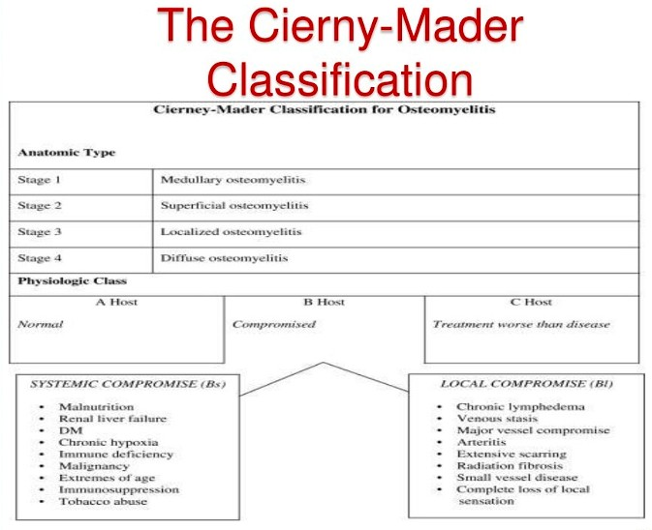

Slide 30
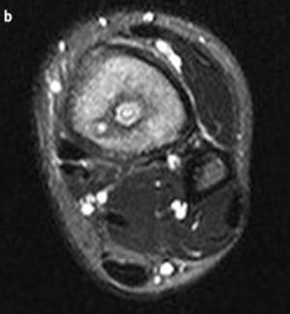
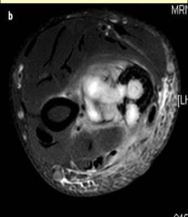
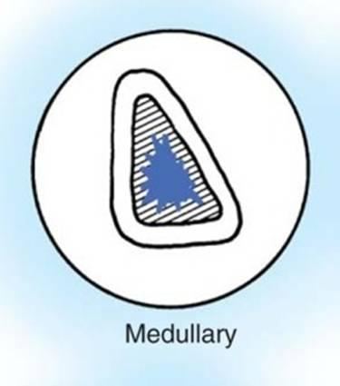
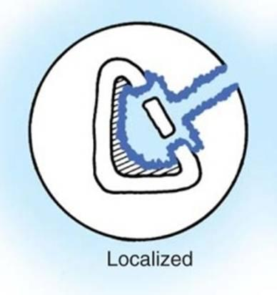
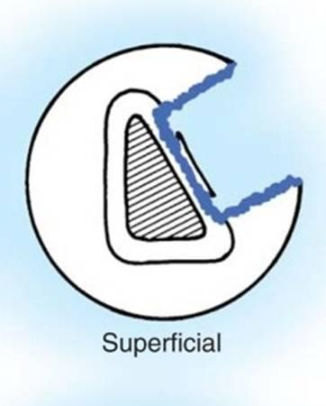
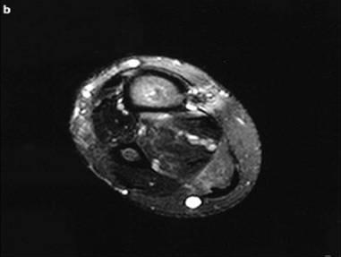
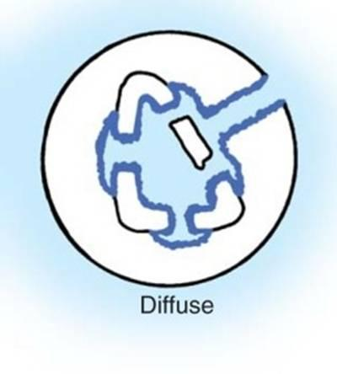
Stage I
Stage III
Stage I
Stage III
Stage II
Stage IV

Slide 31
Radiological Findings
Radiography
  Bone resorption and lysis
  Thickened sclerotic surrounding
  Sequestrum
  Brodie’s abscess with sclerotic margins
Bone scan
  Increased activity on all phases
CT and MRI scans
  Shows extent of infection, hidden lesions, plan for surgery

Slide 32
Management
Antibiotics
  Starts 10 days prior to planned surgical debridement
  Give bactericidal Abx with good bone penetration (Fucidic acid, clindamycin)
  Purpose: a. Stop the spread b. Control flare ups
  Continue after debridment for a minimum of 6 weeks with inflammatory markers control

Slide 33
Surgical treatment
  Excision of sinus tract
  Debride all devitalized soft tissue
  Debride all sequestrae and infected bone
  May end up with amputation

