Slide 1
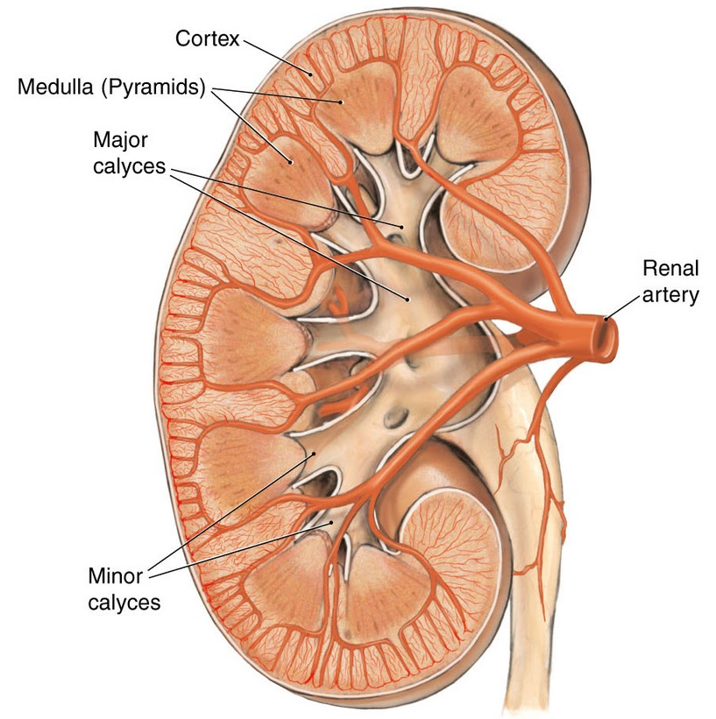
The Urinary System
Dr. Mustafa Saad
(2018)

Slide 2
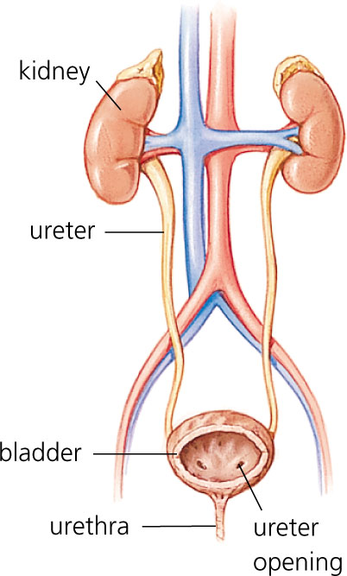
Overview
The urinary system is involved in the formation and elimination of urine. In addition, this system performs other important functions.
The urinary system is formed of:
2 Kidneys
2 Ureters
1 Urinary Bladder
1 Urethra
Fig.1: Organs of the urinary system.

Slide 3
Functions:
Organ | Functions
Kidneys | Regulate blood volume and contents, pH and blood pressure. Produce hormones. Excrete waste products in urine.
Ureters | Transport urine from kidneys to urinary bladder.
Bladder | Stores urine and expels it into the urethra when necessary.
Urethra | Excretes urine to the outside of the body.

Slide 4
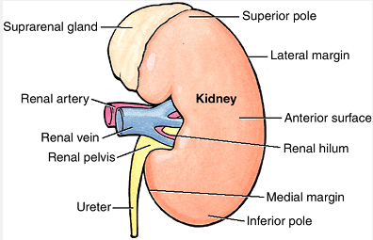
The Kidneys
Bean-shaped organs.
Located on the posterior abdominal wall on each side of the vertebral column.
Right kidney is lower (pushed down by the liver).
Each kidney has upper and lower poles, anterior and posterior surfaces and medial and lateral borders.
The concave medial border is the hilum. Through it pass: the ureter, renal artery and vein, lymphatics and nerves.
Fig.2: The kidney.

Slide 5
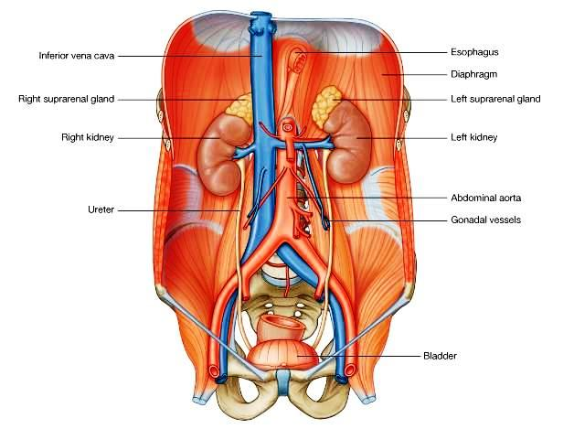
Fig.3: Position of the kidneys.

Slide 6
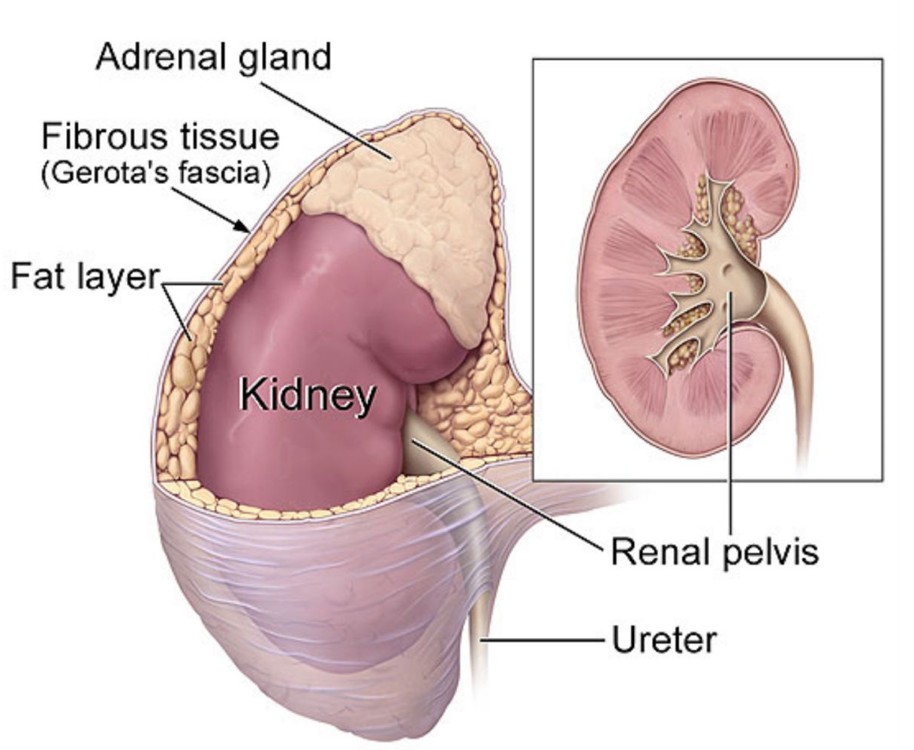
Renal Capsule
The kidney is surrounded by:
Renal capsule: protects the kidneys.
Adipose Capsule: fatty tissue surrounding the renal capsule. It protects the kidneys and keeps them in place.
Renal fascia: connective tissue layer that helps adhere the kidneys to surrounding structures.
Fig.4: Coverings of the kidney.

Slide 7
Relations of the Kidneys
The right kidney is related to
Anteriorly: suprarenal gland, liver, right colic flexure and duodenum.
Posteriorly: diaphragm and 12th rib.
The left kidney is related to:
Anteriorly: suprarenal gland, stomach, pancreas, spleen, left colic flexure and jejunum
Posteriorly: diaphragm, 11th and 12th ribs.

Slide 8
Fig.5: Relations of the two kidneys.

Slide 9
Internal Anatomy of the Kidneys
  Renal cortex – superficial
    Outer cortical zone.
    Inner juxtamedullary zone.
    Renal columns – portions of cortex that extend between renal pyramids.
  Renal medulla – inner region
    Several cone shaped renal pyramids – base faces cortex and apex (renal papilla) points toward hilum.
  Renal lobe – renal pyramid, overlying cortical area, and ½ of each adjacent renal column.

Slide 10
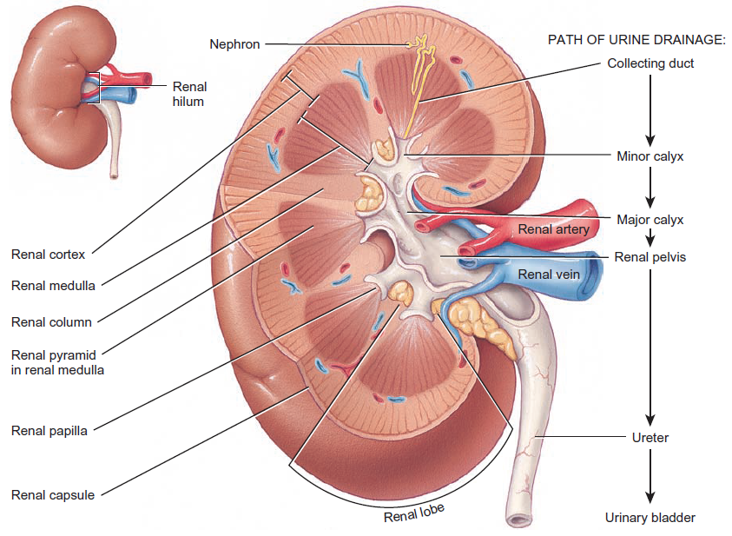
Fig.6: Internal anatomy of the kidney.

Slide 11
The Nephron
Nephrons are the functional units of the kidneys.
There are millions of nephrons in each kidney.
They are formed of 2 parts:
  Renal corpuscle – filters blood plasma.
    Glomerulus – capillary network.
    Glomerular (Bowman’s) capsule – double-walled cup surrounding the glomerulus.
  Renal tubule – filtered fluid passes into:
    Proximal convoluted tubule (PCT).
    Descending and ascending limbs of the loop of Henle (nephron loop).
    Distal convoluted tubule (DCT).

Slide 12
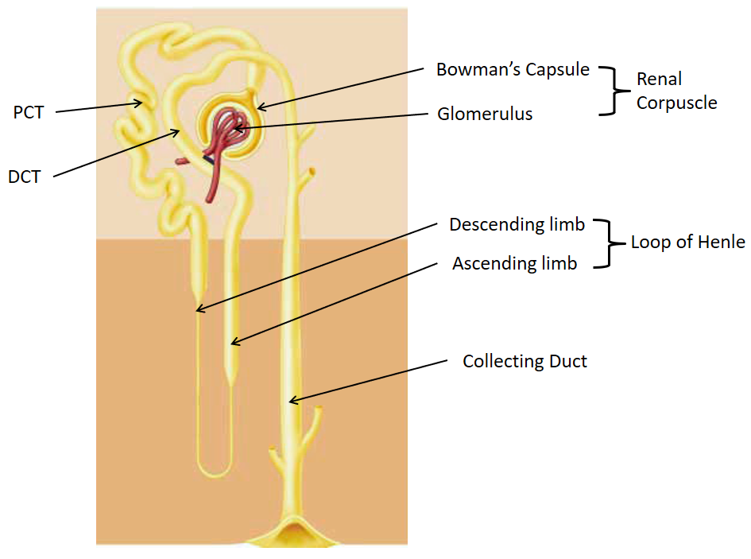
Fig.7: The nephron.

Slide 13
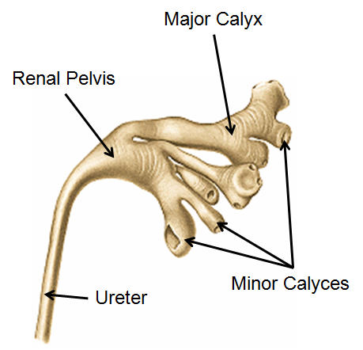
Several nephrons open into the same collecting duct. These nephrons constitute a renal lobule.
Collecting ducts open into minor calyces. Several of these open into a major calyx. 2-3 major calyces open into the renal pelvis (the upper dilated part of the ureter).
Fig.8: Minor and major calyces.

Slide 14
Blood supply of the kidney
Because the kidneys function in the regulation of blood contents, they receives an abundant blood supply despite their small size.
Blood is supplied to each kidney by the renal artery.
Renal artery forms segmental arteries.
Segmental arteries give rise to interlobar arteries (pass between lobes).
Interlobar arteries arches near the base of the renal pyramids to form the arcuate arteries.
From the arcuate arteries arise the interlobular arteries.
From the interlobular arteries arise a single afferent arteriole for each nephron.
Afferent arteriole forms a ball of capillaries called glomerulus.
Capillaries then unite to form a single efferent arteriole.

Slide 15
The efferent arteriole will form peritubular capillaries around the renal tubules.
Blood is drained into veins corresponding to the arteries.
The blood is finally collected into a single renal vein that exits the kidney through the hilum.
The right and left renal veins drain into the inferior vena cava.

Slide 16
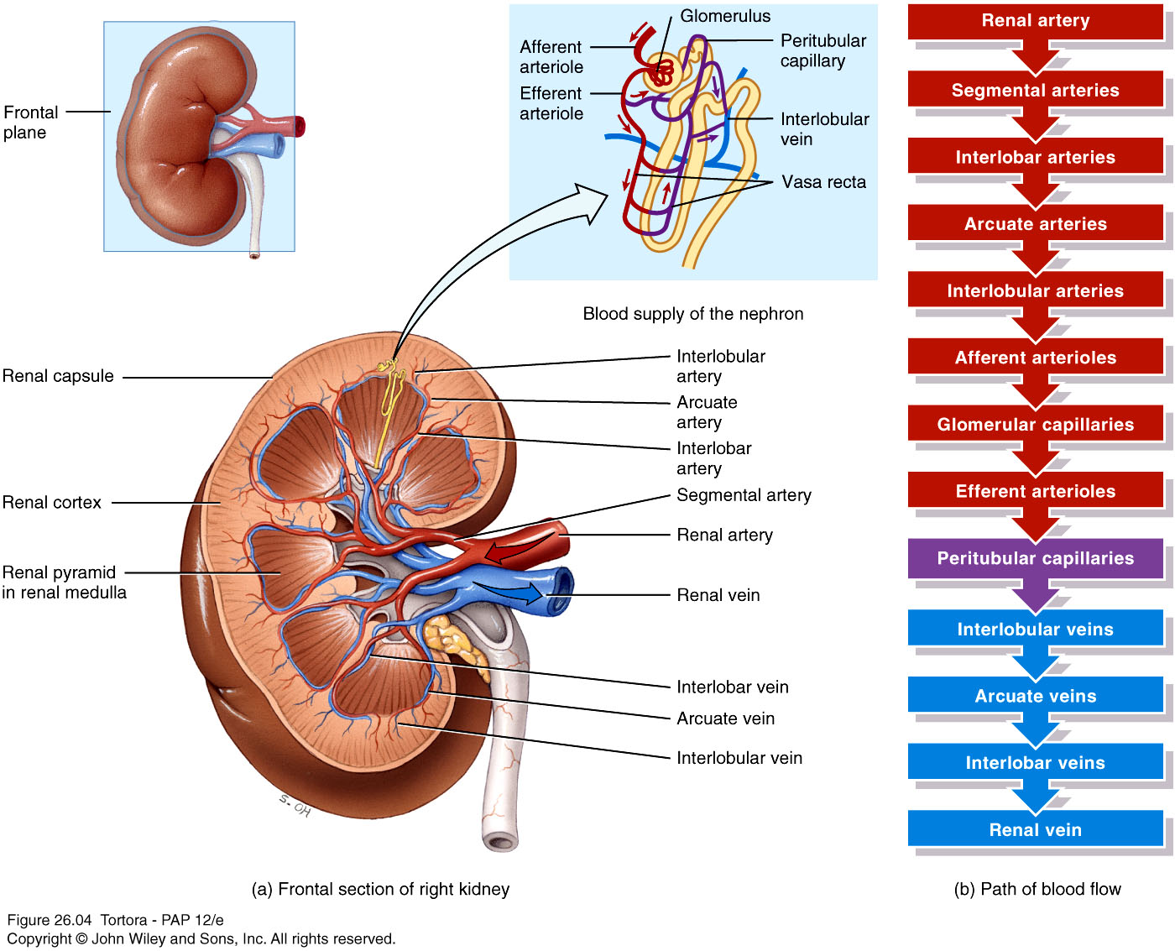
Fig.9: Blood supply of the kidney.

Slide 17
The Ureters
Two long muscular tubes that transport urine from the kidneys to the bladder.
The upper part of the ureter is dilated and forms the renal pelvis.
Course:
  Pass inferiorly in front of the psoas major muscle.
  Cross the bifurcation of the common iliac artery.
  Pass over the pelvic brim to enter the true pelvis.
  Pass down in the pelvis.
  Enter the posterior wall of the urinary bladder.
  Moves through the wall for a short distance before opening into the bladder lumen.

Slide 18
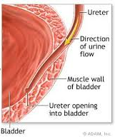
Fig.10: Course of the ureters. The small image shows the passage of the ureter within the bladder wall.

Slide 19
The ureters are constricted at three regions. These are common sites of stones:
  Junction of renal pelvis and ureter
  As ureter crosses pelvic brim
  Within the wall of the bladder
Forces that move urine through the ureters:
  Peristalsis
  Hydrostatic pressure
  Gravity

Slide 20
The Urinary Bladder
The bladder is a storage site for urine. It’s a pelvic organ. But, when it’s filled with urine, it may reach into the abdominal cavity.
An empty bladder is pyramidal in shape.
It has a superior, a posterior and two inferolateral surfaces.
The base is posterior, and its apex is directed anteriorly and related to the pubic symphysis.
The base is shaped like an inverted triangle. The two ureters enter the bladder through the superior corners of the base. The urethra exits the bladder through the inferior corner of the base

Slide 21
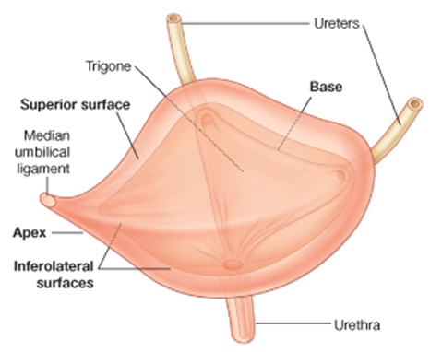
Fig.11: The urinary bladder.

Slide 22
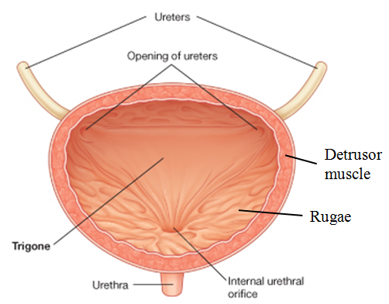
On the inner surface of the bladder, the area between the openings of the two ureters and the urethra is smooth and triangular and known as the Trigone.
Elsewhere in the bladder, the wall shows several rugae because the mucosa of the bladder is thrown into folds.
The muscularis is formed of smooth muscle fibers called the detrusor muscle.
Fig.12: The inner surface of the urinary bladder.

Slide 23
The Urethra
Short tube that carries urine to the outside of the body. In males the urethra is a passageway for semen also.
It starts from the urinary bladder at the internal urethral orifice (surrounded by a sphincter).
It’s longer in males than in females.
It opens to the outside at the external urethral orifice.

