Slide 1
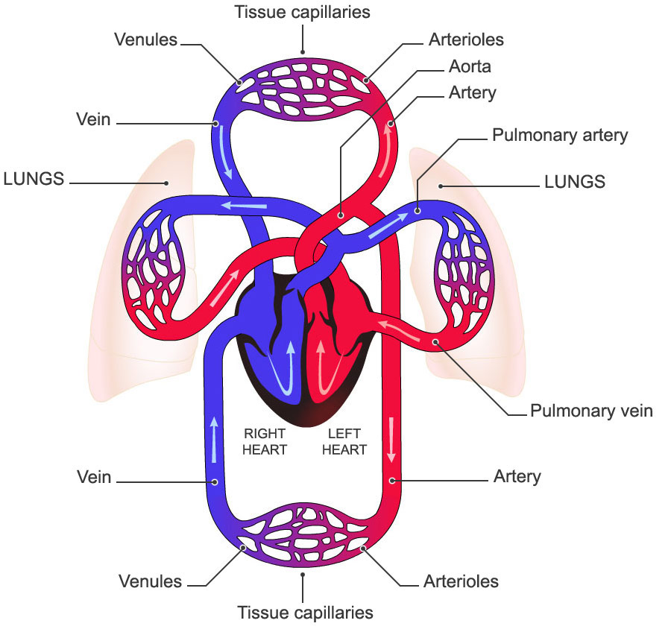
The Cardiovascular System
Dr. Mustafa Saad
(2018)
The Blood
The Heart
and The Vessels

Slide 2
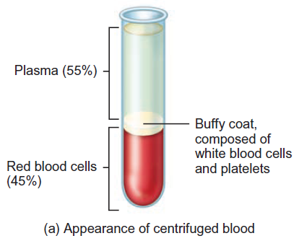
Blood
Fluid connective tissue
  Extracellular matrix = plasma
  Cellular elements = Red blood cells, White blood cells and Platelets
Functions:
  Transportation
    Gases, nutrients, hormones, waste products
  Regulation
    pH, body temperature
  Protection
    Clotting, white blood cells, proteins
Fig.1: Appearance of centrifuged blood.

Slide 3
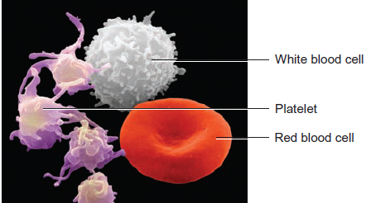
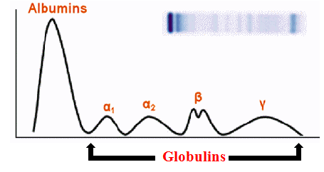
Components of Blood
Blood
Plasma
55% of blood
Water
91% of plasma
Solutes
(mostly protein)
Formed Elements
45% of blood
Red Blood Cells
White Blood Cells
Platelets
Proteins
(Mostly Albumin)
Other Solutes

Slide 4
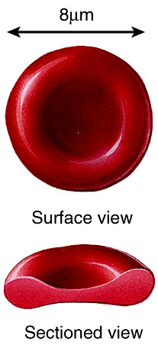
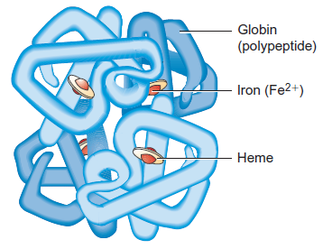
Red Blood Cells/ Erythrocytes
Formed Elements of Blood
Biconcave disc in shape. This increases surface area.
Lack nucleus and other organelles:
  No mitochondria – doesn’t use oxygen
Strong, flexible plasma membrane. This allows the cell to change its shape without rupturing as it passes through narrow capillaries.
Life span about 120 days.
Cytoplasm filled with the oxygen-carrying protein hemoglobin.
Fig.2*: The shape of red blood cells and hemoglobin molecule.

Slide 5
Functions of the red blood cells
The hemoglobin in the RBCs functions in the transportation of:
  Oxygen – this is the main function of RBCs.
  CO₂
  Nitric Oxide(NO) – this gas is a vasodilator that helps in increasing blood flow.
Glycolipids in plasma membrane are responsible for ABO and Rh blood groups.
When RBCs are destroyed by some microorganism, they release substances that can kill these microorganism.

Slide 6
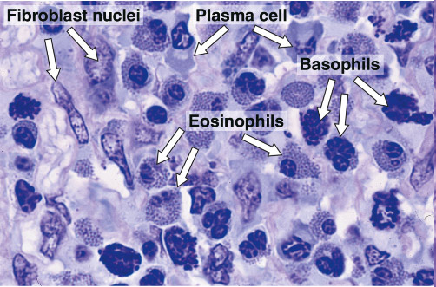
White Blood Cells/ Leukocytes
Wandering cells: formed in bone marrow, circulate in blood and enter tissues.
Respond to local factors in inflammation.
Fig.3: Leukocytes in inflamed tissue.

Slide 7
Classification of Leukocytes
Leukocytes
Granulocytes
Neutrophils
Eosinophils / Acidophils
Agranulocytes
Monocytes
Basophils
Lymphocytes
T-Lymphocytes
B-Lymphocytes
Has specific granules
No specific granules

Slide 8
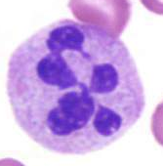
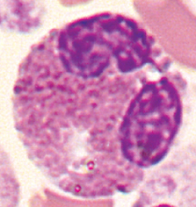
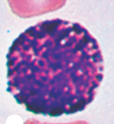
Granulocytes | Neutrophils | Eosinophils | Basophils
Abundance (% of leukocytes) | Most common |  | Least common
Nucleus | Multilobed | Bilobed | S shaped (obscured by granules)
Granules | Sparse and stain variably | Large eosinophilic | Large basophilic
Function | Phagocytosis | Defense against parasitic infection Allergic reactions | Release of inflammatory molecules
Fig.4*: Granulocytes.

Slide 9
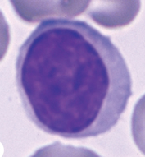
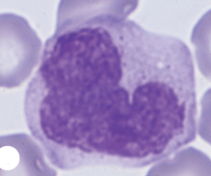
Fig.5*: Agranulocytes.
Agranulocytes:
Lymphocytes:
Variable in size.
Nucleus very dark and occupies most of the cell.
Functions: T-cells → Cell mediated immunity.
B-cells → Antibody-mediated immunity.
Monocytes:
Kidney or U-shaped nucleus.
Cytoplasm basophilic.
Function: formation of macrophages.

Slide 10
Platelets/ Thrombocytes
Megakaryocyte is fragmented into 2000-3000 fragments.
Each fragment enclosed in a piece of plasma membrane and is called a platelet.
Disc-shaped with many vesicles but no nucleus.
Help stop blood loss by forming platelet plug.
Vesicles contain blood-clot promoting chemicals.
Short life span – 5-9 days.

Slide 11
ABO Blood Group
Blood group is type of blood designated to a person based on the presence/absence of an antigen on the surface of RBCs.
The ABO blood groups are based on the A and B antigens.
Reason for antibodies presence not clear.
Blood Type | Antigen on RBCs | Antibody in Plasma
A | A | Anti-B
B | B | Anti-A
AB | A & B | None
O | None | Anti-A & Anti-B

Slide 12
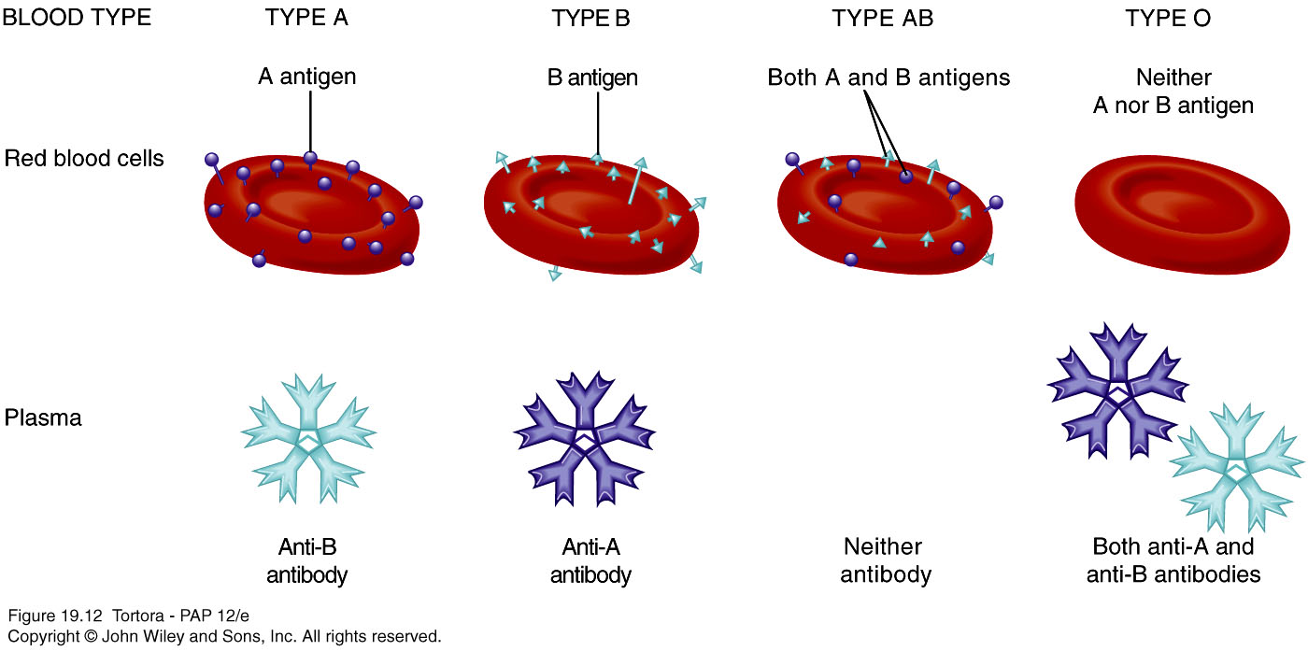
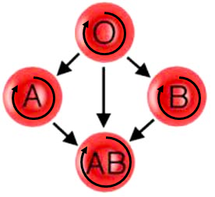
Fig.6*: Antigens and antibodies in the different blood groups.
Each blood group can give to itself
AB is the Universal Recipient
O Is the Universal Donor
Fig.7*: Relation of the different blood groups.

Slide 13
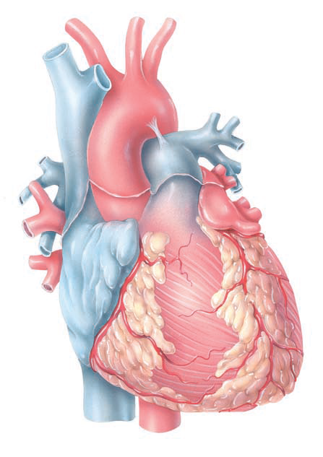
The Heart
A hollow pyramidal shaped muscular organ located within the pericardium in the middle mediastinum in the thoracic cavity.
The heart features:
3 surfaces (anterior, inferior and posterior).
4 borders (right, inferior, left and superior).
Apex.
4 chambers (right and left atria and ventricles).
Fig.8*: The Heart.

Slide 14
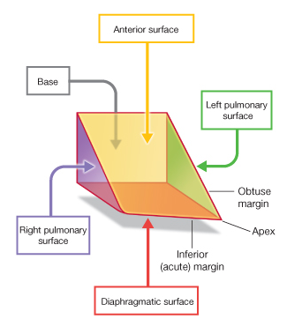
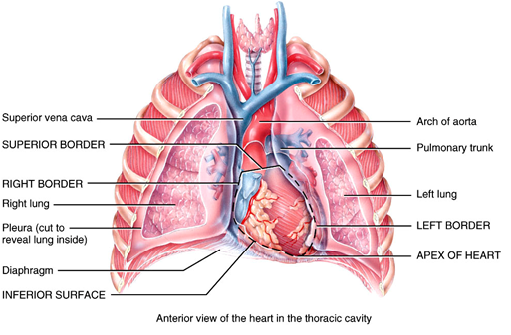
Fig.9: Left, the pyramidal shape of the heart. Below, position of the heart within the chest.

Slide 15
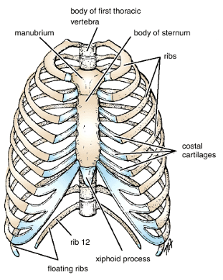
Thoracic (Chest) cavity:
A body cavity bounded by:
Anteriorly: Sternum
Laterally: Ribs, costal cartilages and contents of intercostal spaces
Posteriorly: Thoracic vertebrae
Inferiorly: Diaphragm
Superiorly: The thoracic outlet, an oblique plane passing from the superior border of the sternum, between the two first ribs to the first thoracic vertebra
Fig.10: Boundaries of the thoracic cavity, anterior view.

Slide 16
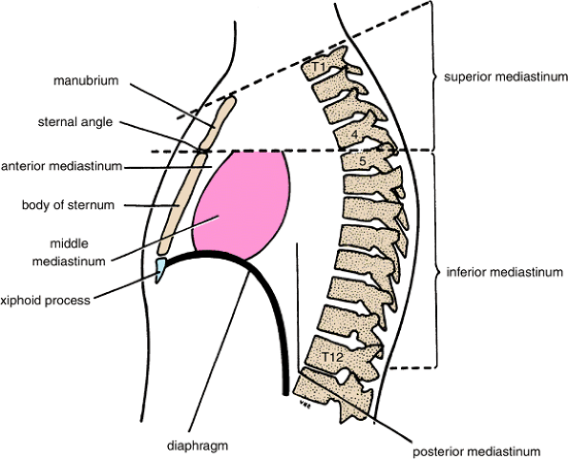
Fig.11: Lateral view of the mediastinum after removing the lungs.
The Mediastinum:
A midline region that extends from the thoracic outlet to the diaphragm. It’s bounded by:
Anteriorly: Sternum
Posteriorly: Thoracic vertebrae
Laterally: Lungs and plurae
Inferiorly: Diaphragm
The mediastinum is divided into superior and inferior parts by a plane passing from the sternal angle (between the manubrium and the body of the sternum) to the lower border of T4. The inferior mediastinum is divided into anterior, middle and posterior parts by the pericardium.

Slide 17
The Pericardium
  Membrane surrounding and protecting the heart.
  2 main parts:
    Outer Fibrous pericardium: tough. Function: prevents overstretching, protection, anchorage (to sternum and diaphragm).
    Inner Serous pericardium – thinner, more delicate membrane – double layer (parietal layer fused to fibrous pericardium, visceral layer also called epicardium).
    Pericardial fluid reduces friction – secreted into pericardial cavity between the parietal and visceral pericardium.

Slide 18
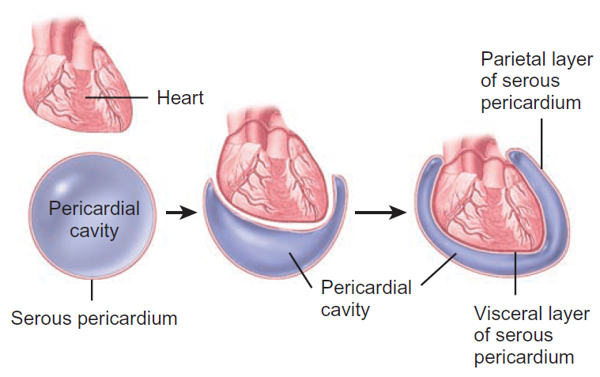
Fig.12: The pericardium.

Slide 19
Layers of the heart wall
Epicardium (external layer)
  Visceral layer of serous pericardium
  Smooth
  Formed of mesothelium with underlying connective tissue containing fat
Myocardium
  95% of heart is cardiac muscle
Endocardium (inner layer)
  Smooth lining for chambers of heart and the heart valves. It’s continuous with lining of the large blood vessels.
  Lined by endothelium.

Slide 20
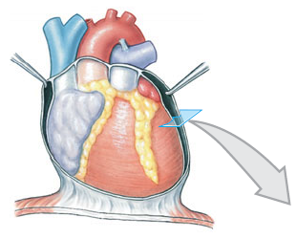
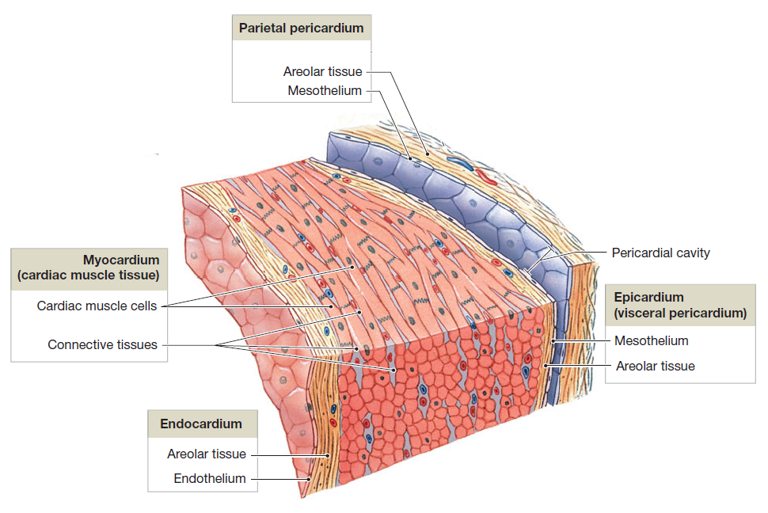
Fig.13: Layers of the heart wall.
Fibrous Pericardium

Slide 21
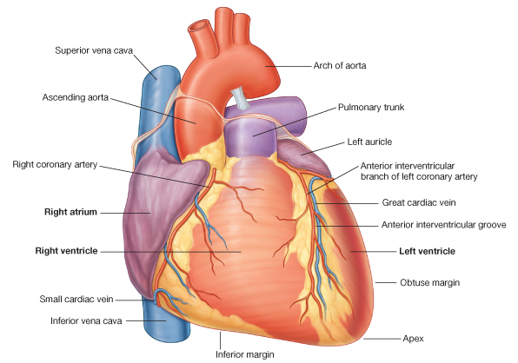
Surfaces of the heart
Anterior Surface:
Formed by the:
Right atrium
Right ventricle
Left ventricle
Related to the sternum.
Fig.14: The anterior surface of the heart.

Slide 22
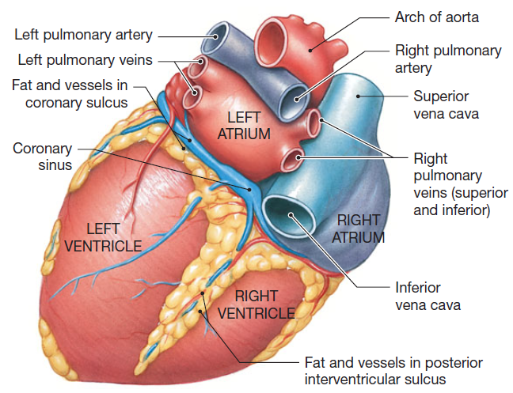
Fig.15: The posterior and inferior surfaces of the heart.
Posterior Surface (Base):
Formed by the:
Left atrium
Related to the esophagus.
-----------------------
Inferior Surface:
Formed by:
Right ventricle
Left ventricle
It’s the surface upon which the heart rests on the diaphragm.

Slide 23
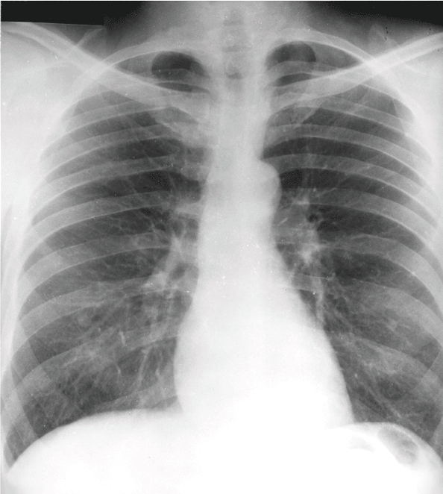
Borders of the heart
They’re very important to know to understand X-rays of the heart.
Left border: Left auricle and left ventricle.
Inferior border: Left ventricle, right ventricle and right atrium.
Right border: Right atrium.
Superior border: is obscured by the great vessels.
Fig.16: Boundaries of the heart as seen on an X-ray. Compare with the gross anatomy of the heart.

Slide 24
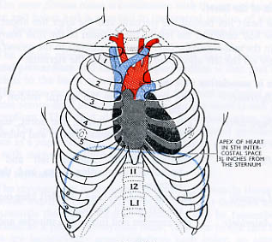
Apex of the heart
Formed by the left ventricle.
Directed downwards, forwards and to the left.
Located at the left 5th intercostal space 9cm from the midline.
Can be felt by palpation.
Fig.17: Location of the apex of the heart.

Slide 25
Chambers of the heart
2 atria – receiving chambers
  Auricle: small pouch that increase capacity of atria
2 ventricles – pumping chambers
Sulci – grooves on the surface of the heart:
  Contain coronary blood vessels.
    Coronary sulcus: separating the atria from the ventricles.
    Anterior interventricular sulcus: between the two ventricles anteriorly.
    Posterior interventricular sulcus: between the two ventricles posteriorly.

Slide 26
Fig.18: Sulci of the heart.
Fat and vessels in coronary sulcus
Fat and vessels in anterior interventricular sulcus
Fat and vessels in posterior interventricular sulcus
Anterior view
Posterior view

Slide 27
The Right Atrium (RA)
  Receives blood from:
    Superior vena cava.
    Inferior vena cava.
    Coronary sinus. Drains most of the blood from the heart.
    Small heart veins
  Interatrial septum has fossa ovalis
    Remnant of foramen ovale
  Blood passes through the right atrioventricular orifice (which’s guarded by the tricuspid valve) into right ventricle

Slide 28
The Right Ventricle (RV)
  Forms anterior surface of heart.
  Possess trabeculae carneae – ridges formed by raised bundles of cardiac muscle fiber.
  Cusps of the tricuspid valve are connected to chordae tendinae which are connected to papillary muscles (3 in number).
  Interventricular septum.
  Blood leaves through pulmonary orifice which’s guarded by the pulmonary semilunar valve into pulmonary trunk and then right and left pulmonary arteries.

Slide 29
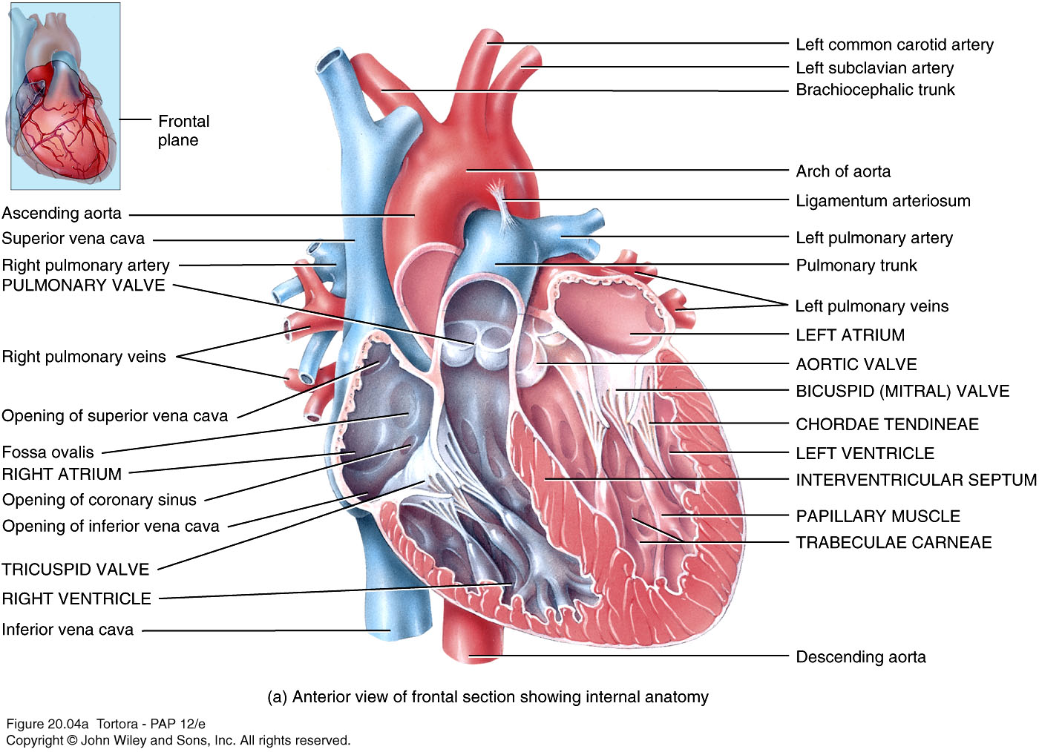
Fig.19: The left atrium and ventricle of the heart.

Slide 30
The Left Atrium (LA)
  About the same thickness as right atrium.
  Receives blood from the lungs through pulmonary veins.
  Blood Passes through the left atrioventricular orifice into the left ventricle. This orifice is guarded by the bicuspid/ mitral valve.

Slide 31
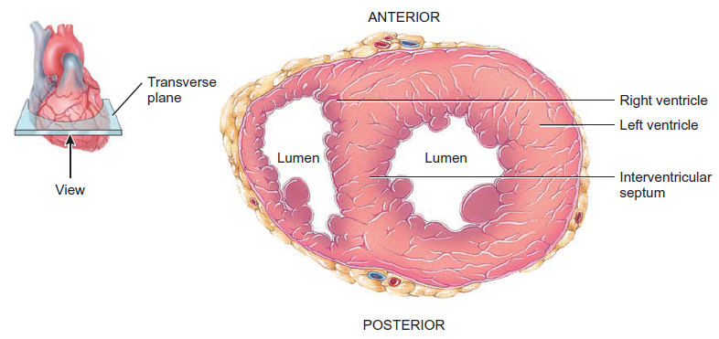
The Left Ventricle (LV)
Thickest chamber of the heart.
Forms apex.
The cusps of the mitral valve are attached to chordae tendinae which are attached to papillary muscles (2 in number).
Blood passes through aortic orifice into the aorta. This orifice is guarded by the aortic semilunar valve.
The interventricular septum is convex on the side of the RV making the cavity of the LV larger.
Fig.20: The interventricular septum.

Slide 32
Fig.21: The right atrium and ventricle of the heart.

Slide 33
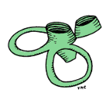
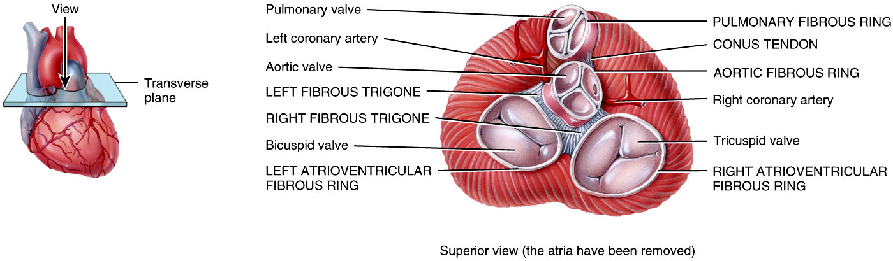
The Fibrous Skeleton of the heart
  Dense collagenous connective tissue that forms ⁽¹⁾base for the valves, ⁽²⁾point of insertion for cardiac muscles and ⁽³⁾electrical insulator between atria and ventricles.
Fig.22: The shape and position of the fibrous skeleton of the heart.

Slide 34
Valves: Atrioventricular Valves
  Tricuspid (3 cusps) and bicuspid (2 cusps)
  Atria contract/ ventricles relaxed
      The higher pressure inside the atria pushes the cusps aside opening the valves and the cusps project into the ventricles
      In the ventricles, papillary muscles are relaxed and chordae tendinae slack
  Atria relax/ ventricles contract
      Higher pressure in the ventricles drives the cusps towards the atria until edges of the cusps meet and close the valve
      Papillary muscles contract tightening the chordae tendinae and preventing regurgitation

Slide 35
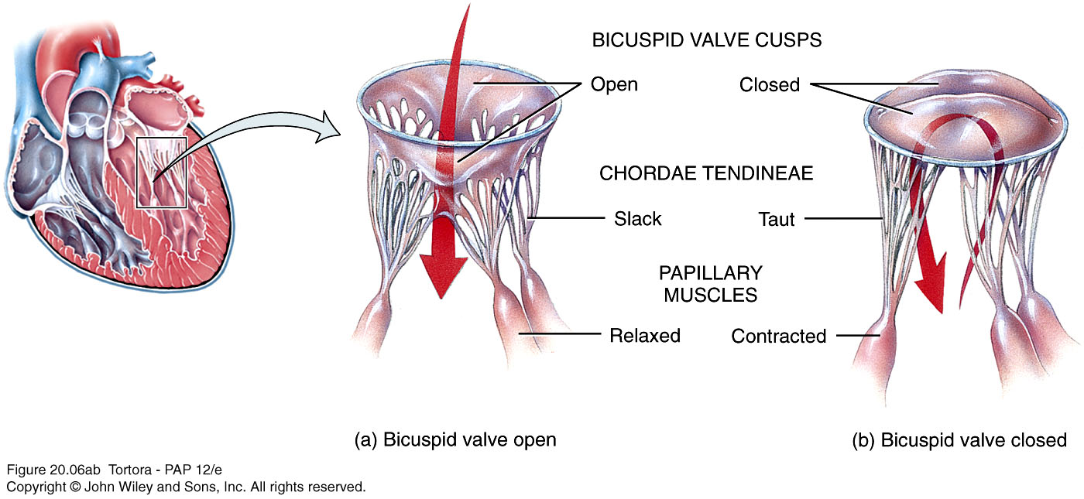
Fig.23: How the atrioventricular valves function.

Slide 36
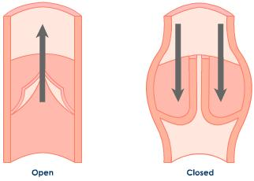
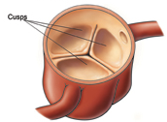
Valves: Semilunar Valves
  Aortic and pulmonary valves (each has 3 cusps).
  When ventricles contract the pressure in ventricles exceeds pressure in arteries pushing the cusps aside and opening the valve.
  As ventricles relax, some blood flows back towards the ventricles, but blood fills the valve cusps closing them tightly.
  The aortic valve has openings for the coronary arteries into which blood flows when LV relaxes.
Fig.24: Above, how the semilunar valves function. Below, opening of the coronary arteries.

Slide 37
The Conduction System of the heart
  Formed of specialized cardiac muscle fibers.
  Nerve impulses from autonomic nervous system and hormones modify timing and strength of each heartbeat but do not establish fundamental rhythm.
  2 important functions of these specialized cells:
    Act as pacemaker
    Form conduction system

Slide 38
Conduction Pathway
  Begins in sinoatrial (SA) node in right atrial wall
    Propagates through atria via gap junctions
    Atria contract
  Reaches atrioventricular (AV) node in interatrial septum where it’s delayed
  Enters atrioventricular (AV) bundle (Bundle of His)
    Only site where action potentials can pass from atria to ventricles due to fibrous skeleton
  Enters right and left bundle branches which extends through interventricular septum towards apex
  Finally, large diameter Purkinje fibers conduct action potential to remainder of ventricular myocardium
    Ventricles contract

Slide 39
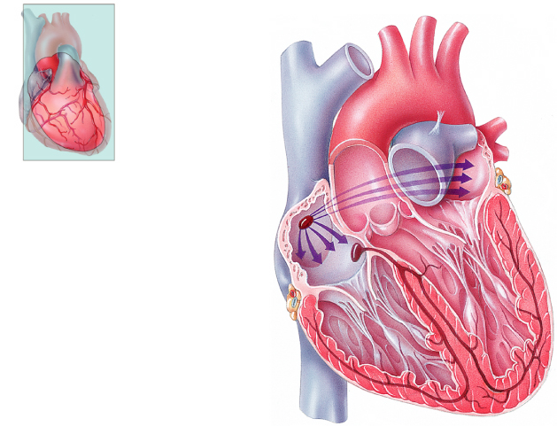
Frontal plane
Frontal plane
Frontal plane
Frontal plane
Frontal plane
Frontal plane
Left atrium
Left atrium
Left atrium
Left atrium
Left atrium
Left atrium
Right atrium
Right atrium
Right atrium
Right atrium
Right atrium
Right atrium
1
1
1
1
1
SINOATRIAL (SA) NODE
SINOATRIAL (SA) NODE
SINOATRIAL (SA) NODE
SINOATRIAL (SA) NODE
SINOATRIAL (SA) NODE
2
2
2
2
ATRIOVENTRICULAR
(AV) NODE
ATRIOVENTRICULAR
(AV) NODE
ATRIOVENTRICULAR
(AV) NODE
ATRIOVENTRICULAR
(AV) NODE
3
3
3
ATRIOVENTRICULAR (AV)
BUNDLE (BUNDLE OF HIS)
ATRIOVENTRICULAR (AV)
BUNDLE (BUNDLE OF HIS)
ATRIOVENTRICULAR (AV)
BUNDLE (BUNDLE OF HIS)
Left ventricle
Left ventricle
Left ventricle
Left ventricle
Left ventricle
4
Left ventricle
4
RIGHT AND LEFT
BUNDLE BRANCHES
RIGHT AND LEFT
BUNDLE BRANCHES
Right ventricle
Right ventricle
Right ventricle
Right ventricle
Right ventricle
Right ventricle
5
PURKINJE FIBERS
Fig.25: The conduction system of the heart.
Anterior view of frontal section
Anterior view of frontal section
Anterior view of frontal section
Anterior view of frontal section
Anterior view of frontal section
Anterior view of frontal section

Slide 40
The Coronary Circulation
  The heart has its own network of blood vessels.
  Coronary arteries branch from ascending aorta.
    Anastomoses provide alternate routes or collateral circuits
    Allows heart muscle to receive sufficient oxygen even if an artery is partially blocked
  Left Coronary Artery → Anterior Interventricular and Circumflex branches
  Right Coronary Artery → Marginal and Posterior Interventricular branches
  Coronary veins:
    Include the Great, Anterior and Middle cardiac veins
    Collects in Coronary Sinus (in the coronary sulcus)

Slide 41
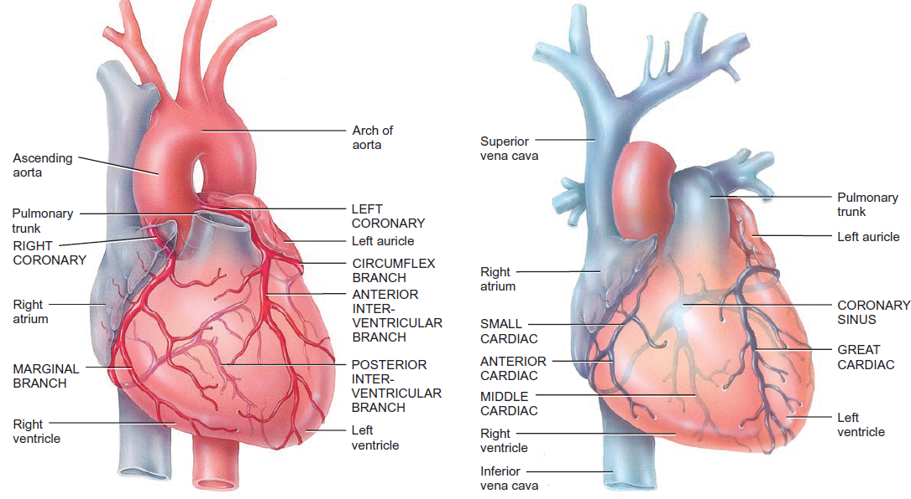
Fig.26: The coronary circulation.

Slide 42
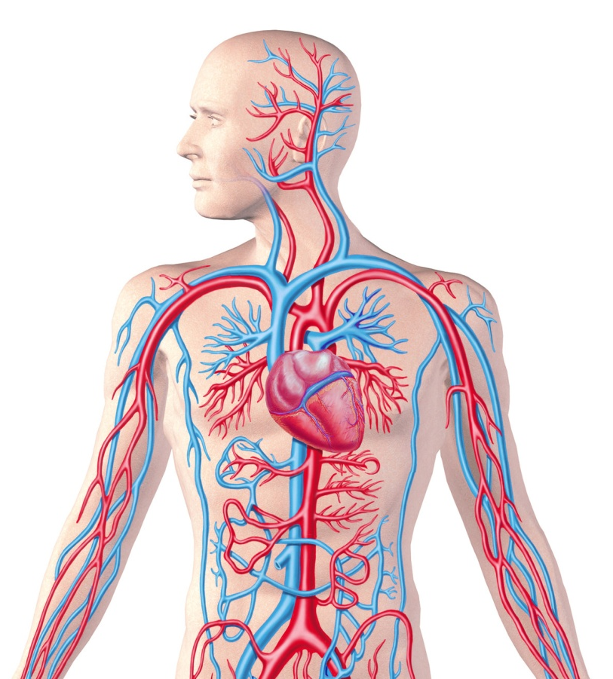
The Blood Vessels
Tube-like structures through which blood is carried
5 main types
  Arteries – carry blood AWAY from the heart
  Arterioles
  Capillaries – site of exchange
  Venules
  Veins – carry blood TOWARDS the heart and they possess valves
Fig.27: The blood vessels.

Slide 43
Basic structure of the wall of blood vessels
Tunica interna (intima)
  Inner lining in direct contact with blood
  Endothelium continuous with endocardial lining of heart
Tunica media
  Muscular and connective tissue layer
  Greatest variation among vessel types
  Smooth muscle regulates diameter of lumen
Tunica externa
  Elastic and collagen fibers
  Vasa vasorum (blood vessels that supply the blood vessel)
  Helps anchor vessel to surrounding tissue

Slide 44
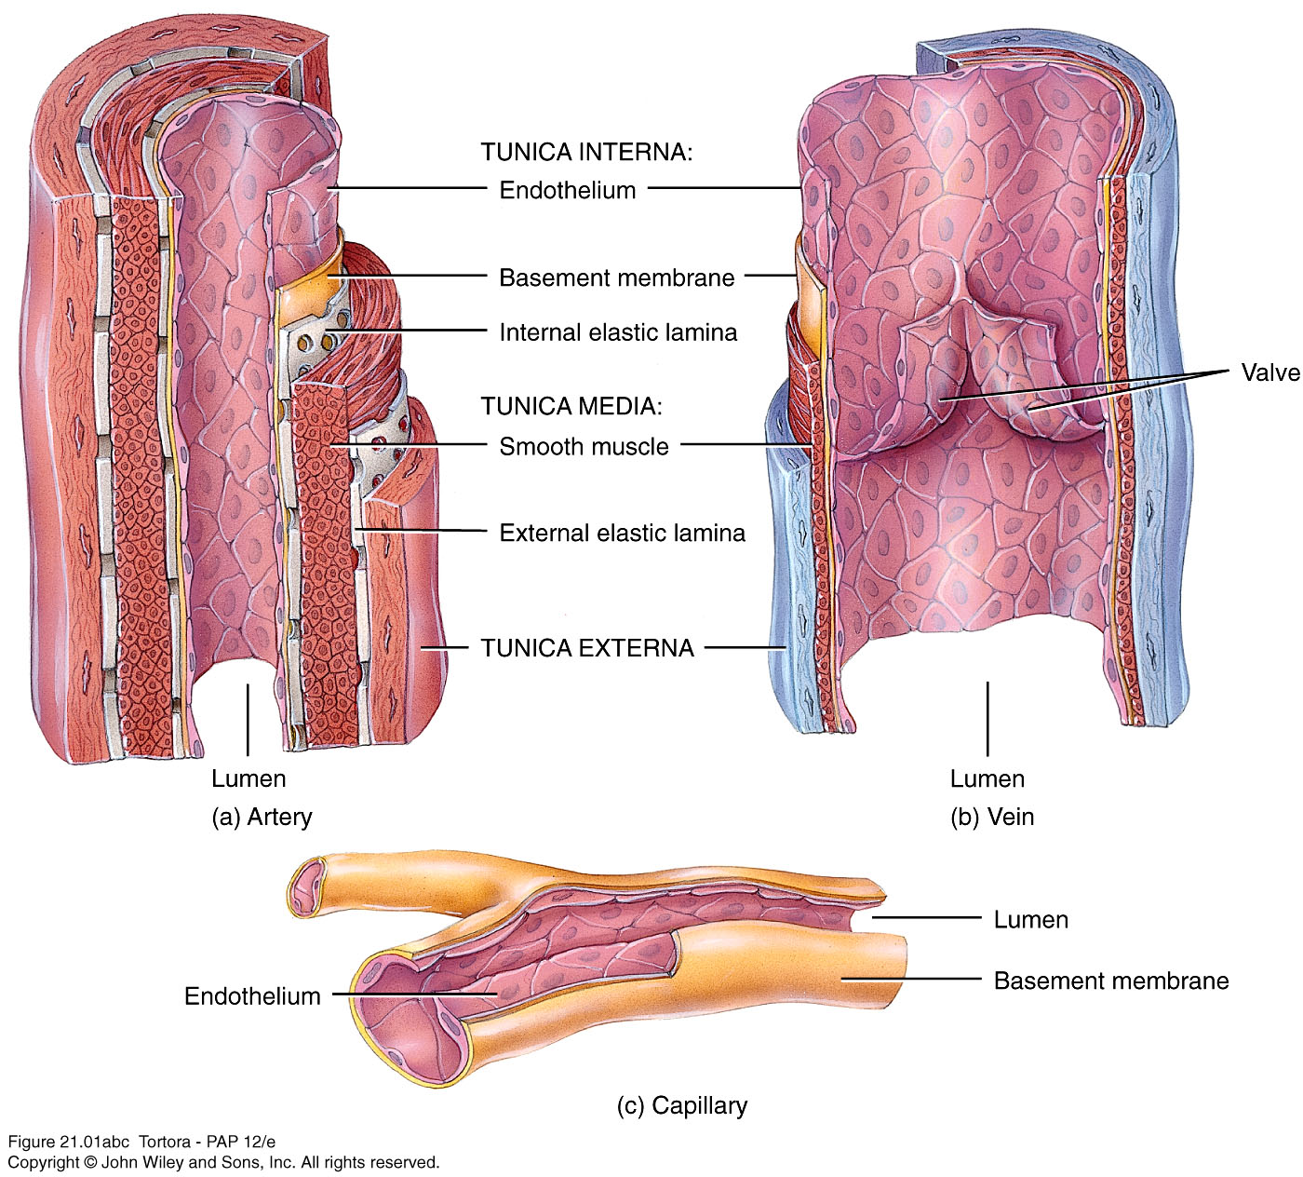
Fig.28: The difference between the walls of (a) large artery, (b) large vein, and (c) capillary.

Slide 45
Pulmonary and Systemic Circulation
- 2 circuits in series
  Pulmonary circuit
    Right side of heart
    Receives deoxygenated blood from systemic circulation
    Ejects blood into pulmonary trunk then pulmonary arteries
    Gas exchange in pulmonary capillaries in the lungs
    Pulmonary veins take blood to left atrium
  Systemic circuit
    Left side of heart
    Receives oxygenated blood from lungs
    Ejects blood into aorta
    Systemic arteries, arterioles
    Gas and nutrient exchange in systemic capillaries
    Systemic venules and veins lead back to right atrium

Slide 46
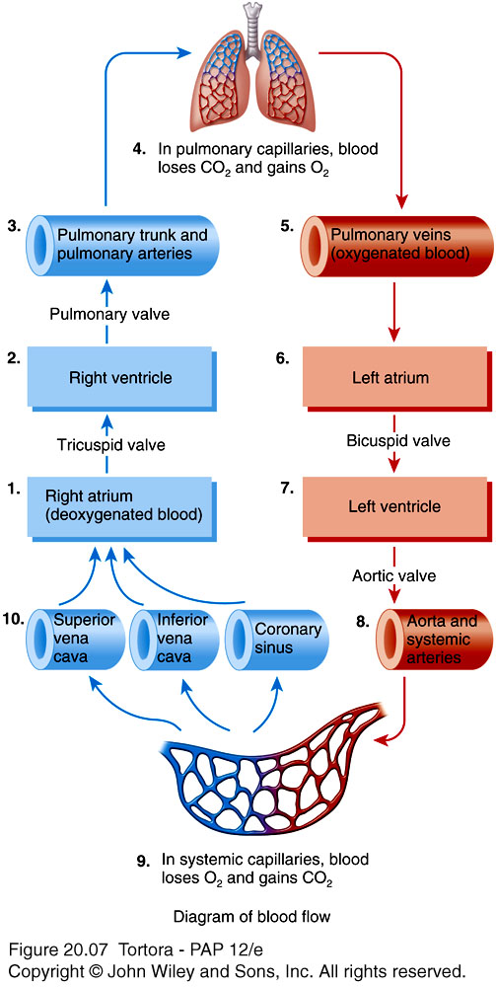
Fig.29: The pulmonary and systemic circulation.

Slide 47
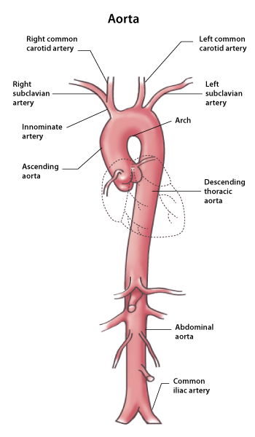
Major Blood Vessels of the Thorax
The Major Arteries
The Aorta
Is the largest artery in the body
Arises from the LV
Divided into 4 parts:
Ascending aorta
Arch of aorta
Descending Thoracic aorta
Abdominal aorta
Brachiocephalic artery
Fig.30: aorta.

Slide 48
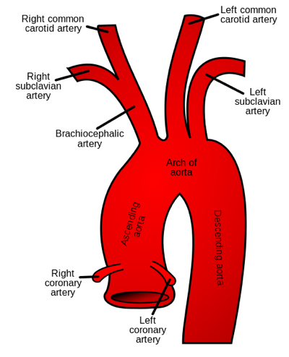
Important Branches (In the Thorax):
Ascending Aorta:
Right Coronary artery
Left Coronary artery
Arch of aorta:
Brachiocephalic trunk
a. Right Subclavian artery
b. Right Common Carotid artery
Left Common Carotid Artery
Left Subclavian Artery
Fig.31: The ascending and the arch of aorta.
Descending Thoracic Aorta:
Gives various branches to the intercostal spaces, pericardium, esophagus and bronchi

Slide 49
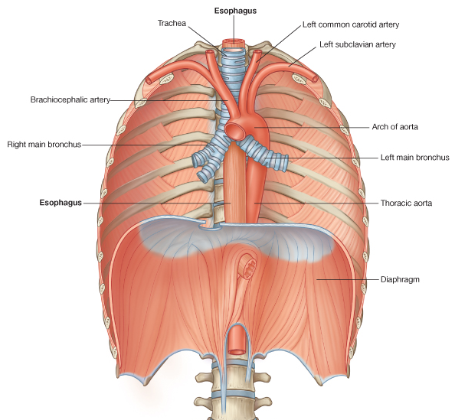
Fig.32: Relation of the descending thoracic aorta to the nearby structures.

Slide 50
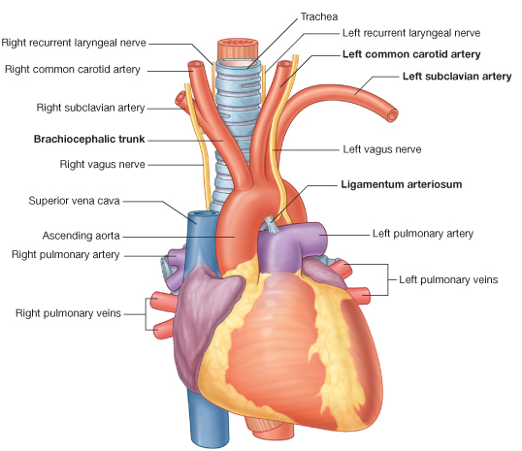
The Pulmonary Trunk
Is the only artery in the body which carries deoxygenated blood.
Arises from the RV.
Divides into the Right and Left Pulmonary arteries which pass into the corresponding lung.
The pulmonary trunk is connected to the arch of aorta by the ligamentum arteriosum.
Fig.33: Anterior view of the heart.
This is the remnant of the ductus arteriosus which shunted blood from the pulmonary trunk to the aorta during fetal life thus bypassing the lung. During fetal life, the fetus does not need his lungs because it already receives oxygenated blood from the mother.

Slide 51
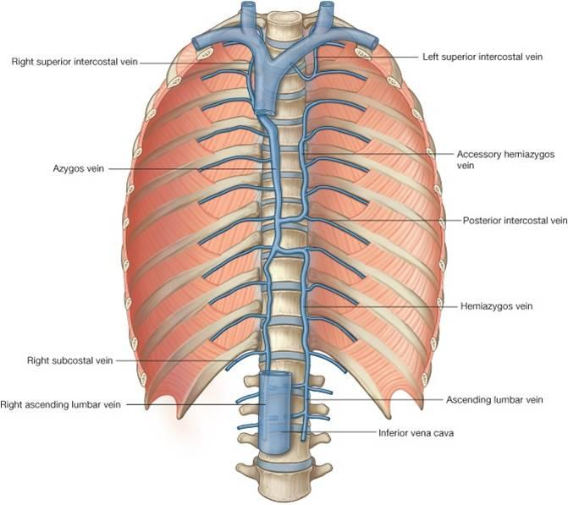
The Major Veins
Blood from the thoracic region is collected by several veins that ultimately drain into the azygos system which shows considerable variation among people.
The major veins of this system are the accessory hemiazygos, hemiazygos and azygos veins.
The azygos vein eventually arches forwards to enter the superior vena cava.
Fig.34: The azygos system of veins.

Slide 52
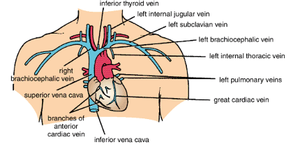
The Brachiocephalic veins:
The right brachiocephalic vein is vertical, whereas the left is more horizontal. They drain blood from the head, neck and upper limbs. They unite to form the Superior Vena Cava (SVC) which opens into the RA.
Fig.35: The major veins of the thorax..
The Pulmonary Veins:
These are 4 veins (2 from each lung) that carry oxygenated blood from the lung to the LA of the heart.
The Inferior Vena Cava (IVC):
This is formed in the abdomen and its terminal part enters the thorax (through the diaphragm) to open into the RA.

Slide 53
Major Blood Vessels of the Head and Neck
The Major Arteries
The Carotid Arteries
The right and left common carotid arteries are responsible for supplying blood to structures in the head and neck.
They ascend superiorly in the neck where they are closely related to the internal jugular vein and the vagus nerve.
About the level of the upper border of the thyroid cartilage (Adam’s Apple), each artery divides into the External and Internal Carotid arteries. (this where the carotid pulse can be felt).
The branches of the external carotid supply almost all structures in the head and neck except the brain.

Slide 54
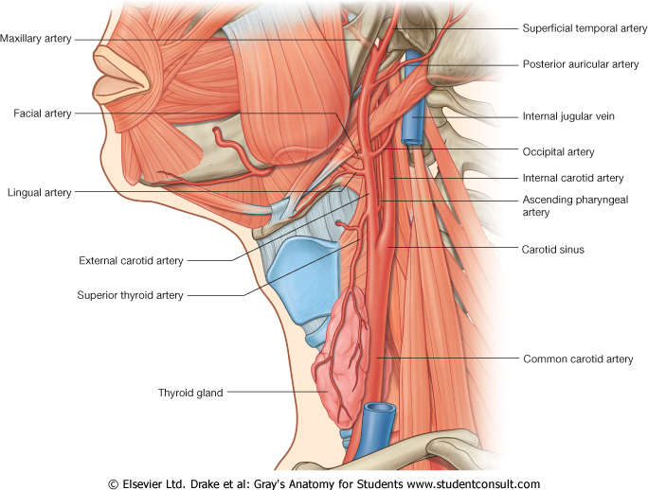
Fig.36: The carotid arteries.

Slide 55
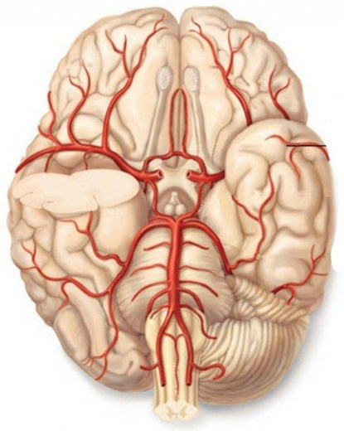
Branches of External Carotid | Structures supplied
Facial | Structures in the face
Lingual | The tongue
Others
The Internal Carotid supplies the brain and various other structures.
Branches from the internal carotid and the subclavian arteries form an arterial circle under the brain called the Circle of Willis. This provides blood to various parts of the brain.
Fig.37: Inferior surface of the brain showing the circle of Willis.

Slide 56
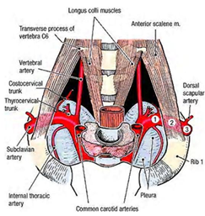
The Subclavian Arteries
The right and left subclavian arteries arch laterally from their origins.
At the outer border of the first rib they become the axillary artery.
The scalenus anterior muscle is related to this artery.
They give off several branches that supply various structure in the head, the neck and even the chest
Fig.38: The subclavian arteries.

Slide 57
The Major Veins
All blood from the brain (and related structures) will drain into Sinuses (enlarged veins). These sinuses will eventually drain into the Internal Jugular vein (IJV).
The IJV is formed inside the skull, leaves the skull by passing through the jugular foramen and descends through the neck in close relation to the internal carotid and common carotid arteries.
Blood from the neck drain into IJV and the External Jugular vein.
The external jugular will drain into the subclavian vein. This vein will unite with the IJV to form the brachiocephalic vein.

Slide 58
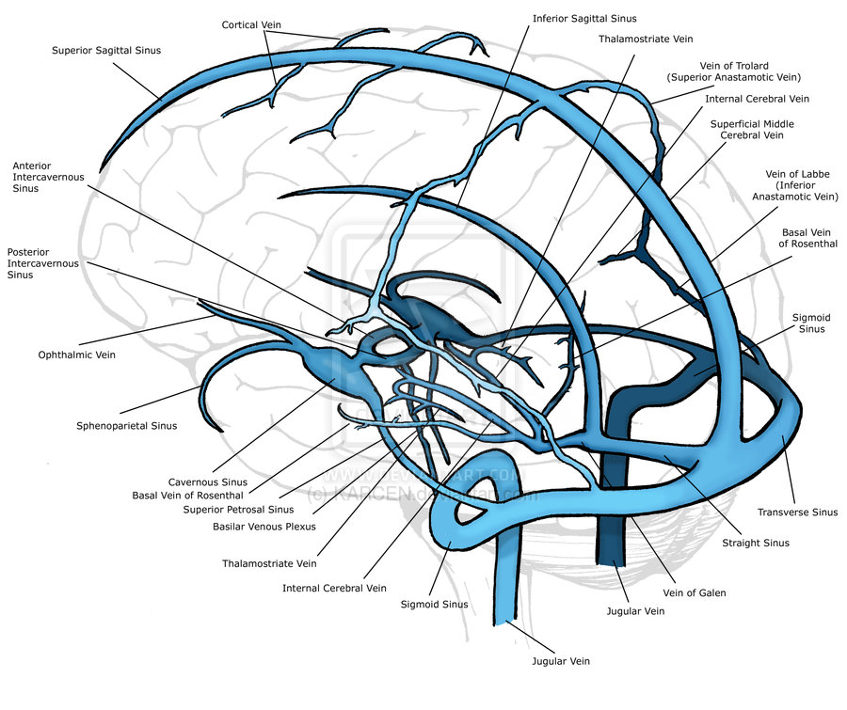
Fig.39: The venous sinuses of the brain.

Slide 59
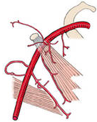
Major Blood Vessels of the Upper Limb
The Major Arteries
The Axillary Artery
It’s the direct continuation of the subclavian artery when it passes the lateral border of the first rib.
The pectoralis minor muscle divides the artery into 3 part.
Its several branches supply surrounding structures.
At the lower border of the teres major muscle, it becomes the brachial artery.
Pectoralis minor
Teres major
Fig.40: The axillary artery.

Slide 60
The Brachial Artery
It’s the direct continuation of the axillary artery when it passes the lower border of the teres major muscle.
Its branches supply surrounding muscles, the humerus and the elbow joint.
It terminates at the neck of the radius by dividing into the radial and ulnar arteries.
In the cubital fossa, the brachial artery passes medial to the tendon of the biceps muscle where it’s superficial. This is the site for taking the brachial pulse and measuring the blood pressure.

Slide 61
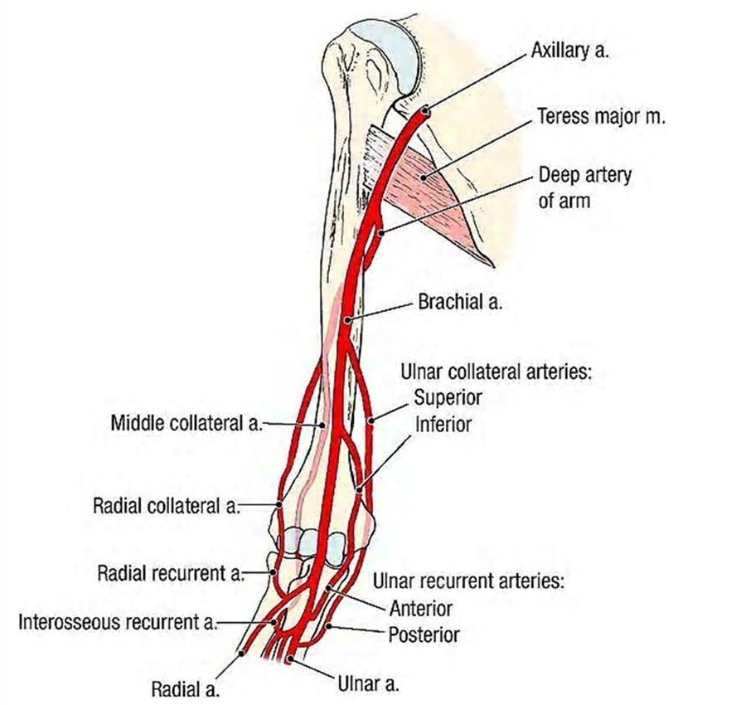

Fig.41: Above, the brachial artery. To the right, location of the brachial artery in the cubital fossa.

Slide 62
The Radial and Ulnar Arteries
The radial artery passes down on the lateral aspect of the forearm. The ulnar passes on the medial side. They enter the palm where they form the superficial and deep palmar arches.
The radial and ulnar arteries supply structures in the forearm. The two palmar arches supply structures in the hand and fingers.
The radial artery is superficial as it passes over the wrist. It’s here that the radial pulse can be felt.

Slide 63


Fig.42: To the left, the radial and ulnar arteries. Above, the superficial and deep palmar arches.

Slide 64
The Major Veins
In the upper limb, we have superficial and deep veins.
The superficial veins run just under the skin. They start as a network on the dorsum of the hand. From this network the Cephalic and Basilic veins arise. These two superficial veins are connected with each other at the elbow by the median cubital vein. Superficial veins are used to take blood samples.
Most of the deep veins are in the form of two small veins (venae comitantes) accompanying the arteries.
The basilic vein unites with the venae comitantes of the brachial artery to form the axillary vein (a large deep vein accompanying the axillary artery). This receives the cephalic vein. Upon passing the outer border of the first rib, the axillary vein becomes the subclavian vein.

Slide 65

Fig.43: Veins of the upper limb.

Slide 66

Major Blood Vessels of the Abdomen
The Major Arteries
The Abdominal Aorta
The abdominal aorta is the continuation of the descending thoracic aorta. It begins where the aorta passes through the diaphragm to enter the abdominal cavity opposite T12 vertebra.
The abdominal aorta is closely related to the vertebral column and the IVC.
It terminates opposite L4 by dividing into the two Common Iliac Arteries.
Fig.44: The abdominal aorta and the inferior vena cava.

Slide 67
Branch | Structures supplied
Celiac trunk | Organs of the digestive system from the esophagus to the upper half of the anal canal Liver Pancreas Spleen
Superior Mesenteric artery
Inferior Mesenteric artery
Suprarenal arteries | Adrenal glands
Renal arteries | Kidneys
Others

Slide 68

Fig.45: Some branches of the abdominal aorta.

Slide 69

The Major Veins
All Blood from the abdomen drains ultimately into the IVC.
The IVC passes upwards close to the abdominal aorta, then passes through the diaphragm at level of T8 to enter the thorax where it opens into the RA.
The blood from the digestive organs (esophagus, stomach, small and large intestines, liver, Pancreas and spleen) drains first into the Portal vein then into the IVC.
Fig.46: The inferior vena cava.

Slide 70

Fig.47: The Portal Venous System.

Slide 71

Major Blood Vessels of the Lower Limb
The Major Arteries
Each common iliac artery soon divide to give the internal and external iliac arteries.
The internal iliac artery supplies structures in the pelvis.
The external iliac artery passes into the thigh where it becomes the Femoral artery.
The femoral artery gives branches that supply structures in the thigh and the knee joint.
When this artery reaches the knee joint it becomes known as the Popliteal artery. The branches of this artery supply structures in the leg and foot.
Fig.48: Major arteries of the lower limb.

Slide 72

The Major Veins
Here we have superficial and deep veins.
The deep veins are venae comitantes. Some large deep veins correspond to the larger arteries.
The superficial veins are:
The Great Saphenous vein which drains into the femoral vein.
The Small Saphenous vein which drains into the Popliteal vein.
Fig.49: Major veins of the lower limb.

