Slide 1
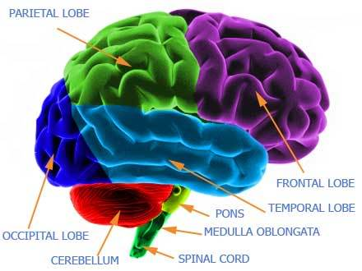
The Nervous System
Dr. Mustafa Saad
(2018)

Slide 2
Overview
The nervous system is the system that controls the various functions of the body by the means of electrical impulses
In comparison, the endocrine system controls various functions of the body by means of chemical substances called hormones

Slide 3
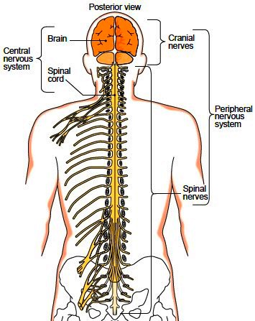
Divisions of the nervous system
Nervous System
Central
Brain
Spinal Cord
Peripheral
Nerves
Ganglia
Spinal
Cranial
Fig.1: Divisions of the nervous system.

Slide 4
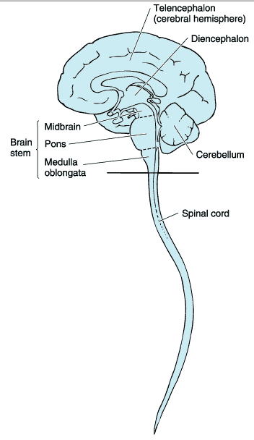
The Central Nervous System (CNS)
Formed of the brain and spinal cord
Formed of millions of nerve cells (neurons) and supporting cells (glia cells)
Well protected within the skull and vertebral column
Functions:
Initiates motor commands (movement and secretions)
Receives and perceives sensory information
Responsible for our emotions, personality, behavior, memory and others
Fig.2: The central nervous system.

Slide 5
The Peripheral Nervous System (PNS)
Formed of the peripheral nerves (cranial and spinal), the ganglia and the sensory receptors
The nerves may be sensory (carry information to CNS) or motor (carry orders from the CNS)
Ganglia are collection of neurons outside the central nervous system
Sensory receptors are parts of neurons or specialized structures that can detect changes in the internal or external environment. The skin, for example, contains several types of receptors that detect pain, touch and heat

Slide 6
Functionally, the PNS can be divided into:
Somatic part: connected to skin, muscles, joints and the special senses. We are fully conscious of this part. Our voluntary movements and our sensation of pain and touch are controlled by this part
Autonomic Nervous System: this part usually operates without conscious control, as it controls all of our involuntary actions, like our heart rate, respiratory rate and blood pressure
Enteric part: controls the secretions and movements of the various parts of the digestive system unconsciously

Slide 7
Histology Of The Nervous System
The nervous tissue is formed of two types of cells:
The nerve cell – Neurons
Supporting cells –Neuroglia or Glia cells
In the nervous tissue, there is a very small amount of extracellular matrix found around the blood vessels.
The space between the cells is filled with neuropil which is formed of the processes of both neurons and glia cells and some fluid.

Slide 8
Neurons
Functional unit of nervous system
Have capacity to produce action potentials
Cell body
  Single nucleus with prominent nucleolus
  Nissl bodies formed of rough endoplasmic reticulum & free ribosomes for protein synthesis. These will give the cytoplasm a dark appearance
  Neurofilaments give cell shape and support (these give the cell a dark color when stained with silver)
Cell processes = dendrites & axons
Mature neurons cannot divide. A damaged neuron cannot be repaired and is replaced by fibrous tissue

Slide 9
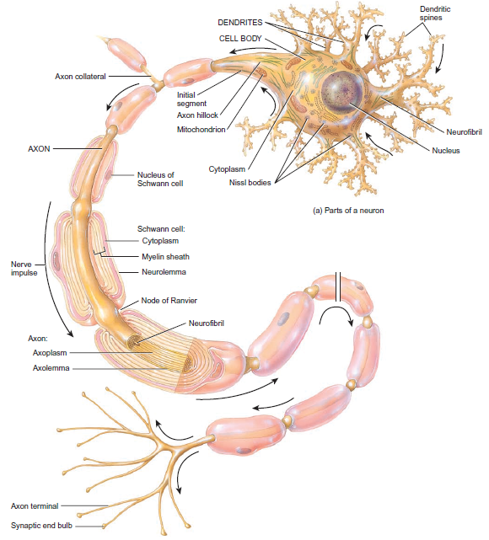
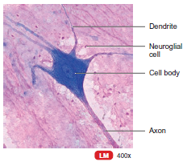
Fig.3: The neuron and its parts. Note the dark color of the cytoplasm (in the small image).

Slide 10
 | Dendrites | Axon
1 | Mostly multiple branches | A Single branch
2 | Usually short | Usually the longest branch and is called nerve fiber
3 | Taper as they extend away from cell body | Has a fixed diameter
4 | Branch profusely | No branches near cell body Collateral branches along course Terminal branches
5 | Not covered by a myelin sheath | Some are covered by a myelin sheath
6 | Conduct impulse towards cell body | Conducts impulse away from cell body

Slide 11
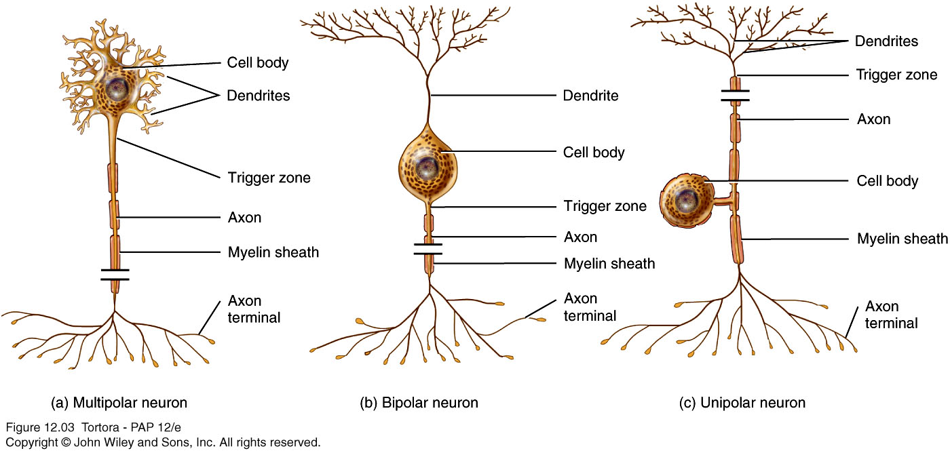
Types of neurons
Multipolar Neurons
1 Axon
Multiple dendrites
Pseudounipolar Neuorns
1 process divides into a central branch (to CNS) and a peripheral branch (to receptors)
Bipolar Neurons
1 Axon
1 Dendrite

Slide 12
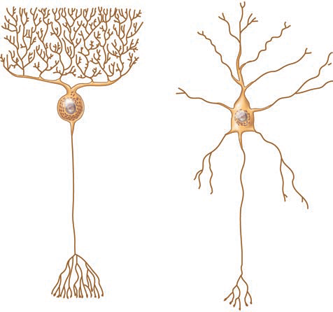
Example of Neurons
Purkinje Cells | Feature | Pyramidal Cells
Cerebellar cortex | Location | Cerebral cortex
Large Pear shaped | Cell Body | Large Pyramidal
Multipolar | Type | Multipolar
Motor | Function | Motor

Slide 13



Glia cells
Cell | Location | Function
Astrocytes | CNS | Part of blood-brain barrier Provide nutrients for neurons Form scar tissue after injury
Oligodendrocytes |  | Form myelin sheath
 |  | Defense (by phagocytosis)
Microglia cells
 |  | Line cavities
Ependymal cells
Schwann cells | PNS | Form myelin sheath
 |  | Support neurons in dorsal root ganglia
Satellite cells

Slide 14
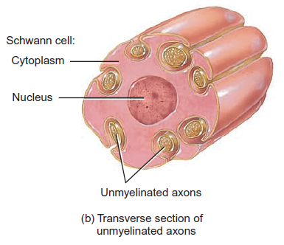
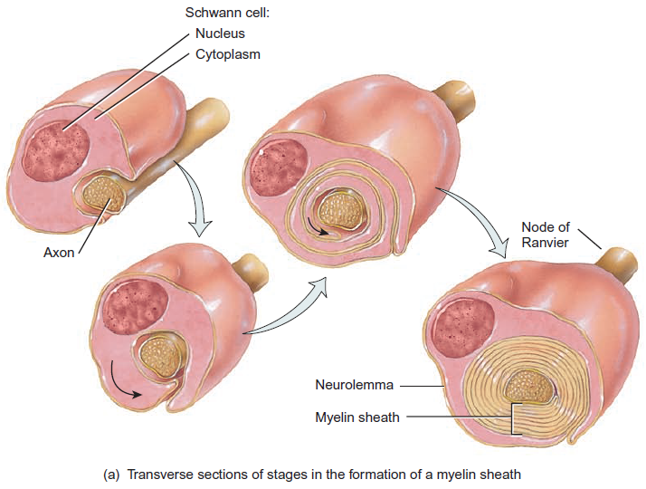
Myelination
Myelin = multiple layers of cell membrane
In the PNS, Schwann cells surround both myelinated and unmyelinated fibers.
In the CNS, oligodendrocytes surround myelinated fibers only
Fig.4*: The process of myelination in the peripheral nervous system and unmyelinated axons.

Slide 15
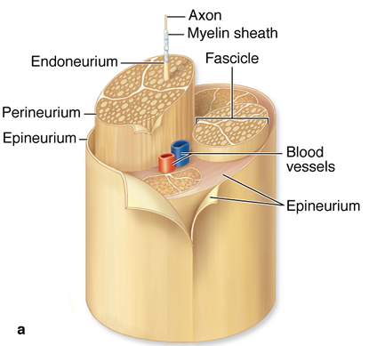
Histology of a nerve
Nerve: a group of bundles of nerve fibers and their covering connective tissue layers
The whole nerve is surrounded by the epineurium
Each bundle is surrounded by the perineurium, which forms a blood-nerve barrier
Each nerve fiber (axon) is surrounded by myelin sheath an areolar connective tissue endoneurium
Fig.5: Peripheral nerve and its covering layers.

Slide 16
The Central Nervous System -
The Brain
The brain is the part of the nervous system present within the skull. The brain is formed of two halves which are similar to each other grossly. The two halves are connected with each by a number of nerve bundles.
The brain is formed of:
The Cerebrum
The Diencephalon
The Cerebellum
The Brainstem

Slide 17
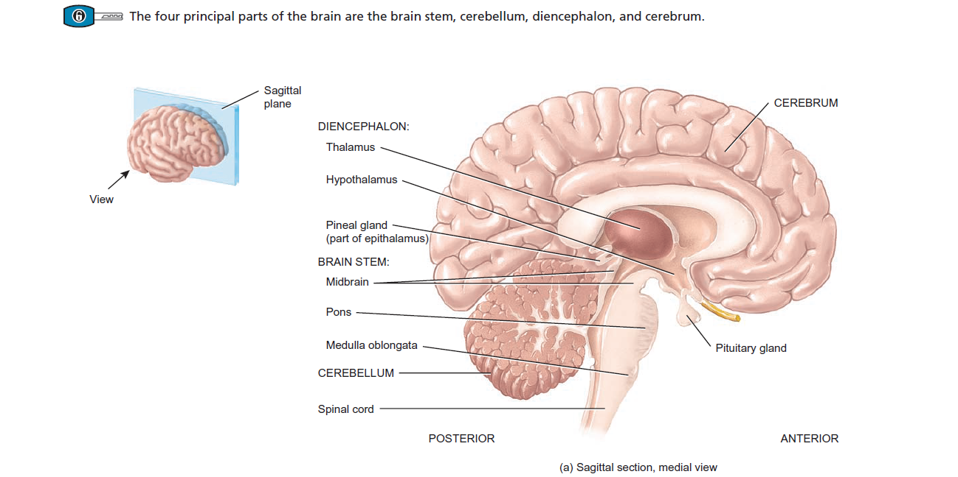
Fig.6: Sagittal section, medial view showing parts of the right side of the brain.

Slide 18
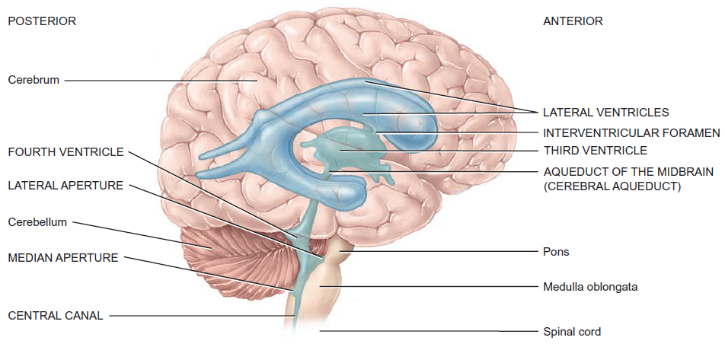
Ventricular system
Within the different parts of the brain, there are several cavities lined by ependymal cells and filled with Cerebrospinal fluid
Fig.7: Ventricles of the brain.

Slide 19
Protective coverings of the brain
The cranium
The cranial meninges:
Dura mater: the hard outermost layer. Separated from the skull bones by the epidural space. The venous sinuses of the brain are located within the dura mater
Arachnoid mater : the thin middle layer. Separated from the dura by the subdural space. Beneath the arachnoid, we have the large subarachnoid space
Pia mater: thin innermost layer. Directly covers the brain.

Slide 20
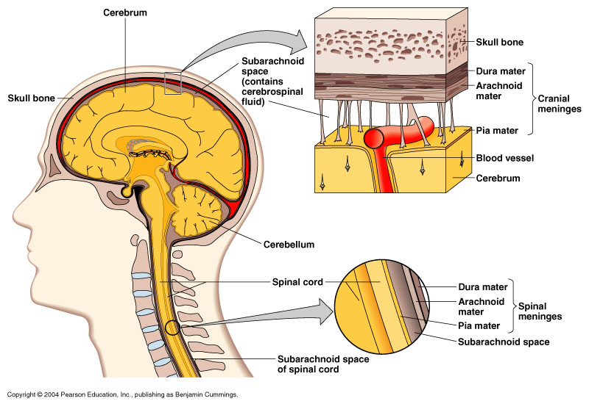
Fig.8: The cranial and spinal meninges.

Slide 21
The Cerebrospinal Fluid (CSF)
Clear fluid.
Circulates through cavities in the brain (ventricles) and the spinal cord (central canal) and also in the subarachnoid space.
Functions:
Absorbs shock and protects the brain and the spinal cord.
Helps transport nutrients and wastes from the blood and the nervous tissue.

Slide 22
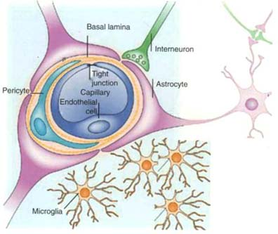
The Blood-Brain Barrier
This include a number of structures that control the passage of substances from blood to the nervous tissue to protect it against harmful agents.
It’s formed of:
Endothelium of capillaries
Pericytes: cells present around the capillaries beneath its basal lamina
Basal lamina
Processes of astrocytes
Fig.9: The blood-brain barrier.

Slide 23
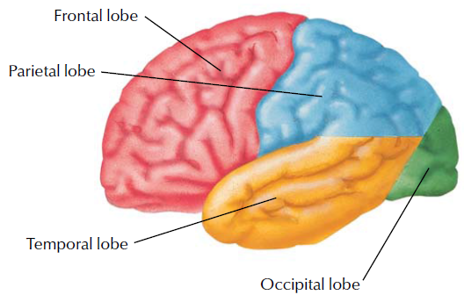
The Cerebrum
Fig.10*: The Cerebrum (lateral view).
All motor commands issue from the cerebrum. All sensations are perceived here. In addition, this part is responsible for emotions, behavior and memory
The cerebrum is formed of two parts (called hemispheres) each of which is formed of four lobes: frontal lobe, parietal lobe, temporal lobe and occipital lobe.
It’s characterized by the presence of fissures called sulci and protrusions called gyri (Fig.12). The cavity within it is the lateral ventricle.

Slide 24
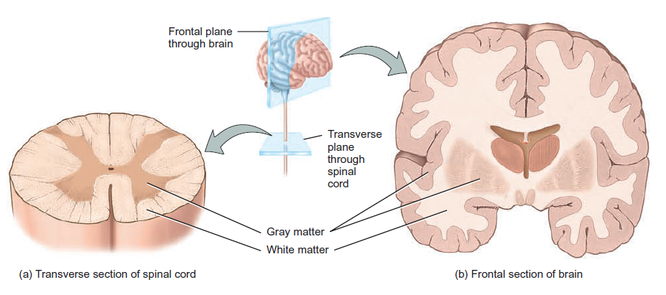
The outer layer of the cerebrum is called the cerebral cortex. It’s formed mainly of the body of neurons and therefore it’s called the gray matter. Deep to it, we have the white matter, formed mainly of nerve fibers.
In the spinal cord, the arrangement is reversed
Fig.11: The arrangement of the gray and white matter in the cerebrum and spinal cord.

Slide 25
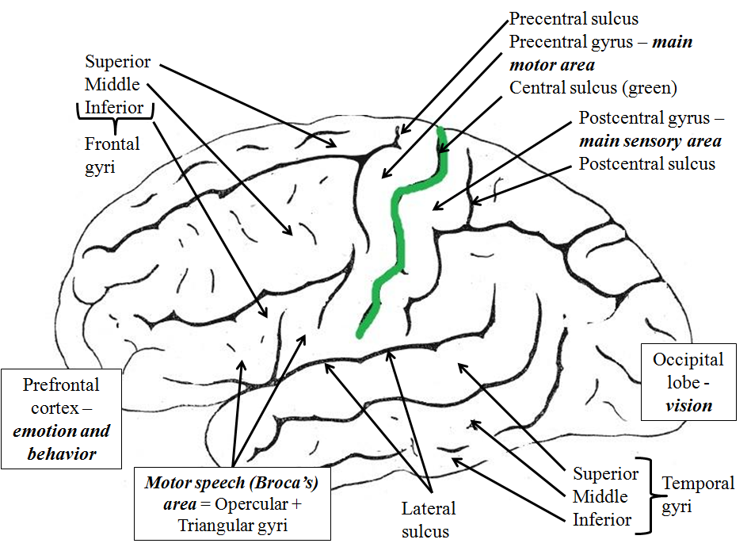
Fig.12*: Important Sulci and Gyri:

Slide 26
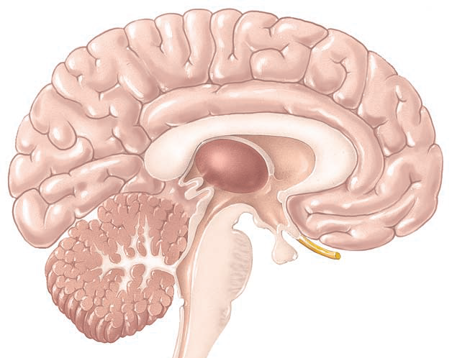
The Diencephalon
This part of the brain is located on the medial aspect of the cerebrum. The cavity here is the 3rd ventricle
It’s formed of the:
Thalamus
Hypothalamus
Epithalamus
Fig.13: The location and parts of the diencephalon.

Slide 27
Part | Main Function
Thalamus | Relay station for most sensation
Hypothalamus | Controls hormone secretions of all endocrine glands in the body Control body temperature Control eating and drinking
Pineal gland of the epithalamus | Secrete melatonin hormone which regulates diurnal (day-night) cycles

Slide 28
The Cerebellum
Second largest part of the brain.
The central constricted area is the vermis. On each side of the vermis, we have the expanded cerebellar hemispheres
The cerebellum is located inferior to the occipital lobe and posterior to the brainstem. It’s separated from the brainstem by the 4th ventricle
The function of the cerebellum is the coordination of movement and the maintaining of balance

Slide 29
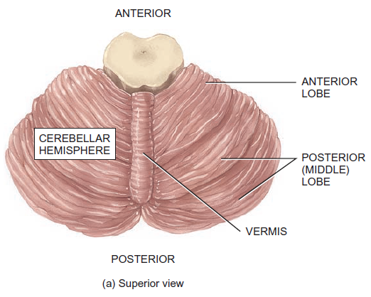
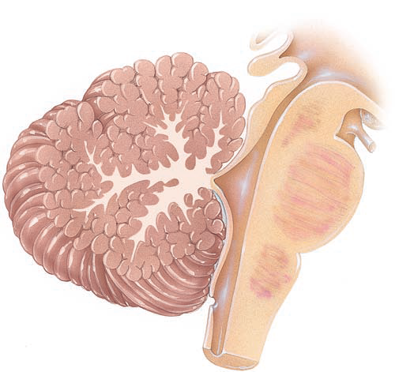
4th ventricle
Gray matter
White matter
Fig.14: The cerebellum.

Slide 30
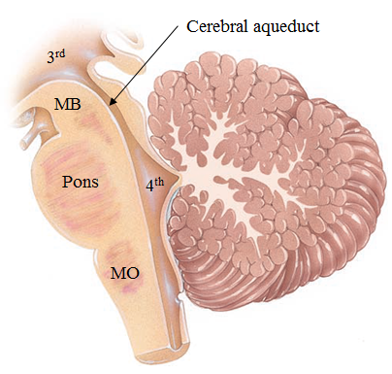
The Brainstem
The part of the brain that connects the diencephalon with the spinal cord
Formed of 3 parts:
  Midbrain (MB)
  Pons – connect several parts of the CNS together. Contains respiratory centers.
  Medulla oblongata
The brainstem contains several important control centers and the attachment of several cranial nerves
Also in the brainstem is the Reticular Formation. This an area of mixed gray and white matter related to consciousness and muscle tone.
Fig.15: Location and parts of the brainstem.

Slide 31
The Midbrain
Fig.16: Section through the midbrain.
Cerebral aqueduct
Superior colliculus – related to visual reflexes
Inferior colliculus (not shown) – related to auditory pathway
Mesencephalic nucleus – contains pseudounipolar neurons that carry proprioceptive sensations from the face. The only place in the CNS with such neurons; all other pseudounipolar neurons are located in peripheral ganglia
Red nucleus – involved in coordination of muscle activity
Substantia nigra – neurons here release Dopmaine and is involved in muscular activity. Lesion in this area is associated with Parkinson’s disease

Slide 32
The Medulla Oblongata
Contains important control centers:
  Cardiovascular center
  Respiratory center
Anteriorly, near the midline, are the pyramids which are formed by the descending motor tracts.
At a certain point in the medulla, the majority of the fibers in these tracts will cross to the other side forming the decussation of the pyramid.
This is why each half of the brain controls the opposite side of the body.
Fig.17: The medulla oblongata.

Slide 33
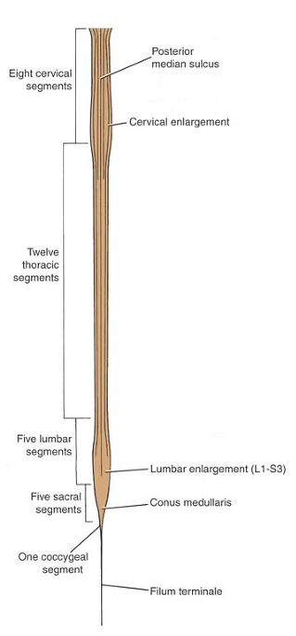
The Central Nervous System -
The Spinal Cord
A grayish-white cylindrical structure.
Starts at the foramen magnum and ends at lower border of L1 in adults. In children, it ends at L3.
Protected by the vertebral column and the three layers of meninges.
The pia matter will continue after the termination of the spinal cord as a thin thread called the filum terminale.
Fig.18: The spinal cord.

Slide 34

External features of the spinal cord
It has two enlargements: cervical and lumbar. The cervical enlargement is the origin of the cervical and brachial plexuses. The lumbar enlargement is the origin of the lumbar and sacral plexuses.
The terminal part of the spinal cord is cone shaped and called the Conus medullaris.
From the spinal cord arise the dorsal (posterior) and ventral (anterior) roots of the spinal nerves. The dorsal root possesses a swelling called the Dorsal Root Ganglion which contains bodies of pseudounipolar neurons. The two roots unite to form the spinal nerves.
Fig.19: The conus medullaris.

Slide 35
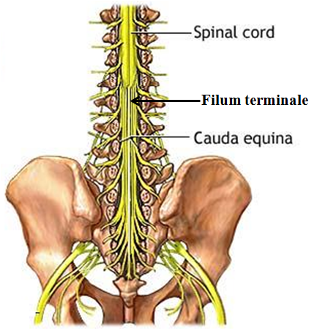
The spinal cord is divided into segments: 8 Cervical, 12 Thoracic, 5 Lumbar, 5 Sacral and 1 Coccygeal. From each segment arises a pair of spinal nerves. Thus, we have a total of 31 pairs of spinal nerves.
The nerves pass laterally to exit the vertebral column. The spinal cord is shorter than the spine. Therefore the lower nerves must pass down for a distance before exiting. These will form a structure like a wisp of hair around the filum terminale called the Cauda Equina.
Fig.20: The cauda equina.

Slide 36
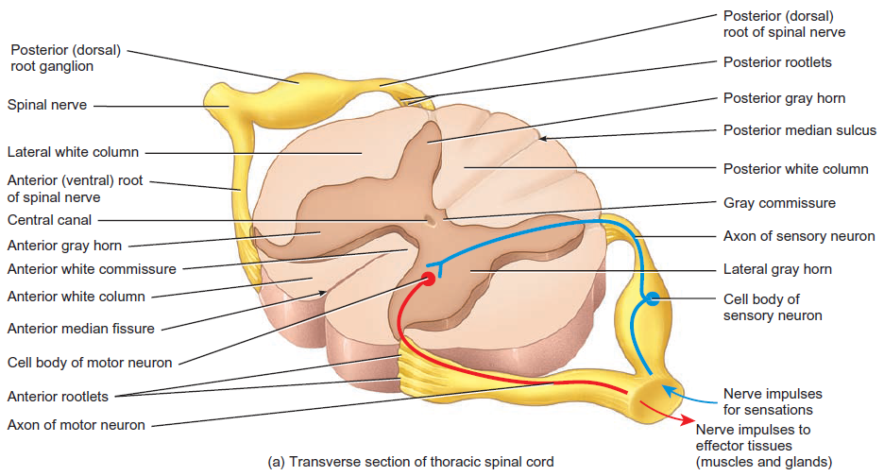
Internal features of the spinal cord
Fig.21*: Cross section through the spinal cord showing important internal features.

Slide 37
The Peripheral Nervous System -
The Cranial Nerves
Cranial Nerve | Central Attachment | Main Functions
I – Olfactory | Cerebrum | Olfaction (Smelling)
II – Optic | Cerebrum | Vision
III – Oculomotor | Midbrain | Supplies extrinsic muscles of eye
IV - Trochlear
V – Trigeminal | Pons | Carries sensation from face Supplies muscles of mastication
VI – Abducent | Between pons and medulla | Supplies extrinsic muscles of eye

Slide 38
Cranial Nerve | Central Attachment | Main Functions
VII – Facial | Between pons and medulla | Supplies muscles of facial expression Carries taste sensations from anterior 2/3 of tongue
VIII - Vestibulocochlear |  | Hearing and equilibrium
IX - Glossopharyngeal | Medulla | Supplies some muscles Carries taste sensation from posterior 1/3 of tongue
X – Vagus |  | Supplies various muscles Carries various sensation Supplies internal organs
XI – Accessory |  | Supplies the sternocleidomastoid and trapezius muscles
XII – Hypoglossal |  | Supplies all muscles of the tongue (except palatoglossus)

Slide 39
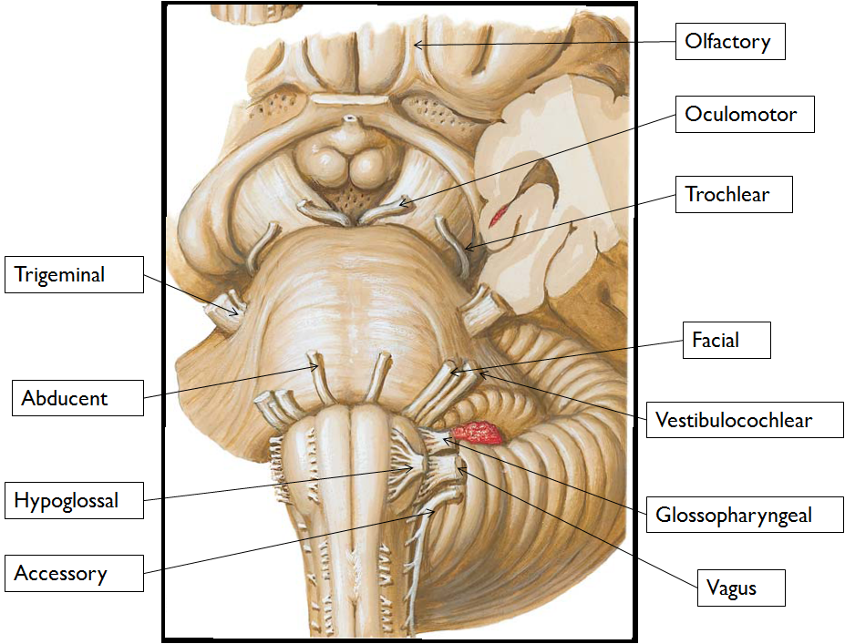
Fig.22: The cranial nerves.

Slide 40
The Peripheral Nervous System -
The Spinal Nerves
31 pairs; mixed nerves (sensory and motor)
Cervical (C1-C8), thoracic (T1-T12), lumbar (L1-L5), sacral (S1-S5) and coccygeal (Co).
A spinal nerve gives off two main branches: anterior ramus and posteior ramus.
Anterior rami of spinal nerves usually arranged in groups called plexuses. These include: Cervical, Brachial, Lumbar and Sacral plexuses.

Slide 41
Plexus | Main Branches
Cervical | Phrenic
Brachial | Axillary Musculocutaneous Radial Median Ulnar
Lumbar | Obturator Femoral
Sacral | Sciatic | Biggest nerve in the body

Slide 42
The Autonomic Nervous system
The autonomic nervous system (ANS) is part of the peripheral nervous system.
Functionally, it operates without our conscious control.
It controls involuntary muscles (cardiac and smooth) and glands.
It’s formed of two divisions: The Sympathetic and Parasympathetic.

Slide 43
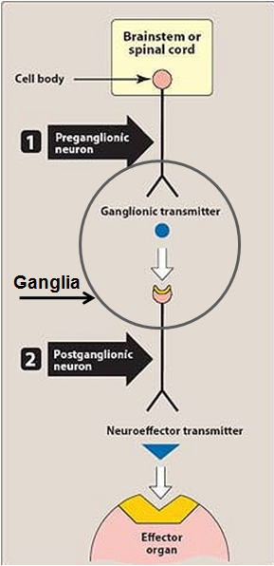
The ANS is formed of Preganglionic and Postganglionic fibers
The preganglionic fibers arise from autonomic centers in the CNS and pass through cranial and spinal nerves to autonomic ganglia outside the CNS.
The postganglionic fibers arise from the autonomic ganglia to supply the involuntary muscles and glands
The autonomic centers are controlled by the Hypothalamus
Fig.23: The two-neuron pathway of the ANS.

Slide 44
The Sympathetic (Thoracolumbar) Division
The gray matter of the T1-L2 segments of the spinal cord possess a lateral horn in which are located the cell bodies of the sympathetic preganglionic neurons.
The myelinated axons of these neurons leave the spinal cord through the anterior root of the spinal nerves.
They pass through the white ramus to enter the sympathetic trunk.
  Sympathetic trunk is a chain of ganglia located on each side of the vertebral column.

Slide 45
In the sympathetic trunk, the preganglionic neuron may either:
  Synapse with the postganglionic neurons in the ganglia at the same level on the same side. In this case, the unmyelinated postganglionic fibers exit the trunk through the gray ramus to re-enter the spinal nerves where they pass to supply the smooth muscles of blood vessels, sweat glands and the arrector pili muscles of the skin.
  Pass up/down in the sympathetic trunk to synapse with postganglionic neurons at a different level to supply skin.
  Some postganglionic fibers will supply various organs in the head, chest, abdomen and pelvis.
  Leave the trunk without synapsing. Here preganglionic fibers will form the Splanchnic nerves and they will eventually synapse with postganglionic neurons in the preaortic ganglia (celiac, superior mesenteric, inferior mesenteric and renal). The postganglinic fibers will then pass to supply the viscera.

Slide 46
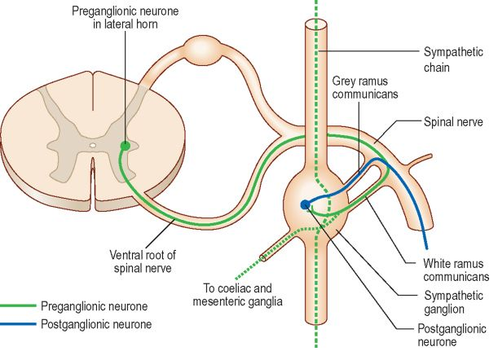
Fig.24: The pathway of the sympathetic neurons.

Slide 47
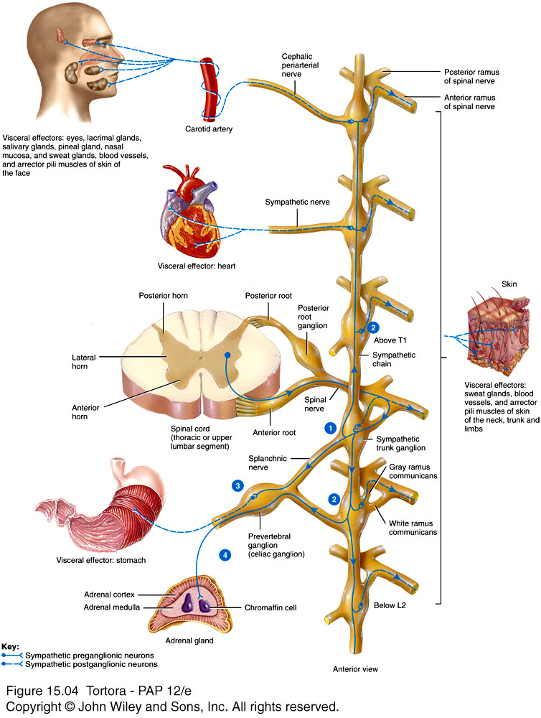
Fig.25: The distribution of the sympathetic nervous system.

Slide 48
The sympathetic splanchnic nerves are the greater, lesser, least (lowest) and lumbar splanchnic nerves.
Some preganglionic fibers will pass, without synapsing, in the sympathetic chain, the greater splanchnic nerves, and the celiac ganglia to end in the Adrenal Medulla where they stimulate the release of hormones.
A single sympathetic preganglionic fiber has many axon collaterals and may synapse with 20 or more postganglionic neurons. The postganglionic axons typically terminate in several visceral effectors.
Therefore the effects of sympathetic stimulation are more widespread than the effects of parasympathetic stimulation.

Slide 49
The Parasympathetic Division
Also called Craniosacral division.
Preganglionic neurons pass through:
  The cranial nerves III, VII, IX and X
  Sacral spinal nerves S2-S4 (form the Pelvic Splanchnic nerves)
Parasympathetic ganglia: terminal ganglia (close to or within effector organs).
A preganglionic neuron usually synapses with 4-5 postganglionic neurons all of which supply a single visceral effector. So the effect is limited.

Slide 50
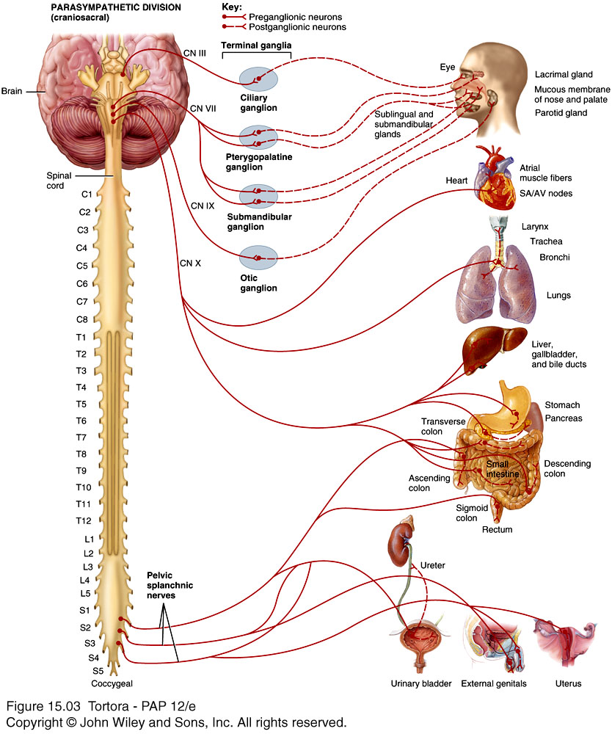
Fig.26: The distribution of the parasympathetic nervous system.

Slide 51
General and Special Sensations

Slide 52
General and Special Senses
General Senses
Special Senses
Include:
  Somatic sensations (tactile, thermal, pain, and proprioceptive – sense of position) from body and joints
  Visceral sensations from the organs.
Scattered throughout the body.
Simple structures.
Include
  Smell
  Taste
  Vision
  Hearing and equilibrium.
Concentrated in specific locations in the head.
Anatomically distinct structures.
Complex neural pathway.

Slide 53
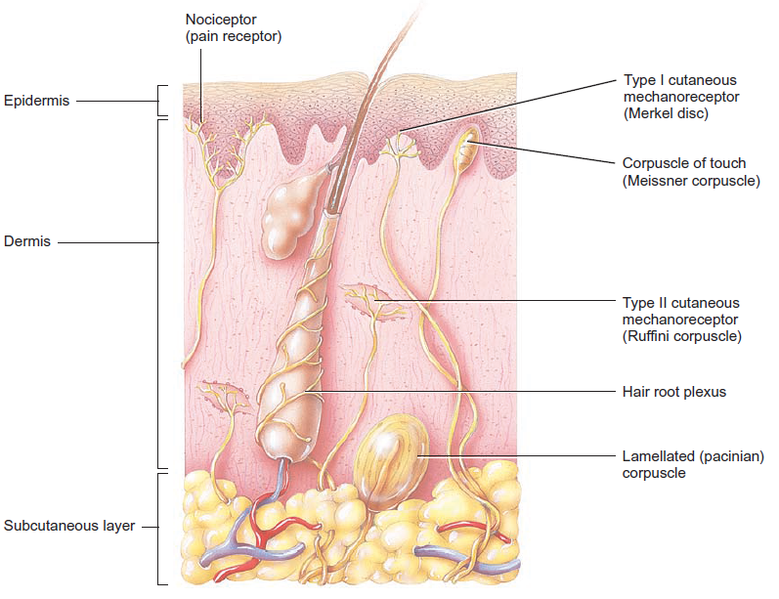
The General Sensory Structures
All serve for tactile sensations
Fig.27*: Structures of General Sensations in the skin.

Slide 54
Special Senses – Olfaction = Smell
The olfactory epithelium is located in the roof of the nasal cavity. It contains 10-100 million receptors.
The olfactory epithelium is formed of:
  Olfactory receptors - bipolar neurons with cilia called olfactory hairs.
  Supporting cells- provide support and nourishment.
  Basal cells- replace olfactory receptors.
Olfactory glands produce a secretion that helps in moistening the surface of the epithelium

Slide 55
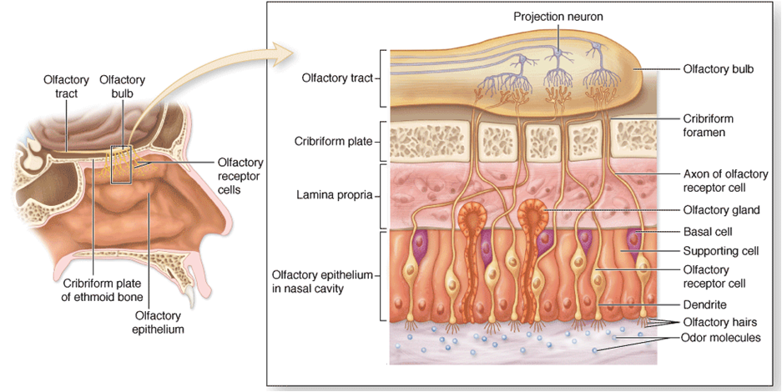
Fig.28: Olfactory epithelium – location and types of cells.

Slide 56
Special Senses – Gustation = Taste
Gustation is performed by specialized structures called Taste Buds that are mainly present in the papillae of the tongue.
Taste buds are oval structures formed of:
  Gustatory cells- Each one has a gustatory hair (a long microvillus) that projects through an opening in the bud called the taste pore.
  Supporting cells- provide support and nourishment.
  Basal cells- replace the other cells.

Slide 57
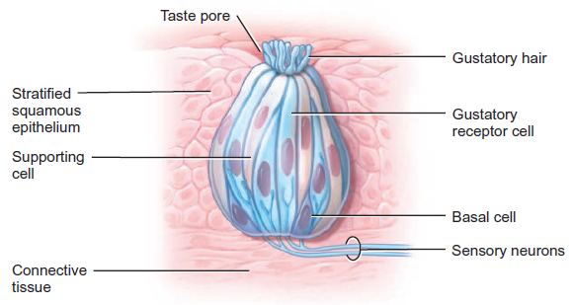
Fig.29: Taste bud.

Slide 58
Special Senses – Vision
Vision is the function of the eye.
The eyeball is located in the orbital cavity of the skull.
Accessory structures of the eye include:
  The eyelids
  The lacrimal apparatus
  The extrinsic muscles of the eye

Slide 59
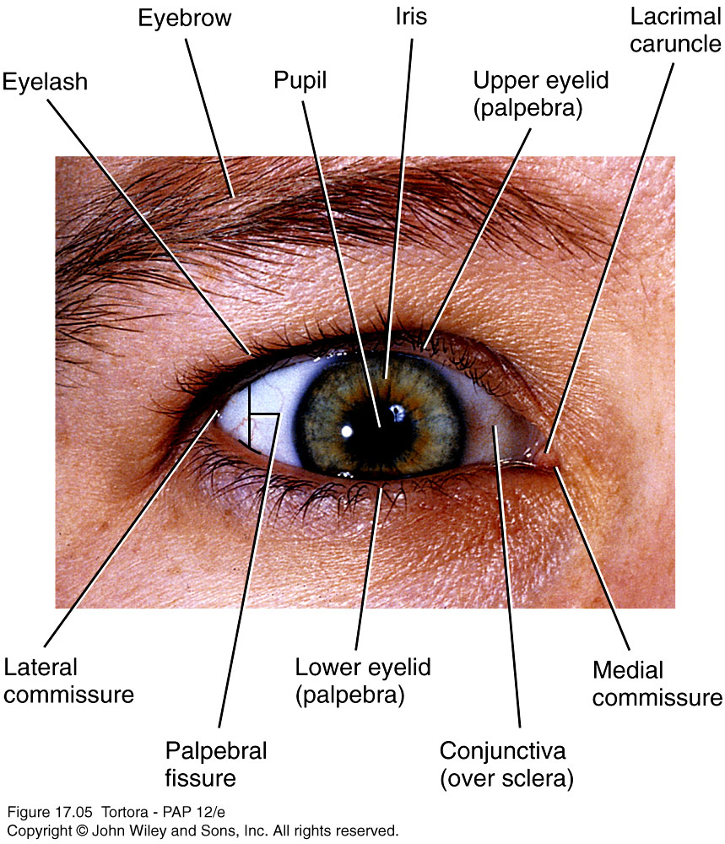
The Eyelids (Palpebrae)
The eyelids:
  Protect eye from light
  Shade eye during sleep
  Spread lubricating secretions (tear)
The space between the eyelids that exposes the eyeball is called the palpebral fissure.
The eyelids meet each other at the medial and lateral commisures.
Fig.30: The eyelids.
The levator palpebrae superioris muscle raises the upper eyelid.

Slide 60
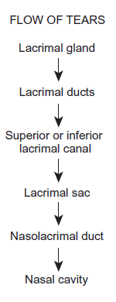
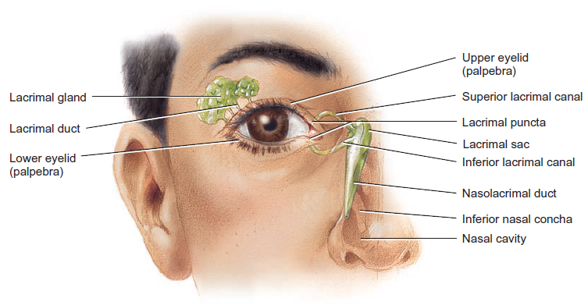
The Lacrimal Apparatus
Fig.31*: Components of the lacrimal apparatus.

Slide 61
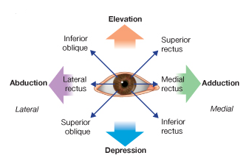
Extrinsic Eye Muscles
Six extrinsic eye muscles control movements of each eyeball. They are called extrinsic because they originate outside the eyeballs in the bony orbit and insert on the outer surface of the sclera (the white of the eye).
Oculomotor
Oculomotor
Abducent
Oculomotor
Trochlear
Oculomotor

Slide 62
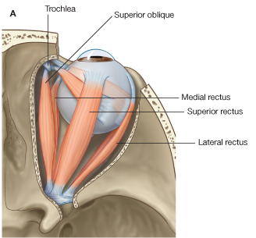
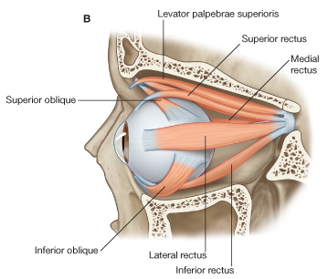
Fig.32: Extrinsic muscles of the eye. (A) superior view. (B) lateral view.

Slide 63
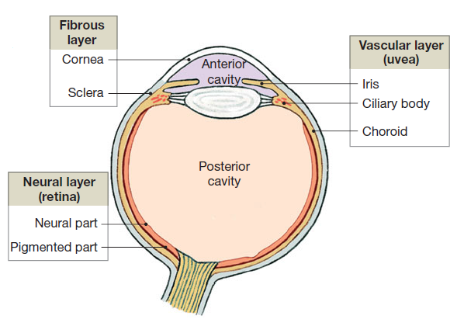
Anatomy of the Eyeball
The Wall of the eyeball
1
Outer
Inner
Middle
3
2
Fig.33*: The wall of the eyeball.

Slide 64
Fibrous tunic (layer)
Sclera “white” of the eye
  The larger posterior part.
  A strong fibrous layer.
  Functions:
    Protect the eye.
    Help maintain shape of the eye.
    Site of attachment of extrinsic eye muscles.
Cornea
  The smaller anterior part. Located in front of the iris.
  Transparent.
  Function: it allows light to enter the eye and it’s the major refractory structure in the eye.

Slide 65
Vascular tunic
Choroid
  The large posterior part.
  Highly vascular layer with numerous melanin-producing melanocytes.
  Functions:
    Supply nutrients to the retina.
    Melanin pigment absorbs any stray lights, thus, making the image sharp.

Slide 66
Ciliary body (Fig.35)
  The middle part of the vascular tunic.
  Located just posterior to the junction of the cornea and sclera.
  Has numerous protrusions called the ciliary processess. These produce the aqueous humor. From them extend the zonular fibers (suspensory ligaments) that are attached to the lens.
  The ciliary muscle is a smooth muscle within the ciliary body. It’s responsible for changing the shape of the lens.

Slide 67
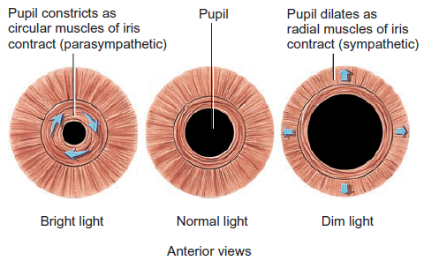
The Iris
  The anterior colored portion of the vascular tunic.
  The opening in the middle of the iris is called the pupil. Through this pupil light can pass to the lens.
The iris contains the circular sphincter pupillae muscle and the radial dilator pupillae muscle. These muscles change the diameter of the pupil regulating the amount of light passing through it.
Fig.34*: The muscles of the iris. Note the effect of the two divisions of the ANS on them.

Slide 68
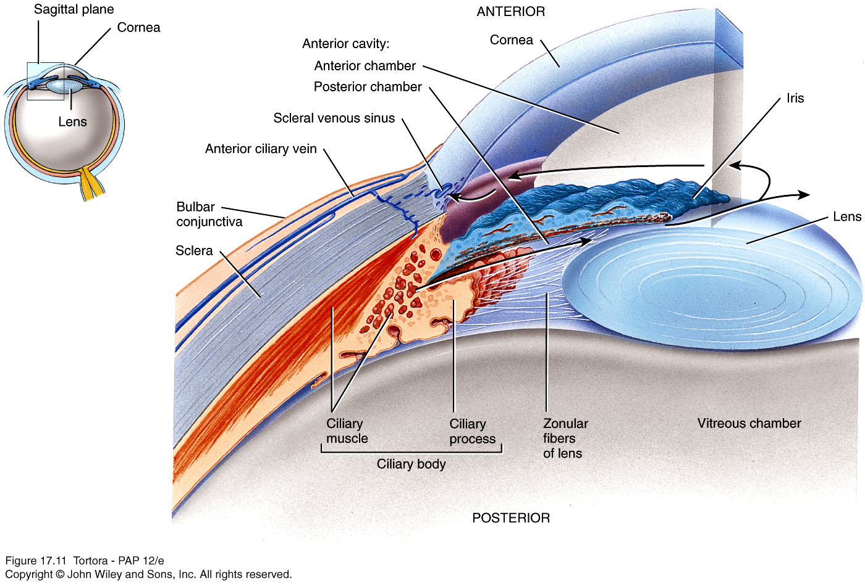
Fig.35: The ciliary body and the iris.

Slide 69
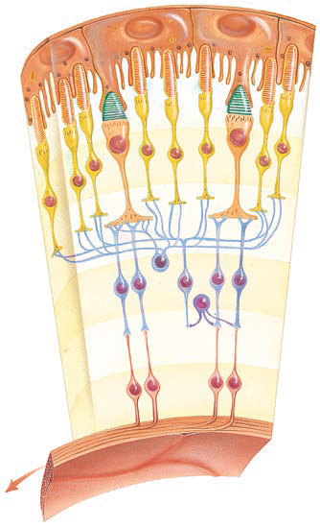
The Retina
Located in the posterior 2/3 of the eyeball
Formed of two layers:
  An outer Pigmented layer which contains melanin that absorbs any stray light
  An inner Neural layer formed of several types of cells including the photoreceptors
Axons from the neural layer will come together to form the Optic nerve (CN II)
Fig.36: The retina.

Slide 70
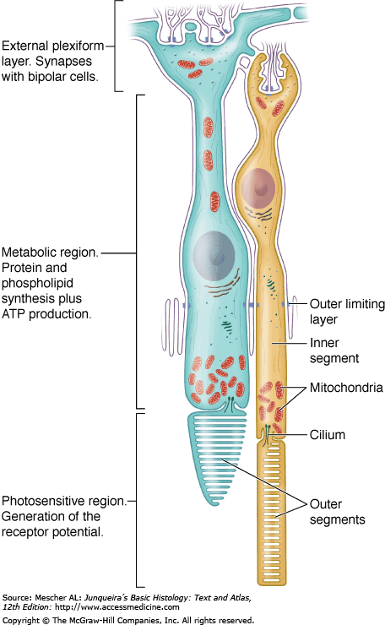
The Photoreceptors of the retina – Rods and Cones
Fig.37: The rods and cones.

Slide 71
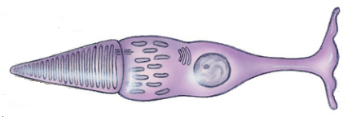

Cones | Feature | Rods
Cone-shaped | Outer segment | Rod-shaped
Continuous with the cell membrane | Membranous discs | Stacked on each other and separated from the cell membrane
Contains the nucleus, mitochondria, Golgi and polyribosomes | Inner segment | Contains the nucleus, mitochondria, Golgi and polyribosomes
Modified cilium | 2 segments connected by | Modified cilium
Less | Sensitivity to light | More
Color vision | Specialized in | Dark vision
Mostly in the center | Location in Retina | Mostly on the periphery

Slide 72
Macula lutea is in the exact center of the posterior portion of the retina, at the visual axis of the eye.
Fovea centralis a small depression in the center of the macula lutea, contains only cones. Thus, any image falling on this spot will have a high resolution.
Optic disc is the point in the retina at which the optic nerve exits the eyeball. This area has no cones or rods and, therefore, it’s called the blind spot.

Slide 73
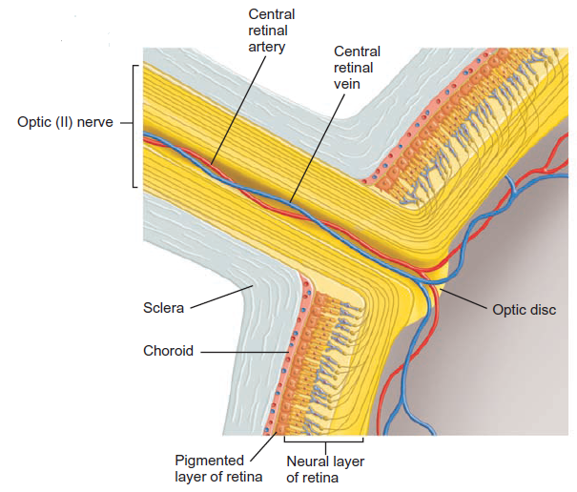
Fig.38*: The optic nerve. Note how the central retinal artery and vein run in the center of the optic nerve

Slide 74
The Interior of the eyeball
Lens
  Transparent structure.
  Lacks blood vessels.
  Divides the eyeball into two cavities: anterior and posterior.
Anterior cavity
  Between the cornea and the lens.
  Contains aqueous humor which helps to provide nutrients for the lens and cornea.
  Further divided into:
    Anterior chamber: between cornea and iris
    Posterior chamber: between iris and lens
Posterior cavity
  Posterior to the lens.
  Filled with the gelatinous vitreous humor which maintains the shape of the eye.

Slide 75
Glaucoma
The aqueous humor is a fluid present inside a closed space (the anterior cavity); therefor, a pressure is formed in this space called ‘The intraocular pressure’.
The aqueous humor is produced by the ciliary processes and circulates in the posterior chamber. After passing through the pupil, it enters and circulates in the anterior chamber. In the angle between the iris and the cornea, there several channels through which this humor passes to enter the systemic venous circulation (Fig.39).
There is a balance between the rate of production and removal of the aqueous humor. Any problem that leads to accumulation of this humor will lead to increased intraocular pressure; and this is a serious condition known as ‘Glaucoma’.

Slide 76
Fig.39: The cavities and chambers of the eye.

Slide 77
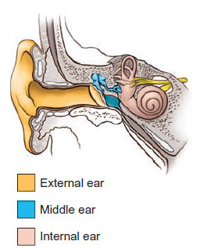
Special Senses – Hearing
Hearing (and equilibrium) is the function of the ear.
The ear is formed of 3 parts:
The external ear, which collects sound waves and channels them inward.
The middle ear, which conveys sound vibrations to the oval window.
The internal (inner) ear, which houses the receptors for hearing and equilibrium.
Fig.40: The three parts of the ear.

Slide 78
The External Ear
Formed of the auricle, the external auditory canal and the tympanic membrane (eardrum).
The auricle (pinna) of the ear is formed of elastic cartilage covered by skin. Its rim is called the helix and its inferior part is called the lobule.
The external auditory canal conveys sounds from the auricle to the eardrum. It contains ceruminous glands and hairs.
The eardrum is a thin semitransparent partition between the external and middle ears. It’s convex towards the middle ear. To it is attached the malleus bone. It transmits sound to the middle ear.

Slide 79
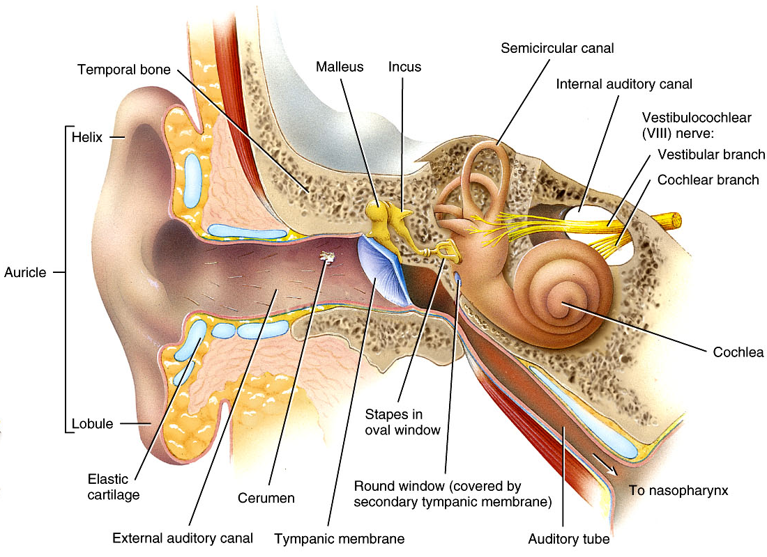
Fig.41: Parts of the external ear.

Slide 80
The Middle Ear
A small, air-filled, epithelium-lined cavity in the petrous part of the temporal bone.
It contains 3 very small bones (ear ossicles): the malleus, incus and stapes. These bones articulate with each other by synovial joints.
The stapes fits into an opening called the oval windows. Below this is another opening called the round window which is closed by a membrane called the secondary tympanic membrane.
Tensor tympani muscle increases tension in the eardrum. The stapedius muscle dampens vibrations of the stapes. These skeletal muscles protect the inner ear from loud noises.
The auditory tube connects the middle ear with the pharynx. This help equalize air-pressure around the eardrum.

Slide 81
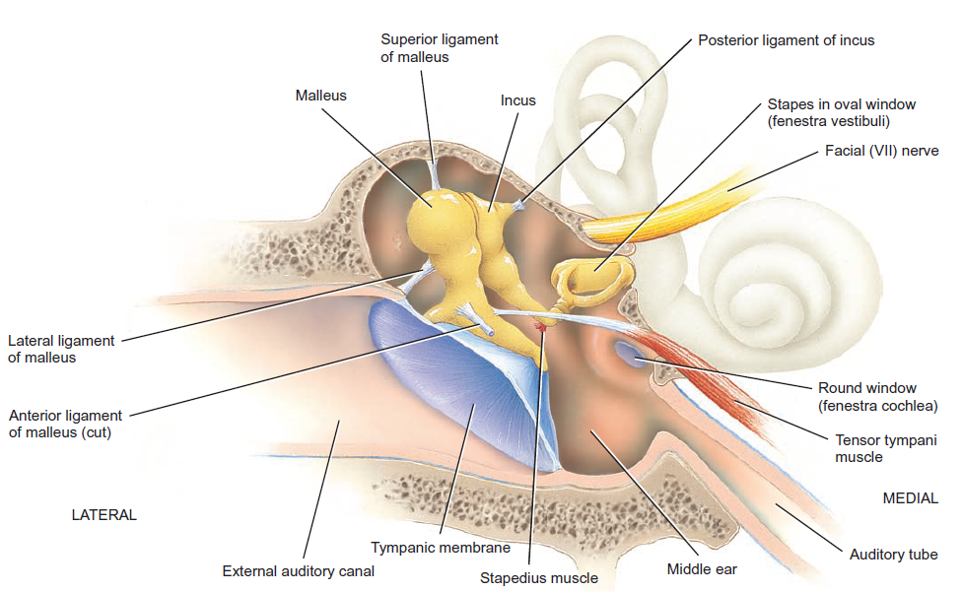
Fig.42: The middle ear.

Slide 82
The Inner Ear (The Labyrinth)
Formed of the vestibule, cochlea and semicircular canals.
These structures are bony cavities that lie within the petrous part of the temporal bone. Inside them is another set of membranous structures that have the same shape (the membranous labyrinth).
Between the bony and membranous labyrinths, we have a fluid called perilymph. Inside the membranous labyrinth, we have another fluid called endolymph.
The vestibule is the central portion of the labyrinth. Inside the vestibule, there are two membranous sacs: the utricle and saccule.
There are three semicircular canals. At one end of each, there’s an ampulla. The membranous semicircular ducts are present inside the canals.

Slide 83
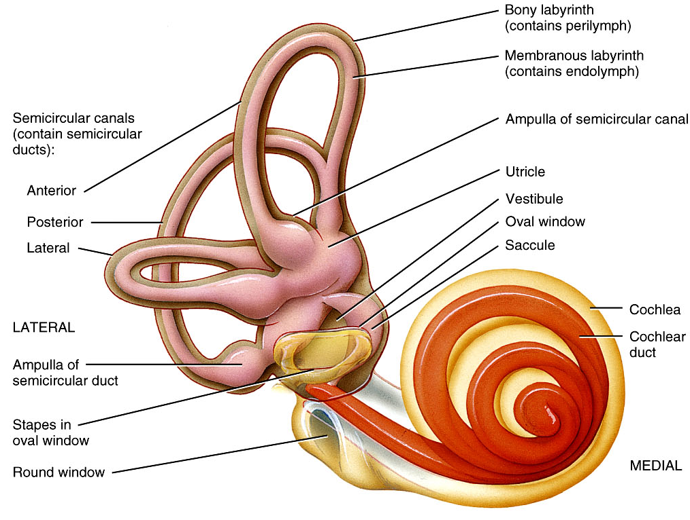
Fig.43: Parts of the inner ear.

Slide 84
The cochlea
  A snail-shaped structure.
  It spirals for almost 3 turns.
  Formed of 3 channels:
    The cochlear duct – continuation of the membranous labyrinth.
    The scala vestibuli – opens at the oval window.
    The scala tympani – opens at the round window.
  The scala vestibuli and scala tympani are completely separated from each other by the cochlear duct until they reach the apex of the cochlea where they’ll meet at the helicotrema.
  The spiral organ (of Corti) lies within the cochlea and spirals with it. It contains hair cells that are responsible for the sensation of sound.

Slide 85
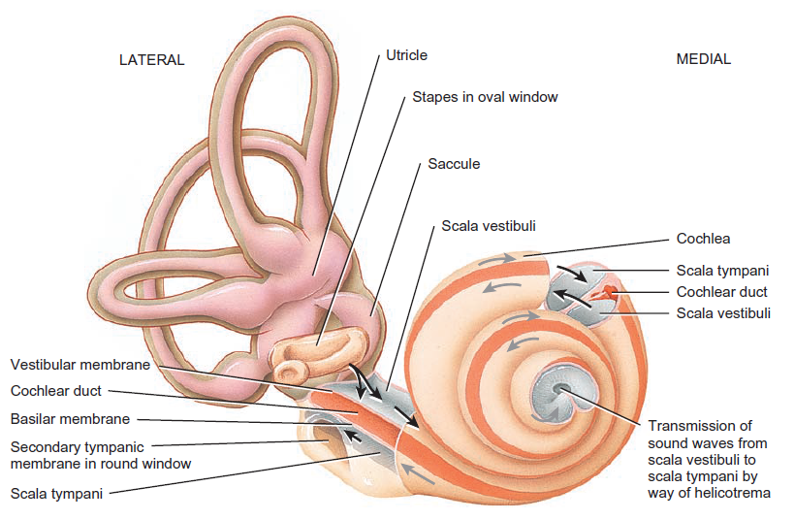
Fig.44: The cochlea.

Slide 86







Stapes vibrating
in oval window
Stapes vibrating
in oval window
Stapes vibrating
in oval window
Stapes vibrating
in oval window
Stapes vibrating
in oval window
Stapes vibrating
in oval window
Stapes vibrating
in oval window
Stapes vibrating
in oval window
Incus
Stapes vibrating
in oval window
Incus
Incus
Incus
Incus
Incus
Incus
Incus
Malleus
Incus
Malleus
Malleus
Malleus
Malleus
Malleus
Malleus
Malleus
Malleus
Cochlea
Cochlea
Cochlea
Cochlea
Cochlea
Cochlea
Cochlea
Cochlea
Helicotrema
Cochlea
Helicotrema
Helicotrema
Helicotrema
Helicotrema
Helicotrema
Helicotrema
Helicotrema
Helicotrema
Sound waves
Sound waves
Sound waves
Sound waves
Sound waves
Sound waves
Sound waves
Sound waves
Sound waves
Perilymph
Perilymph
Perilymph
Perilymph
Perilymph
Perilymph
Perilymph
Perilymph
Perilymph
Scala
tympani
Scala
tympani
Scala
tympani
Scala
tympani
Scala
tympani
Scala
tympani
Scala
tympani
Scala
tympani
3
Scala
tympani
3
3
3
3
3
3
8
7
8
7
4
7
4
4
4
4
4
Scala
vestibuli
Scala
vestibuli
Scala
vestibuli
Scala
vestibuli
Scala
vestibuli
Scala
vestibuli
Scala
vestibuli
Scala
vestibuli
5
Scala
vestibuli
5
5
5
5
6
6
6
6
Basilar
membrane
Basilar
membrane
Basilar
membrane
Basilar
membrane
Basilar
membrane
Basilar
membrane
Basilar
membrane
Basilar
membrane
1
Basilar
membrane
1
1
1
1
1
1
1
1
2
2
2
2
2
2
2
2
9
External auditory
canal
External auditory
canal
External auditory
canal
External auditory
canal
External auditory
canal
External auditory
canal
External auditory
canal
External auditory
canal
External auditory
canal
8
8
Spiral organ
(organ of Corti)
Spiral organ
(organ of Corti)
Spiral organ
(organ of Corti)
Spiral organ
(organ of Corti)
Spiral organ
(organ of Corti)
Spiral organ
(organ of Corti)
Spiral organ
(organ of Corti)
Spiral organ
(organ of Corti)
Spiral organ
(organ of Corti)
Tectorial membrane
Tectorial membrane
Tectorial membrane
Tectorial membrane
Tectorial membrane
Tectorial membrane
Tectorial membrane
Tectorial membrane
Tectorial membrane
Vestibular membrane
Vestibular membrane
Vestibular membrane
Vestibular membrane
Vestibular membrane
Vestibular membrane
Vestibular membrane
Vestibular membrane
Vestibular membrane
Cochlear duct
(contains endolymph)
Cochlear duct
(contains endolymph)
Cochlear duct
(contains endolymph)
Cochlear duct
(contains endolymph)
Cochlear duct
(contains endolymph)
Cochlear duct
(contains endolymph)
Cochlear duct
(contains endolymph)
Cochlear duct
(contains endolymph)
Cochlear duct
(contains endolymph)
Tympanic
membrane
Tympanic
membrane
Tympanic
membrane
Tympanic
membrane
Tympanic
membrane
Tympanic
membrane
Tympanic
membrane
Tympanic
membrane
Tympanic
membrane
Secondary tympanic
membrane vibrating
in round window
Secondary tympanic
membrane vibrating
in round window
Secondary tympanic
membrane vibrating
in round window
Secondary tympanic
membrane vibrating
in round window
Secondary tympanic
membrane vibrating
in round window
Secondary tympanic
membrane vibrating
in round window
Secondary tympanic
membrane vibrating
in round window
Secondary tympanic
membrane vibrating
in round window
Secondary tympanic
membrane vibrating
in round window
Middle ear
Middle ear
Middle ear
Middle ear
Middle ear
Middle ear
Middle ear
Middle ear
Middle ear
Auditory tube
Auditory tube
Auditory tube
Auditory tube
Auditory tube
Auditory tube
Auditory tube
Auditory tube
Auditory tube
Fig.45: How sound is transmitted in the ear.

