Slide 1
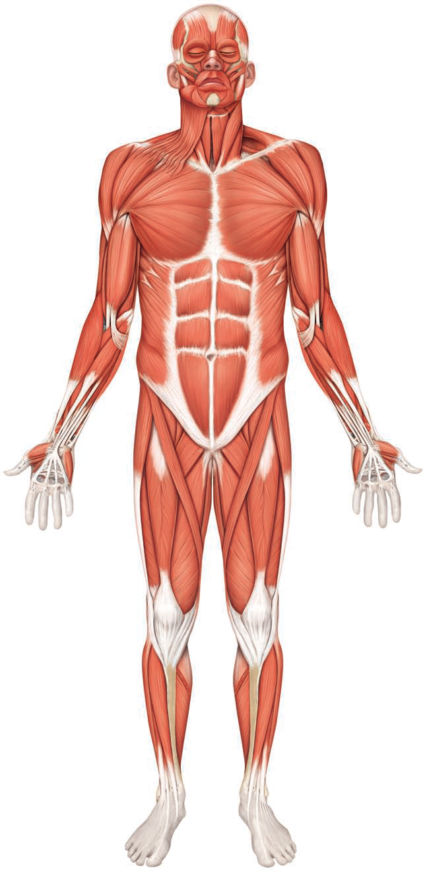
The Muscular System
Dr. Mustafa Saad
(2018)

Slide 2
Skeletal muscles are formed of several bundles of skeletal muscle cells. They are attached by tendons to bones
When a skeletal muscle contracts, the tendon will be pulled and this will pull the bone resulting in Movement
The belly of the muscle is the fleshy (wide) part between the tendons
Muscles have more than one bony attachment:
  the attachment of a tendon to the relatively stationary bone is called the origin.
  the attachment of the muscle’s other tendon to the relatively movable bone is called the insertion.
  the action/s of a muscle are the main movements that occur during contraction (e.g., flexion or extension).

Slide 3
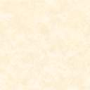
Muscular Tissue
Muscular tissue is the type of tissue whose cells are differentiated to optimally use the contractile ability of the cells.
Cell membrane = Sarcolemma
Cytoplasm = Sarcoplasm
Smooth endoplamsic reticulum = Sarcoplasmic reticulum

Slide 4
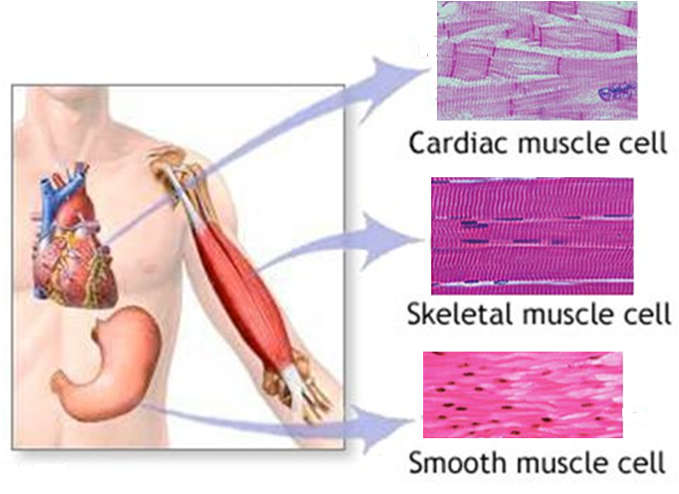
Types of Muscle Cells
Muscle cells are relatively long, therefore, they’re called muscle fibers
There are three types of muscle cells:
Fig.1: Types of muscle cells.

Slide 5
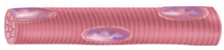

Comparison between the three types of muscle cells:
 | Skeletal | Cardiac | Smooth
Location | Attached to bones | The heart | Internal organs and skin
Shape | Elongated and cylindrical | Branched | Spindle
Nucleus | Several peripherally located nuclei | Single centrally located nucleus | Single centrally located nucleus
Striation | Striated | Striated | Non-striated
Function | Movement of bone Heat production | Beating of the heart | Movement of the viscera
Control | Voluntary | Involuntary | Involuntary

Slide 6
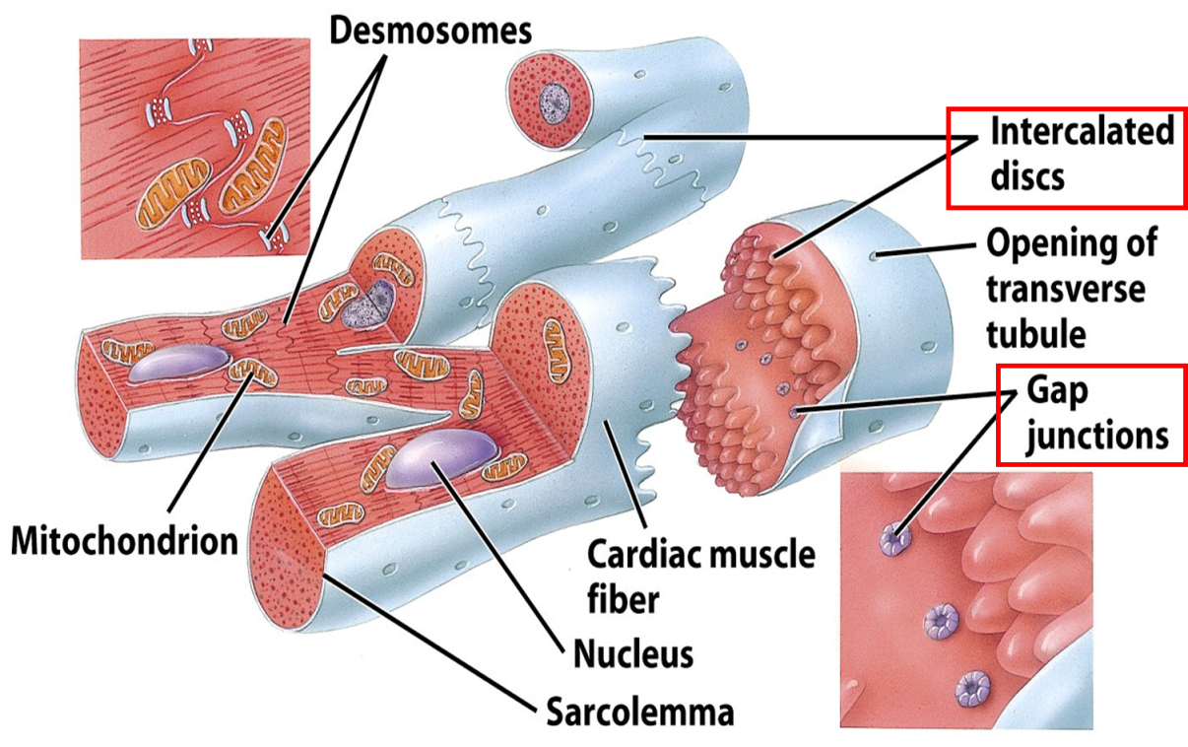
Notes
Smooth muscle cells are held together by desmosomes. Also, gap junctions are present between the cells to allow the spread of Ca²⁺ (and thus contraction) rapidly between them.
The branches of cardiac muscle cells meat each other at specialized structures called the intercalated discs which also contain desmosomes and gap junctions.
Fig.2: Cardiac muscle cells.

Slide 7
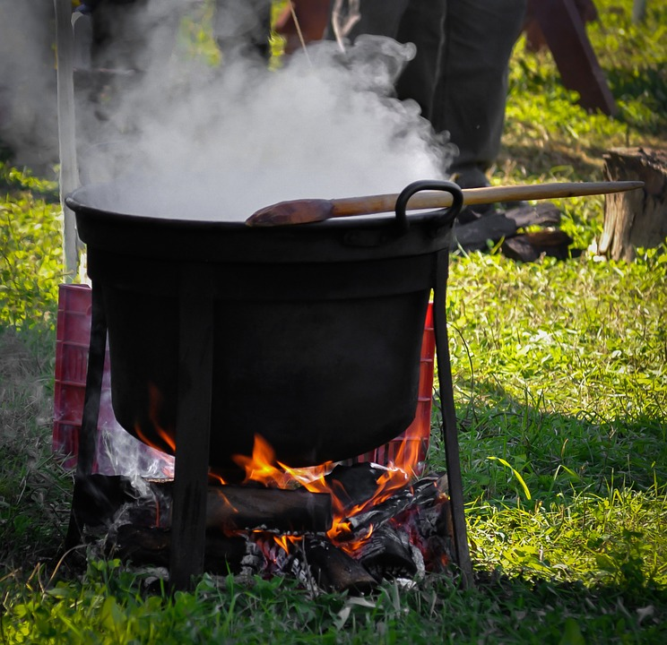
Organization of Skeletal muscles:
Skeletal muscles are formed of several bundles of muscle fibers.
Each fiber is surrounded by Endomysium: a loose areolar connective tissue layer. Each bundle is surrounded by connective tissue Perimysium. The whole muscle is surrounded by Epimysium: a dense connective tissue layer.
These three connective tissue layers will extend beyond the fleshy part of the muscle to form the cord-like tendons or the broad aponeuroses that attach muscles to bones.

Slide 8
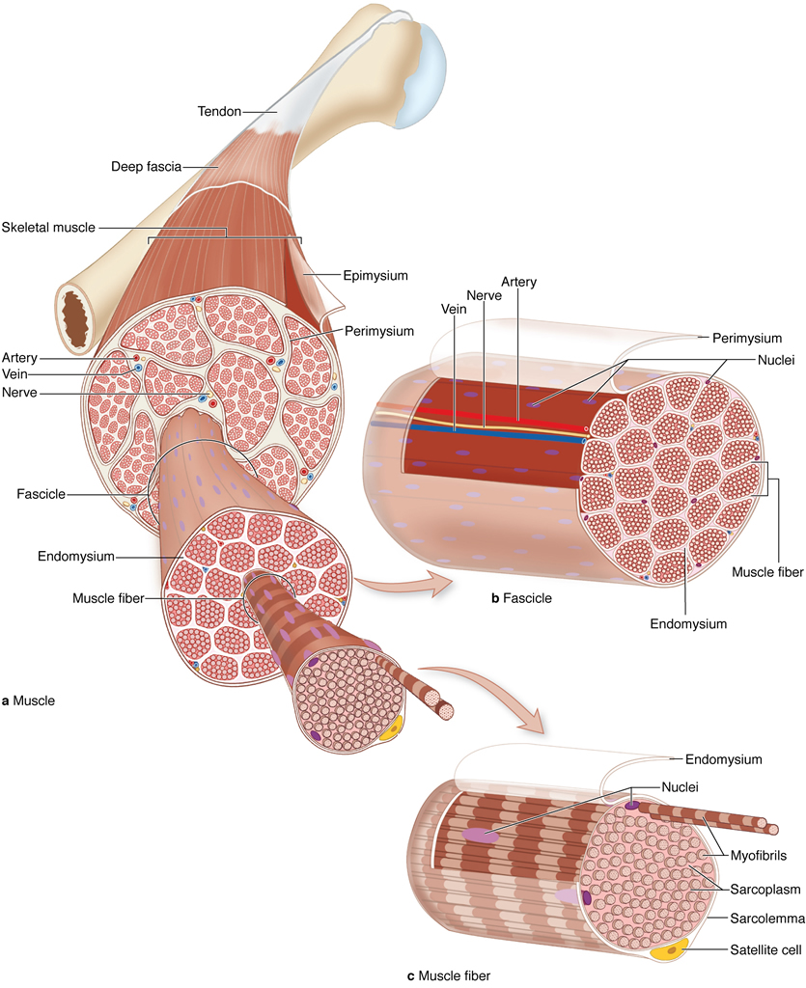
Fig.3: Structure of skeletal muscles and their covering layers.

Slide 9
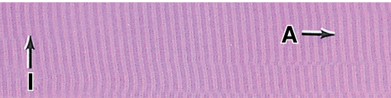
Cross-Striation of skeletal and cardiac muscle cells:
Skeletal and cardiac muscle fibers, under the LM, appear to have alternating dark and light areas. These are called the A and I bands respectively. The banding is due to the regular arrangement of the thin myofilament Actin and the thick myofilament Myosin.
Under the EM, this arrangement proves to be more complex.
Fig.4: Striation under light microscope.

Slide 10
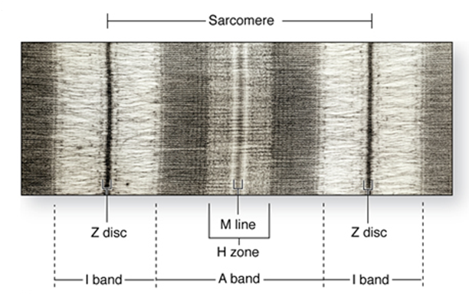
Fig.5*: Striation under electron microscope.
H Zone: a lighter colored area within the A band.
M Line: darker colored line in the middle of the H zone.
Z Disc (Line): a dark line in the middle of the light I band.

Slide 11
The Sarcomere: is the repetitive functional subunit of the contraction apparatus. It extends from one Z-line to the next Z-line.
Several sarcomeres arranged end-to-end form the cylindrical myofibrils. Each muscle fiber contain several myofibrils.
Fig.6: Sarcomeres and myofibrils.

Slide 12
Muscle Regeneration
Skeletal muscle cells cannot divide. Inactive Satellite cells are present close to the muscle fibers. When injury occurs, the satellite cells become active, divide and form new skeletal muscle fibers. This is also thought to be the mechanism by which skeletal muscles hypertorphy after exercise.
Cardiac muscles lack satellite cells. After injury, the damaged muscles are replaced by a connective tissue scar.
Smooth muscle cells can divide, and, therefore, can easily replace damaged cells.

Slide 13
Muscles Of The Head
Muscles Of Facial Expression
Muscles of facial expression:
  Lie within the subcutaneous layer.
  Usually originate from skull bones & insert into the skin.
  Are all supplied by the Facial nerve.
Because of their insertions, the muscles of facial expression move the skin rather than a joint when they contract. Because of this, these muscle produce the wide variety of facial expressions that humans have.

Slide 14
Zygomaticus major –
The muscle of true smile
Risorius –
The muscle of false smile (probably present only in humans and gorillas)
Fig.7*: Muscles of facial expression.

Slide 15
Muscles of Mastication (Chewing)
Four pairs of muscles move the mandible, and are known as ‘muscles of mastication’.
They are all supplied by the mandibular branch of the trigeminal nerve.
The masseter, temporalis, and medial pterygoid close the mouth and account for the strength of the bite.
The medial and lateral pterygoid muscles help to chew by moving the mandible from side to side.
The lateral pterygoid is also the main depresseser of the mandible as in opening the mouth. Note that Gravity assists in depressing the mandible (plus other muscles).

Slide 16
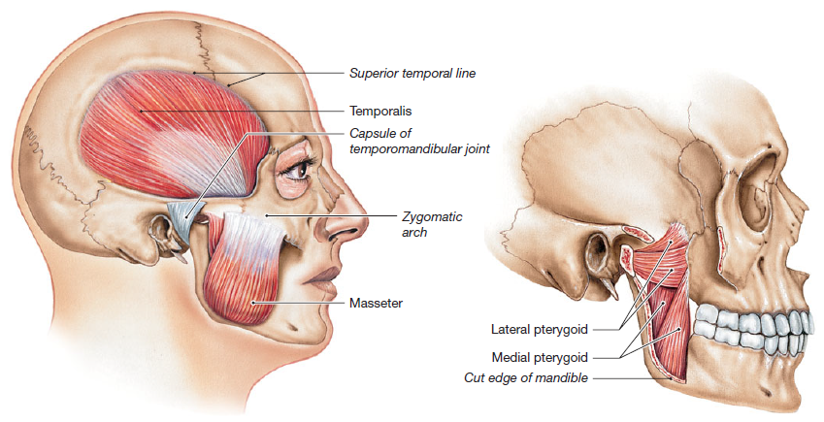
Fig.8: Muscles of mastication.

Slide 17
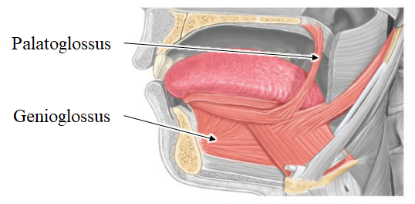
Muscles Of The Tongue
Muscle of the tongue include:
  Intrinsic muscles (originate and insert within tongue). These are responsible for changing the shape of the tongue.
  Extrinsic muscles (originate outside the tongue, insert into tongue). These are responsible for moving the tongue.
Genioglossus is one of these extrinsic muscles. It moves the tongue forwards.
All muscles of the tongue are supplied by the Hypoglossal nerve, except the palatoglossus.
Fig.9: Muscles of the tongue.

Slide 18
Muscles Of The Neck
The Sternocleidomastoid (SCM) muscle is an important anatomical landmark in the neck. It divides the neck into an anterior and a posterior triangle.
The SCM muscle arises from the sternum and clavicle and is inserted into the mastoid process and the occipital bone. Its motor supply is by the accessory (XI) nerve. If the muscles on both sides contract, they’ll flex the head. If the SCM muscle of one side contracts, it’ll rotate the head to the opposite side.

Slide 19
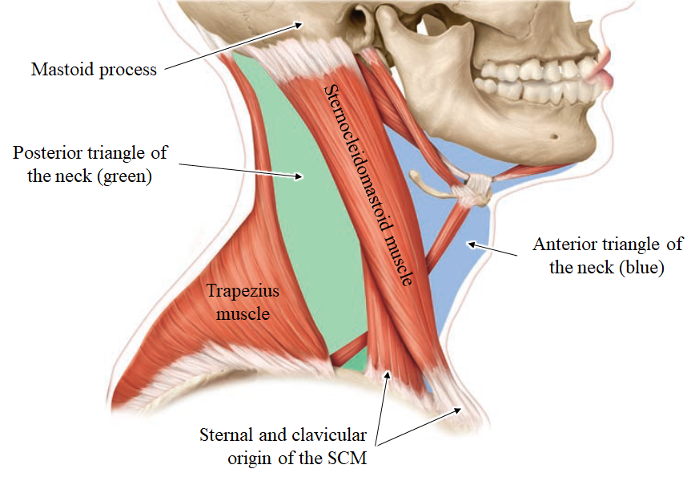
Fig.10: The sternocleidomastoid muscle.

Slide 20
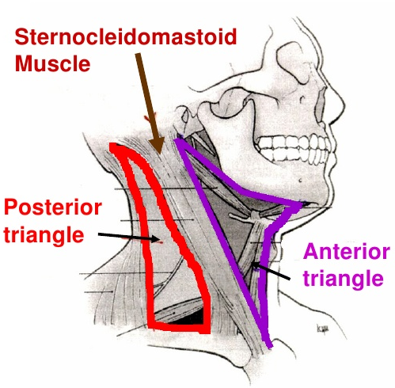
Anterior Triangle:
Anterior border: midline
Posterior border: SCM muscle
Superior border: Mandible
Posterior Triangle:
Anterior border: SCM muscle
Posterior border: Trapezius muscle
Inferior border: Clavicle
Fig.11: Boundaries of the triangles of the neck.

Slide 21
Muscles of the anterior part of neck:
Two main muscle groups:
Muscles | Location | Action
Suprahyoid | Superior to the hyoid bone | Elevate the hyoid bone With the infrahyoids, fix the hyoid bone so that it can act as a base for the tongue Digastric and mylohyoid assist in depressing the mandible
Infrahyoid | Inferior to the hyoid bone | Depress the hyoid bone With the suprahyoids, fix the hyoid bone so that it can act as a base for the tongue Thyrohyoid and sternothyroid move the larynx during swallowing

Slide 22
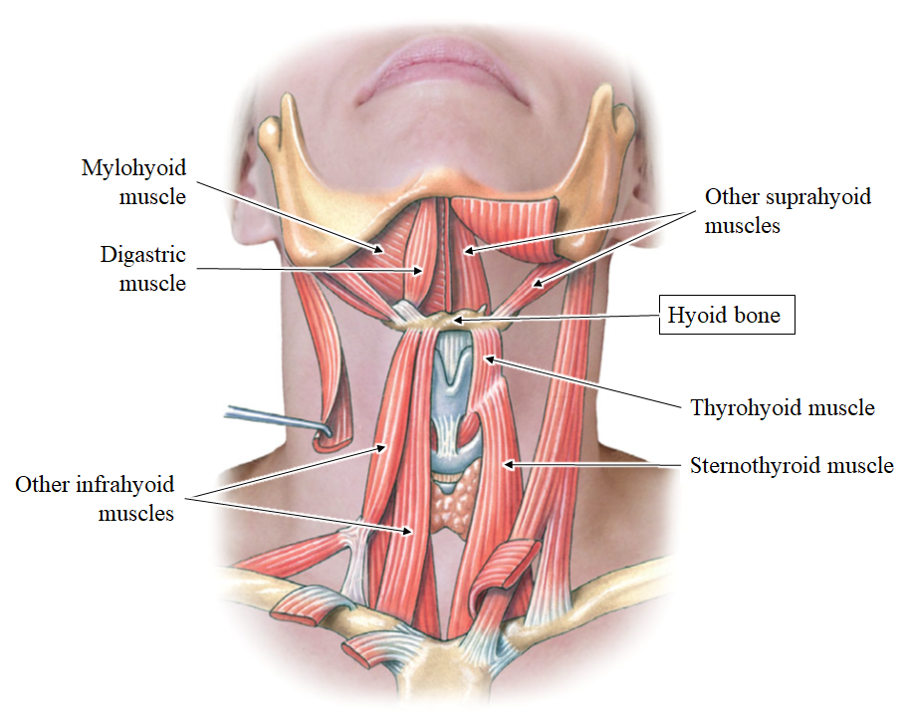
Fig.12: Supra- and infrahyoid muscles.

Slide 23
Lateral Vertebral Muscles – The Scaleni:
These are attached to the cervical part of the vertebral column and pass laterally
Scalenus anterior is an important landmark in the neck with several important relations. Among these relations we have: the subclavian artery and vein and the trunks of the brachial plexus
Muscle | Action
Scalenus Anterior | Lateral flexion and rotation of cervical part of vertebral column Assist in respiration
Scalenus Medius
Scalenus Posterior

Slide 24
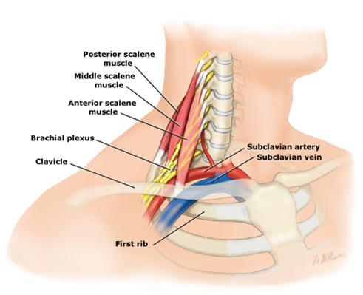
Fig.13: Scalene muscles.

Slide 25
Respiratory Muscles Of The Thorax
Respiratory muscles alter the size of the thoracic cavity which affects the pressure in the lungs, and that determines whether we inhale or exhale.
Between the ribs we have the Intercostal muscles arranged in three layers: the External, Internal and Innermost intercostal muscles. Between the internal and innermost intercosal muscles, we have the intercostal nerve and vessels.
There are also a number of accessory muscles useful in forced breathing: SCM and the scaleni muscles.

Slide 26
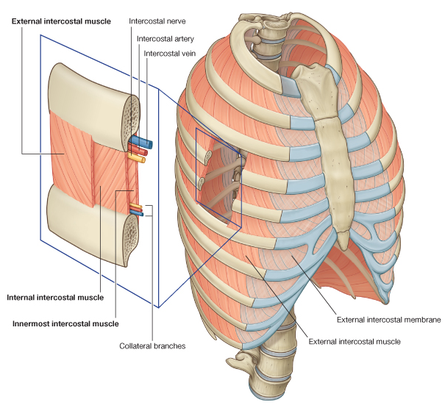
Fig.14: The intercostal muscles.

Slide 27
The Diaphragm
The diaphragm is the most important muscle of respiration
Muscle | Origin | Insertion | Nerve | Action
Diaphragm | Sternal part: Xiphoid process Costal part: Lower 6 costal cartilages and adjacent ribs Vertebral part: Upper 3 lumbar vertebrae and their discs | All muscle fibers converge to be inserted into a centrally located tendon | Phrenic nerve | Contraction of the diaphragm increases vertical diameter of thoracic cage causing inhalation. Its relaxation leads to exhalation.

Slide 28
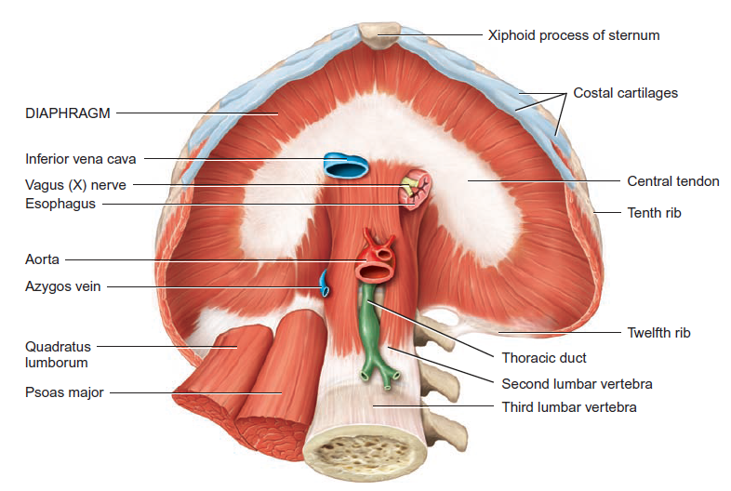
Fig.15: The diaphragm.

Slide 29
Anterior Abdominal Wall Muscles
The anterolateral abdominal wall muscles include the external oblique, internal oblique, and transversus abdominis muscles which form three protective layers around the abdomen.
The muscle bundles of each layer extend in a different direction, offering great protection to the abdominal viscera.
The aponeurosis (broad tendon) of the external oblique forms the thick inguinal ligament inferiorly.
The aponeuroses of these 3 muscles form the rectus sheaths which enclose the rectus abdominis muscles.
  The sheaths meat each other in the midline to form the linea alba, a connective tissue band extending from the xiphoid process to the pubic symphysis.

Slide 30
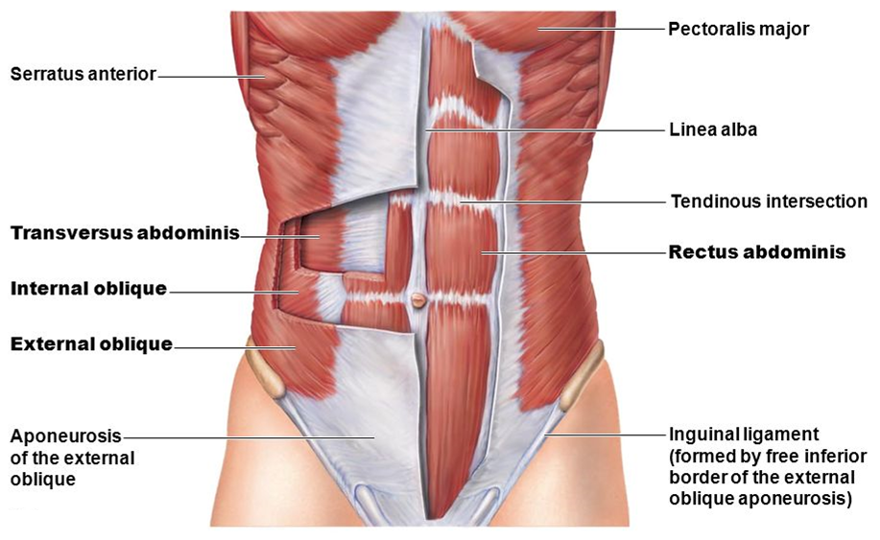
Fig.16: Anterior abdominal wall muscles.

Slide 31
Actions:
They retain the organs within the abdominal cavity.
The oblique muscles laterally flex and rotate the trunk.
The rectus abdominis flexes the lumbar vertebrae.
By contracting simultaneously with the diaphragm, they increase intra-abdominal pressure and help in micturition, defecation, vomiting, and labor.
They may contract at the end of expiration, pushing the relaxed diaphragm further upwards into the thorax.

Slide 32
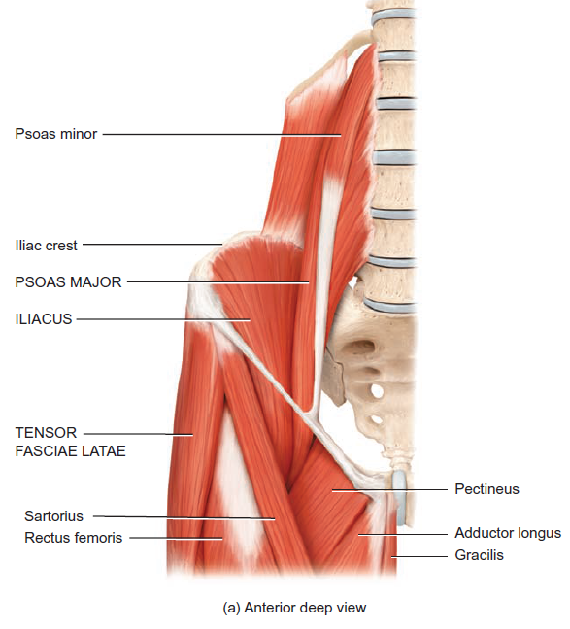
Posterior Abdominal Wall Muscles
Quadratus lumborum: depresses 12th rib
Flex thigh on trunk. If thigh is fixed, flex trunk on thigh
Fig.17*: Posterior abdominal wall muscles.

Slide 33
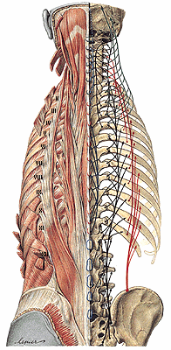
Muscles of the Back
Muscles that move the backbone are quite complex having multiple origins/insertions with considerable overlap between the muscles.
They include several groups of muscles whose main function is the ⁽¹⁾extension of the spine and ⁽²⁾the maintaining of posture.
Fig.18: Deep muscles of the back.

Slide 34
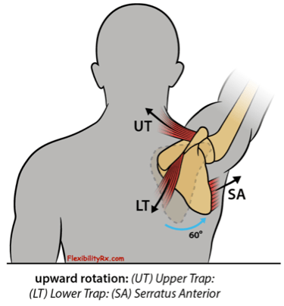
Muscles Of The Upper Limb
Muscles that move the Pectoral Girdle
Subclavius: attached to clavicle
Levator scapulae, Rhomboid major and rhomboid minor
Trapezius: Is a large muscle seen on the back. With the serratus anterior muscle, it rotates the scapula so that its glenoid cavity is raised. This allows the arm to be raised above the head.
Serratus anterior (Punching muscle): fix scapula in position
Pectoralis minor
These muscles also stabilize the girdle so that the free limb can have a firm base to move on

Slide 35
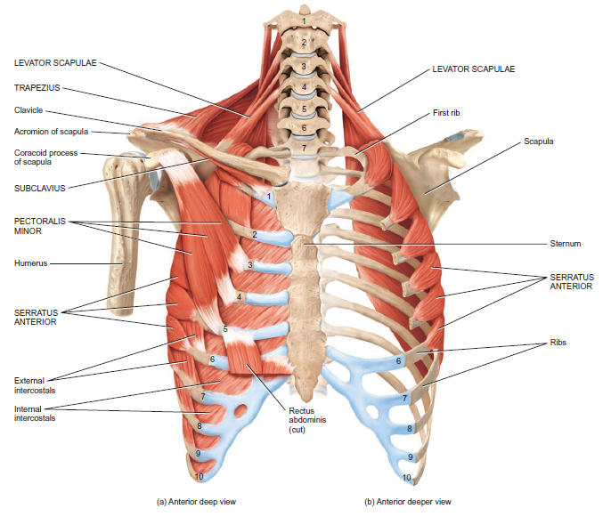
Fig.19: Muscles working on the pectoral girdle – anterior view.

Slide 36
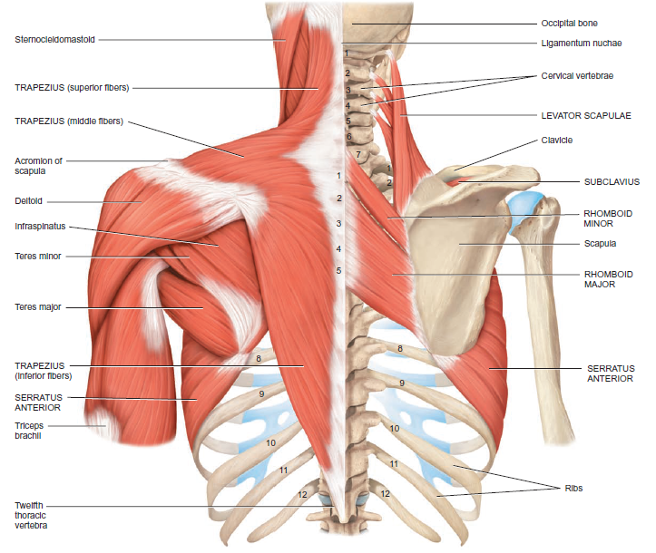
Fig.19: Muscles working on the pectoral girdle – posterior view.

Slide 37
Muscles of shoulder and thorax that move the humerus
Muscle | Origin | Insertion | Main Actions
Deltoid | Clavicle and scapula | Shaft of humerus | Flexion, extension and abduction
Subscapularis | Subscapular fossa | Tuberosities of the humerus | Stabilizes shoulder joint
Supraspinatous | Supraspinous fossa
Infraspinatous | Infraspinous fossa
Teres minor | Scapula
Teres major | Scapula | Intertubercular sulcus of the humerus | Extension, adduction and medial rotation of the arm
Coracobrachialis | Coracoid process | Shaft of humerus | Flexion

Slide 38
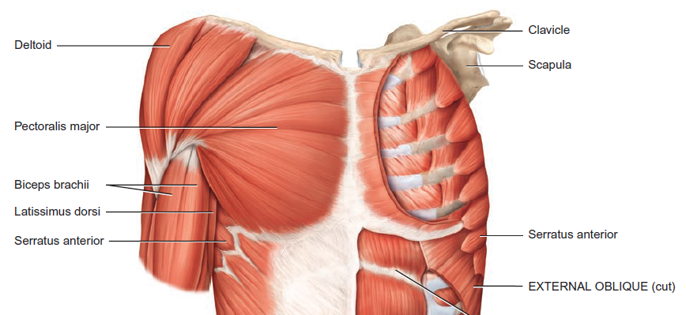
Muscle | Origin | Insertion | Main Actions
Pectoralis major | Clavicle, sternum and costal cartilages | Intertubercular sulcus of the humerus | Flexion, adduction and medial rotation of the arm
Latissimus dorsi |  | Intertubercular sulcus of the humerus | Extension, adduction and medial rotation of the arm
Fig.19: Muscles working on the humerus.

Slide 39
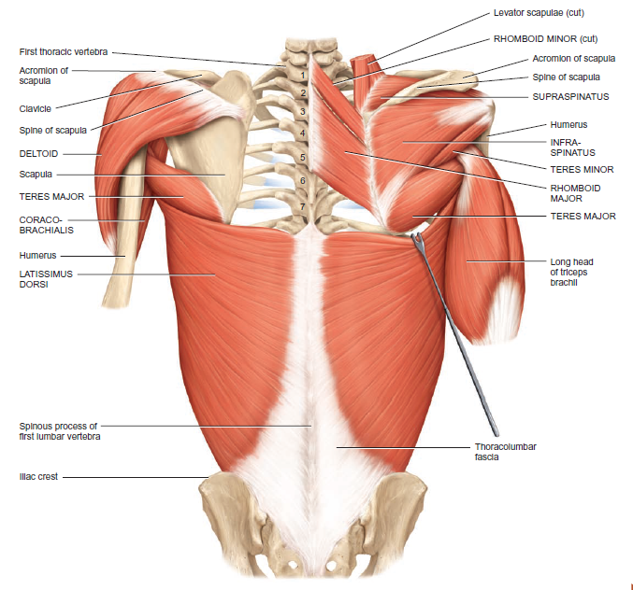
Fig.20: Muscles working on the humerus (continued).

Slide 40
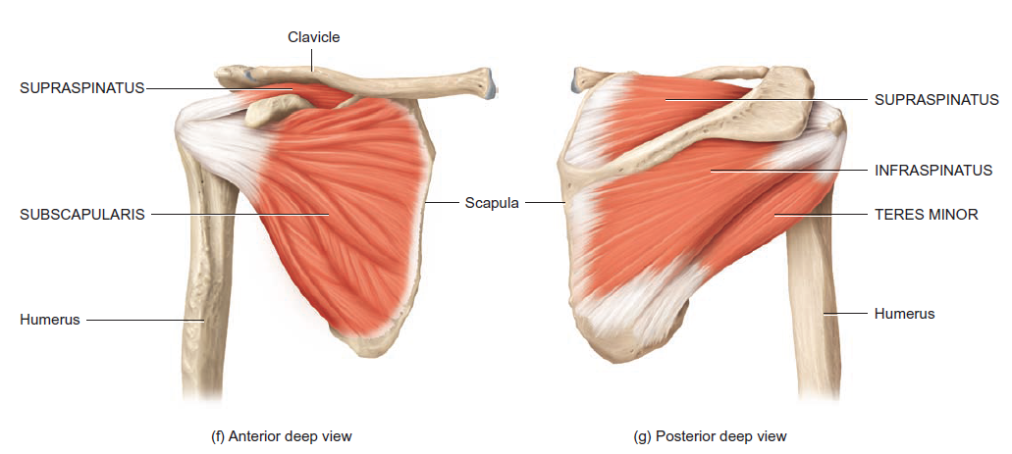
Rotator Cuff Muscles
Fig.21: Rotator cuff muscles.
The tendons of these muscles all blend with the capsule of the shoulder joint, thus help in stabilizing it.
The supraspinatous helps initiate abduction of the arm.

Slide 41
Muscles of the arm (that move the forearm)
The biceps brachii, brachialis, and brachioradialis are flexors. The triceps brachii extends the forearm
The biceps has two heads of origin. The long head passes through the intertubercular sulcus of the humerus. The biceps inserts into the radial tuberosity. It also forms an aponeurosis that inserts medially into fascia and that protects the underlying brachial artery and median nerve as they pass in the cubital fossa.

Slide 42
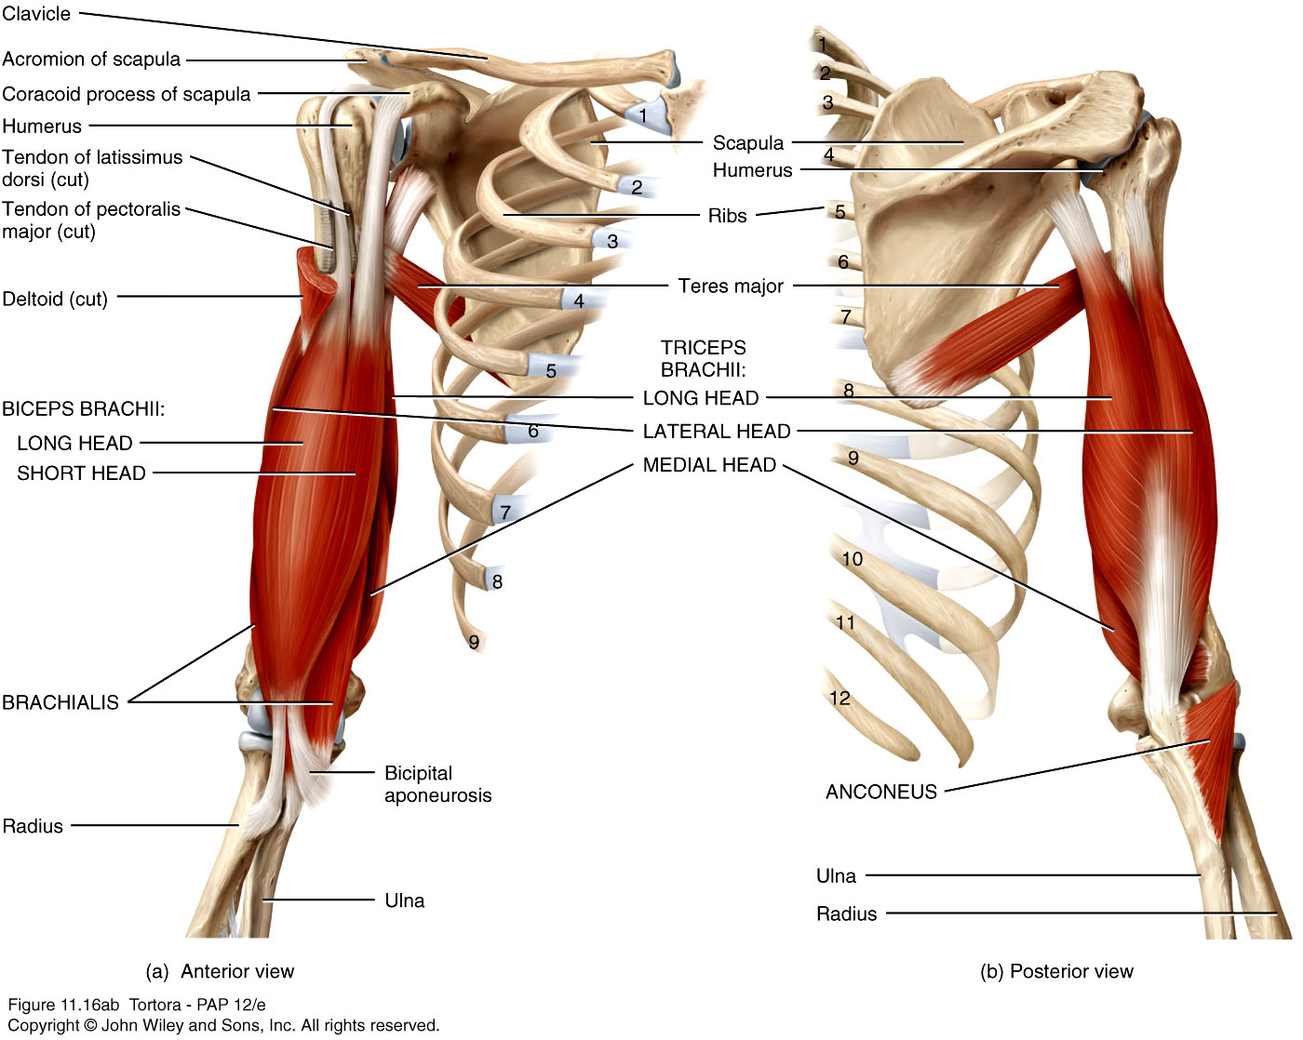
Fig.22: Muscles of the arm.

Slide 43
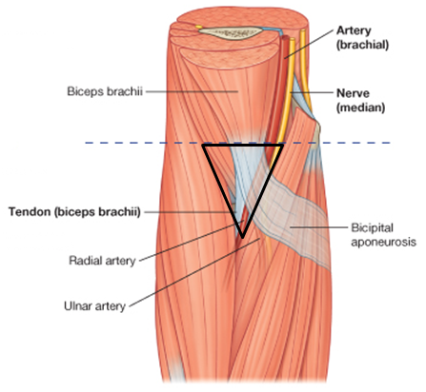
Fig.23: The cubital fossa.
The Cubital Fossa:
Shallow triangular depression anterior to elbow joint.
Tendon of biceps, brachial artery and median nerve pass through it.
Site of measuring brachial artery pulse and taking blood pressure.
The superficial veins passing in the skin overlying this fossa can be used to take blood samples.

Slide 44
Muscles of the Forearm
Muscles in this group that act on the wrist and fingers are known as extrinsic muscles of the hand because they originate outside the hand and insert within it.
Based on location and function, these muscles are divided into an anterior (flexor) compartment and a posterior (extensor) compartment.
Anconeus, supinator and pronator quadratus are muscles in the forearm that act on the forearm.

Slide 45
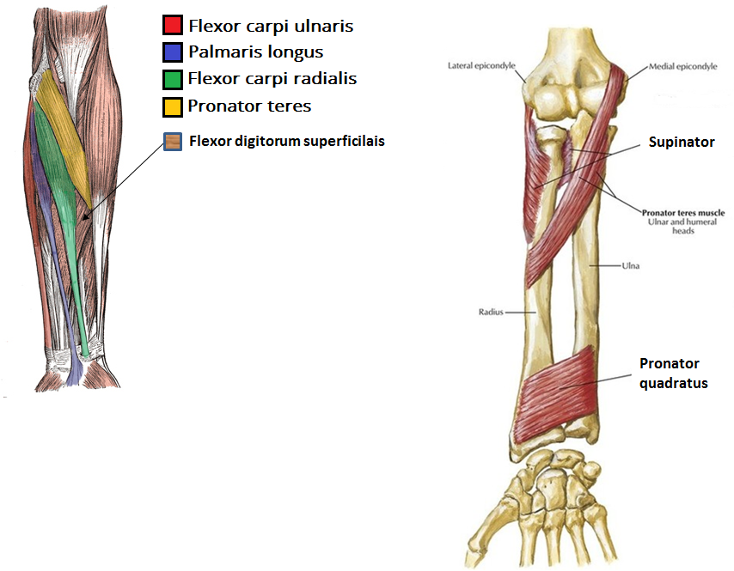
Fig.24*: Muscles of the anterior compartment of the forearm.

Slide 46
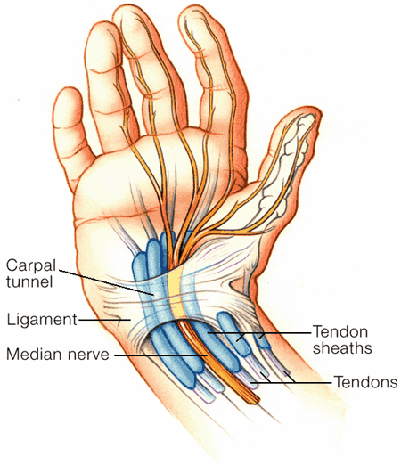
As the long muscles of the anterior forearm pass over the carpal bones, they are held in place by a thick band of connective tissue called the flexor retinaculum (transverse carpal ligament). This band with the carpal bones form a tunnel called the carpal tunnel.
Also passing through this tunnel is the median nerve.
Certain conditions may affect this tunnel (like inflammation of the tendons or the joints) leading to compression of the median nerve. This is called Carpal Tunnel Syndrome.
Fig.25: The carpal tunnel.
The affected person may have pain in the hand, change in sensations and even weakness in the hand muscles supplied by the median nerve.

Slide 47
Movement of Forearm | Muscles that produce them
Flexion | Biceps Brachialis Brachioradialis
Extension | Triceps Anconeus
Supination | Biceps Supinator
Pronation | Pronator teres Pronator quadratus

Slide 48
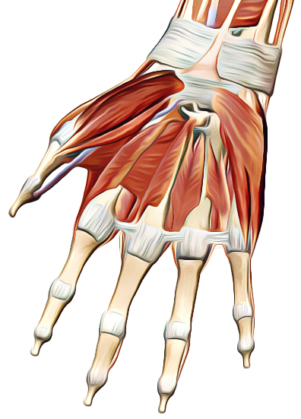
Intrinsic Muscles of the Hand (3 groups)
The intermediate group include the lumbricals, the palmar and dorsal interossei.
The palmar interossei adduct the fingers towards the middle finger. The dorsal interossei abduct the fingers away from the middle finger
Hypothenar muscles act on the little finger
Thenar muscles act on the thumb
Fig.26*: Intrinsic muscles of the hand.

Slide 49
Muscles Of The Lower Limb
Lower limb muscles function in stability, locomotion, and maintenance of posture. In contrast, upper limb muscles are characterized by versatility of movement.
Muscles of the lower limbs often cross two joints and can act equally on both.
Most muscles that move the femur originate from the pelvic girdle and insert on the femur.

Slide 50
Muscles of the Gluteal region (Buttocks)
Muscle | Action | Notes
Gluteus maximus | Extends thigh | With fat forms the buttocks
Gluteus medius | Abduct thigh Medial rotation of thigh Tilt hip | These muscles are essential in initiating walking, because they allow the legs to be lifted off the ground
Gluteus minimus
Piriformis | Abduct thigh Lateral rotation of the thigh | Between the piriformis and gemellus superior muscles is a small space through which pass the big Sciatic nerve
Gemellus superior
Obturator internus
Gemellus inferior
Quadratus femoris

Slide 51
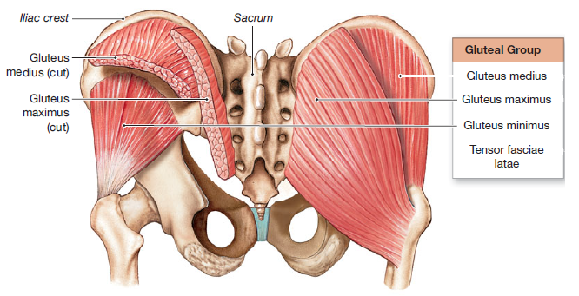
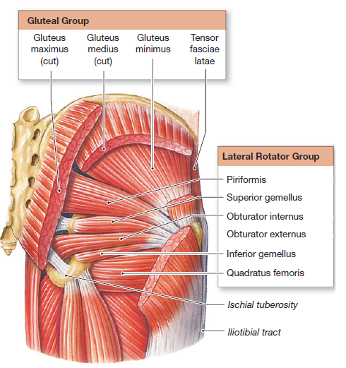
Fig.27: Muscles of the gluteal region.

Slide 52
Muscles of the Thigh
Divided into medial, anterior, and posterior compartments.
  Anterior (extensor) compartment of the thigh extend the leg (and flex the thigh). Supplied by the femoral nerve.
  Medial (adductor) compartment of the thigh adduct the femur at the hip joint. Supplied by the obturator nerve.
  Posterior (flexor) compartment of the thigh flex the leg (and extend the thigh). Supplied by the sciatic nerve.

Slide 53
The anterior compartment of the thigh is divided into 2 triangles by the Sartorius muscle
The sartorius (cross-leg, tailor’s) muscle is the longest muscle in the body. It originates from the anterior superior iliac spine and is inserted into the medial surface of the upper part of the shaft of tibia. It flexes, abduct and laterally rotates the thigh, it also flexes the leg.
Below the sartorius, we have the quadriceps femoris muscle which is formed of the rectus femoris, vastus medialis, vastus intermedius and vastus lateralis. The tendon of the quadriceps inserts into the patellar base. The patellar ligament arises from the apex of the patella and inserts into the tibial tuberosity.

Slide 54
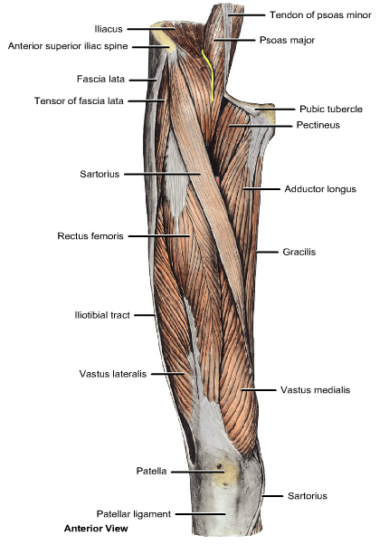
The quadriceps extends the leg at the knee joint.
The rectus femoris muscle also flexes thigh at the hip joint
Fig.28: Muscles of the anterior compartment of the thigh.

Slide 55
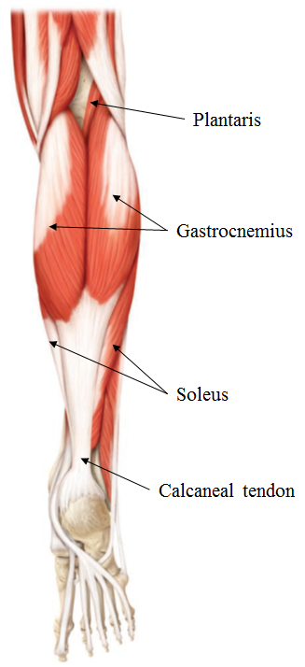
Muscles of the Leg
Leg muscles, like those of the thigh, are divided into three compartments: anterior, lateral, and posterior.
  Anterior compartment muscles dorsiflex the foot.
  Lateral compartment muscles plantar flex & evert the foot.
  Posterior compartment muscles are split into a superficial group: the gastrocnemius, soleus and plantaris; and a deep group (e.g., tibialis posterior). The superficial muscles share a common tendon of insertion, the calcaneal tendon (Achilles tendon – the largest and strongest tendon in the body). They plantar flex the foot and the gastrocnemius also flexes the leg.
Fig.29: Muscles of the posterior compartment of the leg.

Slide 56
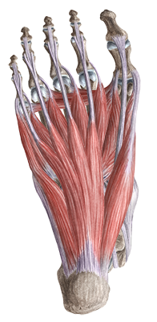
Intrinsic Muscles of the Foot
These muscles are termed intrinsic because they originate & insert within the foot.
These muscles are limited in action. They’re designed for locomotion and support (of the arches).
They include dorsal and plantar groups.
There is only one dorsal muscle which extends toes 2–5.
Plantar muscles are arranged in four layers.
Fig.30: Intrinsic muscle of the foot (plantar group).

