Slide 1
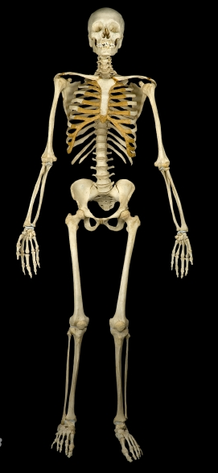

The Skeletal System
Dr. Mustafa Saad
(2018)

Slide 2
Divisions of the Skeletal System
The human skeleton consists of 206 bones
Bones of the skeleton are grouped into two principal divisions:
  Axial skeleton
    Consists of the bones that lie around the longitudinal axis of the human body: Skull bones, auditory ossicles (ear bones), hyoid bone, ribs, sternum (breastbone), and bones of the vertebral column.
    The primary function is protection of vital organs.
  Appendicular skeleton
    Consists of the bones of the upper and lower limbs (extremities), plus the bones forming the girdles that connect the limbs to the axial skeleton. The primary function of this division is movement.

Slide 3
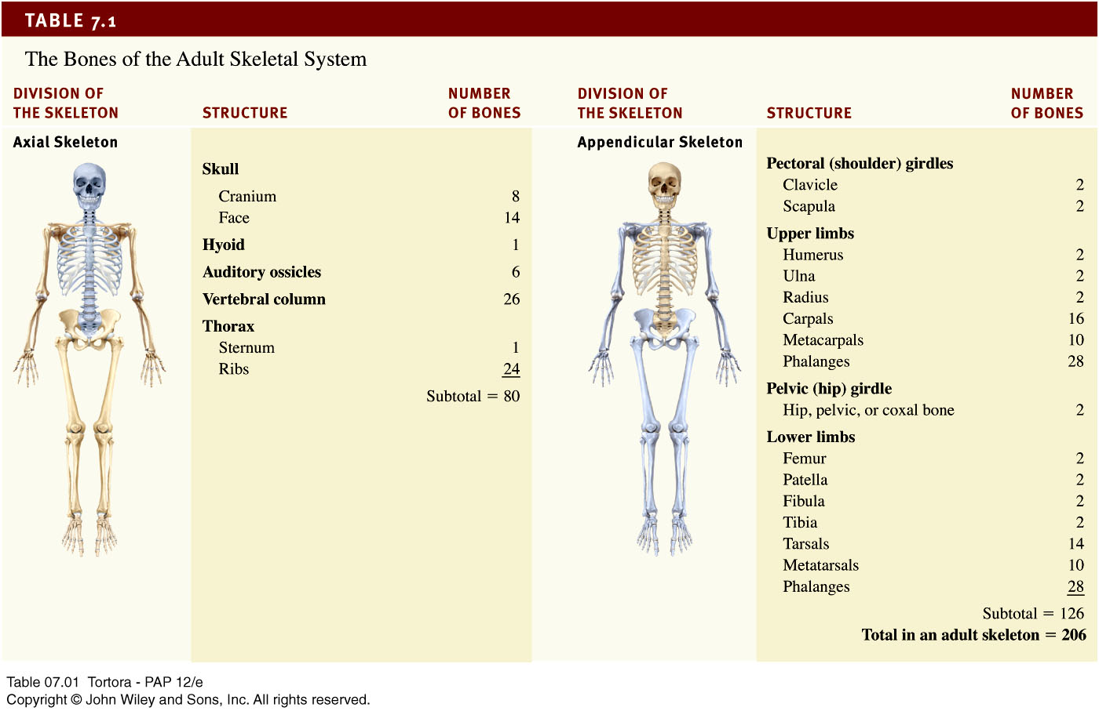
Bones of the Human Body

Slide 4
Bone Tissue
Bone is a structural type of connective tissue characterized by the presence of a calcified extracellular matrix (called bone matrix) and three types of cells: Osteoblasts, Osteocytes and Osteoclasts.
Functions of bones:
Support fleshy structures.
Protect vital organs (example: the skull protects the brain).
Assist in movement.
Synthesis of blood elements.
Storage of fat.
Storage of minerals (calcium and phosphate).

Slide 5
Cells of bones:
Osteoblasts
Responsible for the synthesis of the bone matrix
Osteocytes
Osteoclasts
Responsible for the resorption (destruction) of bone
A type of macrophage
Responsible for the calcification of bone matrix
Maintain the bone
Located inside spaces called lacunae

Slide 6
Bone matrix:
Bone matrix is formed of various organic and inorganic molecules (mainly Ca²⁺ compounds).
Collagen fibers is abundant in bone matrix.
Periosteum:
A thick connective tissue layer that covers the bone.
It’s important in ⁽¹⁾the nourishment of bones, ⁽²⁾the formation of bones and in ⁽³⁾fracture repair.
Endosteum:
A thin tissue layer that lines the cavities inside the bone.

Slide 7
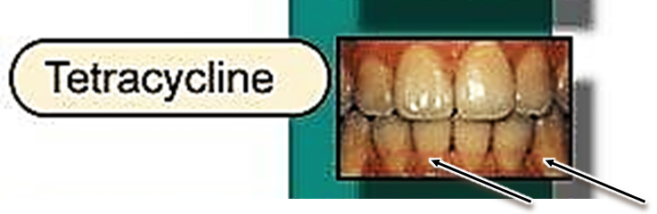
Tetracycline and Bones
Tetracycline is a fluorescent substance and it binds with great affinity with Ca²⁺ in recently deposited bone matrix.
Tetracycline must not be given to a pregnant or lactating women or to a child whose teeth are erupting, because it may bind to Ca²⁺ of the newly forming teeth of the child leading to the permanent discoloration of the teeth.

Slide 8
Classification of bones
Gross Morphology of section
Compact
Cancellous
Histological Features
Primary
Secondary
Shape of bone
Long
Short
Flat
Irregular

Slide 9
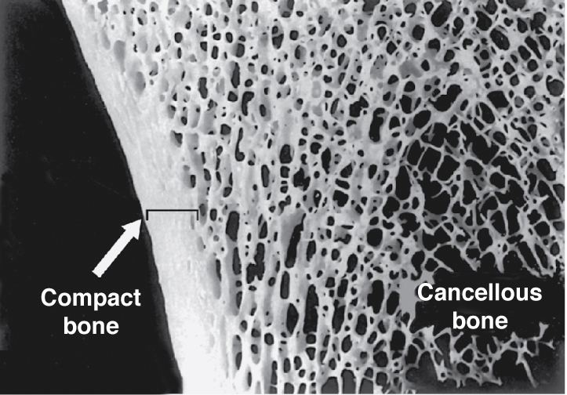
According to Gross Morphology:
In a section, part of the bone appear as a dense area with generally no cavities. This is called Compact Bone.
Other parts have several, small interconnected cavities. These are called Spongy (Cancellous) Bones
Fig.1: Compact and cancellous bone.

Slide 10
According to Histological Features:
Primary (woven) bone in which the collagen fibers of the matrix have no specific arrangement.
Secondary (lamellar) bone in which the collagen fibers are arranged in layers called lamellae.
In secondary bone, the lamellae usually form concentric circles around a central cavity in what’s called Osteons.

Slide 11
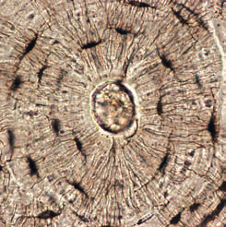
An osteon is formed of:
Central Canal: this contains blood vessels, nerves and areolar connective tissue.
Several concentric lamellae.
Several lacunae containing osteocytes and located between the lamellae.
Several canaliculi that connect the lacunae together. These canaliculi are narrow passages in the bone through which process of osteocytes pass.
Fig.2*: Osteon.

Slide 12
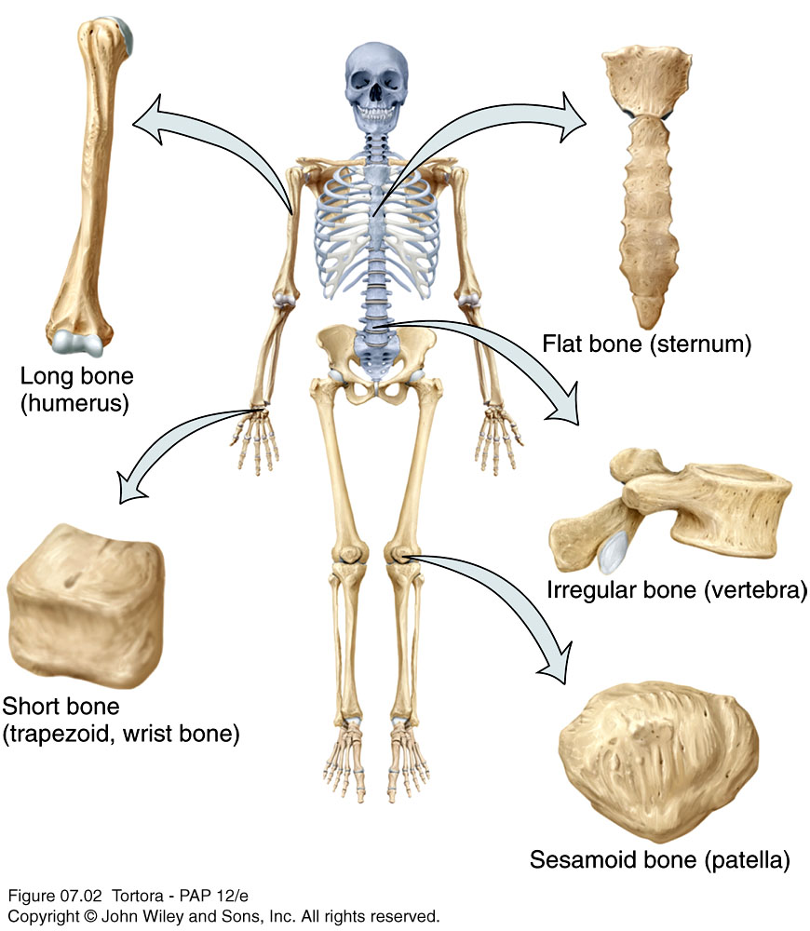
According to Shape:
Bones can be classified into five types based on shape:
Long
Short
Flat
Irregular
Sesamoid
Fig.3: Bones classified according to shape.

Slide 13
Long Bones
  Greater length than width and are slightly curved for strength
  Femur, tibia, fibula, humerus, ulna, radius, phalanges
Short bones
  Cube-shaped and are nearly equal in length and width
  Carpal bones, navicular, cuboid
Flat bones
  Thin and composed of two nearly parallel plates of compact bone tissue enclosing a layer of spongy bone tissue
  Cranial bones, sternum, ribs, scapulae
Irregular bones
  Complex shapes and cannot be grouped into any of the previous categories
  Vertebrae, hip bones, some facial bones, calcaneus
Sesamoid bones
  Found within tendons. Protect the tendons from excessive wear
  Patellae

Slide 14
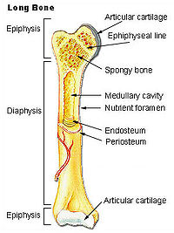
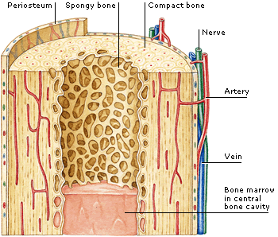
Various parts of long bones.
Proximal
End
Shaft
Distal
End
Fig.4*: Parts of long bones and their composition.

Slide 15
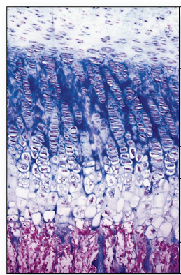
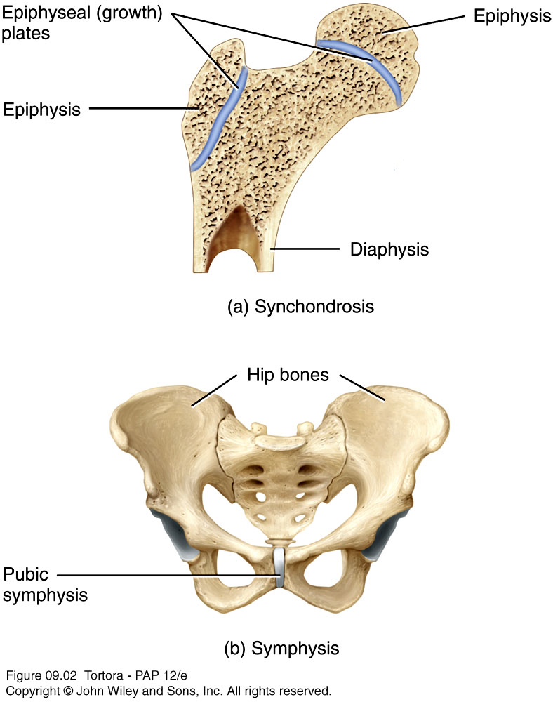
Bone Growth
Increase in length of bones occur at site of epiphyseal plate (made of hyaline cartilage) before they’re closed. After closure of the plates during adulthood, no further increase in bone length can occur. The time of closure of the plate is specific for the bone. This can be used to determine the age of the person.
Increase in width of bone can occur throughout life.
Bone growth is affected by several hormones in the body, like growth hormone.
Fig.5: Epiphyseal growth plate.

Slide 16
The Axial Skeleton

Slide 17

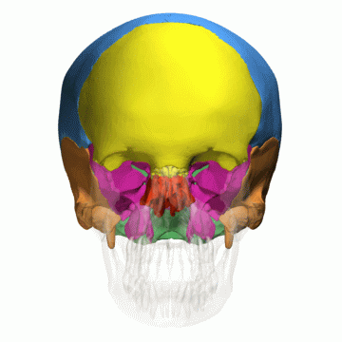
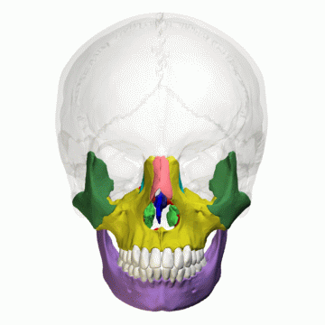
The Skull
The skull is the bony framework of the head. It’s formed of 22 bones divided into two sets:
Cranial bones
  Eight cranial bones that form the cranial cavity which encloses the brain.
  Frontal bone, two parietal bones, two temporal bones, the occipital bone, the sphenoid bone and the ethmoid bone.
Facial bones
  Fourteen facial bones that form the face
  Two nasal bones, two maxillae, two zygomatic bones, two lacrimal bones, two palatine bones, two inferior nasal conchae, vomer and the mandible.

Slide 18
Features of the Skull
The cranial and facial bones protect and support special sense organs and the brain.
All bones of the skull are attached to each other by immovable joints called suture, except the mandible which is attached to the skull by a movable joint.
Skull is site of attachment of muscles of the head and neck.

Slide 19
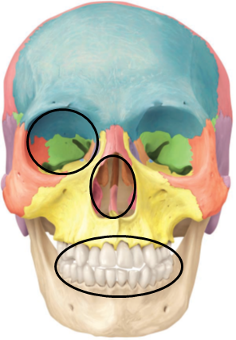
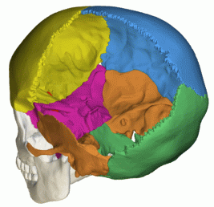
The skull features several cavities:
(1) The cranial cavity
(2) The orbits (eye sockets)
(3) Nasal cavity
(4) Oral cavity
(5) Paranasal sinuses
(6) Middle and inner ear cavities within the petrous part of the temporal bone

Slide 20
Cranial Bones:
Frontal Bone
  Forms the forehead
Parietal Bones
  Form the sides and roof of the cranial cavity
Temporal Bones
  Form the lateral aspects and floor of the cranium
  Consists of 5 parts: squamous part, petrous part, tympanic part, mastoid part and the styloid process
Occipital Bone
  Forms the posterior part and most of the base of the cranium
  The perceptible protrusion on the back of the head is the external occipital protuberance
  The foramen magnum, the largest foramen in the skull, is located in this bone.

Slide 21
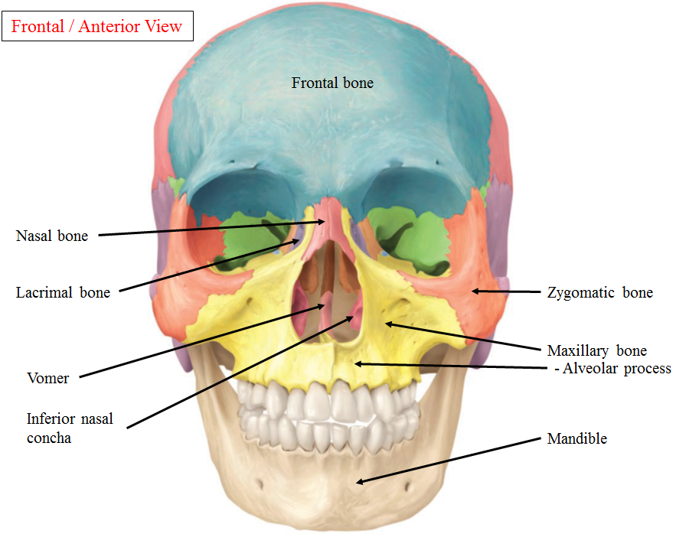
Fig.6

Slide 22
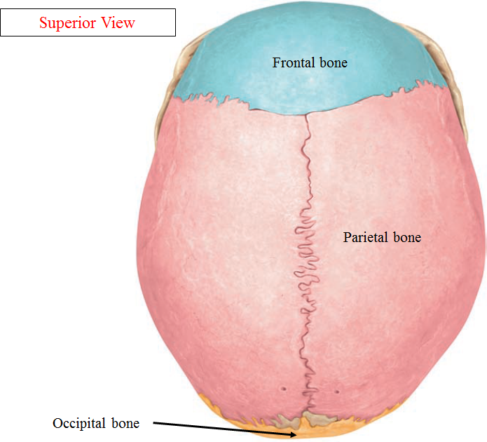
Fig.7

Slide 23
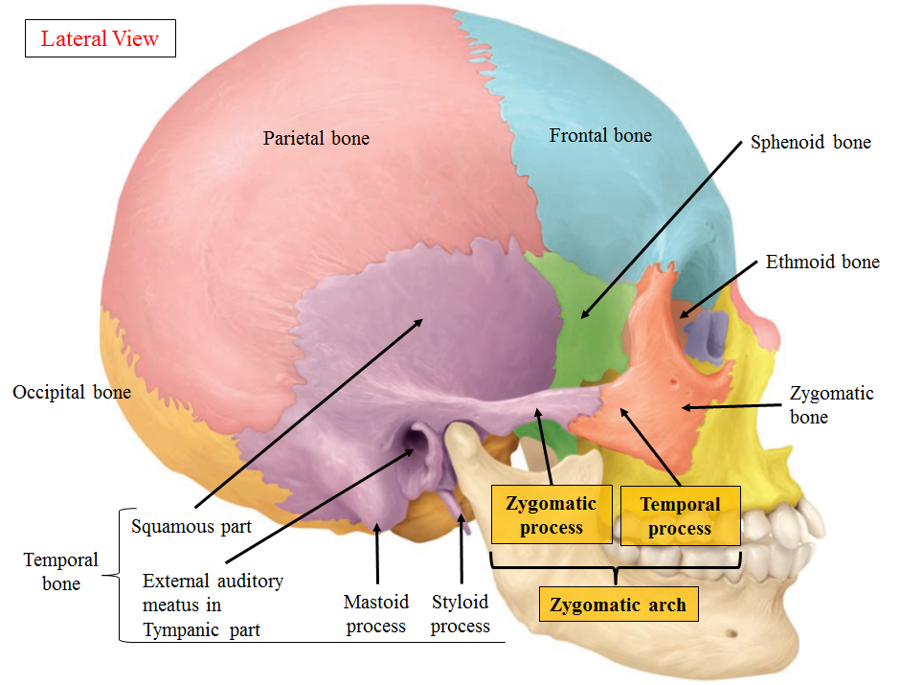
Fig.8

Slide 24
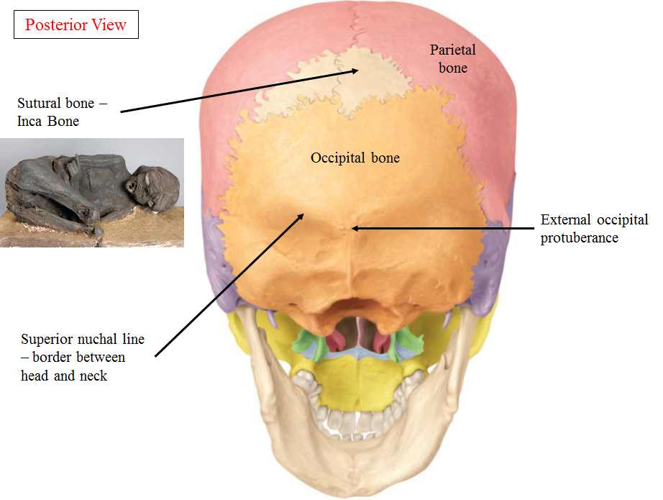
Fig.9

Slide 25
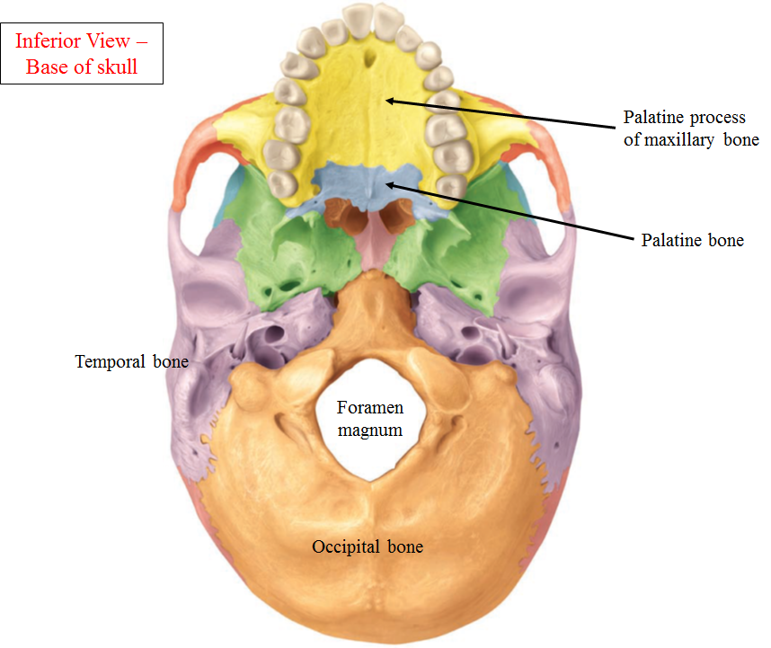
Fig.10

Slide 26
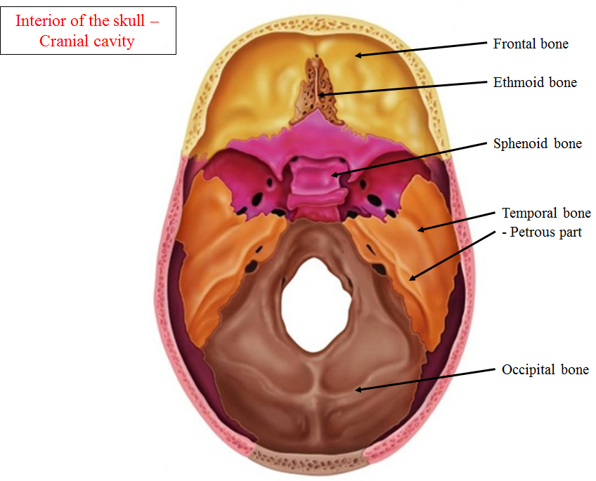
Fig.11

Slide 27
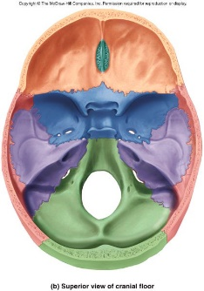
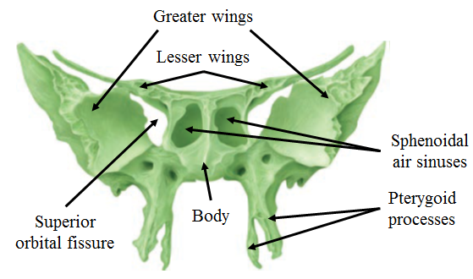
Sphenoid Bone
  Lies in the middle of the base of the skull
  Called the ‘Keystone’ bone because it’s attached to all other cranial bones
  It’s formed of:
  Body
  Lesser wings
  Greater wings
  Pterygoid processes
Fig.12: The sphenoid bone.

Slide 28
Ethmoid Bone
  Located in the midline between the two orbits
  Forms the roof of the nasal cavity
  Contains two thin projections on each side that forms part of the lateral wall of the nasal cavity. These projections are called the superior and middle nasal conchae
  Has a transverse (cribriform) and a perpendicular plate

Slide 29
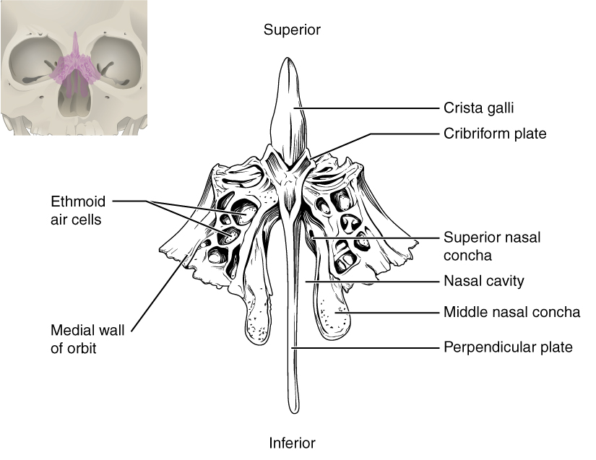
Fig.13: The ethmoid bone.

Slide 30
Facial Bones:
Nasal Bones
  Form the bridge of the nose
Maxillae
  Form the upper jawbone
  Has the following processes:
  Frontal process superiorly
  Zygomatic process laterally
  Palatine process posteriorly
    Forms most of the hard palate
    Separates the nasal cavity from the oral cavity
  Alveolar process inferiorly. Contains sockets for the teeth.
Zygomatic Bones
  Commonly called cheekbones, form the prominences of the cheeks
  The temporal process of this bone unites with the zygomatic process of the temporal bone to form the zygomatic arch.

Slide 31
Lacrimal Bones
  Form part of the medial wall of each orbit. Related to the lacrimal (tear) sac.
Palatine Bones
  Form the posterior portion of the hard palate
Inferior Nasal Conchae
  Form part of the lateral wall of the nasal cavity
Vomer
  Forms the inferior portion of the nasal septum
Mandible
  Lower jawbone
  The largest, strongest facial bone
  The only movable skull bone

Slide 32
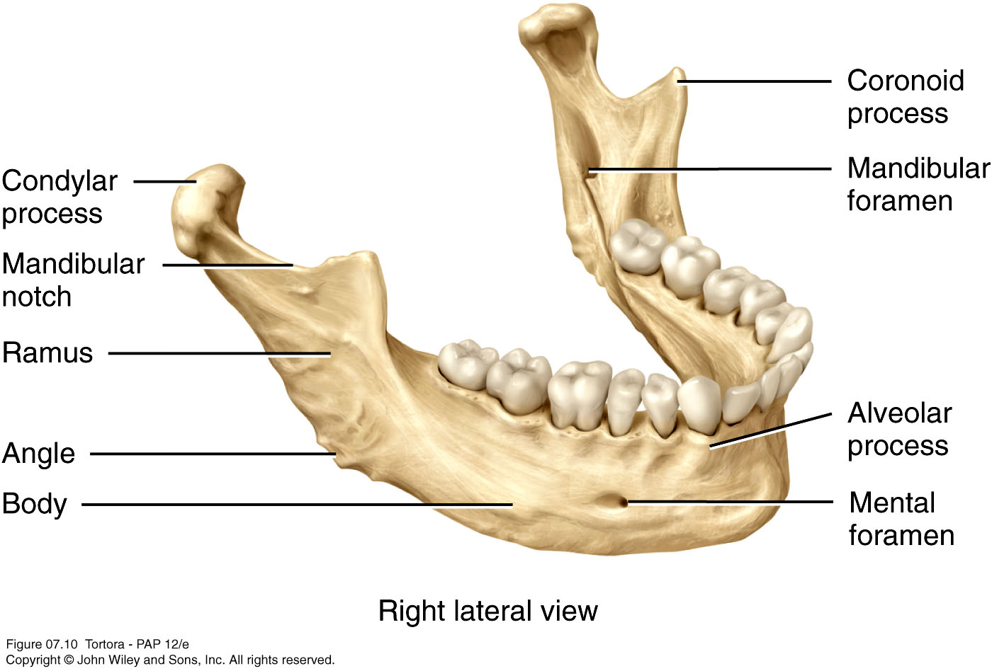
Parts of the Mandible:
Fig.14*: The mandible.

Slide 33
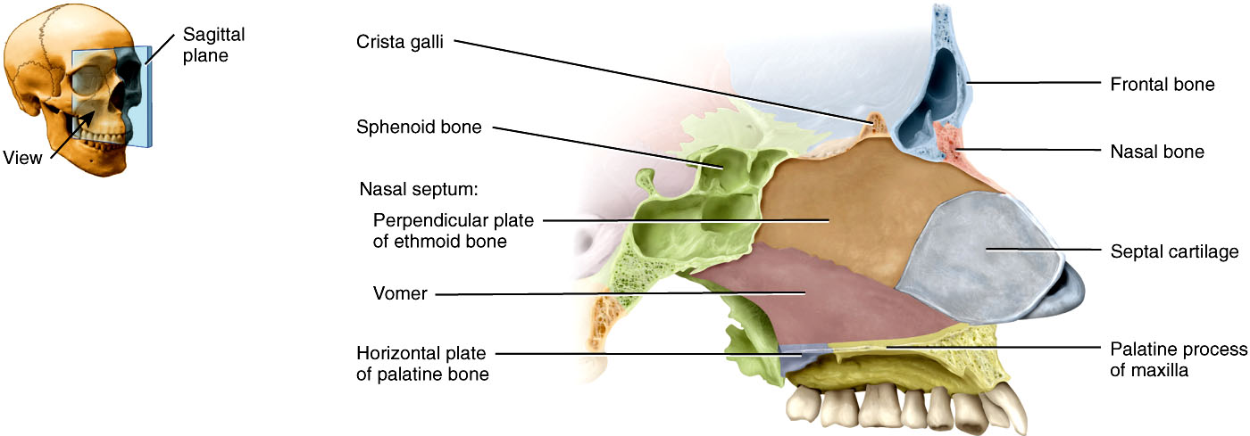
The Nasal Septum:
Fig.15: The nasal septum.
  A partition that divides the nasal cavity into right and left parts.
  It’s formed of:
  The perpendicular plate of the ethmoid bone and the vomer bone posteriorly.
  Septal cartilage anteriorly.

Slide 34
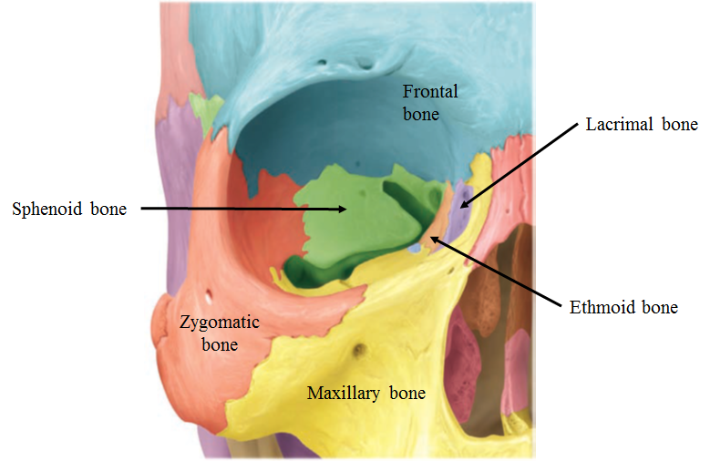
The Orbital Cavity:
  Formed by the following bones:
Fig.16*: Bones of the orbit.

Slide 35
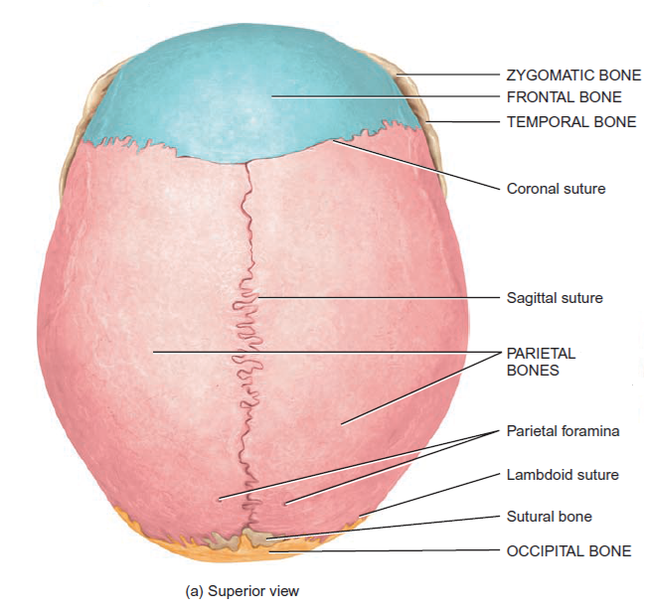
Main Sutures:
Coronal Suture: between the frontal and the two parietal bones.
Sagittal Suture: between the two parietal bones.
Lambdoid Suture: between the two parietal and the occipital bones.
Fig.17: Some of the main sutures of the skull.

Slide 36
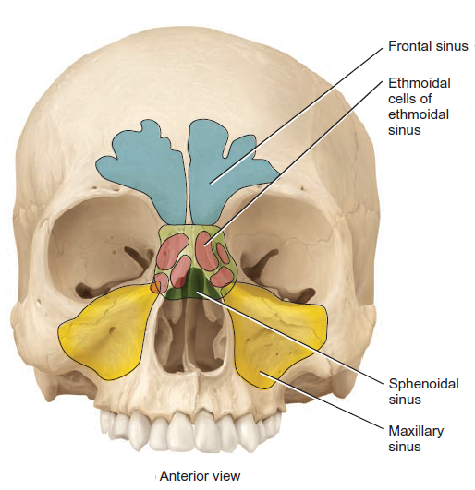
Paranasal Sinuses:
Cavities within cranial and facial bones near the nasal cavity
Secretions produced in the sinuses drain into the nasal cavity
Serve as resonating chambers that intensify and prolong sounds
Found in the Frontal, ethmoid, sphenoid and maxillary bones
Fig.18: Paranasal sinuses.

Slide 37
Fontanels:
Areas of unossified tissue that link the cranial bones at birth
Eventually, they are replaced with bone to become sutures
Provide flexibility to the fetal skull, allowing the skull to change shape as it passes through the birth canal
 | Anterior Fontanel | Posterior Fontanel
Location | Between the frontal and parietal bones | Between the parietal and occipital bones
Shape | Diamond ♦ | Triangular ▲
Size | Larger than the posterior | Smaller than the anterior
Closes | Later than the posterior | Before the anterior

Slide 38
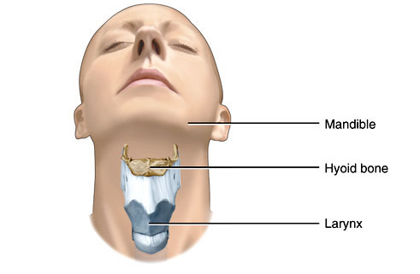
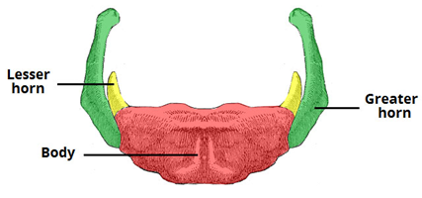
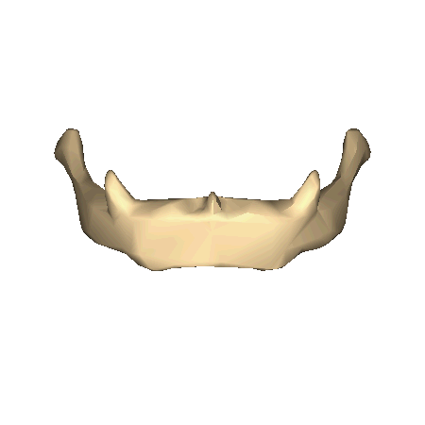
The Hyoid Bone
Located in the upper part of the neck
The only bone in the body that does not articulate with any other bone
Supports the tongue, providing attachment sites for some tongue muscles and for muscles of the neck and pharynx and some ligaments. It’s also attached to the larynx.
Fig.19: The hyoid bone.

Slide 39
The Vertebral Column
Also called the spine, backbone, or spinal column
Functions to:
  Protect the spinal cord
  Support the head
  Serve as a point of attachment for the ribs, pelvic girdle, and muscles
Composed of a series of bones called vertebrae (Adult=26)
  7 cervical, are in the neck region
  12 thoracic, to which the ribs are attached
  5 lumbar, support the lower back
  1 sacrum, triangular in shape and consists of five fused sacral vertebrae
  1 coccyx, triangular in shape and consists of four fused coccygeal vertebrae

Slide 40
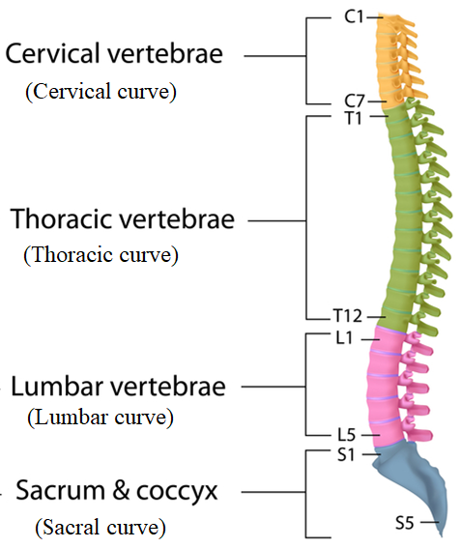
The vertebral column is curved to varying degrees in different locations
  Curves increase the column strength
  Help maintain balance in the upright position
  Absorb shocks during walking, and help protect the vertebrae from fracture
These curves are:
  Cervical
  Thoracic
  Lumbar
  Sacral
Fig.20: Curves of the vertebral column.

Slide 41
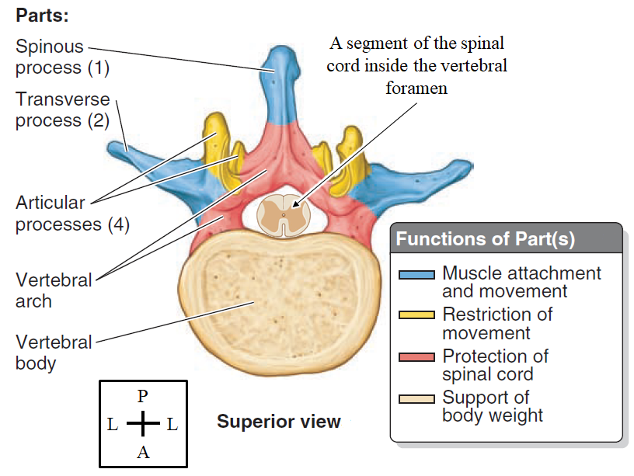
The Vertebrae:
Fig.21*: Vertebra - parts and functions.

Slide 42
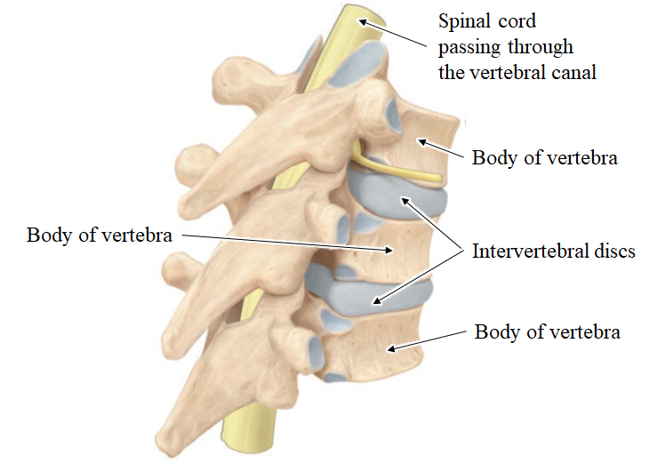
The body and the vertebral arch surrounds a foramen called the vertebral foramen. When the vertebrae are stacked on each other, the vertebral foramina will align together to form the vertebral canal through which the spinal cord passes.
Fig.22: Vertebral column.
Found between the bodies of adjacent vertebrae are the Intervertebral Discs (formed of fibrocartilage). The function of these discs is to:
  Form strong joints
  Permit various movements of the vertebral column
  Absorb vertical shock

Slide 43
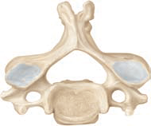
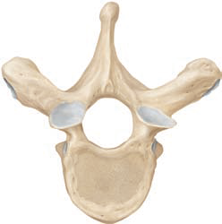
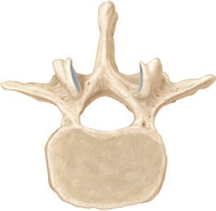
Differences between the typical vertebrae in the different regions:
 | Cervical | Thoracic | Lumbar
Body | Small and rectangular | Large and heart-shaped | Large and kidney-shaped
Vertebral Foramen | Large triangular | Small round | Triangular
Transverse Process (directed laterally) | Small with foramina | Large with no foramina | Large with no foramina
Spinous Process (directed posteriorly) | Short and bifid | Long and directed inferiorly | Broad and directed posteriorly
Facets for the ribs | Not present | Present | Not present

Slide 44
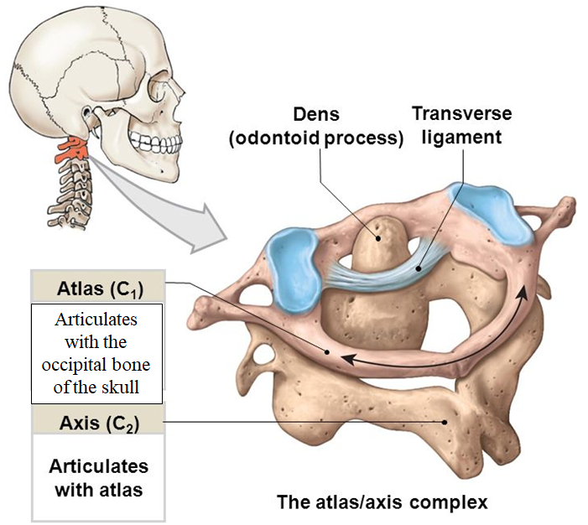
Cervical region of the vertebral column:
Fig.23*:

Slide 45
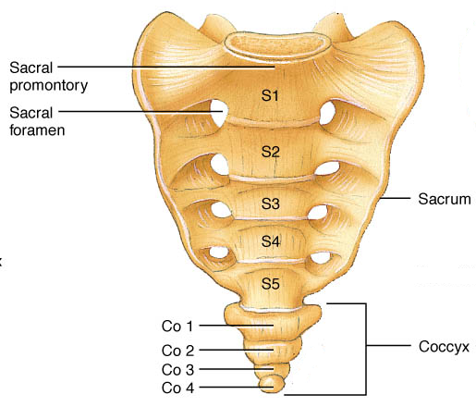
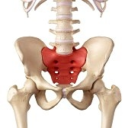
Sacral and coccygeal regions of the vertebral column:
Fig.24*: The sacrum and coccyx.

Slide 46
The Thoracic Cage
Thoracic cage is formed by the:
  Sternum
  Ribs
  Costal cartilages (attach ribs to sternum)
  Thoracic vertebrae
Functions:
  Enclose and protect the organs in the thoracic and abdominal cavities
  Provide support for the bones of the upper limbs
  Play a role in breathing

Slide 47
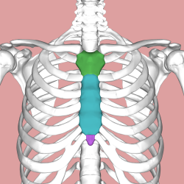
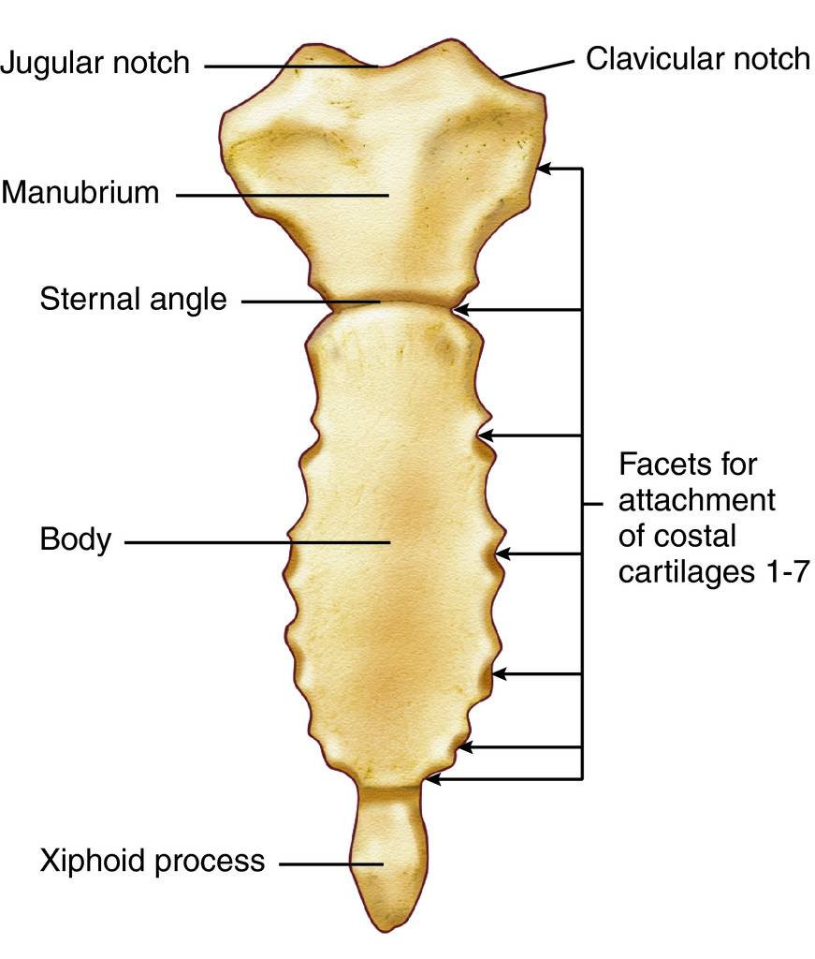
The Sternum (Breastbone):
“Located in the midline of the anterior aspect of the thoracic cage
Consists of the manubrium, body and xiphoid process
To it are attached the clavicles and the costal cartilages
Fig.25: The sternum. Position and features.

Slide 48
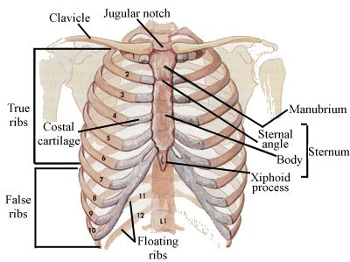
The Ribs:
Twelve pairs of ribs give structural support to the sides of the thoracic cavity
The upper seven pairs are called true ribs because they’re attached to the sternum by their own costal cartilages.
Fig.26: Types of ribs.
Pairs 8-10 are called false ribs because their costal cartilages are attached, anteriorly, to the costal cartilages of the 7th rib.
Pairs 11 and 12 are called floating ribs because they have no anterior attachment.

Slide 49
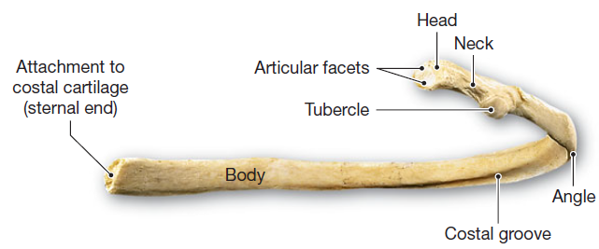
The Ribs:
Fig.27: Features of a rib and its articulation with a vertebra.
Each rib is formed of:
Head: which articulates with the body of the thoracic vertebrae.
Neck: a constricted region immediately after the head.
Tubercle: which articulates with the transverse process of a vertebra.
Shaft (Body).
Angle: area where the shaft bends forwards
Costal groove: this runs along the inferior border of the inner surface of the shaft. It’s occupied by the intercostal nerve and vessels.

Slide 50
The Appendicular Skeleton

Slide 51
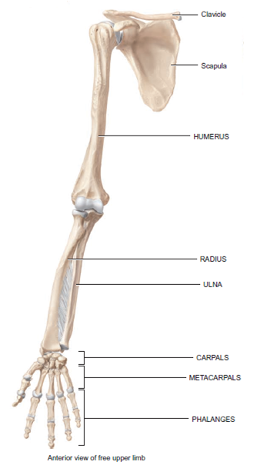
The Upper Limb
Each upper limb has 32 bones
Two separate regions
1. The pectoral (shoulder) girdle which attaches upper limb to trunk → 2 bones: Clavicle and Scapula
2. The free part (30 bones):
1 Humerus (arm)
1 Ulna + 1 Radius (forearm)
8 Carpal bones (wrist)
5 Metacarpals and 14 Phalanges (hand)
Fig.28: Anterior view of the upper limb bones.

Slide 52
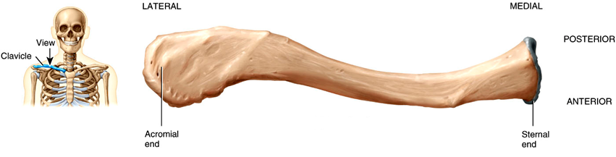
The Pectoral (Shoulder) Girdle:
The Clavicle (Collarbone):
The anteriorly located clavicle is “S” shaped
The medial end articulates with the sternum
The lateral end articulates with the acromion of the scapula
Fig.29: Superior view of the clavicle.
Functions of the clavicle:
Keeps the limb away from the trunk.
Transmits force from the upper limb to the trunk.
The only bony attachment of upper limb with the trunk. Therefore, if the clavicle is fractured, the limb will fall (Dropped limb).

Slide 53
The Scapula (Shoulder blade):
Triangular in shape and located on the posterior aspect of the rib cage level with the 2nd to 7th ribs.
2 surfaces: anterior (costal) surface featuring the subscapular fossa. Posterior surface divided by the spine into upper supraspinous fossa and lower infraspinous fossa.
3 border and 3 angles. The lateral angle presents the glenoid cavity for articulation with the head of the humerus.
3 processes:
Spine - a large process on the posterior surface of the scapula that ends laterally as the acromion.
Acromion - the flattened lateral end of the spine of the scapula. Articulates with the clavicle.
Coracoid process - a protruding projection on lateral end of the superior border.

Slide 54
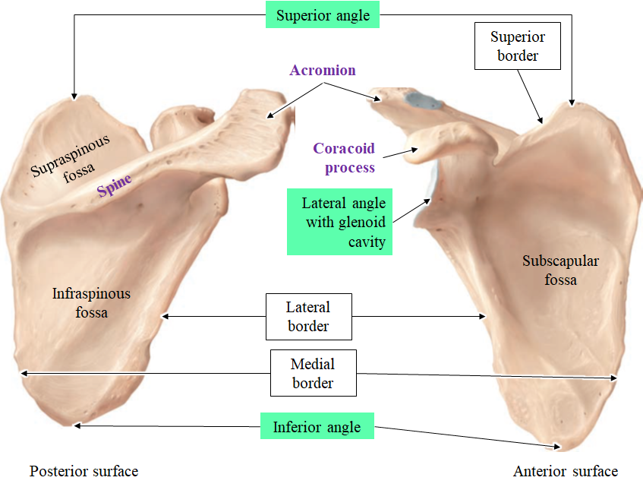
Fig.30: The scapula.

Slide 55
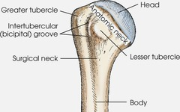
The Humerus:
Longest and largest bone of the upper limb. Formed of an upper end, a shaft, and a lower end.
The Upper End features:
  Rounded head that articulates with the glenoid cavity of the scapula to form the shoulder joint.
  The anatomical neck.
  Distal to the neck, we have the greater and lesser tubercles. Between these tubercles, we have the
Fig.31: The proximal end of the humerus.
intertubercular (bicipital) groove for the tendon of the long head of the biceps muscle.
The surgical neck (the most common site of humerus fracture) separates the upper part from the shaft.

Slide 56
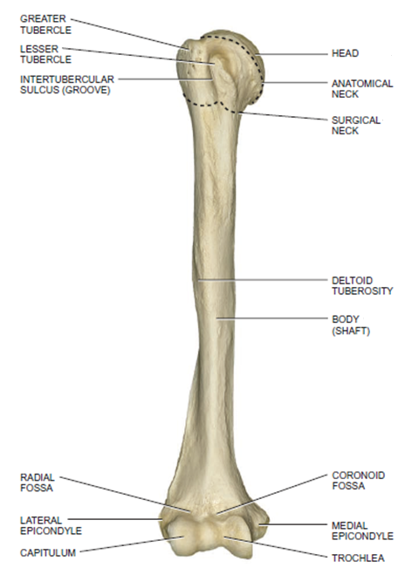
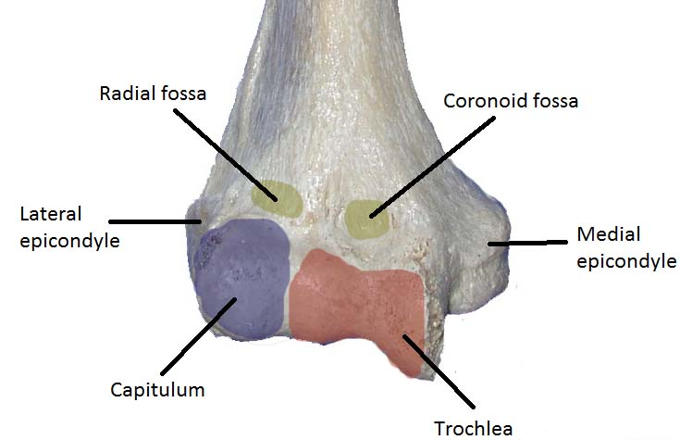
The Shaft: to which muscles are attached and several nerves are related.
The Lower End features the round capitulum which articulates with the head of the radius and the spool-shaped trochlea which articulates with the ulna. Also we have two epicondyles for muscle attachment. The medial epicondyle is more prominent.
Fig.32: Above: anterior view of the humerus. To the left: the distal end of the humerus.

Slide 57
The Ulna and Radius:
Feature | Ulna | Radius
Position | Medial | Lateral
Upper end | Ulnar notch Olecranon process Coronoid process Articulates with trochlea | Disc-shaped head Articulates with capitulum
Shaft | Triangular | Triangular Radial tuberosity for tendon of biceps
Interosseous border | Lateral | Medial
Lower end | Head of ulna Posteriorly located Styloid process | Laterally located Styloid process
Wrist joint | Not involved | Involved

Slide 58

Fig.33: The ulna and radius.

Slide 59
The Carpal Bones (Carpus):
Consists of 8 small bones (carpals)
Two rows of carpal bones (from lateral to medial)
Proximal row - scaphoid, lunate, triquetrum, pisiform
Distal row - trapezium, trapezoid, capitate, hamate
The Bones of the Hand:
Five metacarpals
14 phalanges - two in the thumb (pollex) and three in each of the other fingers

Slide 60

Fig.34: The bones of the wrist and hand.

Slide 61

The Lower Limb
Each lower limb has 31 bones
Two separate regions
1. The pelvic girdle witch attaches lower limbs to trunk → 1 hip bone on each side
2. The free part (30 bones):
1 Femur (thigh)
1 Patella
1 Tibia + 1 Fibula (leg)
7 Tarsal bones
5 Metatarsals and 14 Phalanges (foot)
Fig.35: Anterior view of the lower limb bones.

Slide 62

The Hip (Coxal) Bone:
Each hip bone consists of three bones that fuse together: ilium, pubis, and ischium
The two hip bones are joined anteriorly at the pubic symphysis and they’re joined posteriorly to the sacrum at the sacroiliac joints
Fig.36: Anterior view of the pelvic girdle.

Slide 63
The Ilium:
Largest and most superior of the three hip bones.
Superior border - iliac crest. Possess a tubercle
Has four prominent projections: the superior and inferior anterior and posterior iliac spines
Greater sciatic notch is located between the posterior inferior iliac spine and the ischial spine. Though it pass the sciatic nerve
The Pubis:
Pubis - inferior and anterior part of the hip bone
The two pubic bones meet at the pubic symphysis. The angle below this joint is called the pubic arch

Slide 64
The Ischium:
Ischium - inferior and posterior part of the hip bone
Most prominent feature is the ischial tuberosity, it is the part that meets the chair when you are sitting
Ischial spine – a prominent projection. Below the spine we have the lesser sciatic notch
The 3 bones fuse at and participate in the formation of the acetabulum which the site of articulation with the head of femur.
The obturator foramen is bounded by the pubis and ischium. It’s the largest foramen in the body.

Slide 65

Fig.37: Features of the three pelvic bones.

Slide 66


False and True Pelvis:
Pelvic brim - a plane from the sacral promontory to the upper part of the pubic symphysis
False pelvis - lies above this plane
True pelvis - the bony pelvis inferior to the pelvic brim. It’s the canal a child must pass through during birth.
Fig.38: False and true pelvis.

Slide 67

Comparing Male and Female Pelvis:
These features of female pelvis create more space in the true pelvis to permit an easier process of child birth.

Slide 68

The Femur:
Femur - longest, heaviest, and strongest bone in the body
Proximal End: Features a head witch articulates with the acetabulum to form the hip joint. The head has a small depression called the fovea capitis for attachment of a ligament. Distal to the head is the neck and distal to it are the greater and lesser trochanters.
Fig.39: The proximal end of the femur.
Shaft: for attachment of muscles.
Distal End: Two condyles that articulate inferiorly with the tibia and anteriorly with the patella. Proximal to the condyles are the medial and lateral epicondyles for muscle attachment.

Slide 69

Fig.40: Features of the femur bone.

Slide 70

The Patella:
Largest sesamoid bone in the body
Forms the patellofemoral joint
Triangular in shape. The base is superior. The narrow apex is inferior
Thick articular cartilage lines the posterior surface
Increases the leverage of the quadriceps femoris muscle
Fig.41: The patella.

Slide 71
The Tibia (Shin Bone):
The larger, medial weight-bearing bone of the leg
Proximal End: The lateral and medial condyles on the superior surface which articulates with the condyles of the femur to form the knee joint.
Shaft: Exhibits the tibial tuberosity for attachment of the patellar ligament. The lateral border of the shaft is the sharp interosseous border.
Distal End: It articulates distally with the talus at the ankle joint. Features the medial malleolus.
The Fibula:
The smaller, laterally placed bone of the leg
Non-weight bearing. Serve for muscle attachment
Shaft – medial interosseous border
Distal end, articulates with the tibia and the talus. Features the lateral malleolus.

Slide 72

Fig.42: The tibia and fibula.

Slide 73

The Skeleton of the Foot:
Seven tarsal bones - talus (articulates with tibia and fibula), calcaneus (the heel bone, the largest and strongest tarsal bone), navicular, cuboid and three cuneiforms
Five metatarsals
14 phalanges - two in the big toe (hallux) and three in each of the other toes
Fig.43: Bones of the ankle and foot.

Slide 74
Arches of the Foot:
Two longitudinal and one transverse arches support the weight of the body and assist in walking
Flatfoot - the arches decrease or “fall”
Clawfoot - too much arch occurs due to various pathologies
Fig.44: Arches of the foot.

Slide 75

Joints
Joints are sites where two or more bones meet

Slide 76
Classification of Joints:
The structural classification of joints (according to type of tissue that connects the bones):
  Fibrous joints (bones held together by dense collagen fibers)
  Cartilaginous joints (bones held together by cartilage)
  Synovial joints (there’s a space between the bones and the bones are held together by ligaments)
The functional classification of joints (according to degree of movement):
  Synarthrosis (an immovable joint)
  Amphiarthrosis (a slightly movable joint)
  Diarthrosis (a freely movable joint)

Slide 77
Fibrous Joints:
Lack a joint cavity.
The articulating bones are held very closely together by dense collagenous irregular connective tissue.
Fibrous joints permit little or no movement.
Three types of fibrous joints:
    Sutures - Occur only between bones of the skull.
    Syndesmoses
    Permits slight movement.
    Connecting tissue is a ligament or a membrane.
    Between radius and ulna in the forearm.
  Gomphoses
    Immovable joint.
    Joint in which a cone-shaped peg fits into a socket.
    Articulations of the teeth with the sockets of the maxillae and mandible (the only example in humans). The fibrous tissue holding them is called the periodontal membrane.

Slide 78



Fig.45: Fibrous joints: sutures of the skull, interosseous membrane between tibia and fibula, and joint between a tooth and its socket.

Slide 79
Cartilaginous Joints:
Lack a joint cavity and allow little or no movement.
Joint is tightly connected by cartilage.
Two types of cartilaginous join:
Synchondroses
  Connecting tissue is hyaline cartilage
  Example: Epiphyseal (growth) plate between the diaphysis and epiphysis of bones
Symphyses
  Slightly movable joint
  Ends of the articulating bones are covered with hyaline cartilage, but a disc of fibrocartilage connects the bones
  Example: Pubic symphysis between the hip bones. Intervertebral joints between the bodies of the vertebrae
Fig.46: Cartilaginous joints.

Slide 80
Synovial Joints:
A synovial cavity allows the joint to be freely movable.
Articular surfaces of bones are covered by hyaline articular cartilage.
Articular Capsule
  A sleeve-like capsule encloses the synovial cavity.
  The articular capsule is composed of two layers:
    an outer fibrous capsule
    an inner synovial membrane
Synovial fluid
  The synovial membrane secretes synovial fluid.
  Functions:
    lubricating the joint
    absorbing shocks
    supplying oxygen and nutrients to the cartilage
    removing carbon dioxide and metabolic wastes from the cartilage

Slide 81
Ligaments and articular discs
Nerve and Blood Supply
  Nerves convey information about pain and the degree of movement from a joint.
  Branches from different arteries anatomose around a joint to ensure sufficient blood supply to the joint.
Bursae and Tendon Sheaths
  Bursae
    Sac-like structures containing fluid similar to synovial fluid
    Located between tendons, ligaments and bones
    Cushion the movement of these body parts
  Tendon sheaths
    Tube-like bursae that wrap around tendons
    Reduce friction at joints

Slide 82

Fig.47: Features of synovial joints.

Slide 83
Types of movements in Synovial Joints:
Specific terminology is used to designate the movements that occur at joints
Movements are grouped into four main categories:
    Gliding
    Angular movements
    Rotation
    Special movements

Slide 84
Gliding
  Simple movement back-and-forth and from side-to-side
  There is no significant alteration of the angle between the bones
  Limited in range
  Intercarpal joints
Angular Movements
  Increase or a decrease in the angle between articulating bones
  Angular movements include
    Flexion
    Extension
    Hyperextension
    Lateral flexion
    Abduction
    Adduction
    Circumduction

Slide 85


Flexion
  Decrease in the angle between articulating bones
  Bending the trunk forward
Extension
  Increase in the angle between articulating bones (back to normal anatomical position)
Hyperextension
  Continuation of extension beyond the normal extension
  Bending the trunk backward from the normal anatomical position
Lateral flexion
  Movement of the trunk sideways to the right or left at the waist

Slide 86


Abduction
  Movement of a bone away from the midline
  Moving the humerus laterally at the shoulder joint
Adduction
  Movement of a bone towards the midline
  Movement that returns body parts to normal position from abduction
Circumduction
  Movement of a body part in a circle
  Moving the humerus in a circle at the shoulder joint

Slide 87

Rotation
  A bone revolves around its own longitudinal axis
  Turning the head from side to side as when you shake your head “no”
  Medial Rotation is the rotation of a limb so that the anterior surface of the bone faces medially
  Lateral Rotation is the rotation of a limb so that the anterior surface of the bone faces laterally

Slide 88
Elevation
  Upward movement of a part of the body
  Closing the mouth
Depression
  Downward movement of a part of the body
  Opening the mouth
Protraction
  Movement of a part of the body anteriorly
  Thrusting the mandible outward
Retraction
  Movement of a protracted part of the body back to normal
Opposition
  Movement of the thumb in which the thumb moves across the palm to touch the tips of the fingers on the same hand
4) Special Movements

Slide 89
Inversion
  Movement of the foot so that the sole faces medially
Eversion
  Movement of the sole laterally
Dorsiflexion
  Bending of the foot at the ankle in an upward direction
Plantar flexion
  Bending of the foot at the ankle in a downward direction
Supination
  Movement of the forearm so that the palm is turned anteriorly
Pronation
  Movement of the forearm so that the palm is turned posteriorly

Slide 90

Fig.48: Special movements.

Slide 91
Types Synovial Joints:
Synovial joints are classified according to type of movement and the shape of the articulating bones into:
  Planar
  Hinge
  Pivot
  Condyloid
  Saddle
  Ball-and-socket

Slide 92

Planar Joints
  Primarily permit back-and-forth and side-to-side movements (Gliding)
  Intercarpal joints
Hinge Joints
  Produce an opening and closing motion like that of a hinged door
  Permit only flexion and extension
  Knee, elbow and the interphalangeal joints
Fig.49: Planar joint (left) and hinge joint (right).

Slide 93

Pivot Joints
  Surface of one bone articulates with a ring formed partly by another bone.
  Only rotation can occur
  Altlantoaxial and radioulnar joints
Condyloid Joints
  Oval projection of one bone fits into the oval-shaped depression of another bone.
  Flexion, extension, abduction and adduction are allowed
  Wrist
Fig.50: Pivot joint (left) and condyloid joint (right).

Slide 94

Saddle Joints
  Articular surface of one bone is saddle-shaped, and the articular surface of the other bone fits into the “saddle”
  Flexion, extension, abduction and adduction
  Carpometacapal joint of the thumb
Ball-and-Socket Joints
  Ball-like surface of one bone fitting into a cup-like depression of another bone
  Flexion, extension, abduction, adduction, circumduction and rotation are allowed
  Shoulder and hip
Fig.51: Saddle joint (left) and ball-and-socket joint (right).

Slide 95
The Shoulder (Glenohumeral) Joint:
  Synovial ball-and-socket joint formed by the head of the humerus and glenoid cavity of the scapula
  Movements: Flexion, extension, abduction, adduction, circumduction, and medial and lateral rotation.
  More freedom of movement than any other joint of the body witch comes at the expense of stability
  The articular capsule is thin and extends from the glenoid cavity to the anatomical neck of the humerus. It’s weak inferiorly.
  Some ligaments help to stabilize the joint and bursae prevent friction.
  Glenoid labrum: a narrow rim of fibrocartilage around the edge of the glenoid cavity that slightly deepens it.
  Rotator Cuff: a group of muscles that surround the shoulder joint and help stabilize it (except inferiorly). These are: supraspinatous, infraspinatous, subscapularis and teres minor. They help keep the head of humerus in position.

Slide 96

Fig.52: The shoulder joint.

Slide 97

The Elbow Joint:
  A synovial hinge joint between the humerus, ulna and radius
  Movements: only flexion and extension of the forearm occur at this joint
  Articular Capsule: extends from the humerus proximally to the radius and ulna distally
  Ligaments: The triangular ulnar and radial collateral ligaments on the sides of the joint. The anular radial ligament surrounds the head of the radius stabilizing it
  Ulnar nerve passes behind the medial epicondyle of the humerus. Dislocation of this joint may damage this nerve
Fig.53: Elbow joint.

Slide 98
The Hip (Coxal) Joint:
  Synovial ball-and-socket joint formed by the head of the femur and the acetabulum of the hip bone
  A very stable joint on the expense of decreasing range of movement
  Movements: Flexion, extension, abduction, adduction, circumduction, and medial and lateral rotation.
  The articular capsule is thick and strong. It extends from the acetabulum to the neck of the femur
  Ligaments outside the joint help stabilize it. The ligament of the head of femur is found within the joint and keep the head of the femur in its place inside the acetabulum.
  Acetabular labrum: a narrow rim of fibrocartilage around the edge of the acetabulum that deepens it.

Slide 99

Ligaments of the hip joint
Fig.54: The hip join.

Slide 100
The Knee Joint:
  Synovial modified-hinge joint formed by the femur, tibia and patella
  It’s the largest and most complex joint in the body
  Movements: Flexion, extension, and slight medial and lateral rotation of the leg when flexed.
  The articular capsule is strengthened by ligaments and muscles.
  Ligaments outside the joint help stabilize it. Inside the joint we have the anterior and posterior cruciate ligaments
  Bursae: several are present here to prevent friction.
  Menisci: Two fibrocartilage discs between the tibial and femoral condyles help compensate for the irregular shapes of the bones and circulate synovial fluid

Slide 101

Fig.55: Knee joint.

Slide 102

Fig.56: Knee joint: cruciate ligaments and the menisci.

