Slide 1
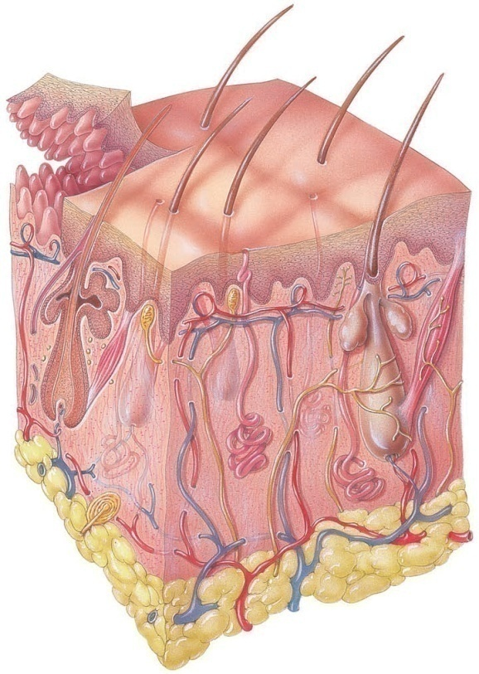
The Integumentary System
Dr. Mustafa Saad
(2018)

Slide 2
The organs of the integumentary system include
The skin.
The accessory structures of the skin, which include:
Hair
Arrector pili muscle
Glands (sebaceous and sweat glands)
Nails
Sensory organs and nerves
Blood vessels

Slide 3
Functions of the Skin
Regulation of body temperature
Blood reservoir
Protection
Cutaneous sensations
Excretion and absorption
Synthesis of vitamin D

Slide 4
Structure of the Skin
The skin (cutaneous membrane) covers the body and is the largest organ of the body by surface area and weight. Weight is about 6% of body weight. It’s thinnest on the eyelids, thickest on the heels.
The skin is formed of two major layers:
Outer layer called the epidermis.
Inner layer called the dermis.
Beneath the dermis is a subcutaneous layer (also called the hypodermis) which attaches the skin to the underlying tissues and organs.

Slide 5
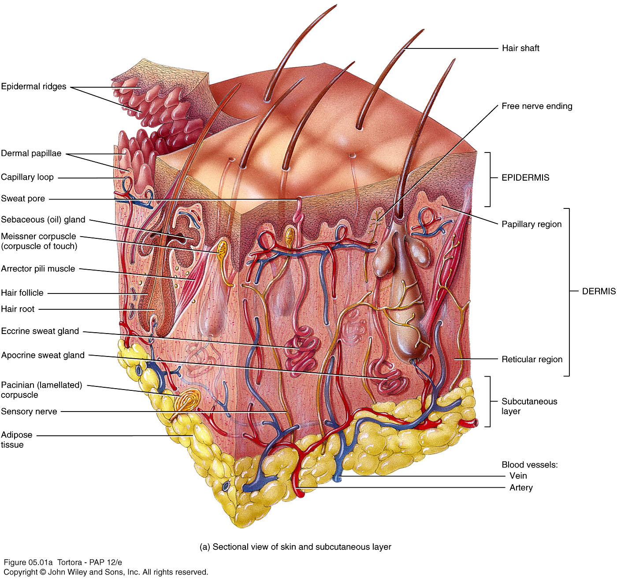
Fig.1*: The skin and its components.

Slide 6
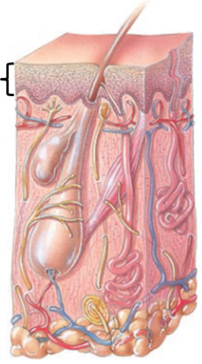
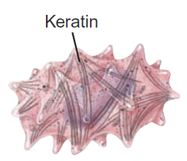
The Epidermis
The epidermis is composed of stratified squamous keratinized epithelium
It contains four major types of cells:
Keratinocytes (90% of the cells) they form the layers of the epidermis and produce keratin which is a tough fibrous protein that provides protection.
Melanocytes: which produce the pigment melanin that protects from damage by ultraviolet radiation.
Fig.2: The epidermis and its cells.

Slide 7
Langerhans cells: involved in immune responses.
Merkel cells: which function in the sensation of touch along with the adjacent tactile discs (derived from a neuron).
Fig.2: The epidermis and its cells (continued).

Slide 8
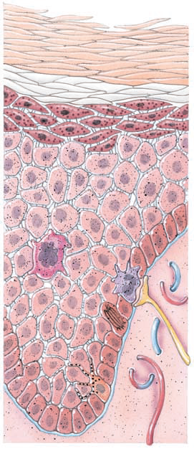
Layers of the Epidermis
The epidermis is formed of four layers (thin skin) or five layers (thick skin)
Stratum basale (deepest layer), where continuous cell division occurs which produces all the other layers.
Stratum spinosum, 8-10 layers of keratinocytes.
Stratum granulosum, which contains granules that could be keratohyalin or lamellar granules.

Slide 9
Stratum lucidum is present only in thick skin (the skin of the fingertips, palms, and soles).
Stratum corneum (The Keratin layer): composed of many sublayers of flat, dead keratinocytes called corneocytes or squames. These are nothing more than cell membrane filled with keratin. They are continuously shed and are replaced by cells from deeper strata.

Slide 10
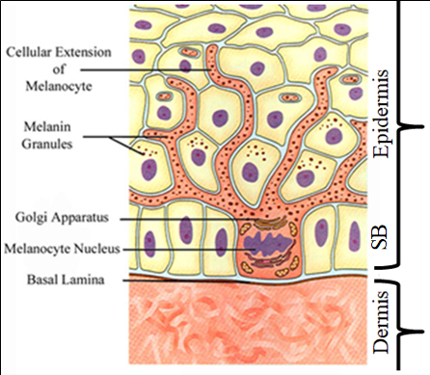
Notes about the layers:
Merkel cells and the cell bodies of melanocytes are found within the stratum basale. The branches of melancoytes extend between adjacent keratinocytes to provide them with melanin pigment.
Fig.3: Position of melanocytes.
The lamellar granules of the stratum granulosum bind with the cell membrane and release a lipid-rich secretion that fills spaces between cells to prevent water loss.
Keratin in the cells bind to desmosomes to help in the adhesion of the cells to each other.

Slide 11
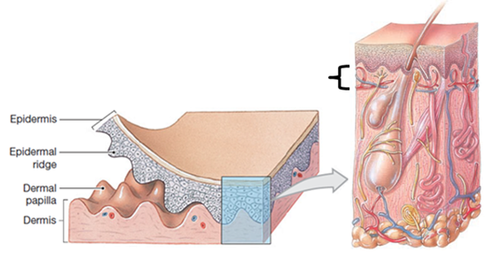
The Dermis
The dermis is a layer of connective tissue that provide structural and nutritional support for the epidermis.
Formed of two regions:
Outer papillary region consists of loose (areolar) connective tissue containing:
Dermal papillae – tissue of the dermis that projects between the epidermal ridges (which are epidermal tissue passing down into the dermis). This increases the area of contact between the epidermis and dermis.
Capillary loops.
Corpuscles of touch and free nerve endings.
Fig.4: Papillary region of the dermis.

Slide 12
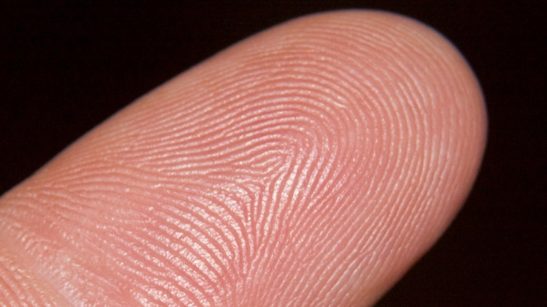
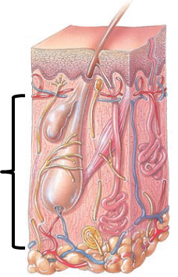
This interdigitation between the dermis and the epidermis is reflected on the surface of the skin by a pattern of elevations and depressions that forms the fingerprints (and footprints). Their function is to increase firmness of grip by increasing friction.
Fig.6: Fingerprint.
The deeper reticular region consists of dense collagenous irregular connective tissue containing:
Adipose cells
Hair follicles
Nerves
Sebaceous (oil) glands, and sweat glands
Fig.6: Reticular region of the dermis.

Slide 13
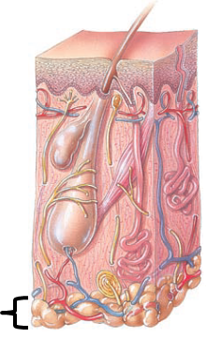
The Subcutaneous Tissue
This layer (and sometimes the dermis) contains lamellated (pacinian) corpuscles which detect external pressure applied to the skin. It also contains various amounts of fatty tissue.
Functions:
Attaches the skin to the underlying tissues and organs
Acts as an insulator
Serves as an energy storage site
Absorbs shocks (as in palms and soles)
Fig.7: Subcutaneous tissue.

Slide 14
Accessory Structures of the Skin
Hair (Pili)
Hair is composed of columns of keratinized cells bonded together by extracellular proteins. It’s present throughout the body, except in certain areas like the palms and soles.
Functions of hair:
Protection (Hair on head protects scalp, eyelashes and eyebrows protect eye).
Reduction of heat loss.
Sensation of light touch.

Slide 15
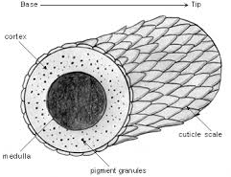
Parts of the hair
The shaft: the superficial part of the hair that extends beyond the surface of the skin.
The Root: the deeper part of the hair that reaches down into the dermis. It’s surrounded by the hair follicle which is a downward extension of the epidermis.
The shaft and root of the hair are formed of 3 concentric layers:
The medulla: The innermost layer
The cortex: The middle layer
The cuticle: The outermost layer. Formed of highly keratinized dead cells arranged like shingles on house roofs.
Fig.8: Layers of hair.

Slide 16
The hair Follicle: is formed of an epithelial root sheaths that’s derived from the epidermal cells and that surrounds the root of the hair. This sheath is surrounded by a thick basal lamina called the glassy membrane which, in turn, is surrounded by a dermal root sheath formed of connective tissue.
The lower part of the hair follicle is expanded to form the hair bulb. This hair bulb:
Is indented by the hair dermal papilla which contains areolar connective tissue and blood vessels that nourish the hair.
Contains the hair matrix which is responsible for the formation of the hair. Within the hair matrix, we have melanocytes that give hair its color.
Is surrounded by the hair root plexus that is sensitive to touch.

Slide 17
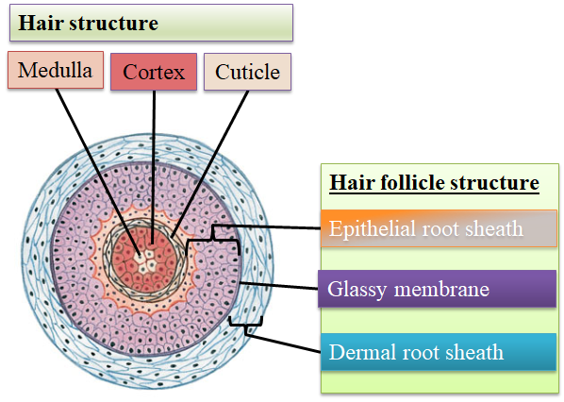
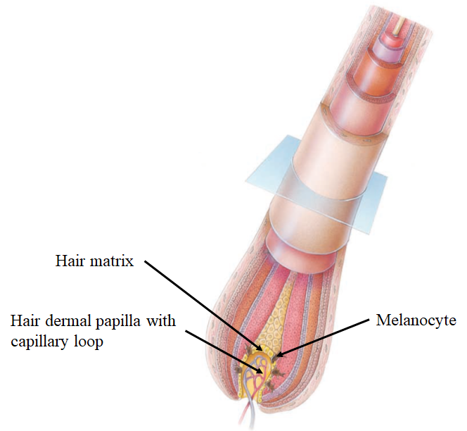
Fig.9*: The hair follicle. To the right, the expanded part is the hair bulb. Above, a cross section through the hair follicle.

Slide 18
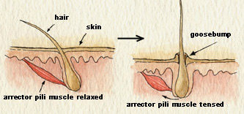
Sebaceous glands open into the hair follicle.
The arrector pili muscle is a bundle of smooth muscle cells that extends from the superficial part of the dermis to the dermal sheath of the hair follicle. Under stressful conditions, the muscle contracts pulling the hair making the shaft perpendicular to the surface and bulging the skin around the hair producing ‘goosebumps’.
Fig.10: Action of the arrector pili muscle.

Slide 19
Sweat Glands
Feature | Eccrine | Apocrine
Location | All over the body, specially palms and soles | Axilla, groin, and bearded facial regions of adult males
Shape | Coiled | Coiled
Secretion | Watery | More viscous (bacteria acts on this secretion to produce body odor)
Method of secretion | Merocrine | Merocrine
Opens | On the surface of the skin | Mostly into the hair follicle
Control | Nervous | Hormonal
Onset of action | From birth | At puberty
Functions | Helps cool the body. Elimination of waste products | Stimulated during emotional stress

Slide 20
Sebaceous Glands
Located in the angle between the arrector pili muscle and the hair
Open into the hair follicle
Sebaceous glands secrete an oily substance called sebum which prevents dehydration of hair and skin, and inhibits growth of certain bacteria
Ceruminous Glands
Modified sweat glands located in the ear canal
Along with nearby sebaceous glands, they are involved in the production of a waxy secretion called cerumen (earwax) which provides a sticky barrier that prevents entry of foreign bodies into the ear canal.

Slide 21
Nails
Nails are plates of hard, keratinized epidermal cells located over the dorsal surface of the distal end of the fingers and toes
Each nail consists of:
Free edge: may extend beyond the distal end of the digit. It’s white in color.
Transparent nail body (plate) with a whitish lunula at its base.
Nail root embedded in a fold of skin called nail matrix that’s responsible for the growth of the nail.

Slide 22
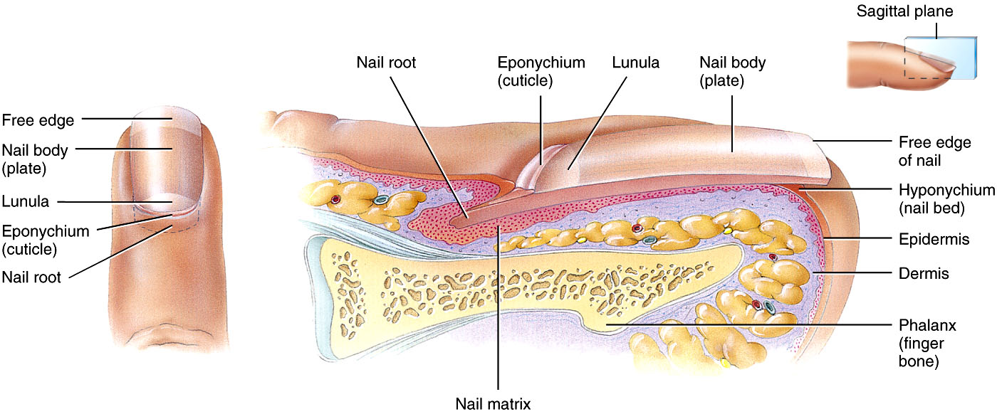
Fig.11: Parts of the nail.

