Slide 1
Tissues

Slide 2
A tissue is a collection of cells with a common embryologic origin and a common function that work together to perform specialized activity. In addition to the cells, a tissue contains a substance that’s present between the cells called the extracellular matrix (ECM).
Body tissues can be generally divided into 4 main types according to the type of cells and the amount and content of the ECM they possess.
The main types of body tissues are:
Epithelial tissue
Connective tissue
Muscular tissue
Nervous tissue

Slide 3
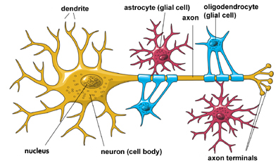
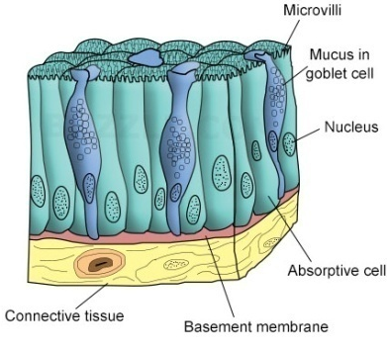
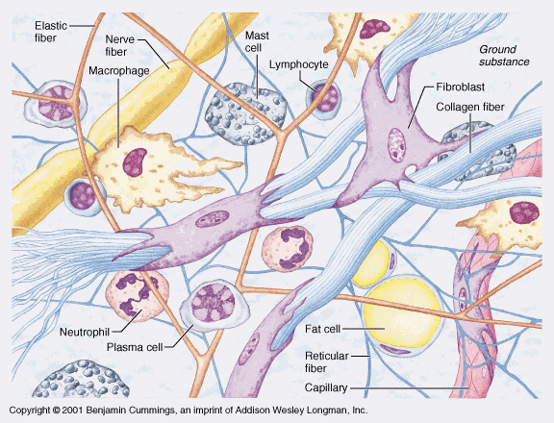
Table 1: Types of tissues and their characteristics
Tissue | Nervous | Epithelial | Muscular | Connective
Cells | Have intertwining elongated processes | Aggregated polyhedral cells | Elongated contractile cells | Several types of fixed and wandering cells
Amount of ECM | Very small | Small | Moderate | Abundant
Main Function | Transmission of nerve impulse | Lining, Secretion | Movement | Support, protection

Slide 4
Epithelial Tissue
Epithelial tissues have the following characteristics:
Cover surfaces or line cavities.
Rapid turn-over (time from the birth of a cell till its death), because it’s exposed to the external environment.
Formed of sheets of closely packed cells.
The cells are polar.
The epithelium rests upon a sheet of extracellular matrix called the Basal Lamina. Also, epithelia have a connective tissue layer under them.
Epithelial tissues lack blood vessels.

Slide 5
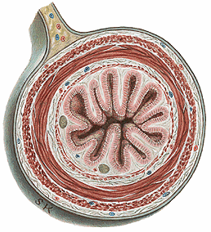
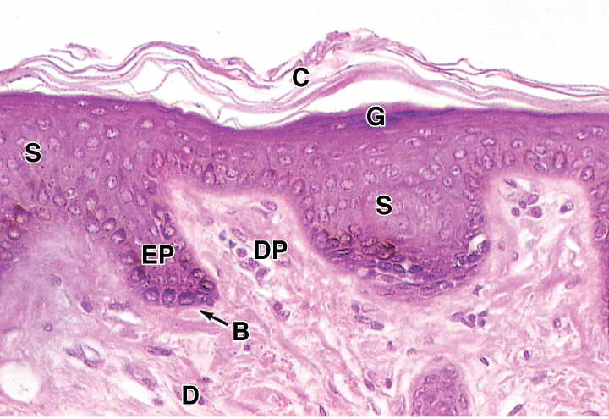
Epithelium
Fig.1: Characteristics of Epithelial tissue. (a) Cross section of small intestine. (b) Section through the skin.
Lamina propria (connective tissue)
(a)
External environment
Epithelium = epidermis
Dermis (connective tissue)
(b)

Slide 6
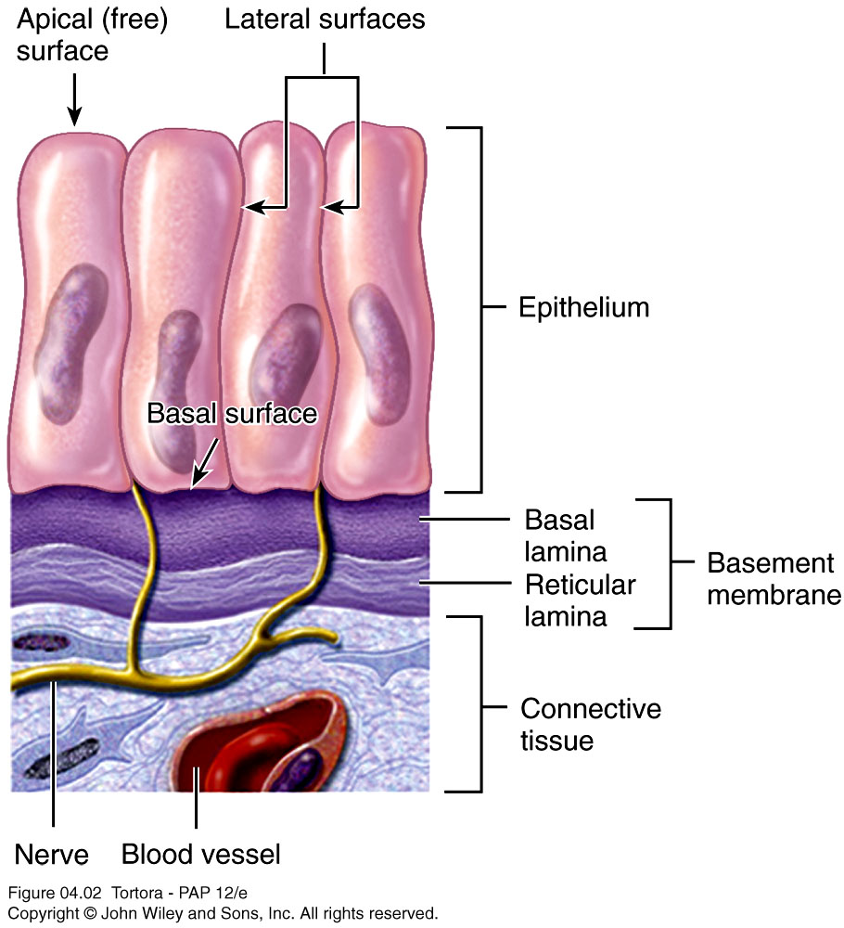
Basement Membrane
Basement membrane is formed of the basal lamina and the reticular lamina. The reticular lamina is the upper part of the connective tissue that’s usually located under the epithelium which is rich in reticular fibers.
In addition to supporting the epithelia, the basement membrane performs other various functions.
Fig.2: Difference between basal lamina and basement membrane.

Slide 7
Types of Epithelium
Epithelium can be divided into two general groups:
Lining or covering epithelium
Glandular epithelium → Main function is secretion
However, some lining epithelial cells secrete (like those in the stomach) and some glandular cells are present between lining cells (like goblet cells of small intestine)

Slide 8
Lining or covering epithelium
According to number of layers
Pseudostratified epithlium
Simple
(1 layer)
Stratified
(≥2 layers)
According to shape of cell
According to shape of cell in upper layer
Squamous
Squamous
Keratinized
Non- keratinized
Cuboidal
Cuboidal
Columnar
Columnar
Transitional

Slide 9
Simple Squamous epithelium
Formed of a single layer of flattened cells.
Location:
- Capillaries → Endothelium
- Lining of body cavities → Mesothelium
- Lining alveoli → Pneumocytes
Function: Their thin cytoplasm allows various substances to pass easily across them (endothelium and pneumocytes). Mesothelial cells, also, produce a lubricating fluid.

Slide 10
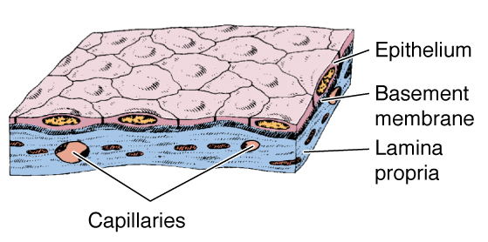
Fig.3: Simple squamous epithelium. To the right, we can see the thin pneumocytes lining the lung alveoli.

Slide 11
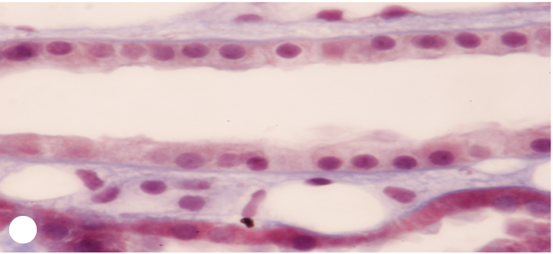
Simple Cuboidal epithelium
Formed of a single layer of cubical cells.
Location:
- Renal collecting tubules
- Covering the ovary
Function: Covering of organs. Involved in active transport.
Fig.4: Simple cuboidal epithelium of the renal collecting tubules. Note the round nuclei.

Slide 12
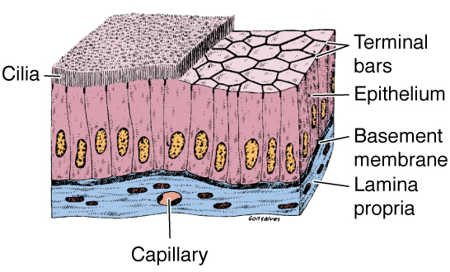
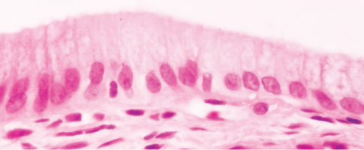
Simple Columnar epithelium
Formed of a single layer of tall cells that could be ciliated or not.
Location:
- Ciliated: Uterine tubes.
- Non-ciliated: most of the
Gastrointestinal tract.
Function: Secretion as in the stomach. Absorption as in the small intestine.
Fig.5: Simple columnar epithelium of the gallbladder. Note the oval nuclei.

Slide 13
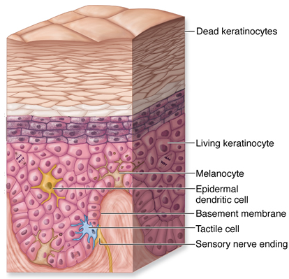
Stratified Squamous epithelium - keratinized
Formed of multiple layers of cells. The topmost layer is formed of squamous cells. The epithelium is covered with keratin (a non-living material).
Location: found in areas that require great protection:
- Skin → Epidermis
Function: protection and prevention of water loss
Fig.6: Skin

Slide 14
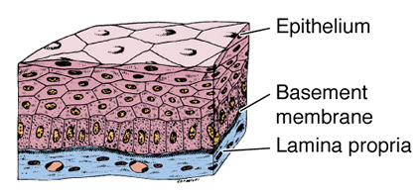
Stratified Squamous epithelium – Non-keratinized
Formed of multiple layers of cells. The topmost layer is formed of squamous cells. The epithelium is not covered with keratin.
Location: it’s found in areas that require great protection and water loss is not a problem: Mouth, esophagus, anal canal
Function: Protection and secretion.
Fig.7: Stratified squamous non-keratinized epithelium.

Slide 15
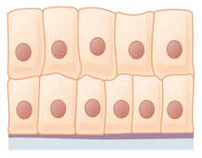
Stratified Cuboidal and Columnar epithelium
They’re formed of several layers of cells. The top-most layer is formed of cuboidal and columnar cells respectively.
Location:
- Stratified Columnar: Conjunctiva
- Stratified Cuboidal: Lining of large excretory ducts of salivary and sweat glands.
Functions: Protection and secretion

Slide 16
Transitional epithelium (Urothelium):
The topmost cells of this stratified epithelium are dome-like (called Umbrella Cells).
Location:
Urinary bladder, ureters, and renal calyces (that’s why it’s also called Urothelium).
The umbrella cells are dome-shaped when the bladder is empty. Once it’s full, these cells will become flattened (hence the name transitional).
Functions: Protection against the adverse effects of urine. Allows the bladder to change size.

Slide 17
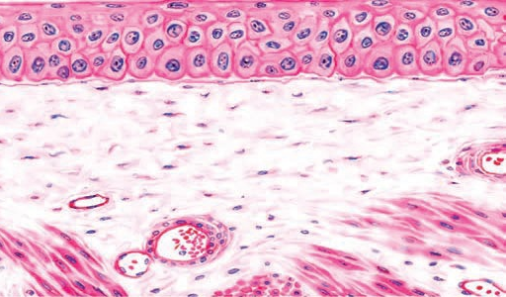
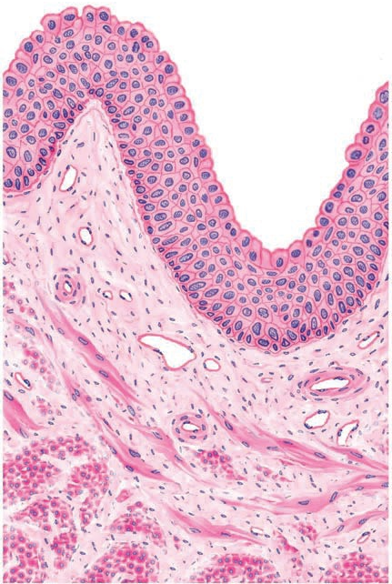
Fig.8: Transitional epithelium of the urinary bladder. To the left, when bladder is empty. Above, when the bladder is full. Note the change in shape of the upper most cells.

Slide 18
Pseudostratified columnar ciliated epithelium:
In this epithelium, the cells have different heights. All cells rest on the same basal lamina, but not all of them reach the surface. This makes the nuclei occupy different levels giving the epithelium a false stratified appearance.
Location:
Trachea, bronchi and nasal cavity (that’s why it’s also called Respiratory Epithelium).
Functions: Protection, secretion. Ciliary movement remove particles from the airway passages.

Slide 19
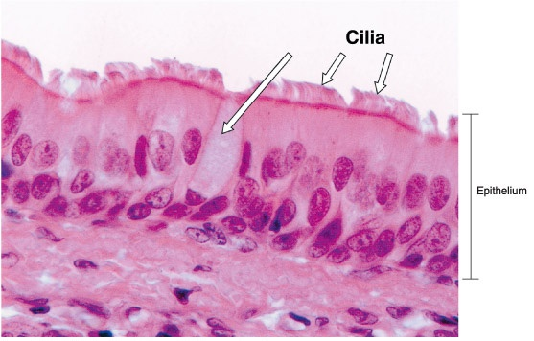
Fig.9: Pseudostratified columnar epithelium. Note how the image below gives the impression that it’s a stratified epithelium. Also note the presence of cilia and mucous secreting goblet cells (long white arrows).

Slide 20
Glandular Epithelium
Is an epithelium specialized for secretion.
Classification of glandular epithelium:
1) According to number of cells:
Unicellular glands: formed of a single cell, like Goblet cells of digestive and respiratory tracts.
Multicellular glands: formed of clusters of cells, like: salivary and sweat glands.

Slide 21
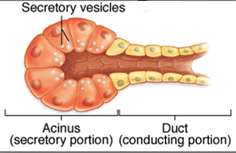
2) According to presence of ducts:
Exocrine glands: possess ducts that transfer the secretion to the outside of the body, like: salivary glands.
Endocrine glands: they lack ducts. Their secretions are transferred to the target organs, usually, by blood. Example: Pancreatic Islets, Pituitary gland.
3) Exocrine glands classified according to morphology of duct and secretory portion:
Each exocrine gland has a secretory portion that produces the secretion and a duct that carries this secretion.
The duct and the secretory portion could branched or unbranched
The secretory portion could acinar (ball-shaped), tubular, or coiled.

Slide 22
4) Exocrine glands classified according to method of secretion:
Merocrine: only the product is secreted by exocytosis. As in salivary glands.
Apocrine: the product and the apical part of the cell is shed. As in mammary gland.
Holocrine: the whole cell disintegrates and is shed with the secretion. As in sebaceous glands of the skin.
Merocrine glands are either serous (excrete a watery solution) or mucous (excrete a thick solution).

Slide 23
Epithelial Cell Polarity
Polarity of a cell means that its various regions have specialized structural features and functions.
Epithelial cells can be generally divided into 3 regions:
Apical (Luminal) region: close to the lumen of the organ.
Lateral regions: adjacent to other cells.
Basal region: lying on the basal lamina.

Slide 24
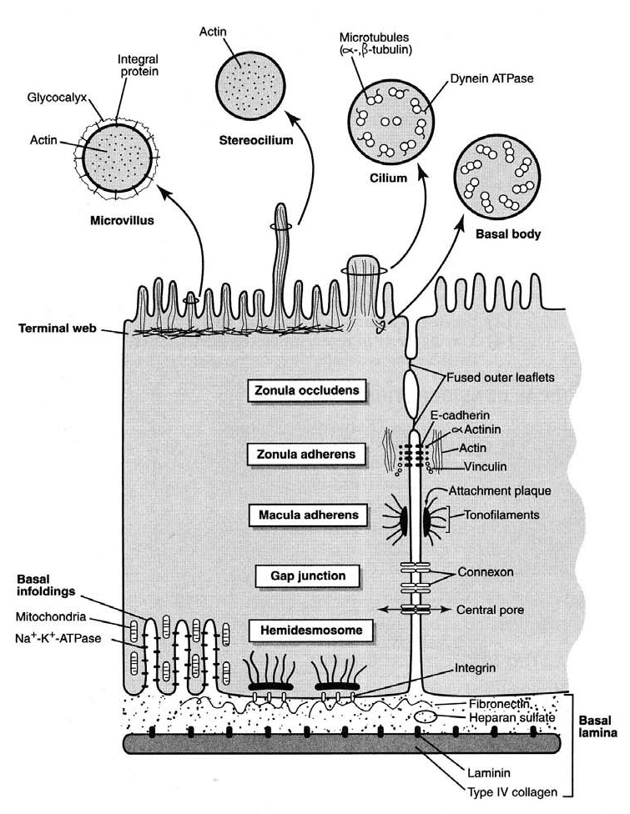
Fig.10: Polarity of epithelial cells. Note the various specialized structures in the different regions of the cell.

Slide 25
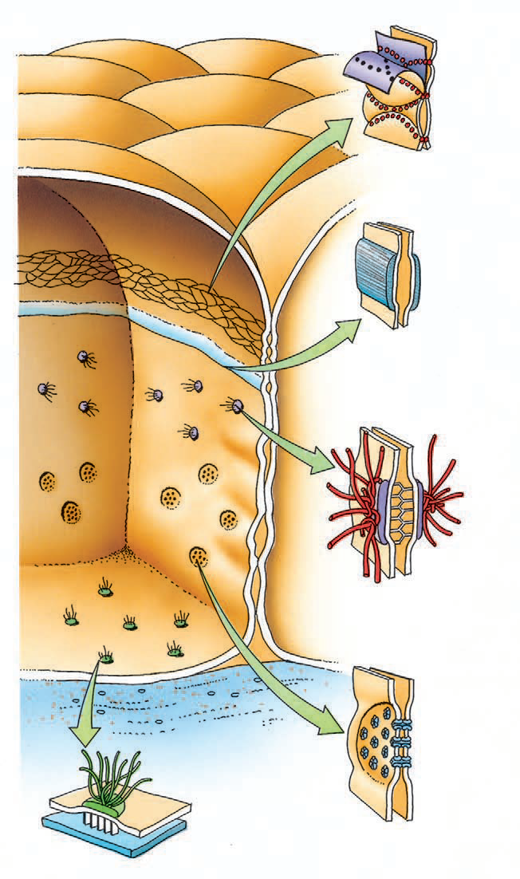
Cellular Junctions
Several cell-membrane-associated structures that contribute to adhesion and communication between cells and between cells and nearby structures.

Slide 26
Tight Junction: area of fusion of cell membrane. Seals the space between two cells.
Adherent Junction: area of adhesion between two cell membrane.
Desmosomes: area of stronger adhesion between two cell membrane.
Gap Junction: porous area in the cell membrane of two cells that allow passage of substances between them.

Slide 27
Hemidesmosomes: area of adhesion between cell membrane and basal lamina.

Slide 28
Features of the apical surface of the cell
1) Microvilli (single = microvillus):
Finger-like cytoplasmic projections that are present in absorptive epithelium, most prominently in the small intestine. They increase the surface area. They have a core of actin filaments.
2) Stereocilia
They’re similar in structure to microvilli; however, they’re longer and less motile. They may act as mechanreceptors as in the inner ear hair cells.

Slide 29
3) Cilia
Elongated, motile structures on the surface of some epithelial cells, like those of the trachea. There are, usually, many cilia on the surface of a single cell. They move in rhythmic fashion backwards and forwards removing fluids and debris in a certain direction. They’re formed of macrotubules.
4) Flagella
They’re similar to cilia in structure but are much longer and, usually, only one flagellum is present on a cell. The movement of the flagellum is rotational. In humans, only sperms possess a flagellum.

Slide 30
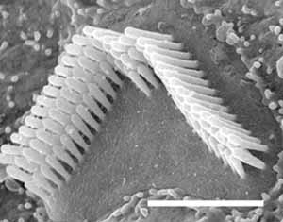
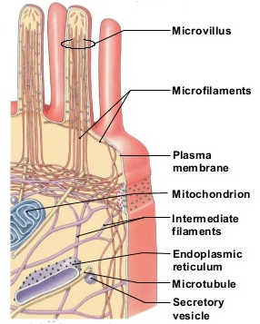
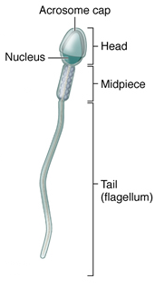
Stereocilia of a hair cell
Microvilli of intestinal cells
The tail of the sperm is a flagellum
Fig.11: Structures that may be present in the apical surface of cells.

Slide 31
Connective
Tissue

Slide 32
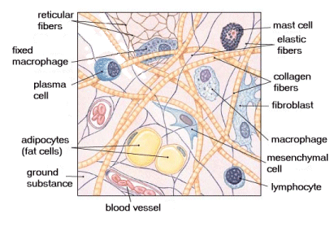
Connective tissue (CT): is a type of body tissue characterized by the presence of an abundant extracellular matrix within which are dispersed different types of cells and fibers.
Fig.12: Components of CT.
Functions:
Provide and maintaine form of organs.
Support of different tissues and organs → fatty tissue.
Connect and bind different tissues → cartilage, bone.
Provide a medium for diffusion of nutrients and waste products → connective tissue proper. Also Blood.

Slide 33
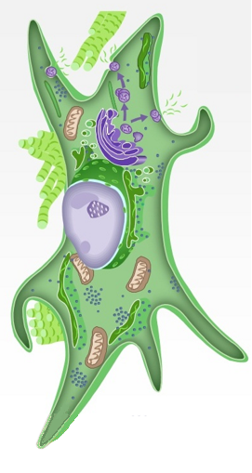
The Cells Of The Connective Tissue
1) Fibroblasts – most common type of cell in the CT
Function: Synthesizes fibers and produces components of extracellular matrix.
Main Features:
Abundant irregularly branched cytoplasm.
Large, pale-staining nucleus and prominent nucleolus and a well developed rough endoplasmic reticulum and Golgi apparatus (features of protein producing cells).
Fig.13*: Fibroblast.

Slide 34
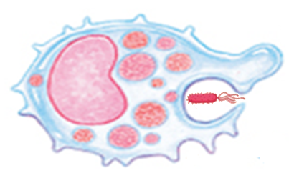
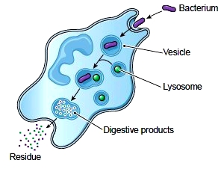
2) Macrophages
Main Features:
Cell surface has indentations and protrusions.
Many rough endoplasmic reticulum and a well developed Golgi.
Many Lysosomes and Phagocytic vesicles.
Fig.14*: Above: features of macrophages. Below: process of phagocytosis.
Derived from monocytes.
Main function: Phagocytosis

Slide 35
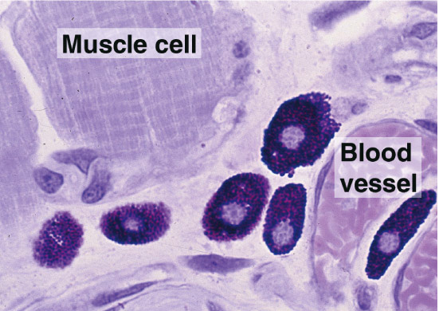
3) Mast Cells
Large, oval cells.
Cytoplasm filled with dark staining secretory granules.
Nucleus spherical and centrally located (may be obscured by granules).
Fig.15: Mast cells.
Function: Release of various inflammatory molecules, like heparin, histamine and many others. Therefore, they’re important in inflammatory and allergic reactions.

Slide 36
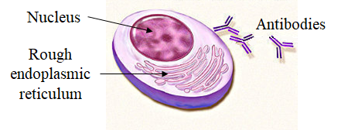
4) Plasma Cells
Main Features:
Large, oval cells.
Cytoplasm rich in rough endoplasmic reticulum
Nucleus spherical and eccentric with alternating dark and light regions (clock-face appearance)
Short life span (10-20 days).
Derived from B-Lymphocytes.
Function: production of Antibodies
Fig.16*: Plasma cells.

Slide 37
Extracellular Matrix Of The Connective Tissue
Formed of:
Fibers: these are elongated protein structures and they include:
Collagen fibers: give strength to the tissue.
Elastic fibers: give elasticity to the tissue.
Reticular fibers: these form a net that surrounds the different parts of the tissue holding them together.
Ground substance: formed of various large molecules with water.

Slide 38
Supportive
Fluid
Dense
Cartilage
Bone
Blood
Areolar
Adipose
Reticular
Collagenous
Elastic
Irregular
Regular
Loose
Proper
Adult
Connective Tissue
Embryonic
Hyaline
Elastic
Fibrocartilage
Lymph
Classification of
Mainly in embryos

Slide 39
Proper connective tissue is the connective tissue in which the main type of cells is the fibroblast or cells derived from fibroblasts.
Loose connective tissue: the fibers are loosely arranged forming a network.
Dense connective tissue: the fibers are densely packed.

Slide 40
Areolar Connective Tissue
A very common type of connective tissue. It gives some support and strength to various organs and tissues.
Found in:
Under epithelia.
Around glands.
Spaces between muscle and nerve fibers.
Around blood and lymph vessels.
It fills many small spaces making it the ‘packing material’ of our body
Contain all three types of fibers and all types of cells embedded in a semi-fluid ground substance.
Fig.17: Areolar connective tissue.

Slide 41
Adipose Tissue
Is a type of loose connective tissue in which adipocytes predominate.
It’s present throughout the body.
It could White (WAT) or Brown (BAT).

Slide 42
White Adipose Tissue
Specialized in energy storage in white adipose cells.
Depending on diet, its color varies from white to bright-yellow.
Features of white adipocytes:
Large spherical cells with a single large fat droplet (unilocular).
Flattened nucleus on one side (pushed by the droplet).
A thin film of cytoplasm around the droplet with thicker cytoplasm around the nucleus.

Slide 43
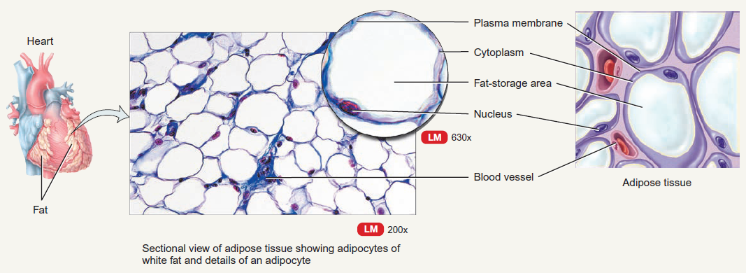
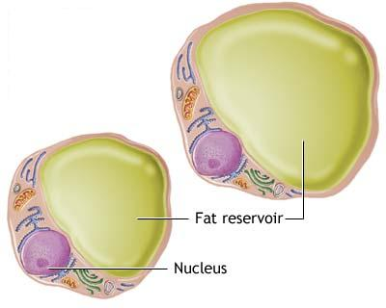
Fig.18: The image on the left shows the features of white adipocyte. Above, the image shows the typical appearance of fatty tissue in a routine preparation. Fat droplets dissolve during tissue preparation and the cell appears as a thin ring with the nucleus projecting on one side (the signet-ring appearance).

Slide 44
Brown Adipose Tissue
Specialized in heat production.
Brown adipocytes are smaller than the white, polygonal, with multiple fat droplets (multilocular). They have numerous mitochondria and a central spherical nucleus. The cells are arranged around a blood capillary.
The brown color is due to the mitochondria and the blood vessels.
It’s abundant in infants and decreases with age.

Slide 45
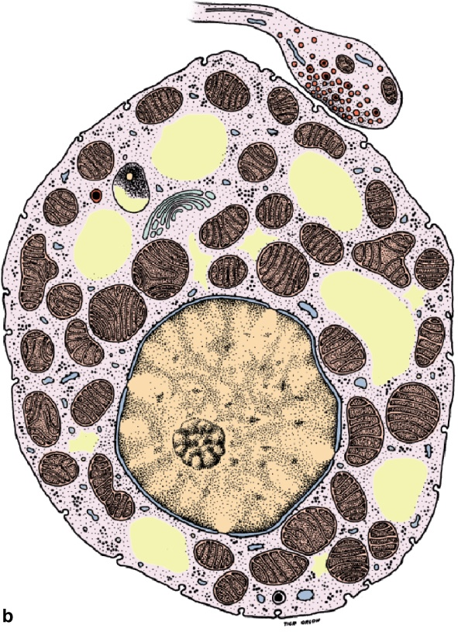
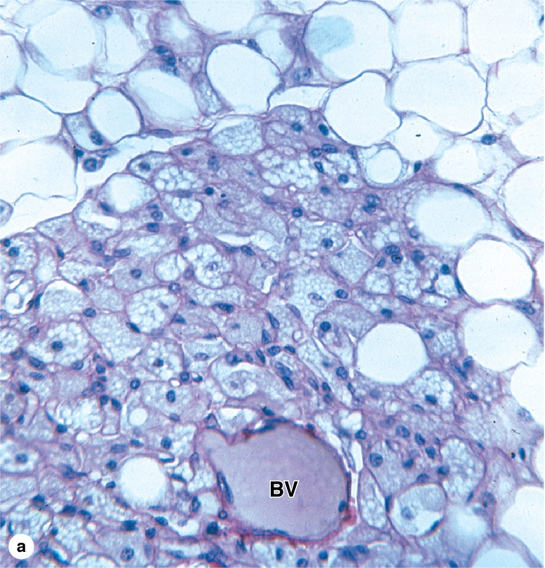
Fig. 19: Above, a brown adipocyte, note the several fat droplets. Right, brown adipose tissue. Note how the cells surround a blood vessel (BV).

Slide 46
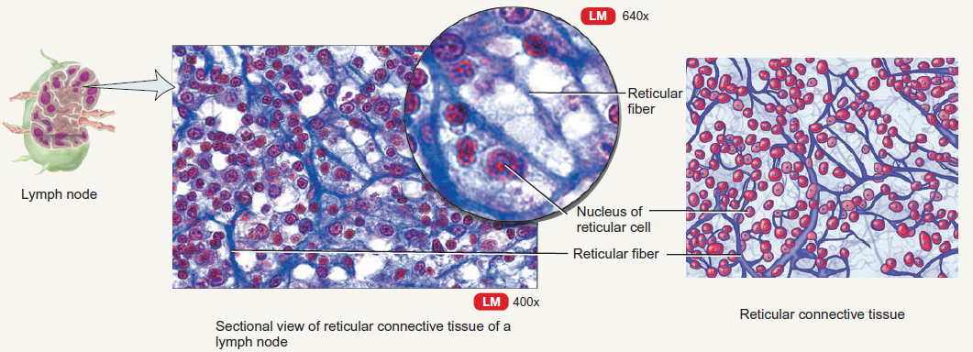
Reticular Tissue
Composed mainly of reticular fibers forming a framework within hematopoietic organs (bone marrow, spleen) and lymphatic organs.
Fig.20: Reticular tissue.

Slide 47
Dense Collagenous Connective Tissue
A type of connective tissue that has numerous collagen fibers. Highly resistant to stress.
Could be irregular or regular
Irregular: fibers arranged in no specific orientation forming a 3-dimensional network that resist stress from all directions. It’s found with the loose areolar connective tissue.
Regular: fibers arranged in a specific orientation with flattened fibroblasts between them. Provides great resistance to traction forces. Found in tendons and ligaments.

Slide 48
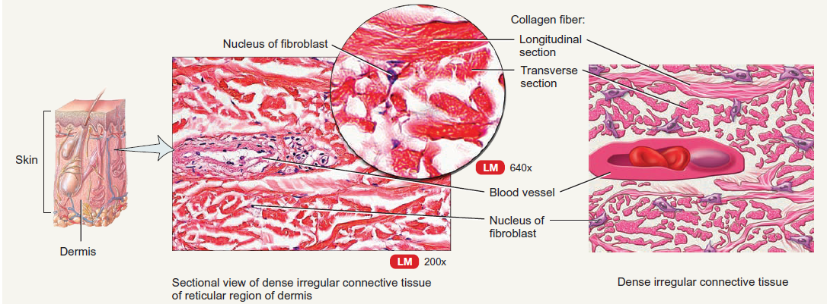
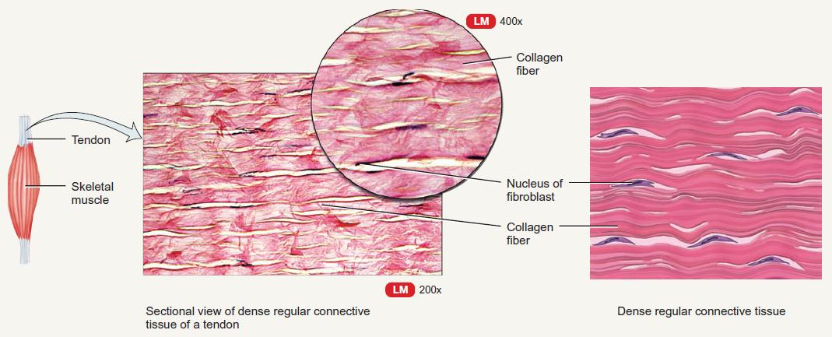
Fig.21: Dense collagenous connective tissue. Above: irregular; below: regular.

Slide 49
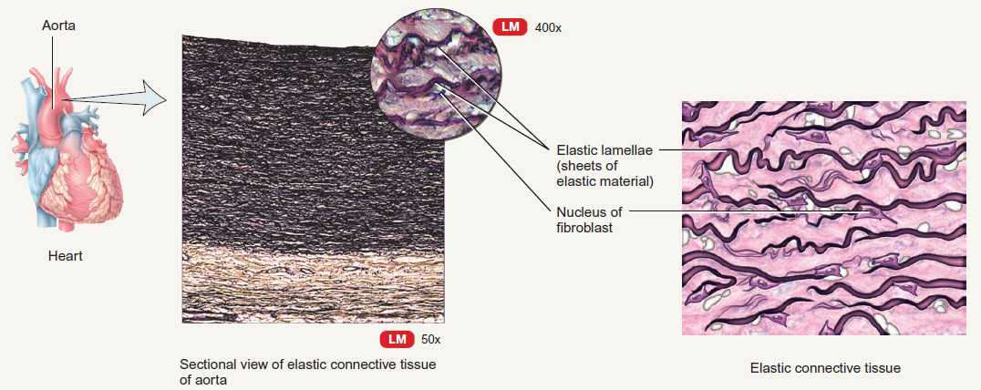
Dense Elastic Tissue
Composed mainly of elastic fibers. Found in aorta, true vocal cords and others. Gives the organ elasticity.
Fig.22: Elastic tissue.

Slide 50
Cartilage
Cartilage is a supportive type of connective tissue whose ECM is of a firm consistency which allows the cartilage to bear mechanical stresses.
Cartilage has no vascular or nervous supply. Nutrients and stimuli reach this tissue by diffusion from the Perichondrium or from the nearby synovial fluid.
Perichondrium:
Is a layer of dense connective tissue that covers all hyaline cartilage (except in joints) and all elastic cartilage. It’s richly vascular and contains collagen fibers and fibroblast cells.

Slide 51
Functions of Cartilage:
Support of soft tissues, as in the larynx and trachea.
Acts as a shock absorber as in the intervertebral discs.
Hyaline cartilage is important for development and growth of bones before and after birth.
Chondrocytes:
Oval or round cells.
Located inside spaces in the surrounding matrix called lacunae.
Each lacuna may contain 1-8 chondrocytes.
Function: production of the extracellular matrix of cartilage.

Slide 52
Hyaline Cartilage
The most common type of cartilage. Fresh hyaline cartilage is bluish-white and translucent.
Location (in adults):
Articular surfaces of some joints.
Cartilages of the nose and trachea
Thyroid and cricoid cartilages of the larynx
Costal cartilages.
The epiphyseal growth plate.
Fig.23: Hyaline Cartilage.

Slide 53
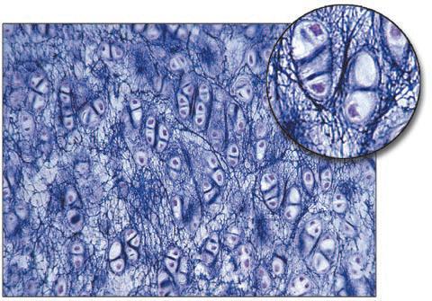
Elastic Cartilage
It’s rich in elastic fibers (which gives the fresh cartilage a yellow color).
Location:
Auricle of the ear.
Fig.24: Elastic Cartilage.
Wall of external auditory canal.
Auditory tube.
Epiglottis and cuneiform cartilages of the larynx.

Slide 54
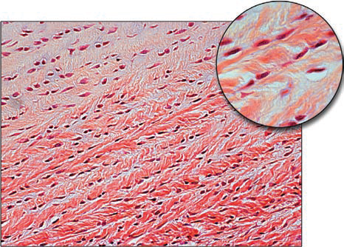
Fibrocartilage
The chondrocytes inside the lacunae are arranged axially.
The matrix is rich in collagen fibers that may be regular or irregular.
Fig.25: Fibrocartilage.
This type of cartilage lacks perichondrium.
Location: Intervertebral discs and the pubic symphysis.

