Slide 1
Introduction
Definitions and Anatomical Terms
Dr. Mustafa Saad
(2018)

Slide 2
What is Anatomy?
Anatomy:
Is the study of the various structures of the human body and the relationship of these structures to each other.
Various methods are used to study body structures leading to the appearance of various disciplines of anatomy.

Slide 3
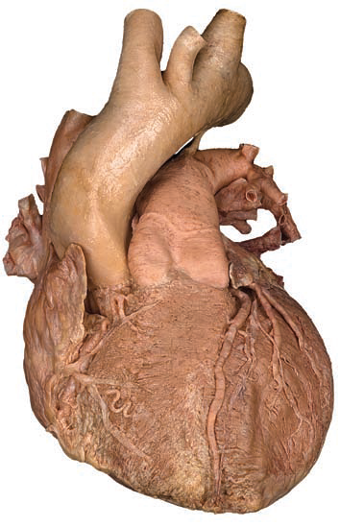
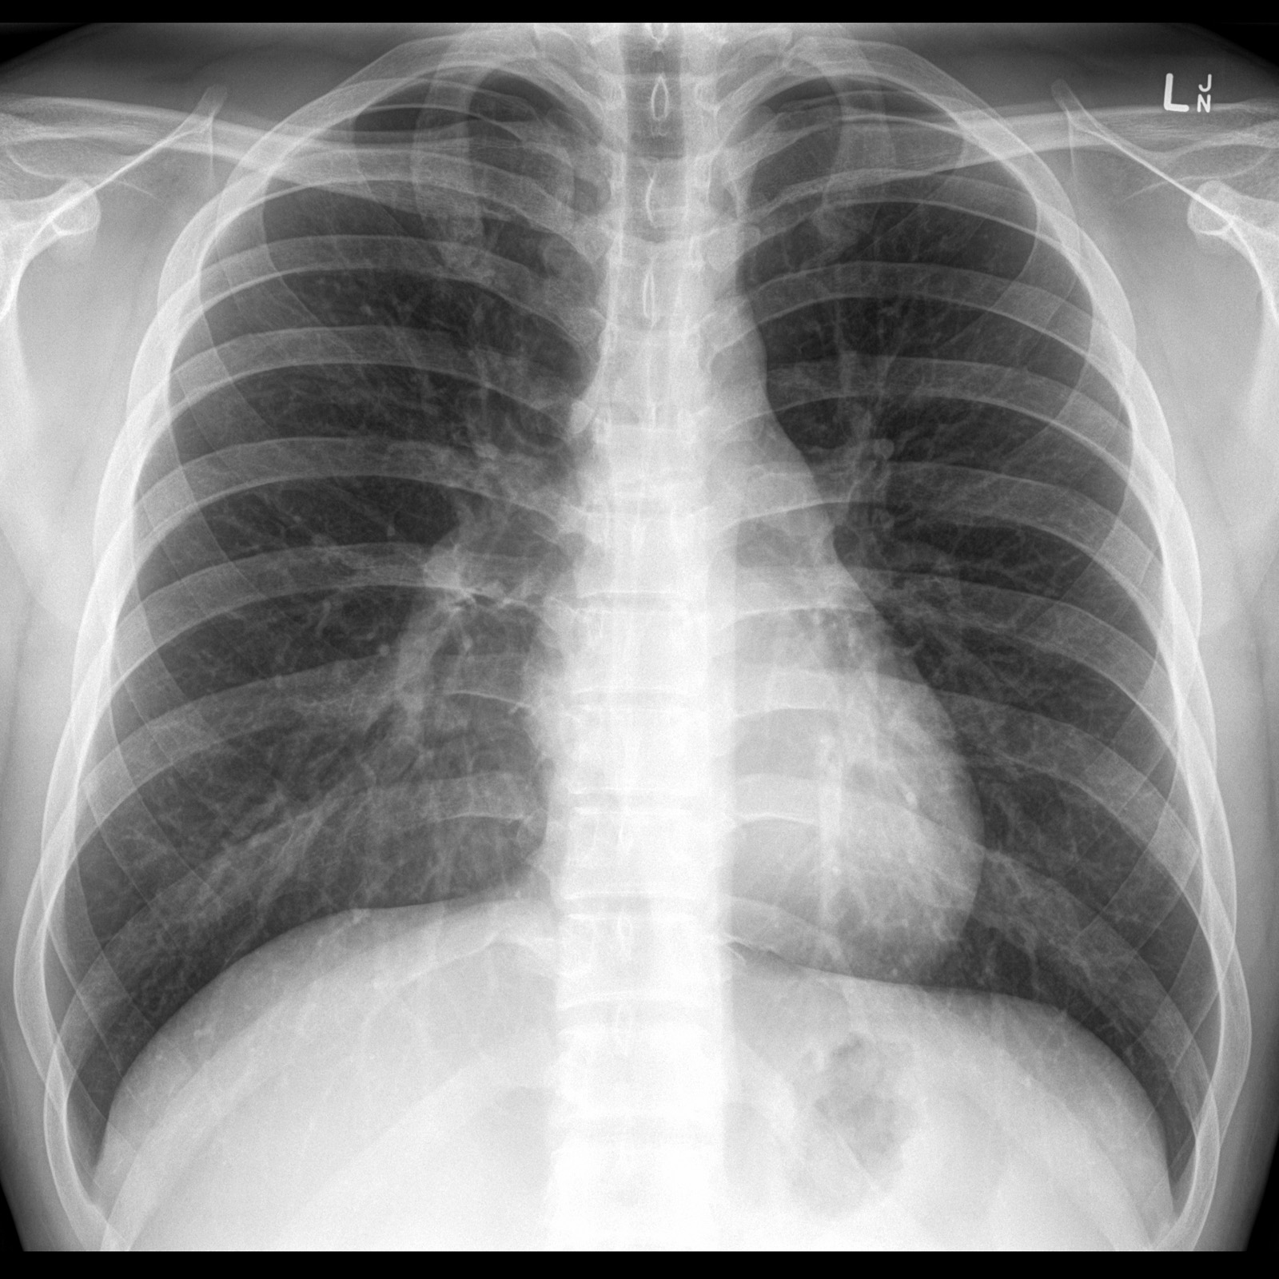
Discipline | Definition | Method Used
Gross Anatomy | Study of body structures without using magnifying instruments (with the eyes). | Dissection (cutting) of cadavers.
Histology | Study of cells and tissues with the aid of a magnifying instrument – the microscope. | Microscopy
Radiographic Anatomy | Studying body structures by using imaging techniques. | X-Ray. CT-Scan. Ultrasound. MRI…..
Fig.1: Some disciplines of anatomy.

Slide 4
Discipline | Definition | Method Used
Embryology | Study of human development | Imaging and dissection
Cytology (branch of histology) | Study of cells | Microscopy
Surface Anatomy | Study of surface markings of the internal organs | Inspection and palpation
Sectional Anatomy | Study of structures through body sections | Dissection and imaging

Slide 5
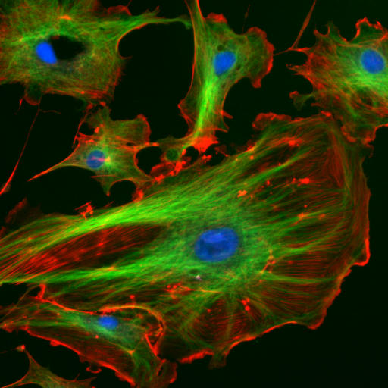
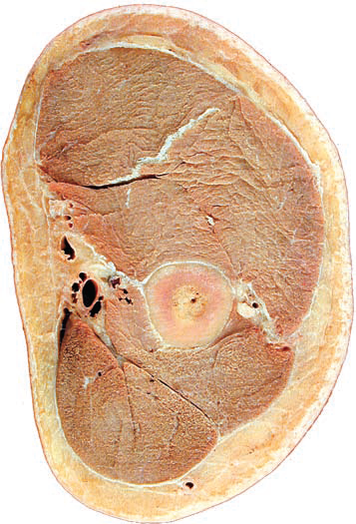
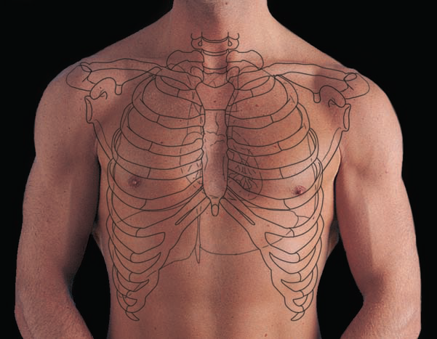
Human embryo, 4 weeks old
A cell, seen under the microscope using special stains
Surface anatomy of the chest
Cross section of the arm
Fig.2: Other disciplines of anatomy.

Slide 6
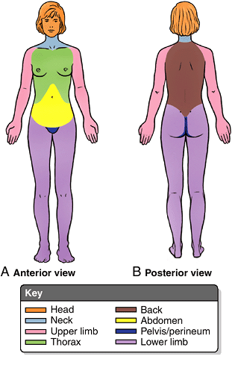
Fig.3: Major regions of the body.
How is anatomy studied:
Regional Anatomy:
Study of all the structures present in
a specific region of the body.
Major regions of the body:
Head
Neck
Thorax = Chest
Abdomen
Pelvis and perineum
Back
Upper limb = Shoulder girdle + Arm + Forearm + Hand
Lower limb = Pelvic girdle + Gluteal region+ Thigh + Leg + Foot
Trunk

Slide 7
Systemic Anatomy:
Study of all the structures that form a specific system in the body.
Body systems include:
Skeletal System:
Bones
Joints
and
Cartilage
Integumentary System:
Skin and its components
Muscular System:
Skeletal muscles

Slide 8
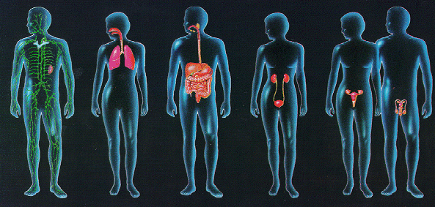
Lymphatic System:
Lymph nodes
Lymphatic
vessels
Spleen
Thymus
Lymph
Respiratory System:
Airway
passages
Lungs
Digestive System:
Mouth
Esophagus
Stomach
Intestines
Liver
Pancreas,…
Urinary System:
Kidneys
Ureters
Bladder
Urethra
Reproductive System:
Male and female internal and external reproductive organs

Slide 9
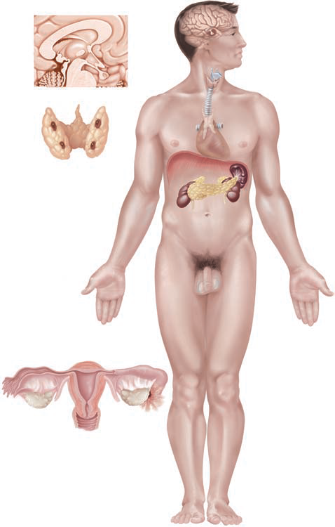
Cardiovascular System:
Heart
Blood vessels
Blood
Nervous System:
Brain
Spinal cord
Nerves
Special senses
Endocrine System
In systemic anatomy, any method used will involve the study of several regions of the body.

Slide 10
Structural levels of organization:
The human body can be seen to be organized at 6 levels. These levels range from the simplest and smallest to the most complex and largest.
These levels are: (Fig.4)
Chemical: This is the simplest level. It includes the atoms which are the building blocks of all matter. The most important atoms in the human body are oxygen, carbon, hydrogen, and Nitrogen. Two or more atoms unite to form molecules that could be small like water or large like DNA.
Cellular: Cells are the simplest structural and functional units of the body. Cells are formed of various molecules.

Slide 11
Tissue level: Several cells come together with some other materials surrounding them to form the various tissues of the body. A certain type of tissue performs a certain function. There are four basic body tissues: epithelial, connective, muscular and nervous.
Organ level: An organ is formed of several types of tissues. It has a specific shape and performs a specified function.
System level: A system consists of several organs that act together to perform certain functions. Example: the digestive system is formed of all the organs that help in the digestion and absorption of food.
Organism level: Each organism is formed of several systems that work together to ensure the survival of the organism.

Slide 12
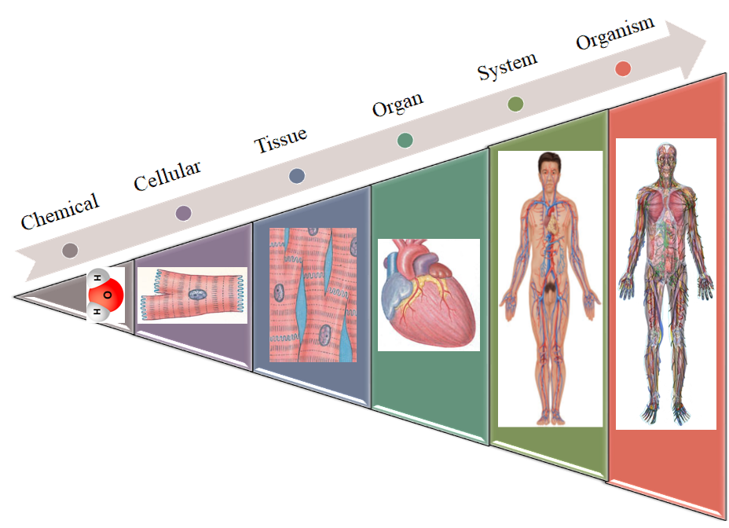
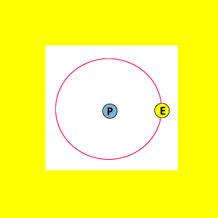
Fig.4*: The 6 levels of structural organization.

Slide 13
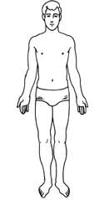
Anatomical Position:*
In order to understand the position of a structure and the positional relationship between structures, a position of reference must be used. This reference position is called the Standard Anatomical Position.
(2) | The head is level with eyes facing forward
In this position:
(1) | The subject stands erect
(3) | Upper limbs at the sides and the palms facing forward
(4) | Feet level on the ground and directed forward

Slide 14
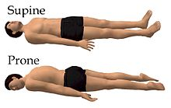
When the person is lying down, he’s either in a prone position (on his belly) or in a supine position (on his back).
Face up
Face down

Slide 15
Anatomical Planes:
These are imaginary flat surfaces that pass through the body, region or organ and divide it into parts.
The anatomical planes are: (Fig.5)
Sagittal plane: is a vertical plane that divides the body, region or organ into right and left parts. If the plane passes through the midline of the body dividing it into equal halves, then it’s called a midsagittal or median plane. If the sagittal plane divides the body into unequal parts, then it’s called a parasagittal plane.

Slide 16
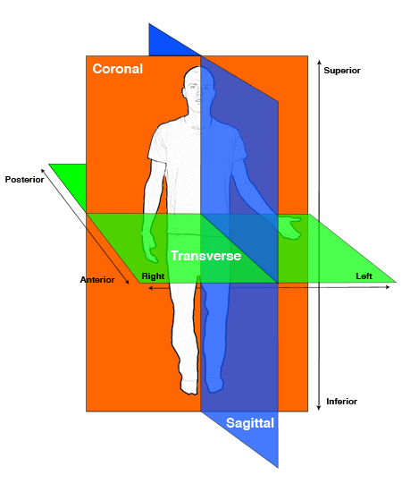
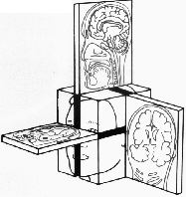
Sagittal
Transverse
Coronal
Fig.5: The anatomical planes.

Slide 17
Coronal (Frontal) plane: is the plane that divides the body, region or organ into front and back portions.
Transverse (Cross-sectional) plane: is the plane that divides the body, region or organ into upper and lower parts.
These planes are at right angles to each other. A plane that passes through the body or organ at an angle not 90º is called an oblique plane.

Slide 18
Directional Terms in Anatomy:
To appreciate the relative position of a structure, some directional terms are used in anatomy.
These terms only make sense when describing the position of a structure relative to another.
Term | Meaning
Anterior | Nearer to the front
Posterior | Nearer to the back
---------------------------------------------------------------------------------------
Superior | Above or higher in position; towards the head.
Inferior | Below or lower in position; towards the feet.

Slide 19
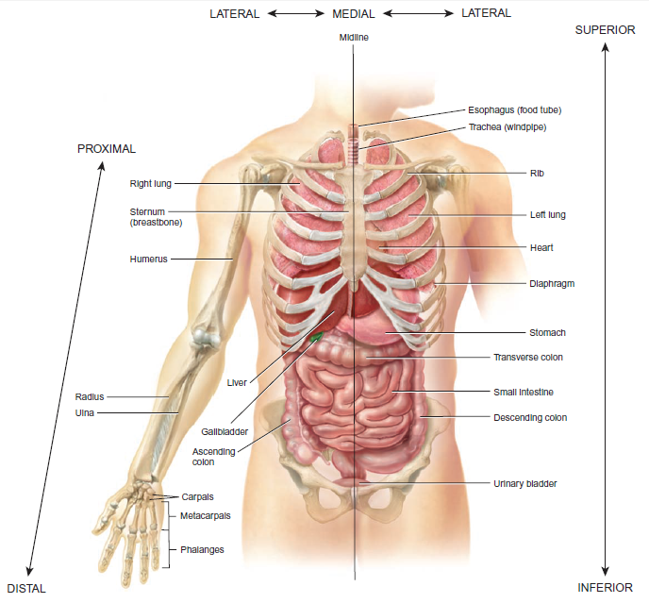
Fig.6: Directional Terms.

Slide 20
Term | Meaning
Lateral | Farther from the midline.
Medial | Nearer to the midline.
Median | In the median plane of the body.
---------------------------------------------------------------------------------------
Proximal | Nearer to the attachment of a limb to the trunk; nearer to the origination of a structure.
Distal | Farther from the attachment of a limb to the trunk; farther from the origination of a structure.
---------------------------------------------------------------------------------------
Ipsilateral | On the same side of the body’s midline as another structure.
Contralateral | On the opposite side of the body’s midline from another structure.

Slide 21
Term | Meaning
Superficial | Closer to or on the surface of the body.
Deep | Away from the surface of the body.
----------------------------------------------------------------------------------
Cranial or Cephalic | Relating to the skull or head; towards the head (in humans = superior).
Caudal | Relating to the tail; at or near the tail (in humans = inferior).
----------------------------------------------------------------------------------
Ventral | Towards the belly (in humans = anterior)
Dorsal | Towards the back (in humans = posterior)
Mostly used in embryology and animals

Slide 22
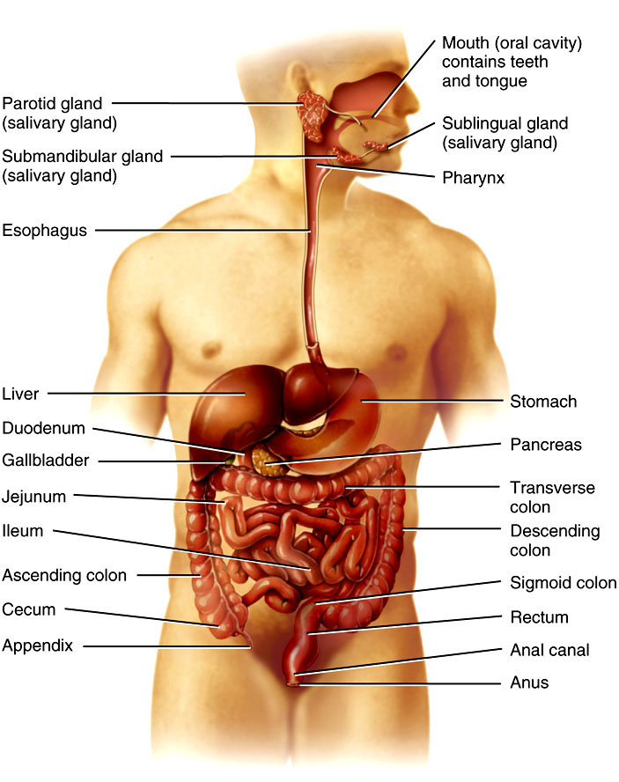
Fig.7: The Digestive system. Note that the Cecum is ipsilateral to the ascending colon and contralateral to the descending colon.

Slide 23
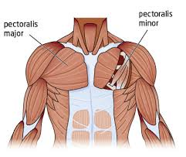
Fig.8: Muscles of chest wall. On the right side we can see the pectoralis major muscle. On the left side, a part of the pectoralis major was removed to show the pectoralis minor muscle. The pectoralis major muscle is superficial to the pectoralis minor. (Pectoralis major is also anterior to the pectoralis minor).

Slide 24
Abdominopelvic Regions:
The abdomen and pelvis are divided into regions to facilitate the description of the position of various organs.
Two methods are used: the 4-quadrant method and the 9-region method.
In the 4-quadrant method, two lines are used to divide the abdomen into 4 quadrants. These lines are the midsagittal line and the transverse umbilical line (pass through the umbilicus). These lines meet at the umbilicus.

Slide 25
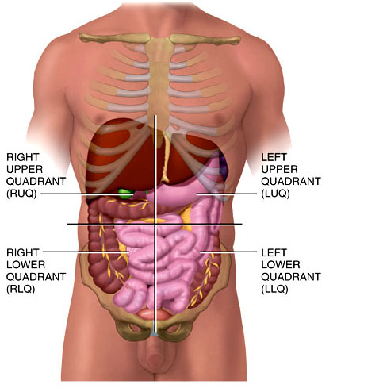
Midsagittal line
Transverse umbilical line
Fig.9: The 4 quadrants of the abdomen.

Slide 26
In the 9-region method, 2 vertical and 2 transverse lines divide the abdomen into 9 regions.
The upper transverse (subcostal) line is drawn just inferior to the lateral margins of the ribcage.
The lower transverse (transtubercular) line intersects the right and left iliac tubercles.
The two vertical lines are the right and left midclavicular lines. These pass through the middle of the right and left clavicles just medial to the nipples.

Slide 27
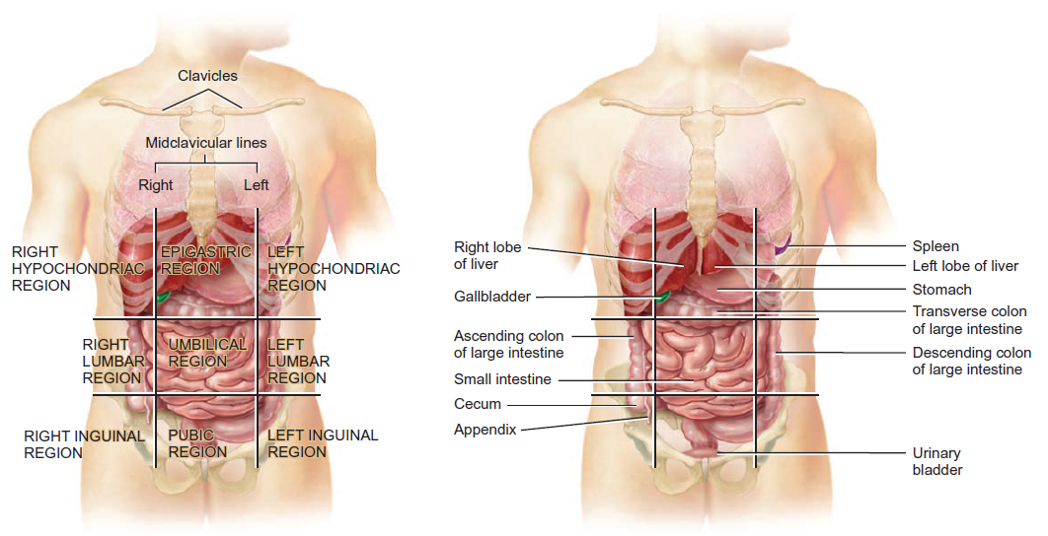
Fig.10*: The 9 regions of the abdomen and the organs they contain.

