Slide 1
Behavioral Finance
Materials collected from:
Fundamental of Corporate Finance by Ross, Westfield and Jordan
Essentials of Investment by Bodie, Kane and Marcus
Others

Slide 2
Why Behavioral Finance?
If we always behaved rationally…
Nobody would ever sell stocks in a panic at the first sign of trouble
Nobody would ever buy stocks (or other investments) based on hunches, hot tips or media hype
Nobody would ever keep money in the bank instead of using it to pay off high-interest credit card balances

Slide 3
What is Behavioral Finance?
Behavioral Finance provides an ‘overlay’ to the Standard Theory.
Theory It provides a framework to understand ‘non-rational’ investor and market behaviors…

Slide 4
What is Behavioral Finance?
Investors
Are not totally rational
Often act based on imperfect information
Make “non-rational” decisions in predictable ways
A suboptimal result in an investment decision can stem from one of two issues:
You made a good decision, but an unlikely negative event occurred
You simply made a bad decision (i.e., cognitive error)

Slide 5
What is Behavioral Finance
Markets
May be difficult to beat in the long term
In the short term, there are anomalies and excesses

Slide 6
What is Behavioral Finance
Behavioral Finance is the study of influence of psychology on the financial decision making and it argues that the emotions of and mental errors cause the Mispricing.
Behaviorisms argue that emotions and sentiment play a crucial role in determining the behavior of investors in the market place and very often they act irrationally due to influence of psychological factor.

Slide 7
In Favor of Behavioral Finance
Behavioral Finance is considered more Realistic
as psychological foundation increases explanatory power of financial models increases.
Solves empirical puzzles of traditional finance, it is a new approach to traditional finance

Slide 8
In Favor of Behavioral Finance
Financial market model emphasizing potential implications of psychological factors affecting investor behavior
Existence of irrational investors is not sufficient to reduce capital markets inefficient

Slide 9
Information Processing Error
Errors in information processing leads investors to misestimate the true probabilities of possible events or the associated rates of returns. The following are some of the biases causing information processing errors:

Slide 10
Information Processing Error
Forecasting errors
People overvalue recent experience compared to prior belief when forecasting.
De Bondt and Thaler (1990) P/E example.
Overconfidence
People overestimate precision of beliefs or forecasts, and overestimate abilities
Barber and Oden (2001) trading is hazardous to your wealth example

Slide 11
Information Processing Error
Conservatism bias
Investors too slow in updating beliefs in response to recent evidence
Sample size neglect and representativeness
People prone to believe small sample is representative of population, infer patterns too quickly
Chopra, Lakonishok and Ritter (1992) example

Slide 12
Behavioral Biases
Even if information processing were perfect, individuals may tend to make irrational decision using that information. This is due to;
Framing
Decisions affected by how choices are modeled, i.e. gains relative to low baseline level or losses relative to higher baseline

Slide 13
Behavioral Biases
Mental accounting
Form of framing; people separate certain decisions
Regret avoidance
People blame themselves for unconventional choices that turn out badly, avoid regret by making conventional decisions

Slide 14
Prospect Theory
Prospect theory
Investor utility depends on gains/losses from starting position, rather than levels of wealth

Slide 15
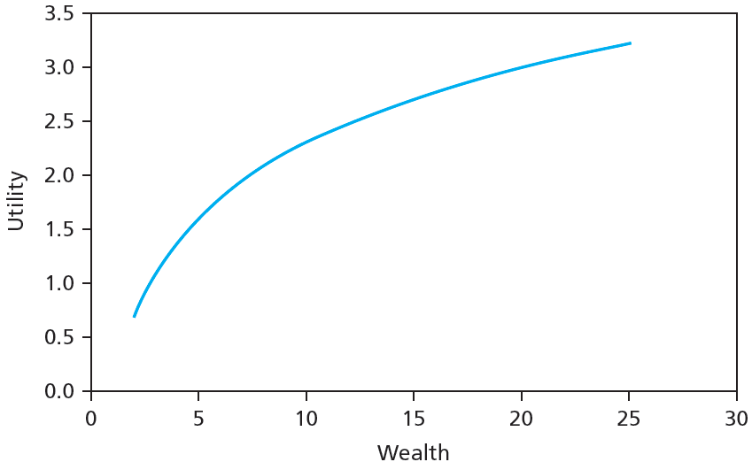
A Conventional Utility Function

Slide 16
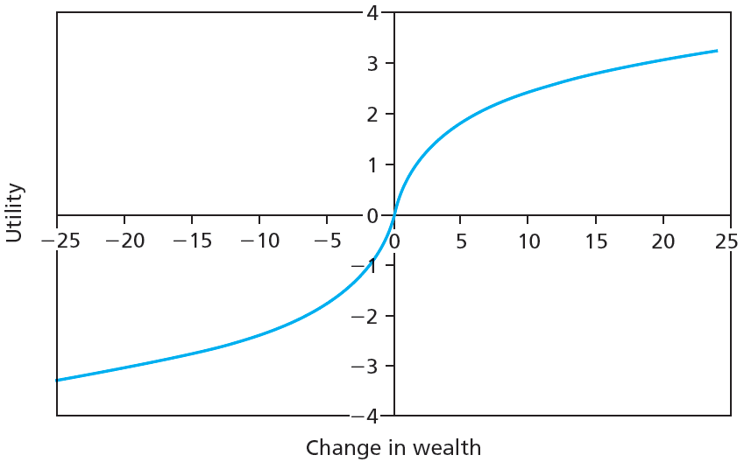
Utility Function under Prospect Theory

Slide 17
Prospect Theory
Limits to Arbitrage
Behavioral biases would not matter for stock pricing if rational arbitrageurs could fully exploit the mistakes of behavioral investors. (a claim of traditional finance)
Behaviorisms, in practice several factors limit the ability to profit from mispricing (Fundamental risk, Implementation costs, Model risk)

Slide 18
Prospect Theory
Fundamental risk
Market changes or irrationality can eliminate profits
Implementation costs
Exploiting overpricing is difficult; costs and time limits can eliminate profits
Model risk
Inaccurate models generate inaccurate stock values

Slide 19
Behavioral Critique
Bubbles and Behavioral Economics
Evidence of irrational investor behavior
Easier to identify once over
Evaluating Behavioral Critique
No coherent theory
Most empirical support from one time period: late ‘90s

Slide 20
Technical Analysis and Behavioral Finance
Trends and Corrections
Moving average
Average price over given interval, interval updated over time
Attempts to identify underlying price directions

Slide 21
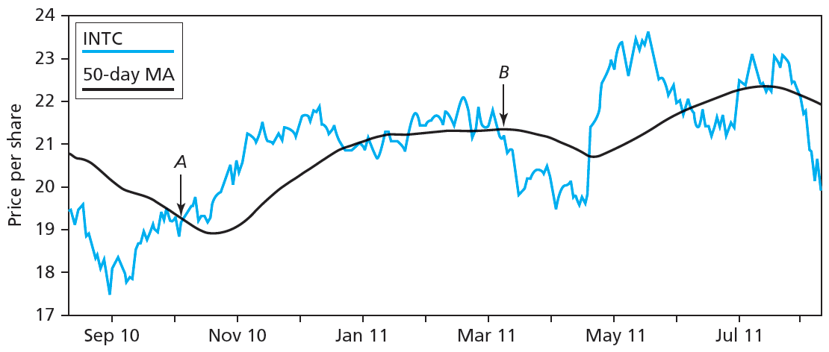
Figure 9.3 Share Price, 50-Day Moving Average for Intel

Slide 22
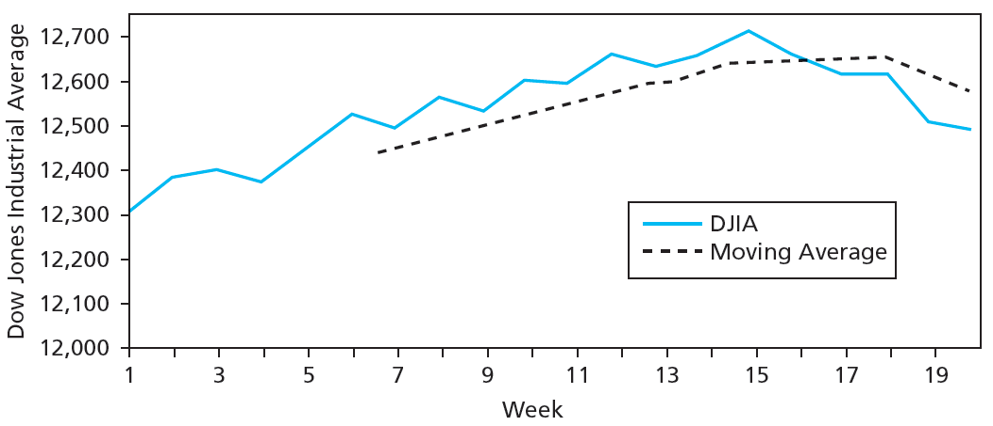
Figure 9.4 Moving Averages

Slide 23
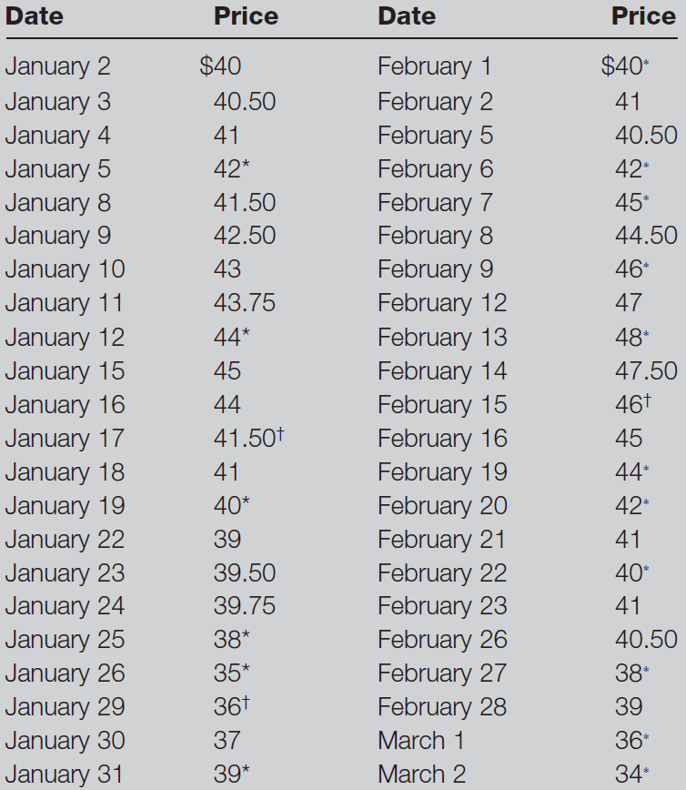
Table 9.1 Stock Price History

Slide 24
9.2 Technical Analysis and Behavioral Finance
Trends and Corrections
Point and figure charts
Traces significant upward/downward movements in prices without regard to timing
X denotes price increase, O denotes decrease
Sell/Buy signals generated when stock penetrates previous lows/highs
Congestion area: Horizontal band of Xs/Os created by price reversals

Slide 25
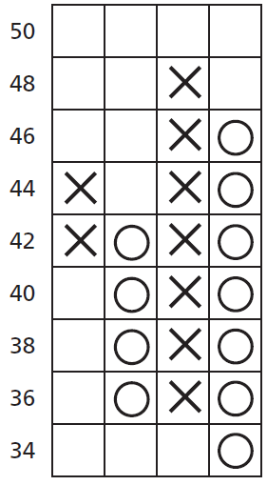
Figure 9.5 Point and Figure Chart for Table 9.1

Slide 26
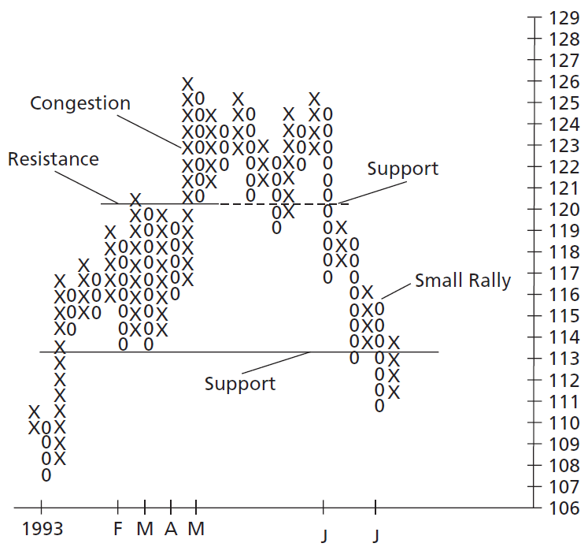
Figure 9.6 Point and Figure Chart for Atlantic Richfield

Slide 27
9.2 Technical Analysis and Behavioral Finance
Trends and Corrections
Breadth
Extent to which broad market index movements affect individual stock prices
Relative Strength
Recent performance of given stock/industry compared to that of broad market index

Slide 28
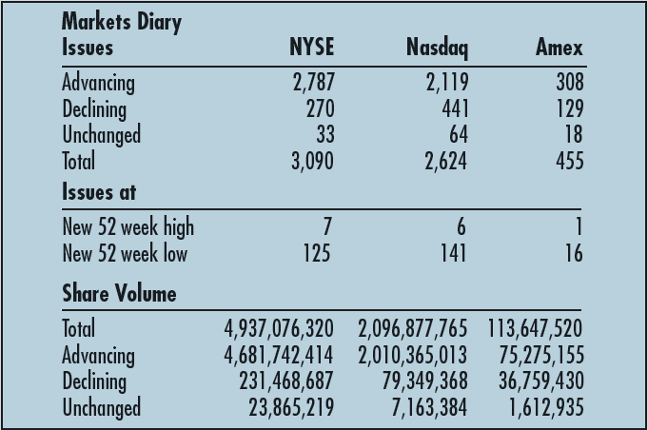
Figure 9.7 Market Diary

Slide 29
Table 9.2 Breadth

Slide 30
9.2 Technical Analysis and Behavioral Finance
Sentiment Indicators
Trin statistic
Ratio of average volume in declining issues to average volume in advancing issues
Confidence index
Ratio of top-rated corporate bond yield to intermediate-grade bond yield

Slide 31
9.2 Technical Analysis and Behavioral Finance
Sentiment Indicators
Short interest
Total number of shares currently short-sold in market
Put/call ratio
Ratio of put options to call options outstanding on stock

Slide 32
9.2 Technical Analysis and Behavioral Finance
A Warning
People perceive patterns where none exist
Data mining generates apparent patterns within limited data sets
When evaluating rules, ask whether rule would be reasonable before looking at data

Slide 33
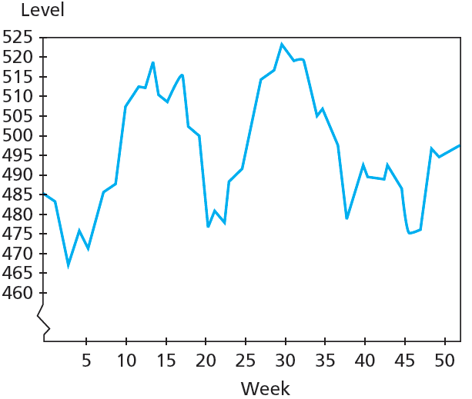
Figure 9.8A Actual Stock Price Levels, 52 Weeks

Slide 34
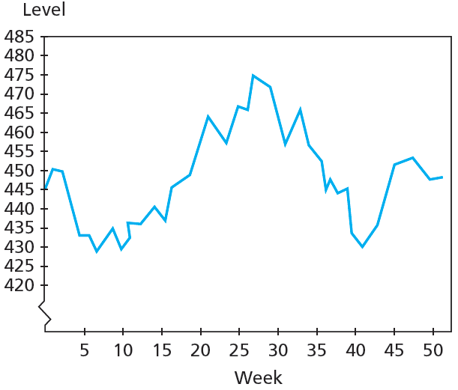
Figure 9.8B Simulated Stock Price Levels, 52 Weeks

Slide 35
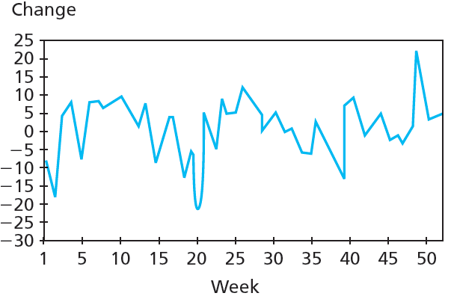
Figure 9.9A Actual Weekly Stock Price Changes, 52 Weeks

Slide 36
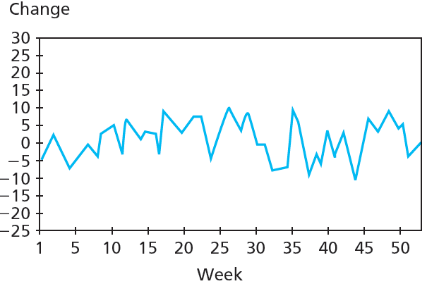
Figure 9.9B Simulated Weekly Stock Price Changes, 52 Weeks

