Slide 1
Equity Valuation
13
Bodie, Kane, and Marcus
Essentials of Investments, 9th Edition

Slide 2
13.1 Equity Valuation
Book Value
  Net worth of common equity according to a firm’s balance sheet
Limitations of Book Value
  Liquidation value: Net amount realized by selling assets of firm and paying off debt
  Replacement cost: Cost to replace firm’s assets
  Tobin’s q: Ratio of firm’s market value to replacement cost

Slide 3
Table 13.1 Microsoft Financial Highlights, Jan 2012
Price per share | $28.25
Common shares outstanding (billion) | 8.41
Market capitalization ($ billion) | 237.6
Latest 12 Months
Sales ($ billion) | 71.12
EBITDA ($ billion) | 30.15
Net income ($ billion) | 23.48
Earnings per share | $2.75
Valuation | Microsoft | Industry Avg
P/E ratio | 10.3 | 17.5
Price/Book | 4.0 | 10.5
Price/Sales | 3.3 | 2.7
Price/Cash flow | 13.9 | 20.5
PEG | 1.1 | 1.2
Profitability
ROE (%) | 44.16 | 24.9
ROA (%) | 17.33
Operating profit margin (%) | 38.78 | 8.58
Net profit margin (%) | 33.01 | 23.2

Slide 4
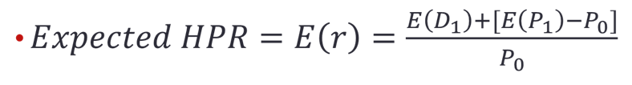



13.2 Intrinsic Value versus Market Price
= expected dividend per share
= current share price
= expected end-of-year price

Slide 5
13.2 Intrinsic Value versus Market Price
Intrinsic Value
  Present value of firm’s expected future net cash flows discounted by required RoR
Market Capitalization Rate
  Market-consensus estimate of appropriate discount rate for firm’s cash flows

Slide 6
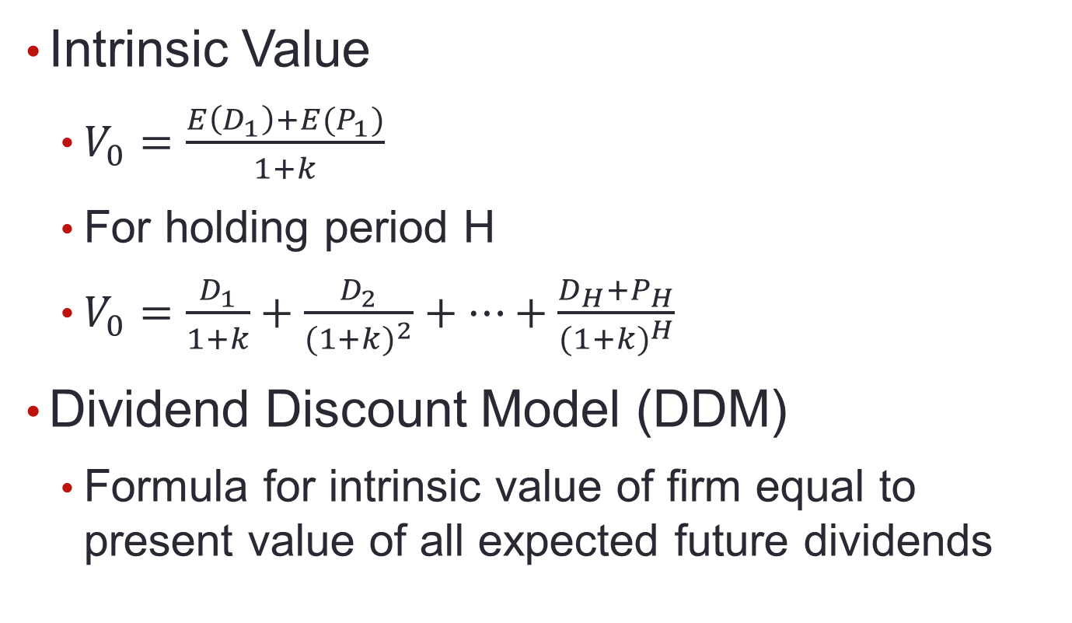
13.2 Intrinsic Value versus Market Price

Slide 7
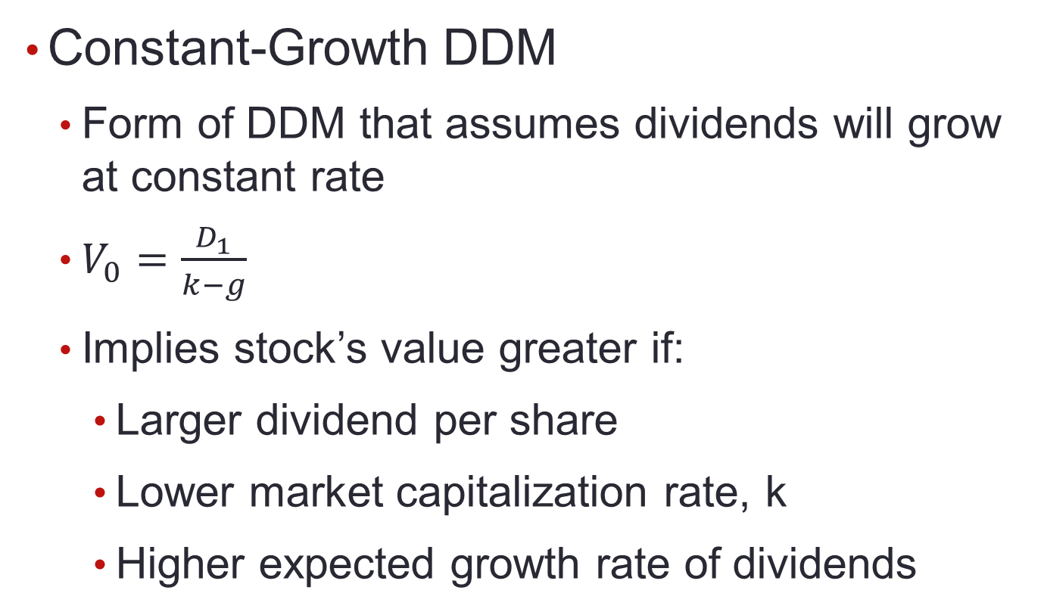
13.3 Dividend Discount Models

Slide 8
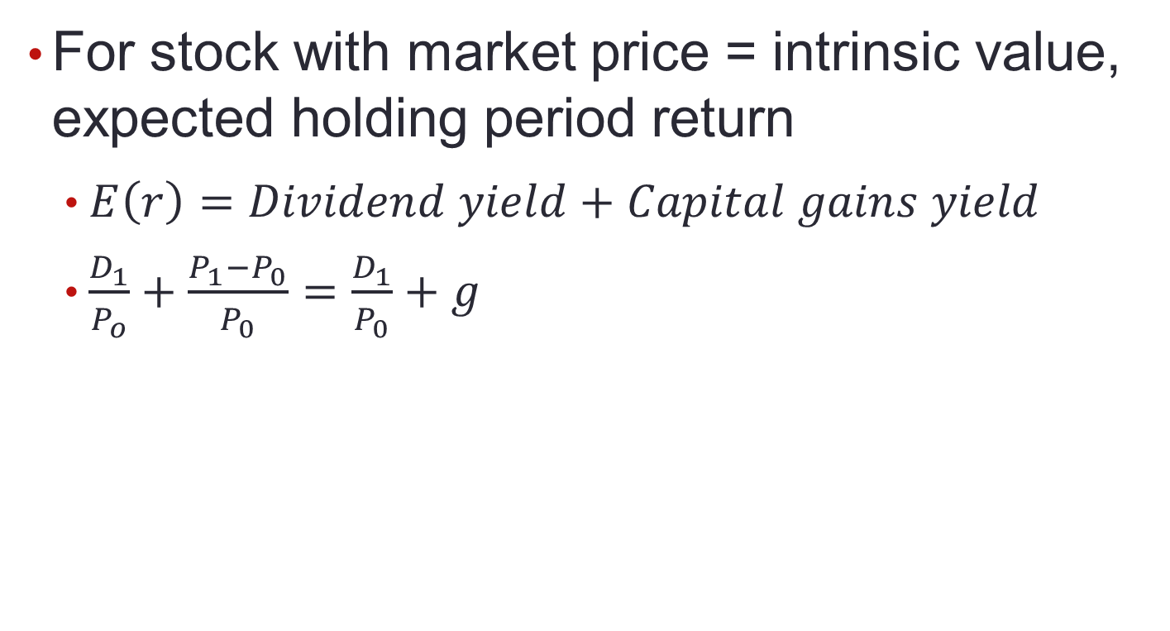
13.3 Dividend Discount Models

Slide 9
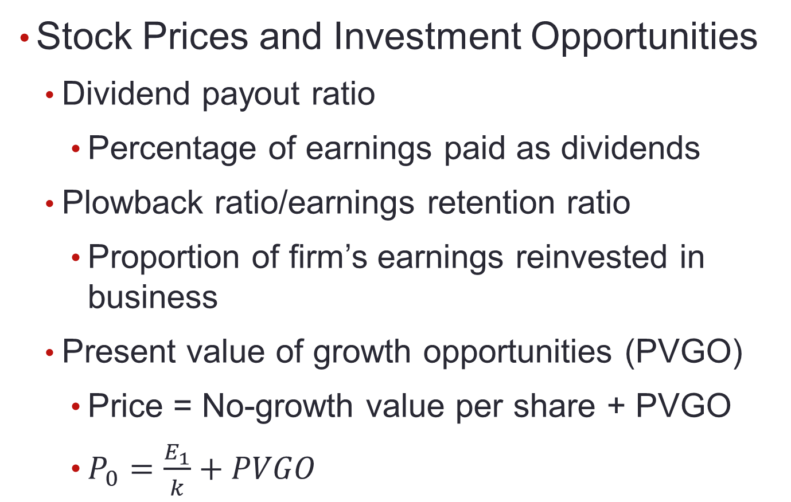
13.3 Dividend Discount Models

Slide 10
13.3 Dividend Discount Models
Life Cycles and Multistage Growth Models
  Two-stage DDM
    DDM in which dividend growth assumed to level off only at future date
Multistage Growth Models
  Allow dividends per share to grow at several different rates as firm matures

Slide 11
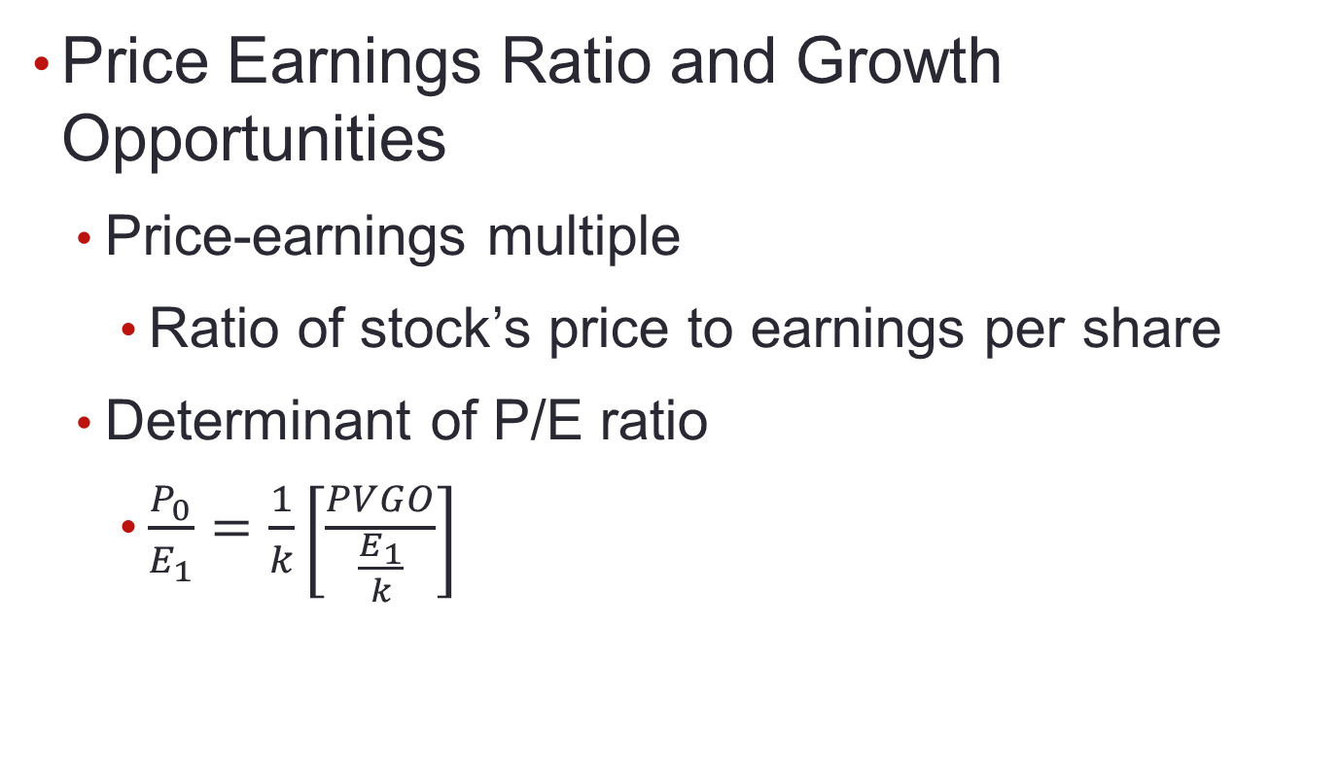
13.4 Price-Earnings Ratios

Slide 12
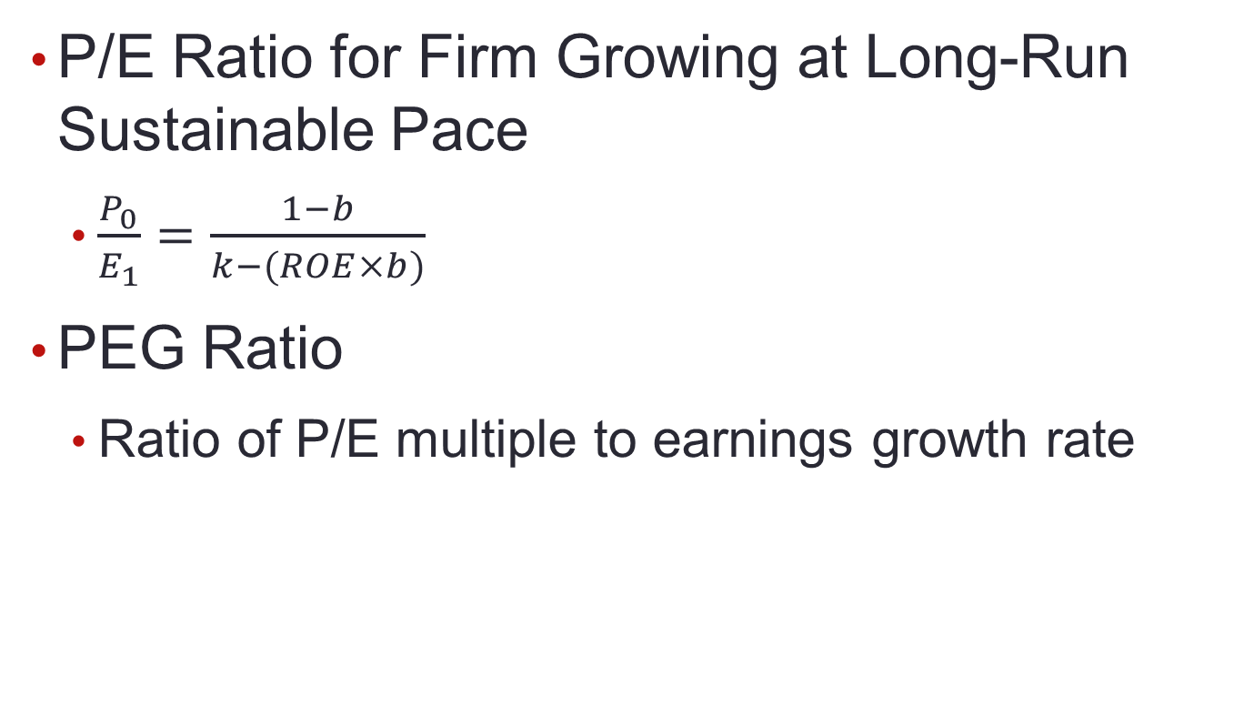
13.4 Price-Earnings Ratios

Slide 13
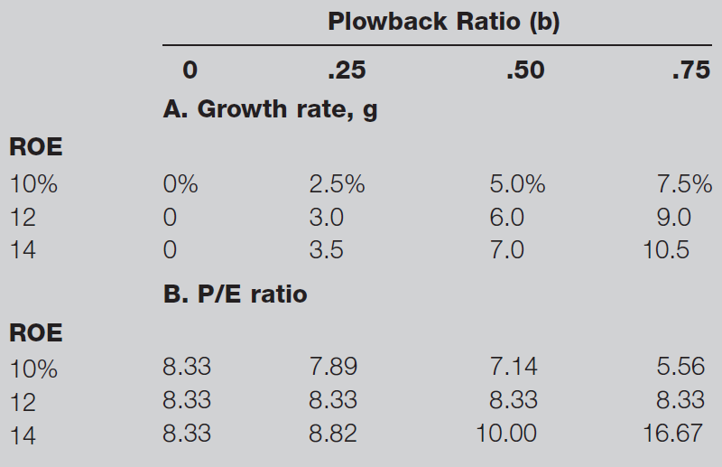
Table 13.3 Effect of ROE and Plowback on Growth and P/E Ratio

Slide 14
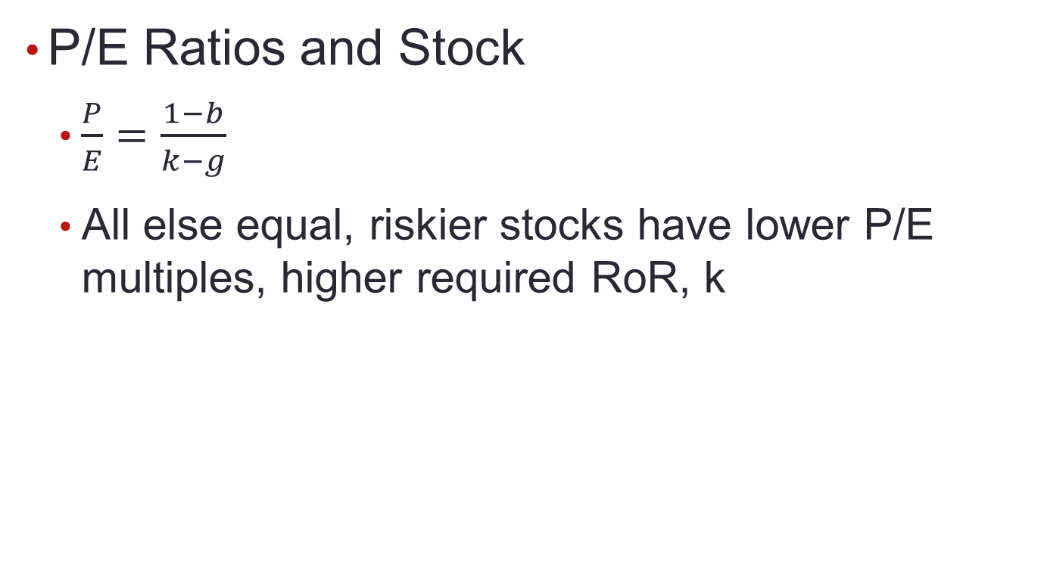
13.4 Price-Earnings Ratios

Slide 15
Figure 13.3 P/E Ratio of S&P 500 and Inflation

Slide 16
13.4 Price-Earnings Ratios
Pitfalls in P/E Analysis
  Earnings Management
    Practice of using flexibility in accounting rules to improve apparent profitability of firm
    Large amount of discretion in managing earnings

Slide 17
Figure 13.4 Earnings Growth for Two Companies

Slide 18
Figure 13.5 Price-Earnings Ratios

Slide 19
Figure 13.6 P/E Ratios

Slide 20
13.4 Price-Earnings Ratios
Combining P/E Analysis and the DDM
  Estimates stock price at horizon date
Other Comparative Valuation Ratios
  Price-to-book: Indicates how aggressively market values firm
  Price-to-cash-flow: Cash flow less affected by accounting decisions than earnings
  Price-to-sales: For start-ups with no earnings

Slide 21
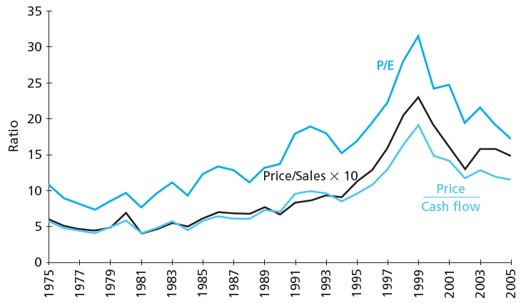
Figure 13.7 Valuation Ratios for S&P 500

Slide 22
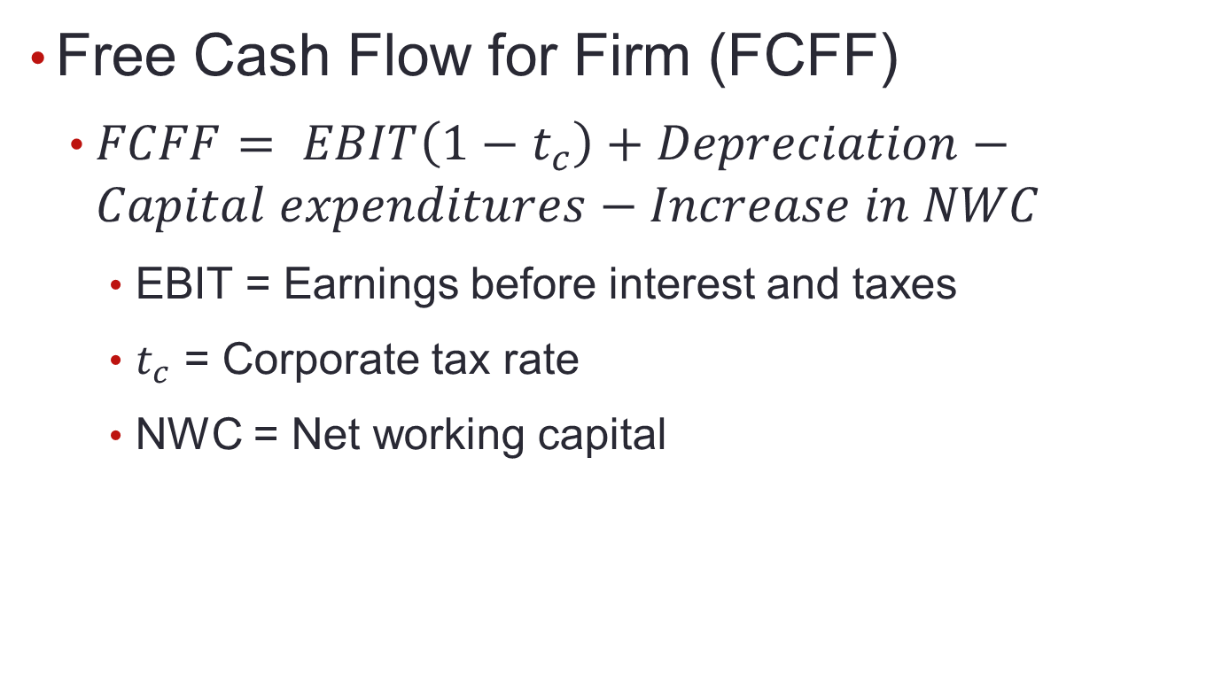
13.5 Free Cash Flow Valuation Approaches

Slide 23
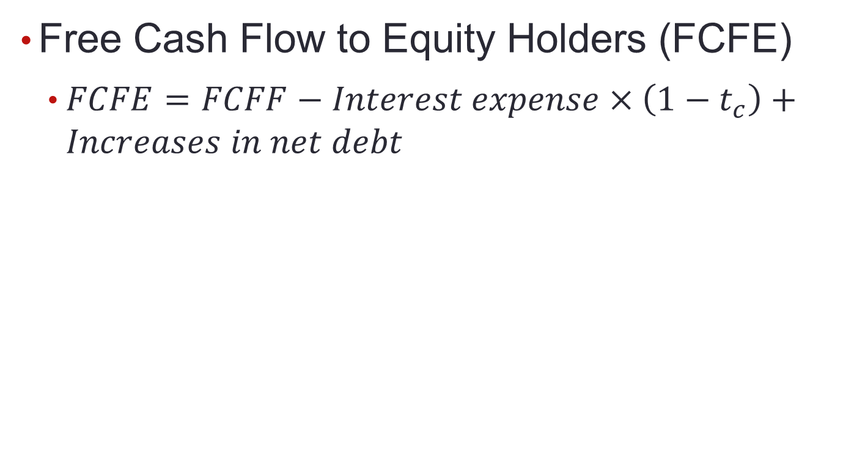
13.5 Free Cash Flow Valuation Approaches

Slide 24
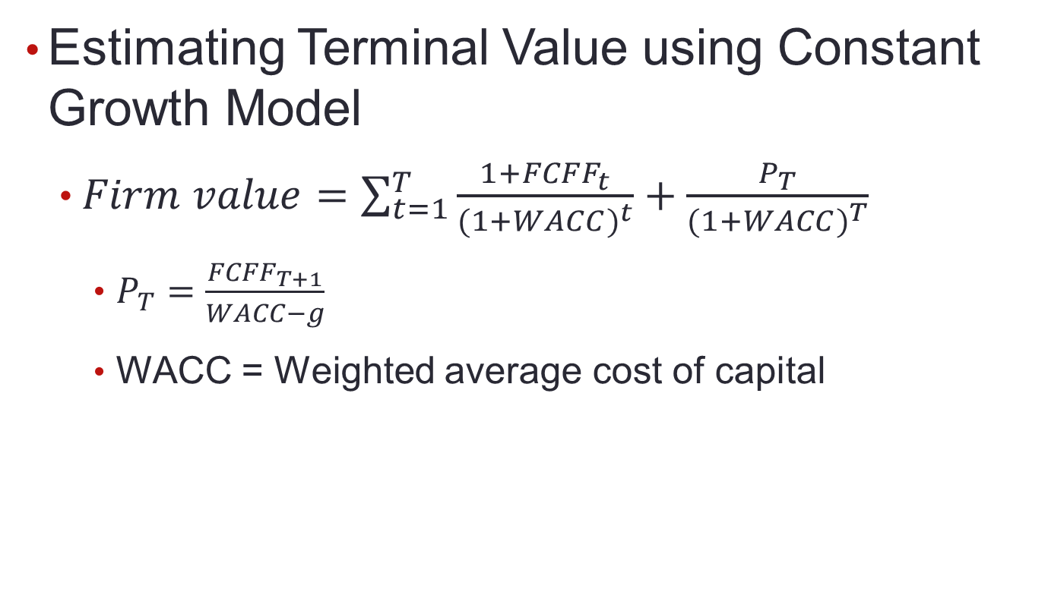
13.5 Free Cash Flow Valuation Approaches

Slide 25
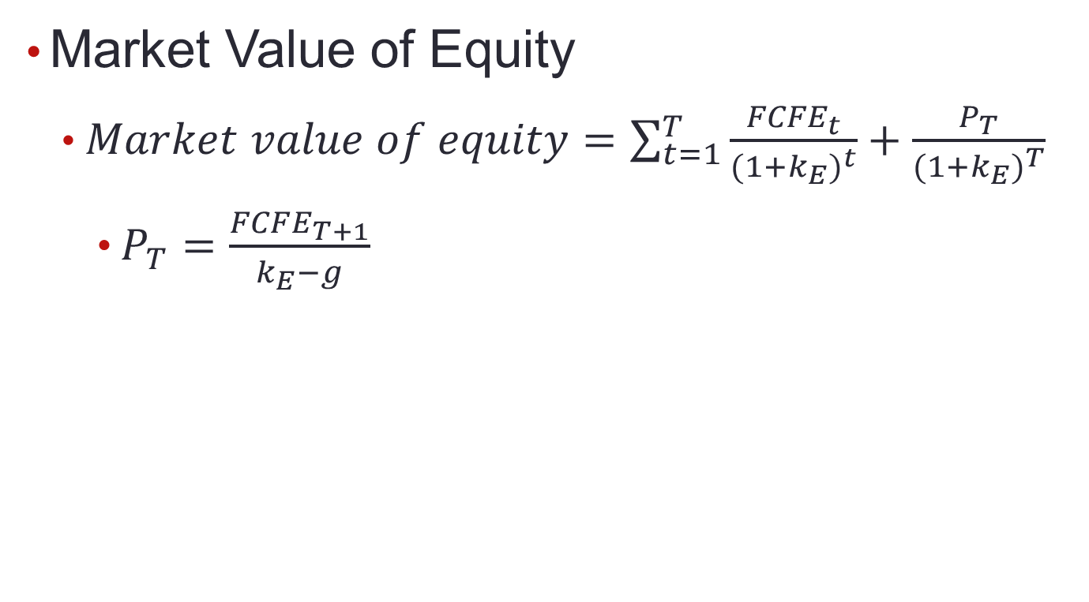
13.5 Free Cash Flow Valuation Approaches

Slide 26
Spreadsheet 13.2
 |  |  |  |  |  |  | Terminal value
FCFF |  |  | -521.0 | 5200.3 | 5444.8 | 5689.4 | 106504.6
FCFE |  |  | 1160.0 | 2760.1 | 3050.2 | 3340.3 | 85210.4 |  | assumes fixed debt ratio after 2015
C. Discount rate calculations
Current beta | 0.9 |  |  |  |  |  |  |  | from Value Line
Unlevered beta | 0.686 |  |  |  |  |  |  |  | current beta /[1 + (1-tax)*debt/equity)]
terminal growth | 0.025
tax_rate | 0.35 |  |  |  |  |  |  |  | from Value Line
r_debt | 0.042 |  |  |  |  |  |  |  | YTM in 2012 on A+ rated LT debt
risk-free rate | 0.029
market risk prem | 0.08
MV equity |  | 57420 |  |  |  | 100940 |  |  | Row 3 x Row 11
Debt/Value |  | 0.32 | 0.29 | 0.26 | 0.23 | 0.20 |  |  | linear trend from initial to final value
Levered beta |  | 0.900 | 0.871 | 0.844 | 0.819 | 0.797 |  |  | unlevered beta x [1 + (1-tax)*debt/equity]
k_equity |  | 0.101 | 0.099 | 0.097 | 0.095 | 0.093 | 0.093 |  | from CAPM and levered beta
WACC |  | 0.077 | 0.078 | 0.078 | 0.079 | 0.080 | 0.080 |  | (1-t)*r_debt*D/V + k_equity*(1-D/V)
PV factor for FCFF |  | 1.000 | 0.928 | 0.860 | 0.797 | 0.738 | 0.738 |  | Discount each year at WACC
PV factor for FCFE |  | 1.000 | 0.910 | 0.830 | 0.758 | 0.694 | 0.694 |  | Discount each year at k_equity
D. Present values |  |  |  |  |  |  |  |  | Intrinsic val | Equity val | Intrin/share
PV(FCFF) |  |  | -483 | 4474 | 4341 | 4201 | 78641 |  | 91174 | 63674 | 35.37
PV(FCFE) |  |  | 1056 | 2291 | 2313 | 2318 | 59136 |  | 67114 | 67114 | 37.29

Slide 27
13.5 Free Cash Flow Valuation Approaches
Comparing Valuation Models
  Model values differ in practice
  Differences stem from simplifying assumptions
Problems with DCF Models
  DCF estimates are always somewhat imprecise
  Investors employ hierarchy of valuation
    Real estate, plant, equipment
    Economic profit on assets in place
    Growth opportunities

Slide 28
13.6 The Aggregate Stock Market
Forecasting Aggregate Stock Market
  Earnings multiplier applied at aggregate level
    Forecast corporate profits for period
    Derive estimate of aggregate P/E ratio based on long-term interest rates
  Some analysts use aggregate DDM

Slide 29
Figure 13.8 Earnings Yield of S&P 500 versus 10-Year Treasury Bond Yield

Slide 30
Table 13.4 S&P 500 Forecasts
 | Pessimistic Scenario | Most Likely Scenario | Optimistic Scenario
Treasury bond yield | 3.6% | 3.1% | 2.6%
Earnings yield | 6.5% | 6.0% | 5.5%
Resulting P/E ratio | 15.4 | 16.7 | 18.2
EPS forecast | 93 | 93 | 93
Forecast for S&P 500 | 1431 | 1550 | 1691

