Slide 1
The Efficient Market Hypothesis
8
Bodie, Kane, and Marcus
Essentials of Investments, 9th Edition

Slide 2
8.1 Random Walks and Efficient Market Hypothesis
Random Walk
Notion that stock price changes are random
Efficient Market Hypothesis (EMH)
Prices of securities fully reflect available information

Slide 3
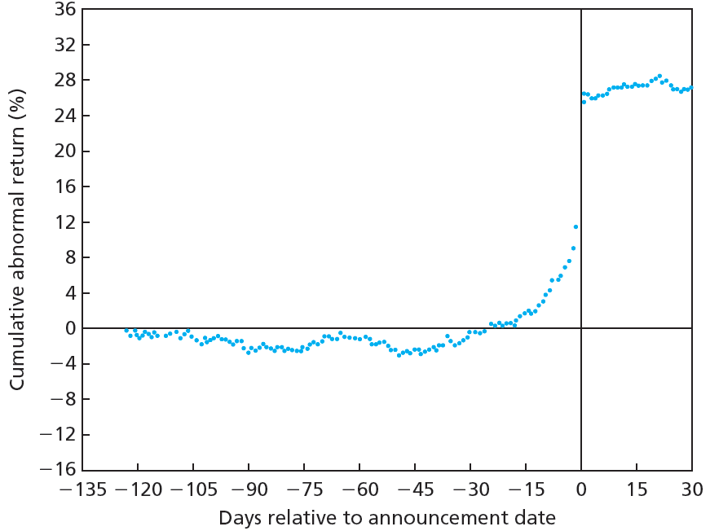
Figure 8.1 Cumulative Abnormal Returns before Takeover Attempts: Target Companies

Slide 4
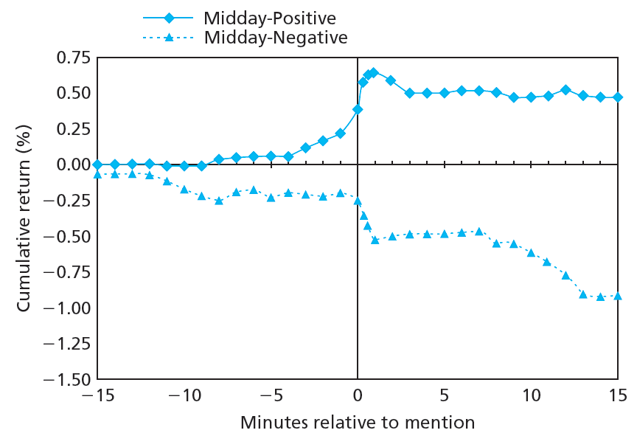
Figure 8.2 Stock Price Reaction to CNBC Reports

Slide 5
8.1 Random Walks and Efficient Market Hypothesis
Competition as Source of Efficiency
Investor competition should imply stock prices reflect available information
Investors exploit available profit opportunities
Competitive advantage can verge on insider trading

Slide 6
8.1 Random Walks and Efficient Market Hypothesis
Versions of EMH
Weak-form EMH
Stock prices already reflect all information contained in history of trading
Semistrong-form EMH
Stock prices already reflect all public information
Strong-form EMH
Stock prices already reflect all relevant information, including inside information

Slide 7
8.2 Implications of the EMH
Technical Analysis
Research on recurrent/predictable price patterns and on proxies for buy/sell pressure in market
Resistance Level
Unlikely for stock/index to rise above
Support Level
Unlikely for stock/index to fall below

Slide 8
Implications of the EMH
Fundamental Analysis
Research on determinants of stock value, i.e. earnings, dividend prospects, future interest rate expectations and firm risk
Assumes stock price equal to discounted value of expected future cash flow

Slide 9
Implications of the EMH
Active versus Passive Portfolio Management
Passive investment strategy
Buying well-diversified portfolio without attempting to find mispriced securities
Index fund
Mutual fund which holds shares in proportion to market index representation

Slide 10
8.2 Implications of the EMH
Role of Portfolio Management in Efficient Market
Active management assumes market inefficiency
Passive management consistent with semistrong efficiency
Inefficient market pricing leads to inefficient resource allocation

Slide 11
8.3 Are Markets Efficient?
Issues
Magnitude issue
Efficiency is relative, not binary
Selection bias issue
Investors who find successful investment schemes are less inclined to share findings
Observable outcomes preselected in favor of failed attempts
Lucky event issue
Lucky investments receive disproportionate attention

Slide 12
8.3 Are Markets Efficient?
Weak-Form Tests: Patterns in Stock Returns
Returns over short horizons
Momentum effect: Tendency of poorly- or well-performing stocks to continue abnormal performance in following periods
Returns over long horizons
Reversal effect: Tendency of poorly- or well-performing stocks to experience reversals in following periods

Slide 13
8.3 Are Markets Efficient?
Predictors of Broad Market Performance
1988—Fama and French: Return on aggregate stock market tends to be higher when dividend yield is low
1988—Campbell and Shiller: Earnings yield can predict market returns
1986—Keim and Stambaugh: Bond market data (spread between yields) can predict market returns

Slide 14
8.3 Are Markets Efficient?
Semistrong Tests: Market Anomalies
Anomalies
Patterns of returns contradicting EMH
P/E effect
Portfolios of low P/E stocks exhibit higher average risk-adjusted returns than high P/E stocks

Slide 15
8.3 Are Markets Efficient?
Semistrong Tests: Market Anomalies
Small-firm effect
Stocks of small firms can earn abnormal returns, primarily in January
Neglected-firm effect
Stock of little-known firms can generate abnormal returns
Book-to-market effect
Shares of high book-to-market firms can generate abnormal returns

Slide 16
8.3 Are Markets Efficient?
Semistrong Tests: Market Anomalies
Post-earnings announcement price drift
Sluggish response of stock price to firm’s earnings announcement
Abnormal return on announcement day, momentum continues past market price
Bubbles and market efficiency
Speculative bubbles can raise prices above intrinsic value
Even if prices are inaccurate, it can be difficult to take advantage of them

Slide 17
Figure 8.3 Average Annual Return: Ten Size-Based Portfolios, 1926-2010

Slide 18
Figure 8.4 Average Annual Return as Function of Book-to-Market Ratio, 1926-2010

Slide 19
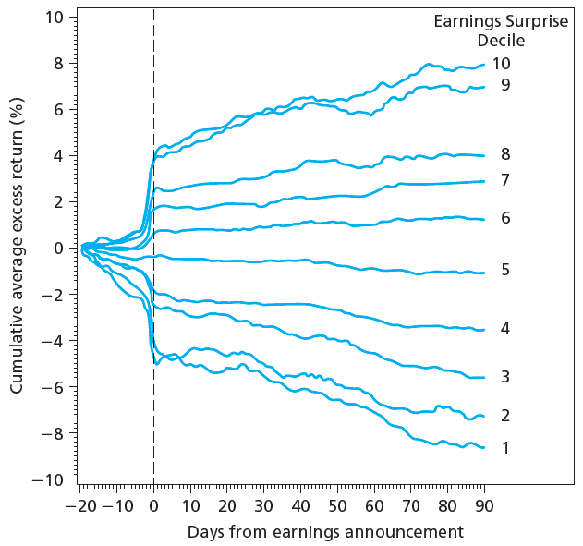
Figure 8.5 Cumulative Abnormal Returns after Earnings Announcements

Slide 20
8.3 Are Markets Efficient?
Interpreting Anomalies
Risk premiums or inefficiencies?
Fama and French: Market phenomena can be explained as manifestations of risk premiums
Lakonishok, Shleifer, and Vishny: Market phenomena are evidence of inefficient markets

Slide 21
8.3 Are Markets Efficient?
Interpreting Anomalies
Anomalies or data mining?
Some anomalies have not shown staying power after being reported
Small-firm effect
Book-to-market effect

Slide 22
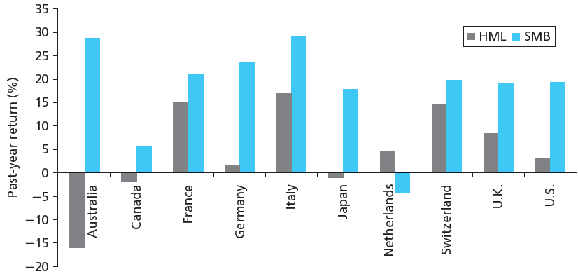
Figure 8.6 Return to Style Portfolio as Predictor of GDP Growth

Slide 23
8.4 Mutual Fund and Analyst Performance
Stock Market Analysis
Analysts are overly positive about firm prospects
Womack: Positive changes associated with 5% increase, negative with 11% decrease
Jegadeesh, Kim, Kristie, and Lee: Level of consensus is inconsistent predictor of future performance
Barber, Lehavy, McNichols, and Trueman: Firms with most-favorable recommendations outperform firms with least-favorable recommendations

Slide 24
8.4 Mutual Fund and Analyst Performance
Mutual Fund Managers
Today’s conventional model: Fama-French factors plus momentum factor
Wermers: Funds show positive gross alphas; negative net alphas after controlling for fees, risk
Carhart: Minor persistence in relative performance across managers, largely due to expense/transaction costs

Slide 25
8.4 Mutual Fund and Analyst Performance
Mutual Fund Managers
Berk and Green: Skilled managers with abnormal performance will attract new funds until additional cost, complexity drives alphas to zero
Chen, Ferson, and Peters: On average, bond mutual funds outperform passive bond indexes in gross returns, underperform once fees subtracted

Slide 26
8.4 Mutual Fund and Analyst Performance
Mutual Fund Managers
Kosowski, Timmerman, Wermers, and White: Stock-pricing ability of minority of managers sufficient to cover costs; performance persists over time
Samuelson: Records of most managers show no easy strategies for success

Slide 27
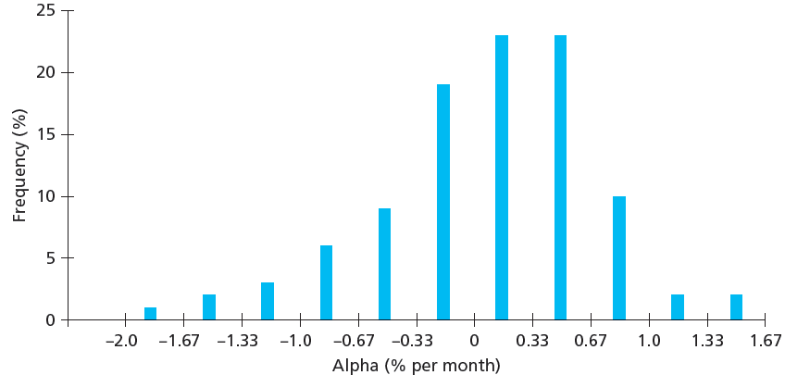
Figure 8.7 Mutual Fund Alphas Computed Using Four-Factor Model, 1993-2007

Slide 28
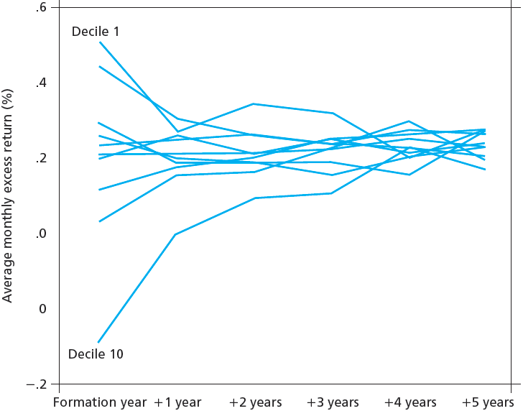
Figure 8.8 Persistence of Mutual Fund Performance

Slide 29
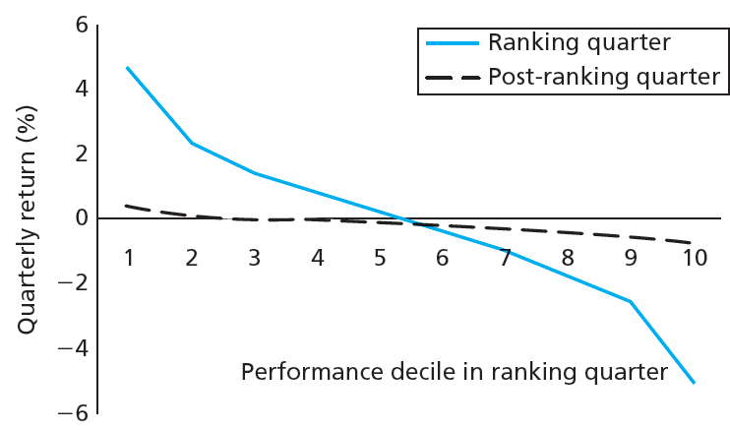
Figure 8.9 Risk-Adjusted Performance in Ranking Quarter, Following Quarter

Slide 30
8.4 Mutual Fund and Analyst Performance
So, Are Markets Efficient?
Enough that only differentially superior information will earn money
Professional manger’s margin of superiority likely too slight for statistical significance

