Slide 1
Risk and Return: Past and Prologue
5
Bodie, Kane, and Marcus
Essentials of Investments, 9th Edition

Slide 2
5.1 Rates of Return
Holding-Period Return (HPR)
Rate of return over given investment period
HPR= [PS − PB + CF] / PB
PS = Sale price
PB = Buy price
CF = Cash flow during holding period

Slide 3
5.1 Rates of Return
Measuring Investment Returns over Multiple Periods
Arithmetic average
Sum of returns in each period divided by number of periods
Geometric average
Single per-period return; gives same cumulative performance as sequence of actual returns
Compound period-by-period returns; find per-period rate that compounds to same final value
Dollar-weighted average return
Internal rate of return on investment

Slide 4
Table 5.1 Quarterly Cash Flows/Rates of Return of a Mutual Fund
 | 1st Quarter | 2nd Quarter | 3rd Quarter | 4th Quarter
Assets under management at start of quarter ($ million) | 1 | 1.2 | 2 | 0.8
Holding-period return (%) | 10 | 25 | −20 | 20
Total assets before net inflows | 1.1 | 1.5 | 1.6 | 0.96
Net inflow ($ million) | 0.1 | 0.5 | −0.8 | 0.6
Assets under management at end of quarter ($ million) | 1.2 | 2 | 0.8 | 1.56

Slide 5
5.1 Rates of Return
Conventions for Annualizing Rates of Return
APR = Per-period rate × Periods per year
1 + EAR = (1 + Rate per period)
1 + EAR = (1 + Rate per period)^{n} = (1 + )^{n}
APR = [(1 + EAR)^{1/n} – 1]^{n}
Continuous compounding: 1 + EAR = e^{APR}
APR
n

Slide 6
5.2 Risk and Risk Premiums
Scenario Analysis and Probability Distributions
Scenario analysis: Possible economic scenarios; specify likelihood and HPR
Probability distribution: Possible outcomes with probabilities
Expected return: Mean value of distribution of HPR
Variance: Expected value of squared deviation from mean
Standard deviation: Square root of variance

Slide 7
Spreadsheet 5.1 Scenario Analysis for the Stock Market

Slide 8
5.2 Risk and Risk Premiums

Slide 9
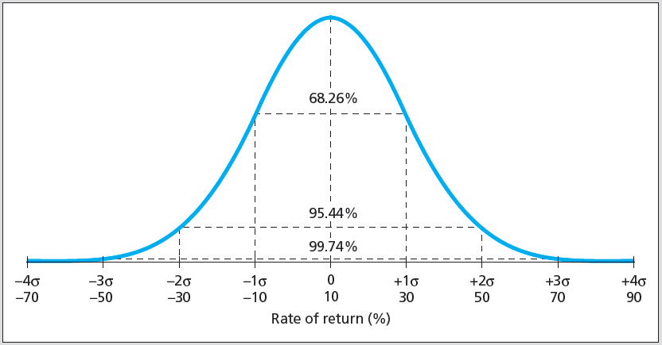
Figure 5.1 Normal Distribution with Mean Return 10% and Standard Deviation 20%

Slide 10
5.2 Risk and Risk Premiums
Normality over Time
When returns over very short time periods are normally distributed, HPRs up to 1 month can be treated as normal
Use continuously compounded rates where normality plays crucial role

Slide 11
5.2 Risk and Risk Premiums
Deviation from Normality and Value at Risk
Kurtosis: Measure of fatness of tails of probability distribution; indicates likelihood of extreme outcomes
Skew: Measure of asymmetry of probability distribution
Using Time Series of Return
Scenario analysis derived from sample history of returns
Variance and standard deviation estimates from time series of returns:

Slide 12
Figure 5.2 Comparing Scenario Analysis to Normal Distributions with Same Mean and Standard Deviation

Slide 13
5.2 Risk and Risk Premiums
Risk Premiums and Risk Aversion
Risk-free rate: Rate of return that can be earned with certainty
Risk premium: Expected return in excess of that on risk-free securities
Excess return: Rate of return in excess of risk-free rate
Risk aversion: Reluctance to accept risk
Price of risk: Ratio of risk premium to variance

Slide 14
5.2 Risk and Risk Premiums
The Sharpe (Reward-to-Volatility) Ratio
Ratio of portfolio risk premium to standard deviation
Mean-Variance Analysis
Ranking portfolios by Sharpe ratios

Slide 15
5.3 The Historical Record
World and U.S. Risky Stock and Bond Portfolios
World Large stocks: 24 developed countries, about 6000 stocks
U.S. large stocks: Standard & Poor's 500 largest cap
U.S. small stocks: Smallest 20% on NYSE, NASDAQ, and Amex
World bonds: Same countries as World Large stocks
U.S. Treasury bonds: Barclay's Long-Term Treasury Bond Index

Slide 16
Figure 5.4 Rates of Return on Stocks, Bonds, and Bills

Slide 17
5.4 Inflation and Real Rates of Return
Equilibrium Nominal Rate of Interest
Fisher Equation
R = r + E(i)
E(i): Current expected inflation
R: Nominal interest rate
r: Real interest rate

Slide 18
5.4 Inflation and Real Rates of Return
U.S. History of Interest Rates, Inflation, and Real Interest Rates
Since the 1950s, nominal rates have increased roughly in tandem with inflation
1930s/1940s: Volatile inflation affects real rates of return

Slide 19
Figure 5.5 Interest Rates, Inflation, and Real Interest Rates 1926-2010

Slide 20
5.5 Asset Allocation across Portfolios
Asset Allocation
Portfolio choice among broad investment classes
Complete Portfolio
Entire portfolio, including risky and risk-free assets
Capital Allocation
Choice between risky and risk-free assets

Slide 21
5.5 Asset Allocation across Portfolios
The Risk-Free Asset
Treasury bonds (still affected by inflation)
Price-indexed government bonds
Money market instruments effectively risk-free
Risk of CDs and commercial paper is miniscule compared to most assets

Slide 22
5.5 Asset Allocation Across Portfolios
Portfolio Expected Return and Risk
P: portfolio composition
y: proportion of investment budget
r_{f}: rate of return on risk-free asset
r_{p}: actual rate of return
E(r_{p}): expected rate of return
σ_{p}: standard deviation
E(r_{C}): return on complete portfolio
E(r_{C}) = yE(r_{p}) + (1 − y)r_{f}
σ_{C} = yσ_{rp} + (1 − y) σ_{rf}

Slide 23
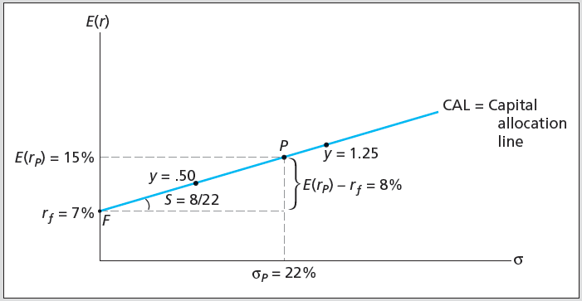
Figure 5.6 Investment Opportunity Set

Slide 24
5.5 Asset Allocation across Portfolios
Capital Allocation Line (CAL)
Plot of risk-return combinations available by varying allocation between risky and risk-free
Risk Aversion and Capital Allocation
y: Preferred capital allocation

Slide 25
5.6 Passive Strategies and the Capital Market Line
Passive Strategy
Investment policy that avoids security analysis
Capital Market Line (CML)
Capital allocation line using market-index portfolio as risky asset

Slide 26
Table 5.4 Excess Return Statistics for S&P 500
 | Excess Return (%)
 | Average | Std Dev | Sharpe Ratio | 5% VaR
1926-2010 | 8.00 | 20.70 | .39 | −36.86
1926-1955 | 11.67 | 25.40 | .46 | −53.43
1956-1985 | 5.01 | 17.58 | .28 | −30.51
1986-2010 | 7.19 | 17.83 | .40 | −42.28

Slide 27
5.6 Passive Strategies and the Capital Market Line
Cost and Benefits of Passive Investing
Passive investing is inexpensive and simple
Expense ratio of active mutual fund averages 1%
Expense ratio of hedge fund averages 1%-2%, plus 10% of returns above risk-free rate
Active management offers potential for higher returns

