Slide 1
Securities Markets
3
Bodie, Kane, and Marcus
Essentials of Investments, 9th Edition

Slide 2
3.1 How Firms Issue Securities
Primary vs. Secondary Market Security Sales
Primary
New issue created/sold
Key factor: Issuer receives proceeds from sale
Public offerings: Registered with SEC; sale made to investing public
Private offerings: Not registered; sold only to limited number of investors with restrictions on resale
Secondary
Existing owner sells to another party
Issuing firm doesn’t receive proceeds, is not directly involved

Slide 3
3.1 How Firms Issue Securities
Privately Held Firms
Up to 499 shareholders
Fewer obligations to release financial statements to public
Private placement: Primary offerings sold directly to a small group of investors

Slide 4
3.1 How Firms Issue Securities
Publicly Traded Companies
Sell securities to the general public; allow investors to trade shares in securities markets
Initial public offering: First sale of stock by a formerly private company
Underwriters: Purchase securities from issuing company and resell them
Prospectus: Description of firm and security being issued

Slide 5
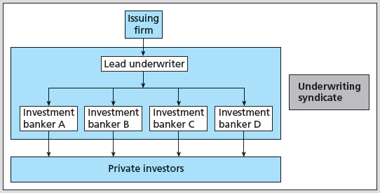
Figure 3.1 Relationship among a Firm Issuing Securities, the Underwriters, and the Public

Slide 6
3.1 How Firms Issue Securities
Shelf Registration
SEC Rule 415
Security is preregistered and then may be offered at any time within the next two years
24-hour notice: Any or all of preregistered amount may be offered
Introduced in 1982
Allows timing of issues

Slide 7
3.1 How Firms Issue Securities
Initial Public Offerings
Issuer and banker put on “road show”
Purpose: Bookbuilding and pricing
Underpricing
Post-initial sale returns average 10% or more—“winner’s curse” problem?
Easier to market issue; costly to issuing firm
Notes:
7

Slide 8
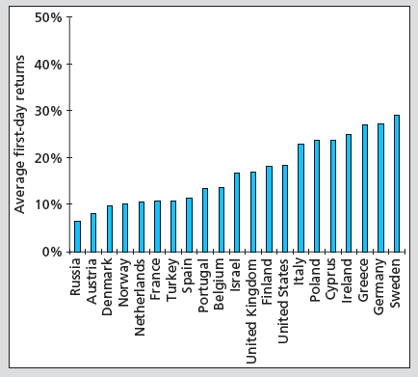
Figure 3.2 Average First-Day Returns for European IPOs

Slide 9
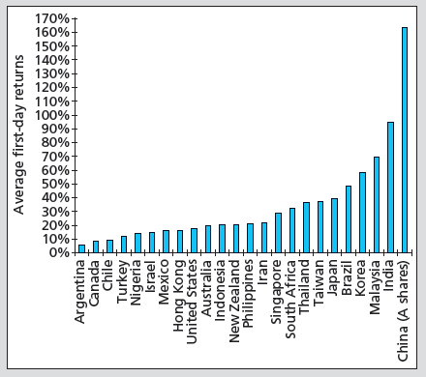
Figure 3.2 Average First-Day Returns for Non-European IPOs

Slide 10
3.2 How Securities Are Traded
Functions of Financial Markets
Overall purpose: Facilitate low-cost investment
Bring together buyers and sellers at low cost
Provide adequate liquidity by minimizing time and cost to trade and promoting price continuity
Set and update prices of financial assets
Reduce information costs associated with investing
Notes:
10

Slide 11
3.2 How Securities Are Traded
Types of Markets
Direct Search Markets
Buyers and sellers locate one another on their own
Brokered Markets
Third-party assistance in locating buyer or seller
Dealer Markets
Third party acts as intermediate buyer/seller
Auction Markets
Brokers and dealers trade in one location
Trading is more or less continuous

Slide 12
3.2 How Securities Are Traded
Types of Orders
Market order: Execute immediately at best price
Bid price: price at which dealer will buy security
Ask price: price at which dealer will sell security
Price-contingent order: Buy/sell at specified price or better
Limit buy/sell order: specifies price at which investor will buy/sell
Stop order: not to be executed until price point hit

Slide 13
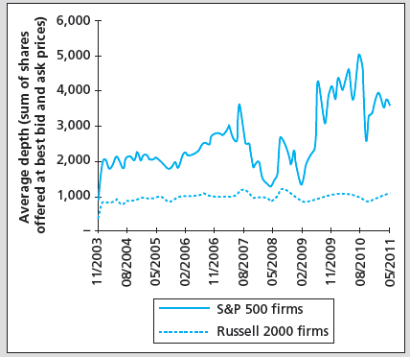
Figure 3.3 Average Market Depth for Large (S&P 500) and Small (Russel 2000) Firms

Slide 14
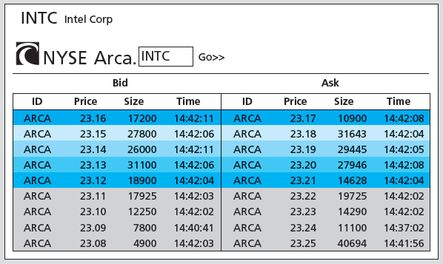
Figure 3.4 Limit Order Book for Intel on the NYSE Arca Market, July 22, 2011

Slide 15
3.2 How Securities Are Traded
Trading Mechanisms
Dealer markets
Over-the-counter (OTC) market: Informal network of brokers/dealers who negotiate securities sales
NASDAQ stock market: Computer-linked price quotation system for OTC market
Electronic communication networks (ECNs)
Computer networks that allow direct trading without market makers
Specialist markets
Specialist: Makes market in shares of one or more firms; maintains “fair and orderly market” by dealing personally

Slide 16
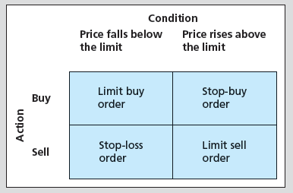
Figure 3.5 Price-Contingent Orders

Slide 17
3.3 The Rise of Electronic Trading
Timeline of Market Changes
1969: Instinet (first ECN) established
1975: Fixed commissions on NYSE eliminated
Congress amends Securities and Exchange Act to create National Market System (NMS)
1994: NASDAQ scandal
SEC institutes new order-handling rules
NASDAQ integrates ECN quotes into display
SEC adopts Regulation Alternative Trading Systems, giving ECNs ability to register as stock exchanges

Slide 18
3.3 The Rise of Electronic Trading
Timeline of Market Changes
1997: SEC drops minimum tick size from 1/8 to 1/16 of $1
2000: National Association of Securities Dealers splits from NASDAQ
2001: Minimum tick size $.01
2006: NYSE acquires Archipelago Exchanges and renames it NYSE Arca
SEC adopts Regulation NMS, requiring exchanges to honor quotes of other exchanges

Slide 19
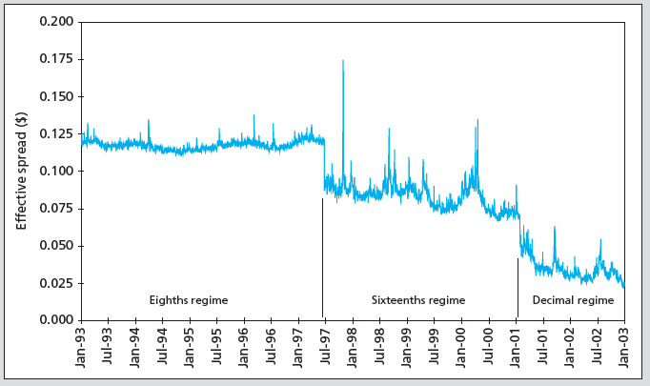
Figure 3.6 Effective Spread vs. Minimum Tick Size

Slide 20
3.4 U.S. Markets
NASDAQ
Approximately 3,000 firms
New York Stock Exchange (NYSE)
Stock exchanges: Secondary markets where already-issued securities are bought and sold
NYSE is largest U.S. Stock exchange
ECNs
Latency: Time it takes to accept, process, and deliver a trading order

Slide 21
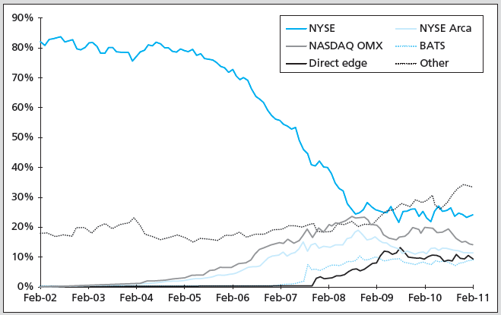
Figure 3.7 Market Share of Trading in NYSE-Listed Shares

Slide 22
3.5 New Trading Strategies
Algorithmic Trading
Use of computer programs to make rapid trading decisions
High-frequency trading: Uses computer programs to make very rapid trading decisions in order to compete for very small profits
Dark Pools
ECNs where participants can buy/sell large blocks of securities anonymously
Blocks: Transactions of at least 10,000 shares

Slide 23
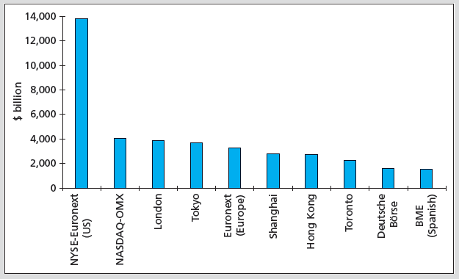
Figure 3.8 Market Capitalization of Major World Stock Exchanges, 2011

Slide 24
3.6 Globalization of Stock Markets
Moving to automated electronic trading
Current trends will eventually result in 24-hour global markets
Moving toward market consolidation

Slide 25
3.7 Trading Costs
Commission: Fee paid to broker for making transaction
Spread: Cost of trading with dealer
Bid: Price at which dealer will buy from you
Ask: Price at which dealer will sell to you
Spread: Ask — bid
Combination: On some trades both are paid

Slide 26
3.8 Buying on Margin
Margin: Describes securities purchased with money borrowed in part from broker
Net worth of investor's account
Initial Margin Requirement (IMR)
Minimum set by Federal Reserve under Regulation T, currently 50% for stocks
Minimum % initial investor equity
1 − IMR = Maximum % amount investor can borrow

Slide 27
3.8 Buying on Margin
Equity
Position value – Borrowing + Additional cash
Maintenance Margin Requirement (MMR)
Minimum amount equity can be before additional funds must be put into account
Exchanges mandate minimum 25%
Margin Call
Notification from broker that you must put up additional funds or have position liquidated

Slide 28
3.8 Buying on Margin
If Equity / Market value ≤ MMR, then margin call occurs
(Market value – Borrowed) / Market Value ≤ MMR; solve for market value
A margin call will occur when:
Market value = Borrowed/(1 − MMR)

Slide 29
3.8 Buying on Margin
Margin Trading: Initial Conditions
X Corp: Stock price = $70
50%: Initial margin
40%: Maintenance margin
1000 shares purchased
Initial Position
Stock | $70,000 | Borrowed | $35,000
 |  | Equity | $35,000

Slide 30
3.8 Buying on Margin
Stock price falls to $60 per share
Position value – Borrowing + Additional cash
Margin %: $25,000/$60,000 = 41.67%
How far can price fall before margin call?
Market value = $35,000/(1 – .40) = $58,333
New Position
Stock | $60,000 | Borrowed | $35,000
 |  | Equity | $25,000

Slide 31
3.8 Buying on Margin
With 1,000 shares, stock price for margin call is $58,333/1,000 = $58.33
Margin % = $23,333/$58,333 = 40%
To restore IMR, equity = ½ x $58,333 = $29,167
New Position
Stock | $60,000 | Borrowed | $35,000
 |  | Equity | $23,333

Slide 32
3.8 Buying on Margin
Buy at $70 per share
Borrow at 7% APR interest cost if using margin; use full amount margin
APRs (365-day year)
Buy at $70 | Sell at $72 in 90 days | Sell at $68 in 90 days
No margin | 11.59% | −11.59%
Margin | 16.17% | −30.17%
Leverage factor | 1.4x | 2.6x

Slide 33
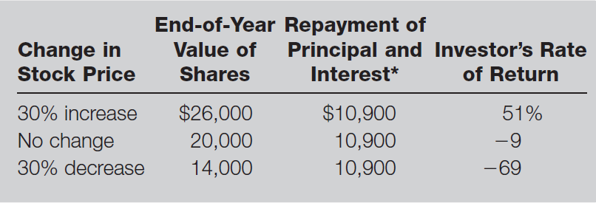
Table 3.1 Illustration of Buying Stock on Margin

Slide 34
3.9 Short Sales
Sale of shares not owned by investor but borrowed through broker and later purchased to replace loan
Mechanics
Borrow stock from broker; must post margin
Broker sells stock, and deposits proceeds/margin in margin account (you cannot withdraw proceeds until you “cover”)
Covering or closing out position: Buy stock; broker returns title to party from which it was borrowed

Slide 35
3.9 Short Sales
Round Trips
Long position
Buy first, sell later
Bullish
Short position
Sell first, buy later
Bearish
“Round trip” is a purchase and a sale

Slide 36
3.9 Short Sales
Required initial margin: Usually 50%
More for low-priced stocks
Liable for any cash flows
Dividend on stock
Zero tick, uptick rule
Eliminated by SEC in July 2007

Slide 37
3.9 Short Sales
Short-sale maintenance margin requirements (equity)
Price | MMR
< $2.50 | $2.50
$2.50-$5.00 | 100% market value
$5.00-$16.75 | $5.00
> $16.75 | 30% market value

Slide 38
3.9 Short Sales
Example
You sell 100 short shares of stock at $60 per share
$6,000 must be pledged to broker
You must also pledge 50% margin
You put up $3,000; now you have $9,000 in margin account
Short sale equity = Total margin account – Market value

Slide 39
3.9 Short Sales
Example
Maintenance margin for short sale of stock with price > $16.75 is 30% market value
30% x $6,000 = $1,800
You have $1,200 excess margin
What price for margin call?

Slide 40
3.9 Short Sales
Example
When equity ≤ (.30 x Market value)
Equity = Total margin account – Market value
When Market value = Total margin account / (1 + MMR)
Market value = $9,000/(1 + 0.30) = $6,923
Price for margin call: $6,293/100 shares = $69.23

Slide 41
3.9 Short Sales
Example
If this occurs:
Equity = $9,000 − $6,923 = $2,077
Equity as % market value = $2,077/$6,923 = 30%
To restore 50% initial margin:
($6,923/2) − $2,077 = $1,384.50

Slide 42
Table 3.2 Cash Flows from Purchasing vs. Short-Selling
Purchase of Stock
Time | Action | Cash Flow*
0 | Buy share | − Initial price
1 | Receive dividend, sell share | Ending price + Dividend
Profit = (Ending price + Dividend) – Initial price
Short Sale of Stock
Time | Action | Cash Flow*
0 | Borrow share; sell it | + Initial price
1 | Repay dividend and buy share to replace share originally borrowed | − (Ending price + Dividend)
Profit = Initial price – (Ending price + Dividend)
*Note: A negative cash flow implies a cash outflow.

Slide 43
3.10 Regulation of Securities Markets
Self-Regulation
The Sarbanes-Oxley Act
Insider Trading
Inside information: Nonpublic knowledge about a corporation possessed by officers, major owners, etc., with privileged access to information

