Slide 1
TRANSFORM BOUNDARIES
Dr. Masdouq Al-Taj

Slide 2
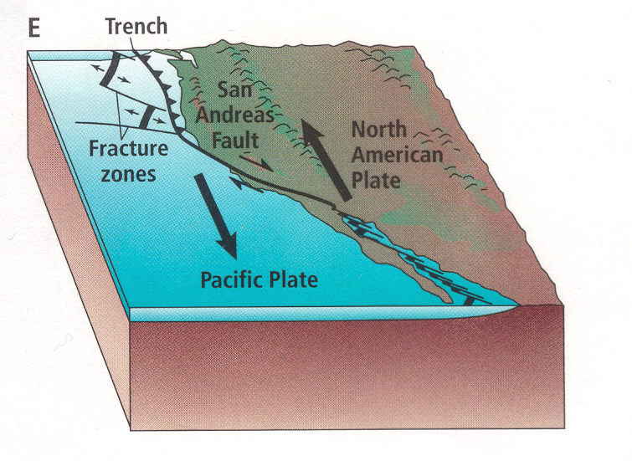
Transform-fault boundary where the North American and Pacific plates are moving ____ each other.
Example: ________________ in California and the Dead Sea Transform fault system in Jordan
past
San Andreas Fault

Slide 3
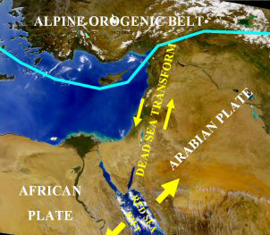

Slide 4
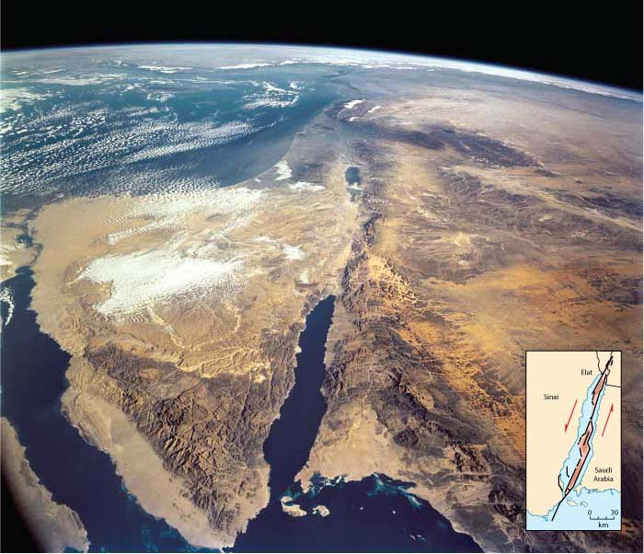

Slide 5
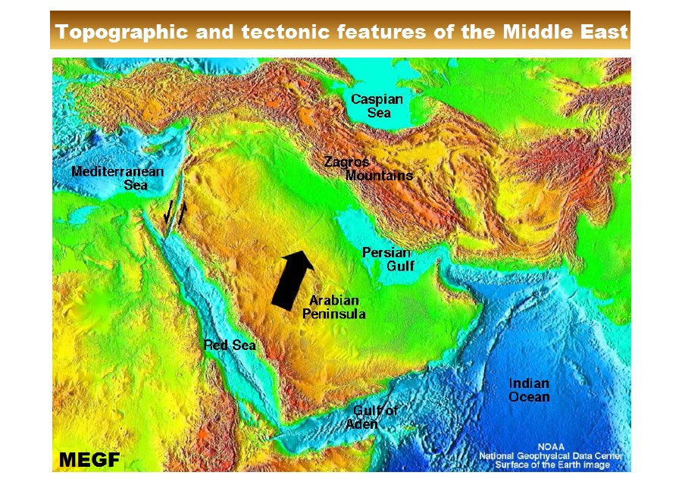

Slide 6
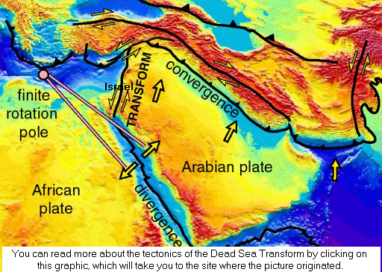

Slide 7
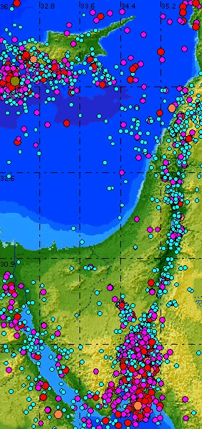

Slide 8
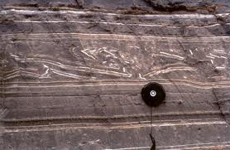
Seismites

Slide 9
THE ACTIVE SINISTRAL MOVEMANT OF THE FAULT
The Active sinistral movement along the transform is represented in many morphotectonics features as:
1.Faults scraps.
2.Sag Ponds.
3.Pressure Ridge.
4.Offset of stream courses.
5.Offset of recent alluvial fan surfaces.

Slide 10
It is part of Great Syrian-African Rift
→ Great Syrian-African Rift (length 6000 km): starts from SE Africa (Mozambique) forming East African rift system
→Gulf of Aden (Afar triple junction, hot spot) …..
→Red Sea (2000 km, age (30 M a and it is divergent boundary with max. depth 2200 m)
→ (DST with length 1100 km) starting from Gulf of Aqaba (width 14-26 km, age (1-1.6) Ma) → Aqaba→ Wadi Araba →Dead sea → Jordan Valley→ Lebanon→ Syria→ SE turkey (East Anatolian fault).

Slide 11
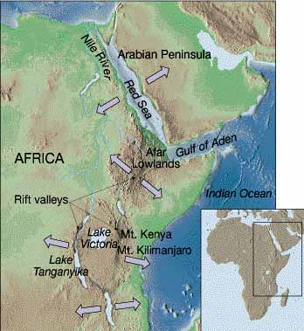

Slide 12
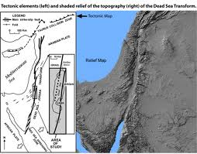

Slide 13
Type of fault is: Transform Fault
length :~ 1100 km
Yearly Displacment of fault : 2 - 10 mm/year
Type of displacement : Left-lateral
type of deformation :localised deformation

Slide 14
a slip rate of 4.9 ±0.2 mm/yr in the last 47 ka was estimated based on field evidence of offset streams and paleoclimatic reconstructions (Ferry et al., 2007).

Slide 15
Lateral displacement of dst
*The accumulated displacement dating from M. Miocene to recent is about 107km,
* Lateral displacement on the DST occurred in two steps:
* 62 km of offset by M. Miocene with 3 degree anticlockwise rotation
* 45 km of offset 2.5 degree anticlockwise rotation since the pliocene to the present.

Slide 16
DST FAULT ZONE
The DST CONSIST of en echeoln fault with step overs:
1. Gulf of Aqaba
(Tiran, Aragonese and Elat (Aqaba) pull-apart basins).
2.Wadi Araba Fault (WAF)
Dead Sea
3. Jordan Valley Fault (JVF).
Tiberias Lake

Slide 17
Formation of Pull-apart basin

Slide 18
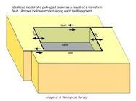

Slide 19
DEAD SEA TRANSFORM IN WADI ARABA
The Dead Sea Transform (DST) in Wadi Araba (about 200 km) shows the detailed distribution of the transform and its subsidiary fractures.
The Dead Sea Transform in Wadi Araba is represented by two major active strike slip faults:
the southern one extends from Gulf of Aqaba to Jabel Ar Risha in central Wadi Araba
the northern one extends from Jabal Ar Risha to Khunaizira fault scrap and end on the northeastern corner of the Dead Sea.

Slide 20
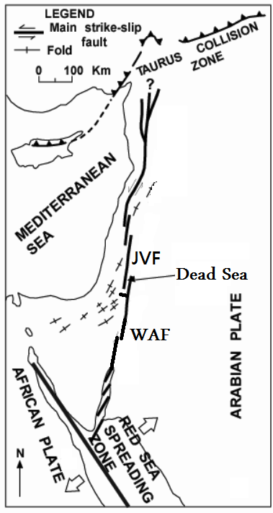

Slide 21
Geological and structural setting of the Dead Sea
basin:
* The Dead Sea basin is the most prominent
morphotectonic pull-apart basin along the Dead Sea rift.
* The basin is about 135 km long, 10-20 km wide and is, at least 8.5 km deep. The basin formed between sinistral, left- stepping en-echelon strike slip faults.
* The steps may have migrated northward with
time, because of the depocenter shift towards
north. The center of the Dead Sea basin has a full
Pull-apart geometry.

Slide 23
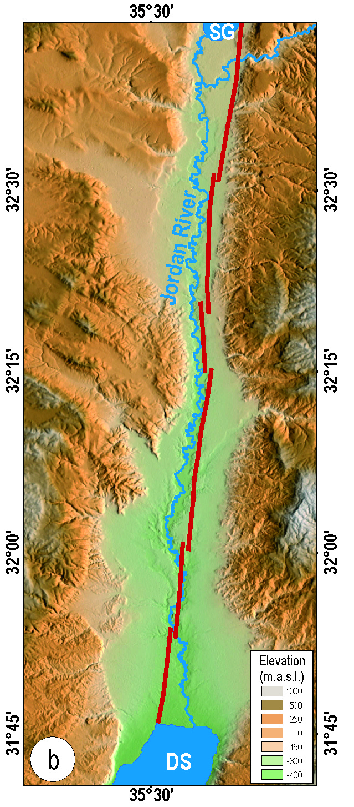

Slide 24
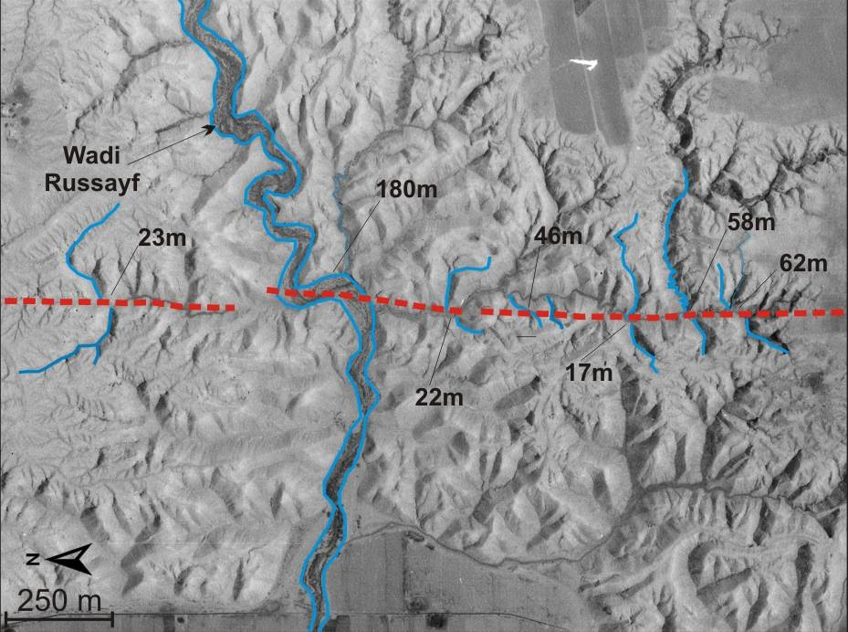
Displacement magnitudes around Dead Sea transform

Slide 25
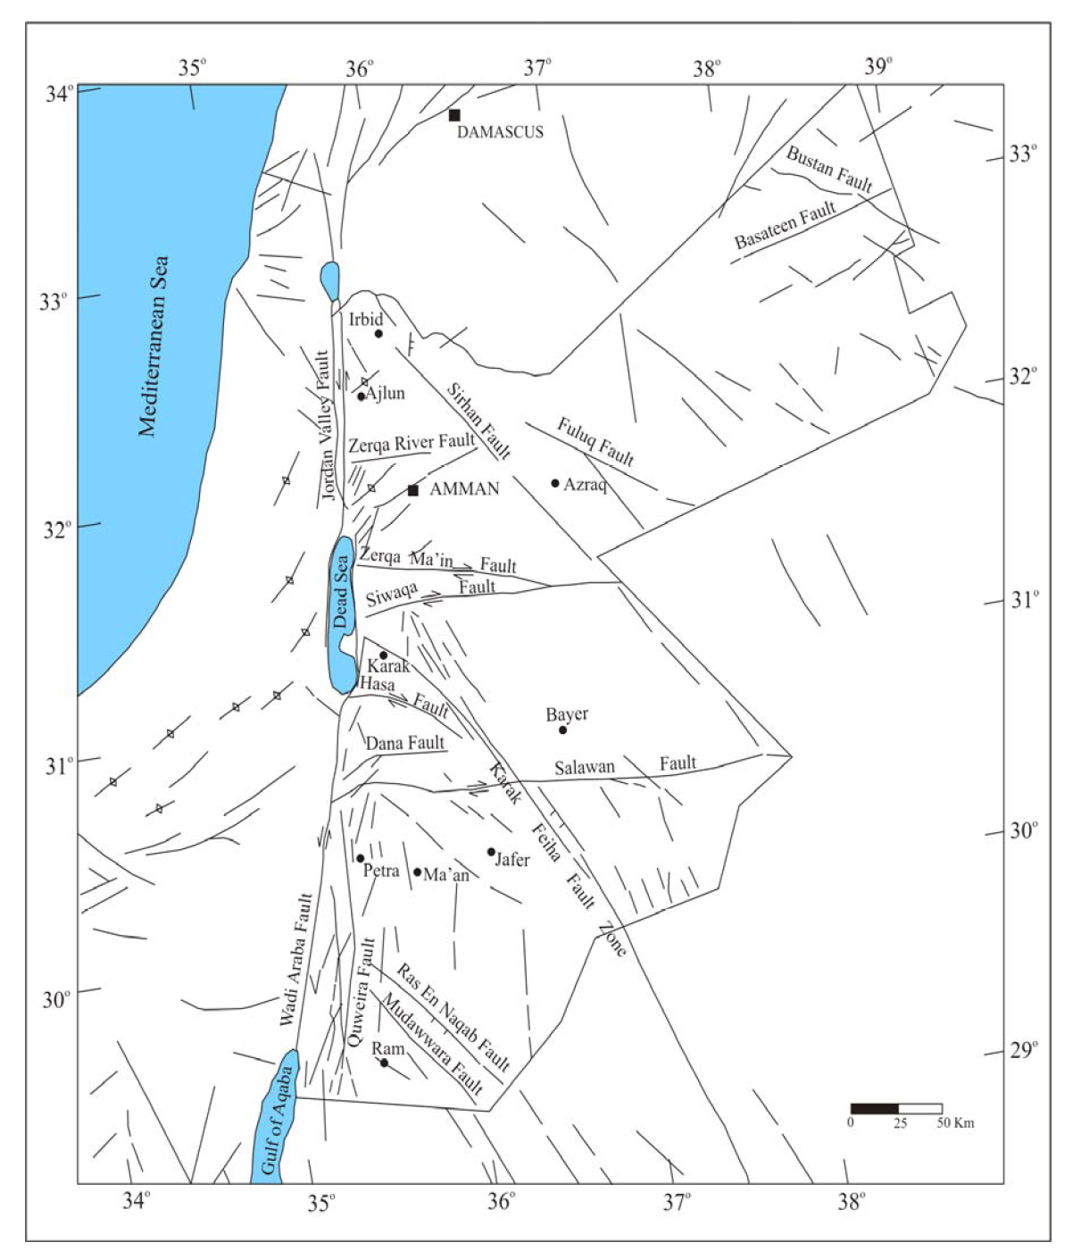

Slide 26
Plate Boundaries Review
Places where plates move apart are called ___________ boundaries.
When continental plates diverge a ___________ is formed.
When two oceanic plates converge what is created? _________________
The Appalachians formed mainly from continental plate collisions and therefore are a __________ mountain range.
The force moving the plates is ____________
divergent
rift valley
an island arc and a trench
folded
Convection currents

Slide 27
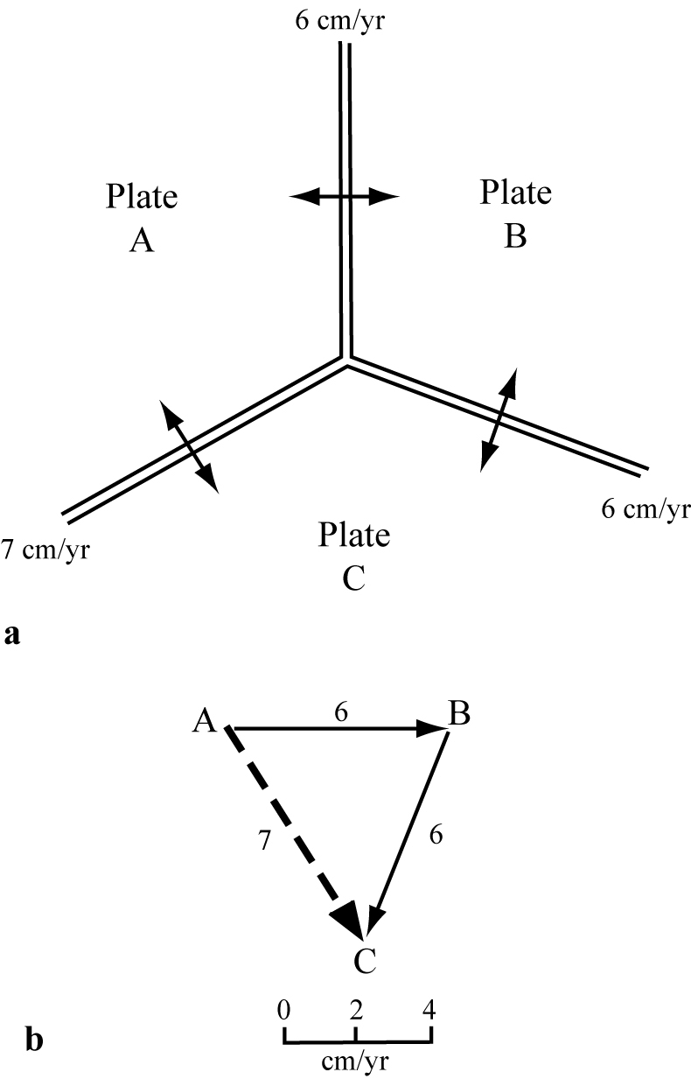
Triple Junction
F=Transform
T=Trench
R=Ridge
RRR is the most stable

Slide 28
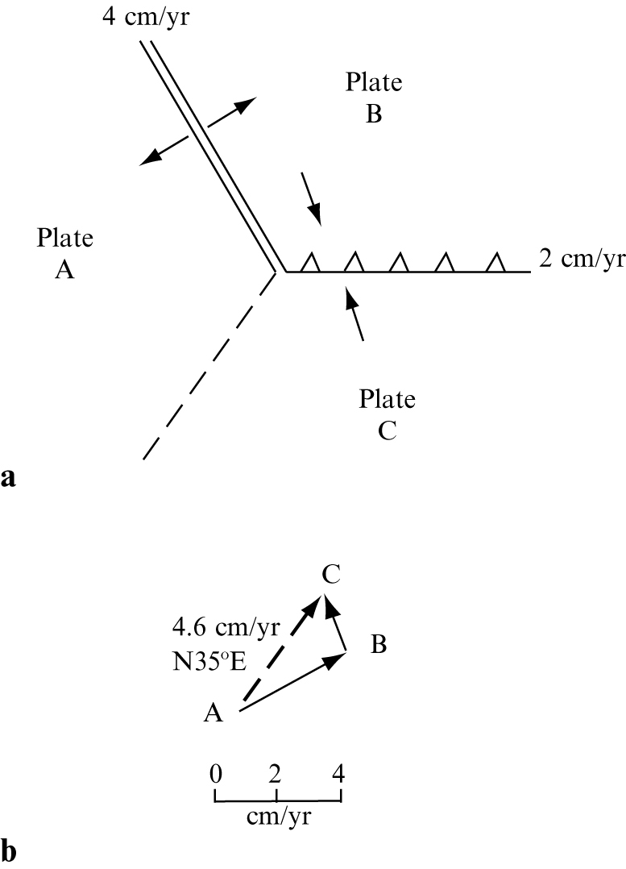
RTF

