Slide 1
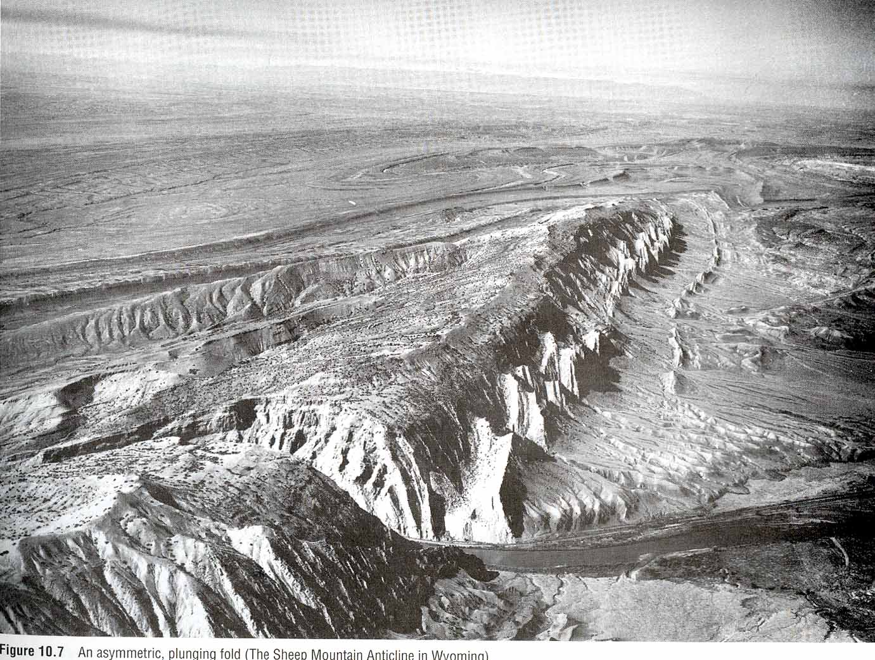
CHAPTER 10
Folds and Folding

Slide 2
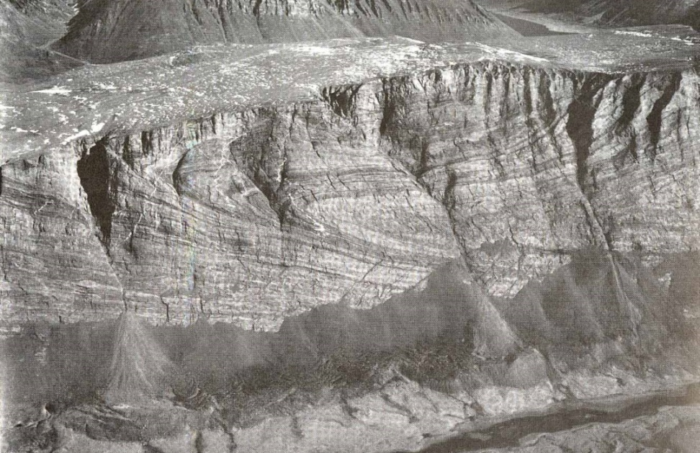
Folds
A fold is a structural feature that is formed when planar surfaces are bent or curved.
In fact, if such surfaces are not available, (e. g., bedding, cleavage, inclusions), you will not see folds even though the rock is deformed.
Folding is a ductile deformation
because it can develop
without fracturing, and
deformation is distributed
over the entire structure.

Slide 3
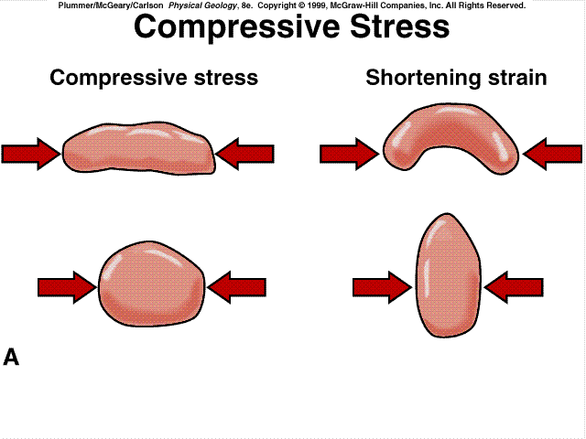
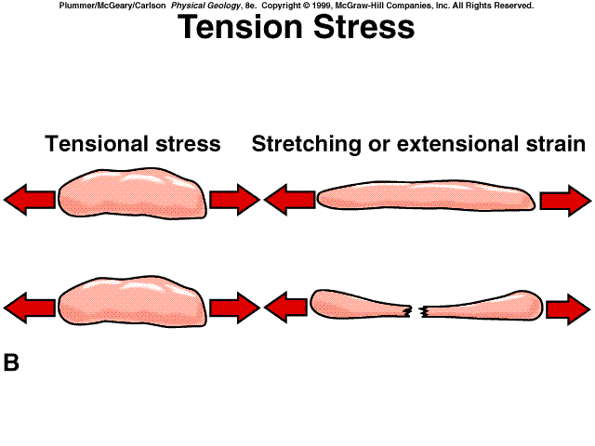
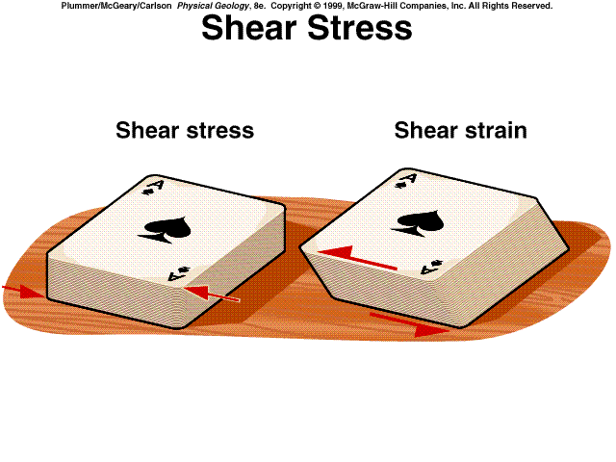
Geologic Structures
Fold forms due to Compressional Stress.

Slide 4
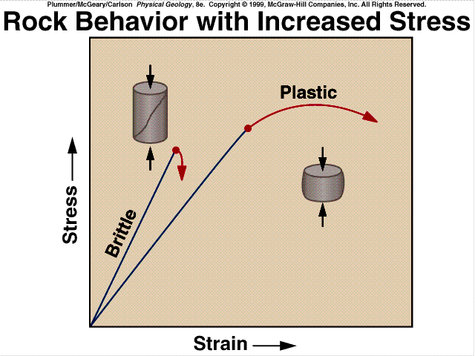
Strain: Elastic, Plastic without rupture.
* It is Ductile Deformation

Slide 5
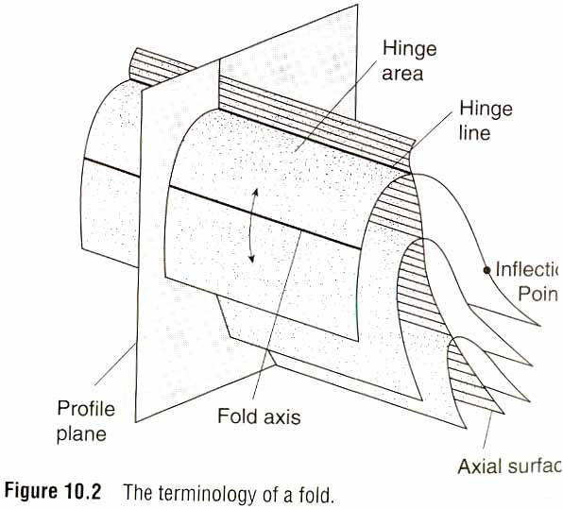
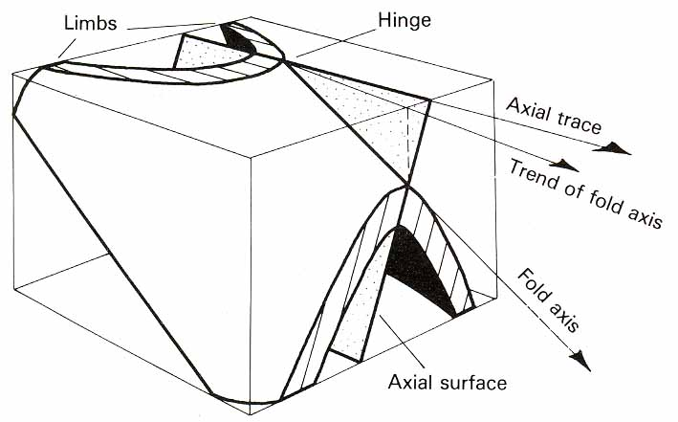
ANATOMY OF A FOLDED SURFACE (Geometric features)
Fold limb: the side of a fold.
Hinge line: line connecting the points of maximum curvature on the fold profile.
Hinge zone: the zone of maximum curvature on the fold profile.

Slide 6
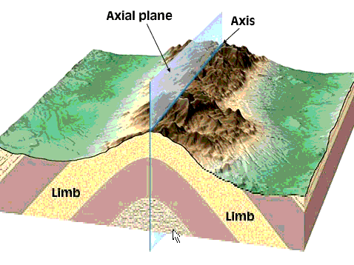

Slide 7
Fold axis: fold generator in cylindrical folds.
Cylindrical fold: fold with straight hinge line parallel to fold axis.
Non cylindrical fold :fold with accrued hinge line.

Slide 8
Axial surface: the surface which passes through all hinges of the successive folded surfaces. Where this surface is planar it is called the axial plane.

Slide 9
Axial trace: the line where the axial surface intersects the ground or other surface. Only when the axial plane is vertical does the axial trace and the direction of the fold axis coincide.
Inflection point: the point in the limb where the sense of curvature changes.

Slide 10
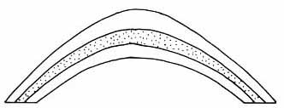
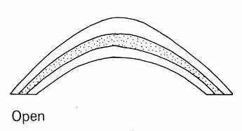
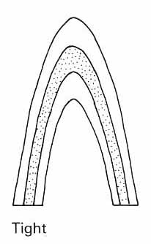
Profile plane: the surface ┴ to the hinge line.

Slide 11
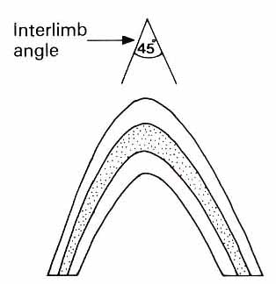
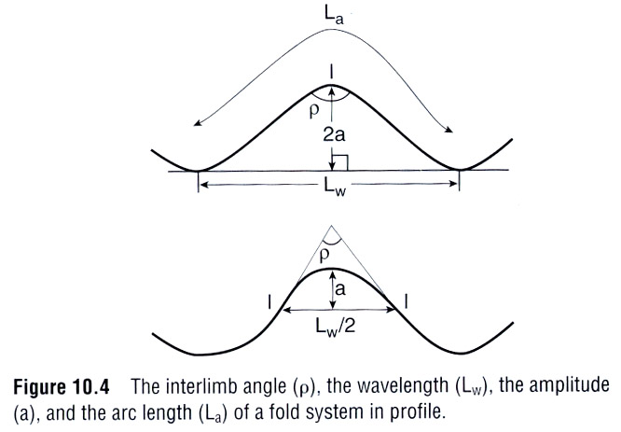
Interlimb angle: the angle
between fold limbs in the
profile plane.
Wavelength: the distance between two
hinges of the same orientation.
Amplitude: half the height of the structure measured from crest to trough.
Arc length: the distance
between two adjacent
fold hinges of the same
orientation as measured
along the folded surface.

Slide 12
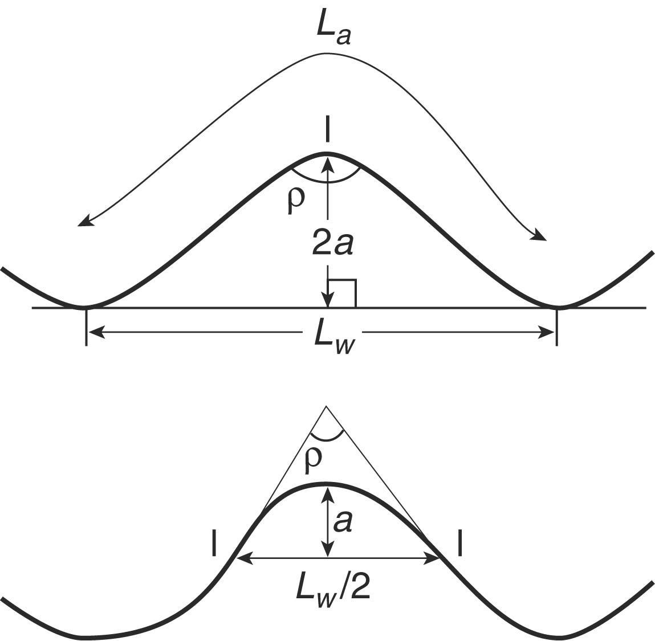
- Harmonic fold: layers in the fold have the same amplitude and wave length.
- Disharmonic fold: some layer in fold have different wave lengths or amplitudes.
* Median surface: the surface that passes through the inflection points on opposing limbs.

Slide 13
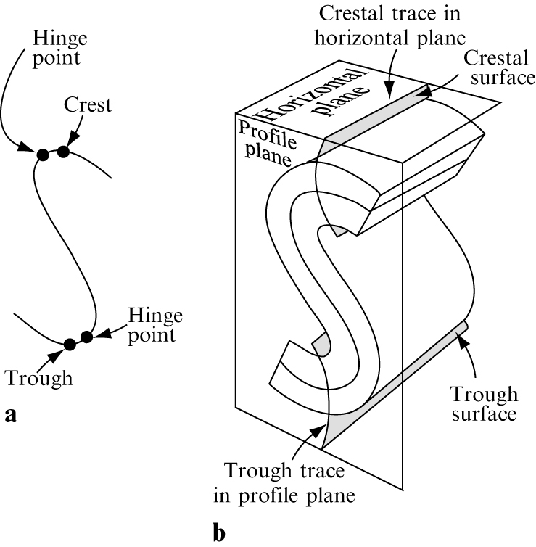
Crest and
Trough

Slide 14
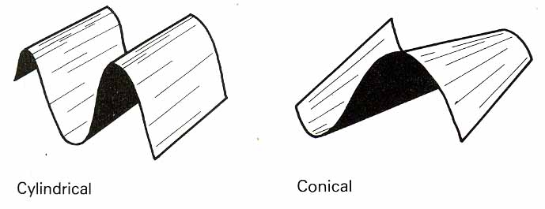
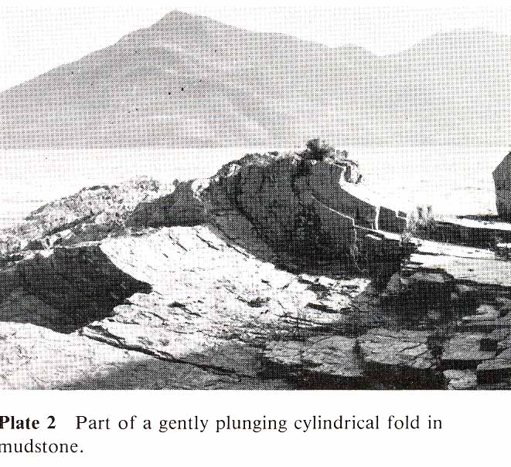
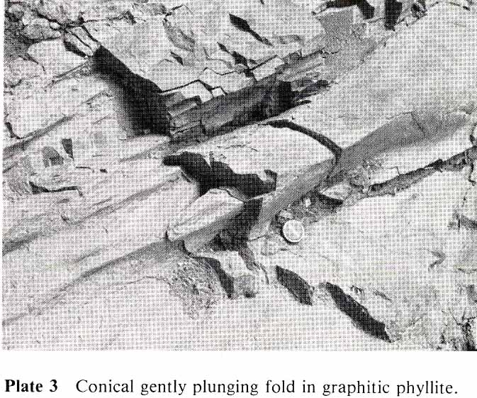
Fold shape in 3D
Cylindrical fold: a fold which can be generated by moving the fold axis parallel to itself. The majority of folds approximate to this form.
Conical fold: a fold which is non-cylindrical and whose folded surface forms part of a cone.

Slide 15
Fold Classification
Fold classified based on 4 main features:
Direction of closing or facing.
Attitude of axial surface and hinge line.
Size of inter-limb angle.
Shape of profile.

Slide 16
1. Fold Closure and Facing Facing means younging direction.
Antiform: The limbs dip away from the center of the fold and close upward (a).
Synform: The limbs dip toward the center of the fold and close downward (b).
Neutral: the limbs close sideway (c).
If the younging direction of rock is known, antiform is called (anticline) and synform is called (syncline).

Slide 17
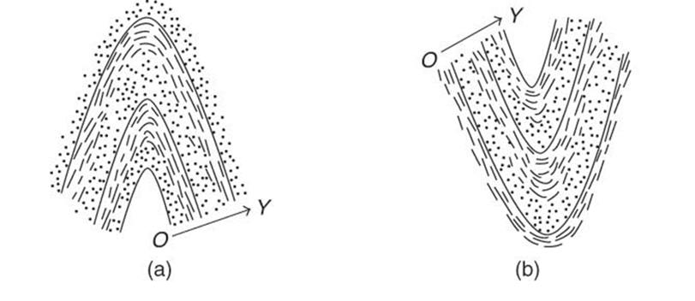
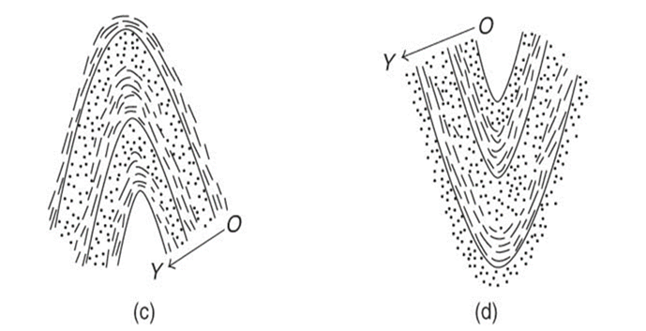
(c)

Slide 18
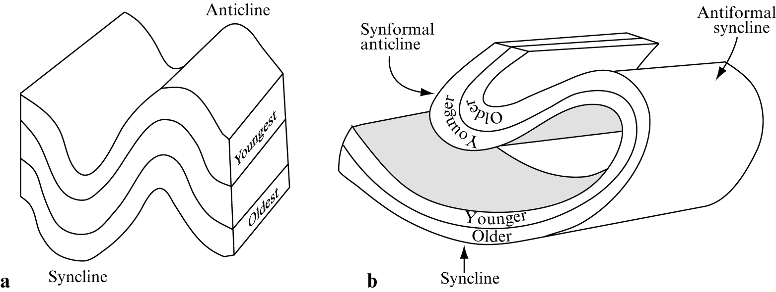

Slide 19
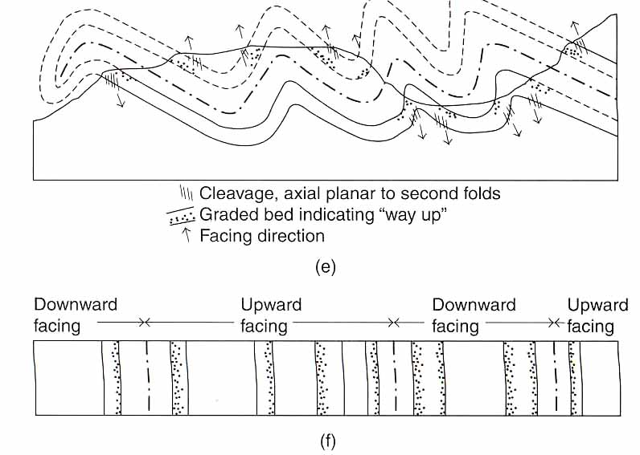
Upward-facing: rocks younging upward.
Downward-facing: rocks overturned and younging downwards.

Slide 20
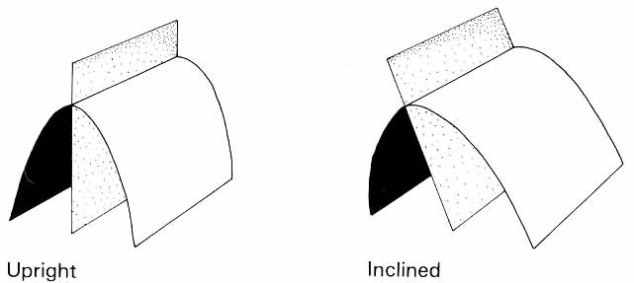
2. Fold Attitude
The orientation of a fold is defined by
(i) the attitude of its axial surface and
(ii) the plunge of its axis.
* the attitude of its axial surface
Upright fold: the axial surface is nearly vertical.
Inclined fold: the dip of the axial surface lies between 10° and 80°.

Slide 21
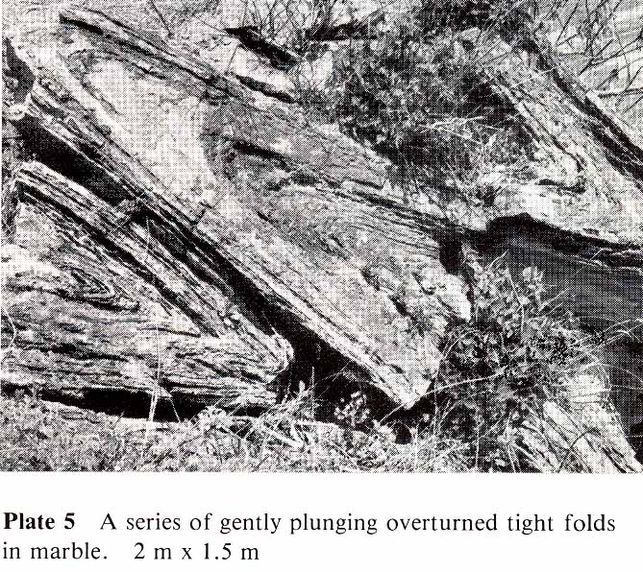
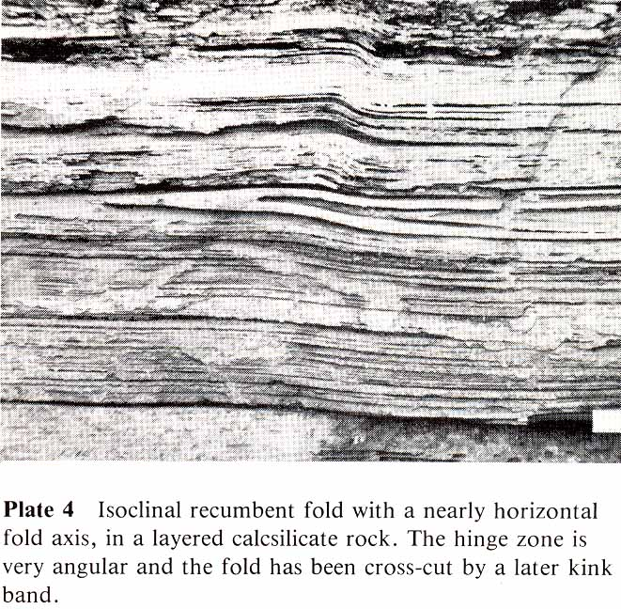
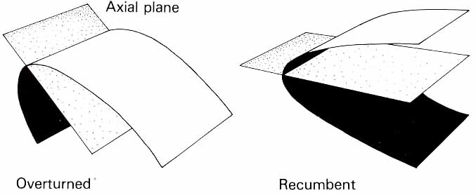
Overturned fold: an inclined
fold whose limbs dip in the
same direction.
Recumbent fold: the axial
surface is nearly horizontal.

Slide 22
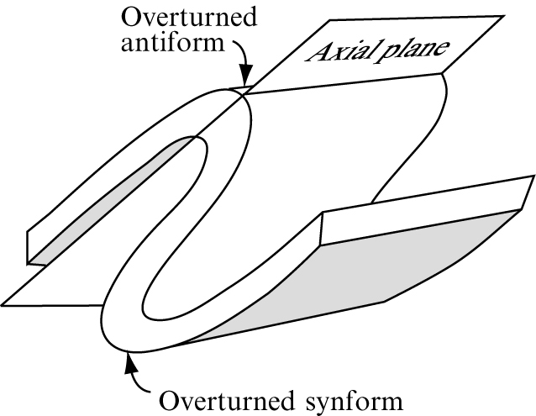

Slide 23
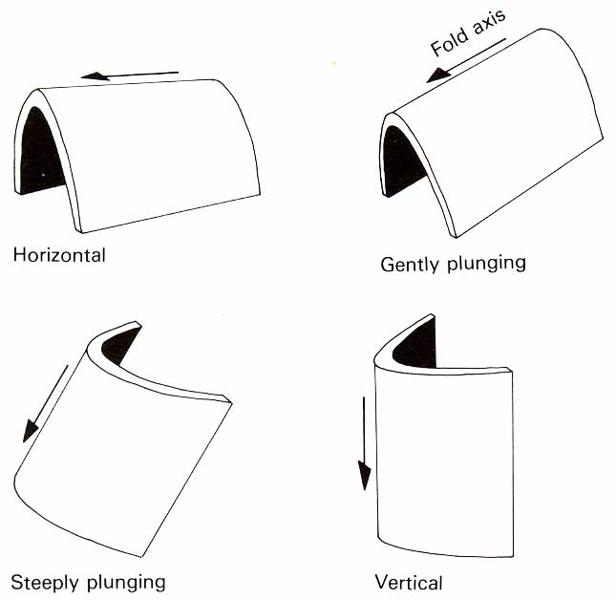
Plunging (Fold axis)
Horizontal fold: the fold axis is nearly horizontal.
Gently plunging fold:
the plunge of the fold axis
lies between 10° – 45°.
Steeply plunge: the
plunge of the fold axis
lies between 45° – 80°.
Vertical fold: the fold
axis is nearly vertical.

Slide 24
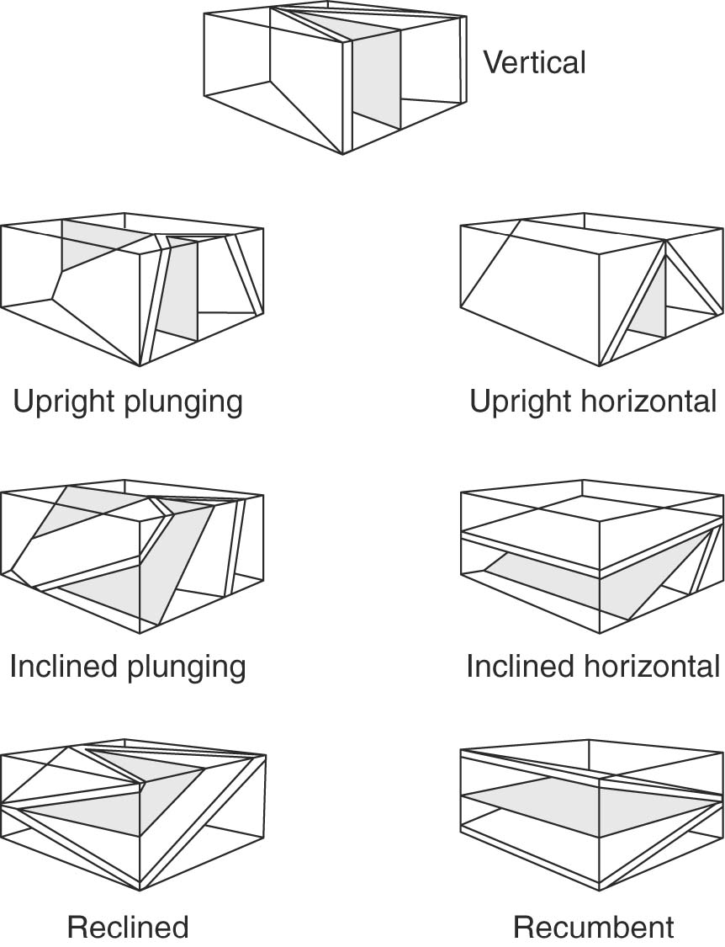

Slide 25
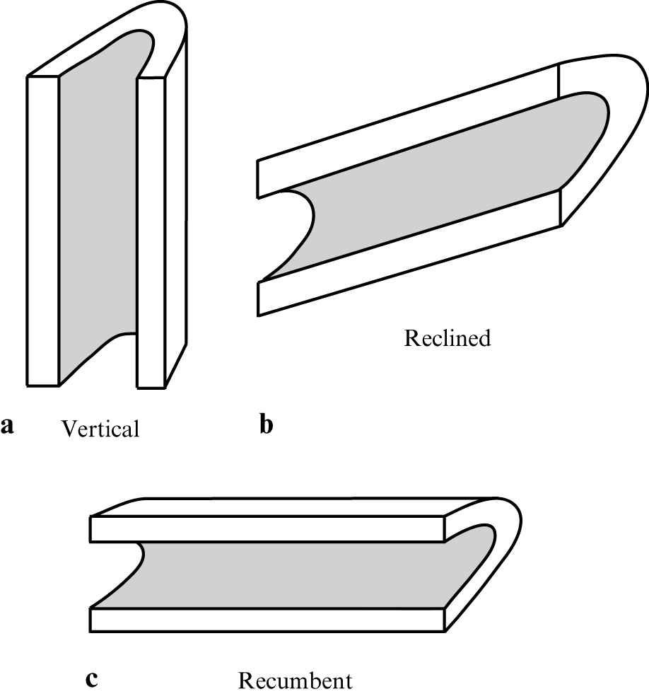

Slide 26
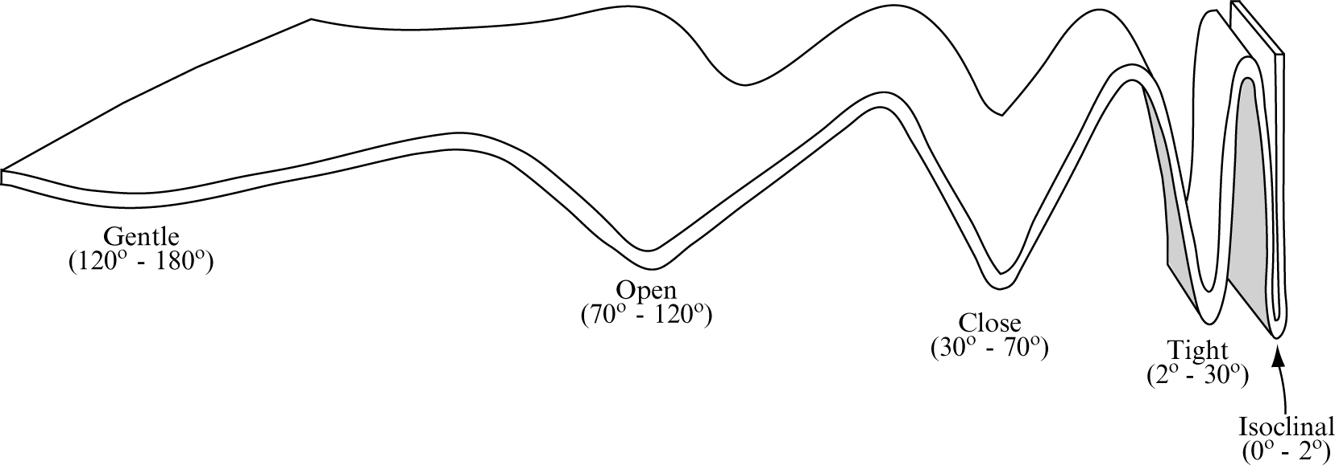
3. interlimb angle

Slide 27
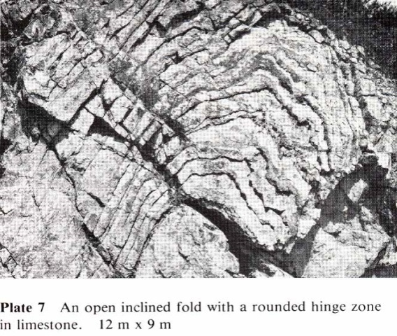
gentle
closed

Slide 28
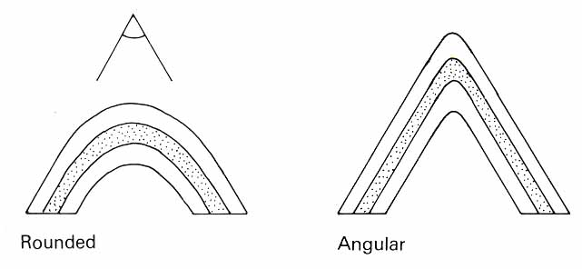
Angularity of the hinge zone
Angular fold: the radius of curvature of the hinge zone is small in relation to the length of the fold limb.
Rounded fold: the radius of curvature of the hinge zone is large in relation to the length of the fold limb.

Slide 29
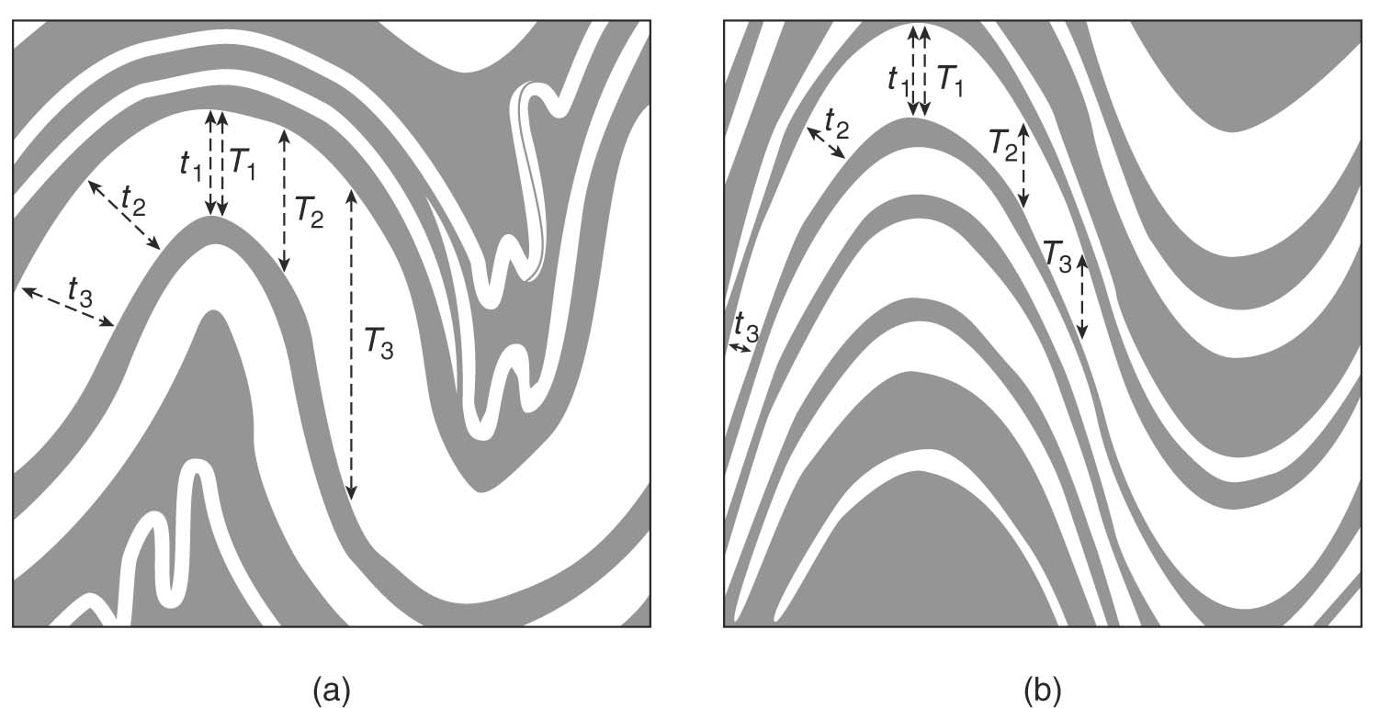
4. Shape of a profile
- thickness of beds.
1) Parallel fold: The thickness of the folded layer (measured ┴ to the fold surface) is constant.
2) Similar fold: The thickness of the folded layer (measured // to the axial surface) is constant.

Slide 30
Asymmetrical, open, rounded, gently plunging antiform, with inclined axial surface

Slide 31
Dip-Isogon Method
Geometry of the Fold Profile
Dip-isogons connect points on the upper and lower boundary of a folded layer where the layers have the same dip relative to a reference layer

Slide 32
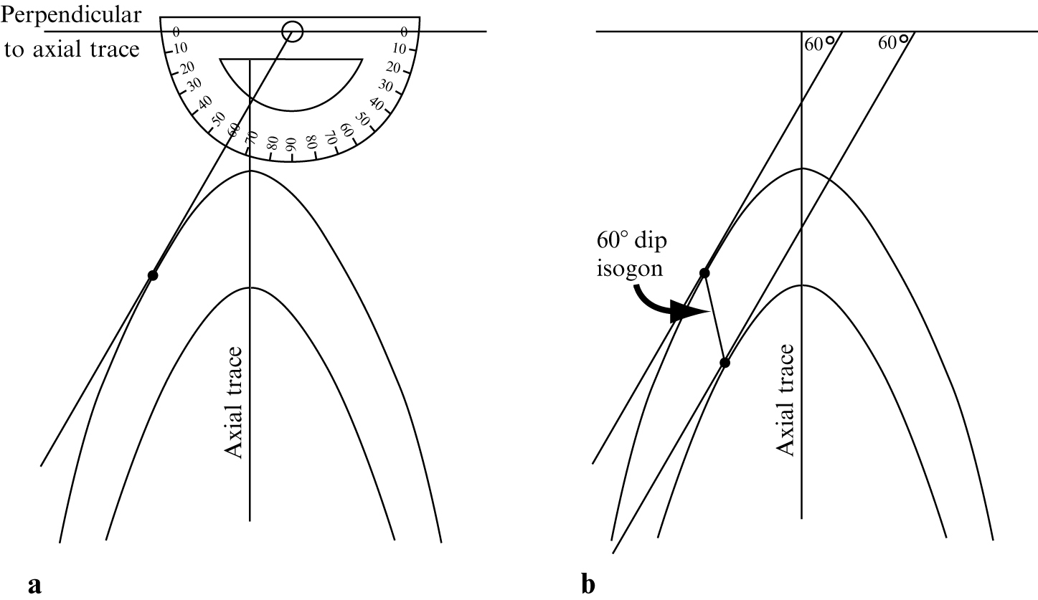

Slide 33
There are three classes of folds based on the dip isogones and thickness of the deformed beds.
Class 1 (1a, 1b, 1c) ( Convergence) parallel bed surfaces with the same thickness.
Class 2 (Parallel) and
Class 3 (Divergent), similar bed surfaces with change in the bed thickness.

Slide 34
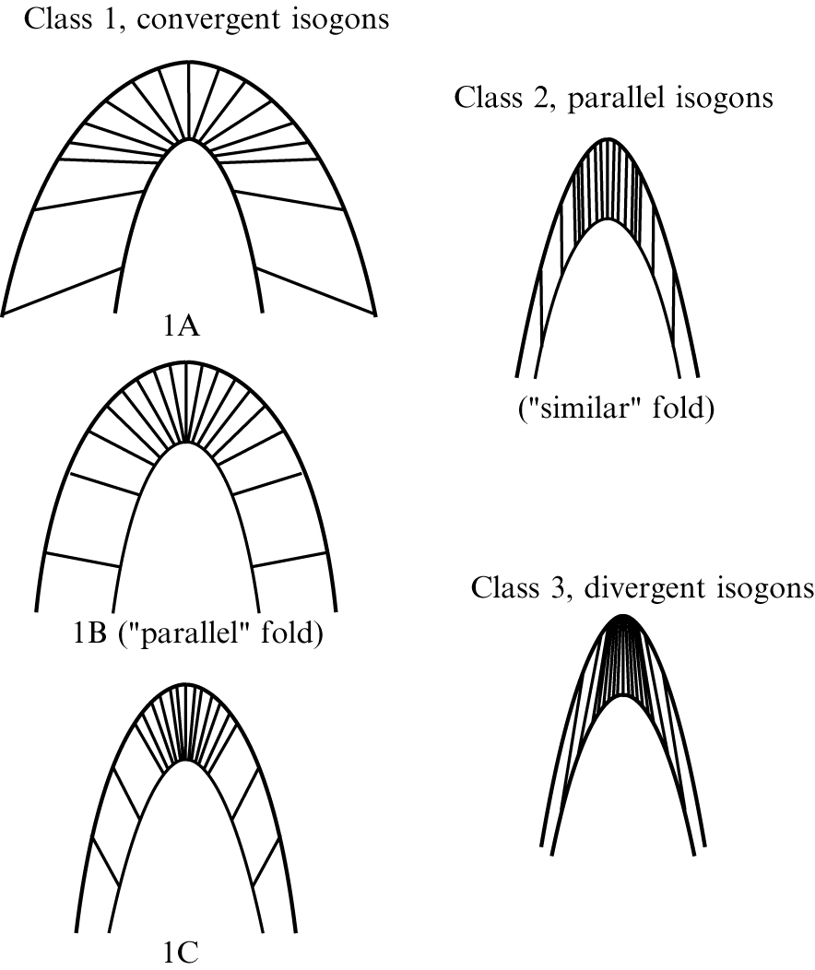

Slide 35
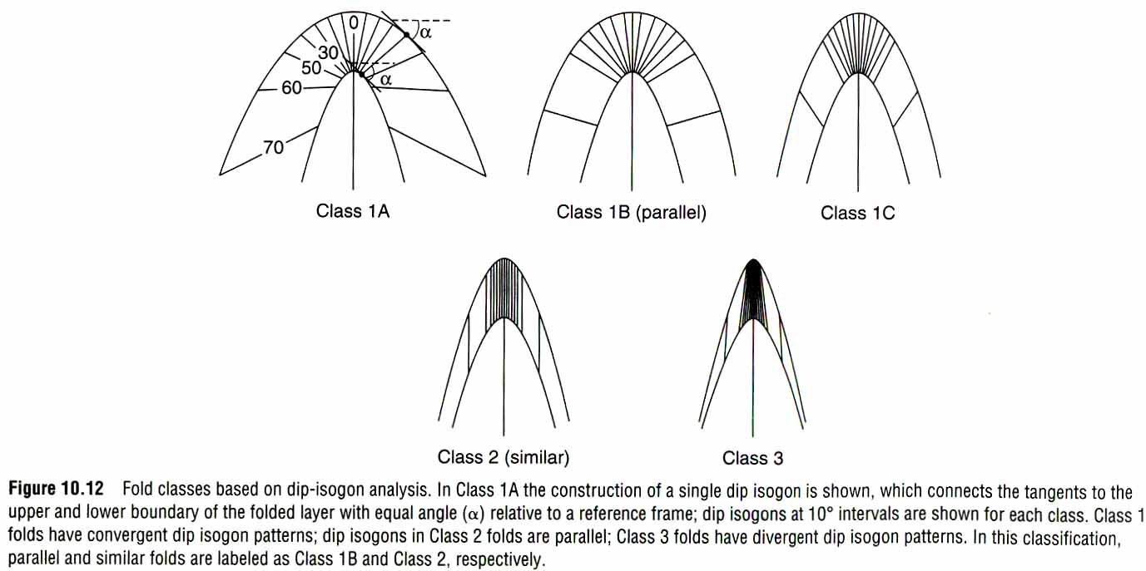
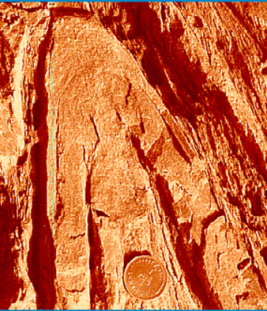

Slide 36
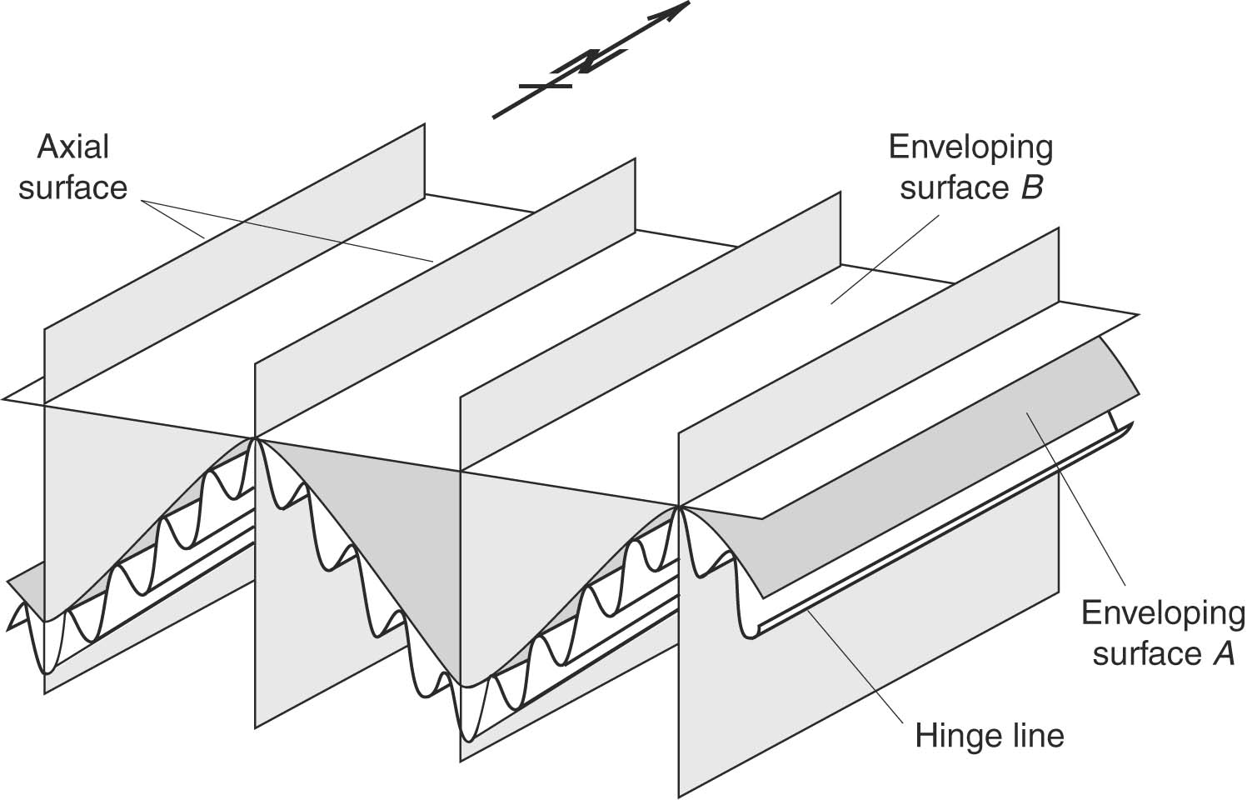
FOLD SYSTEMS
- Fold System: It is array of synclines and anticline.
- Enveloping surface

Slide 37
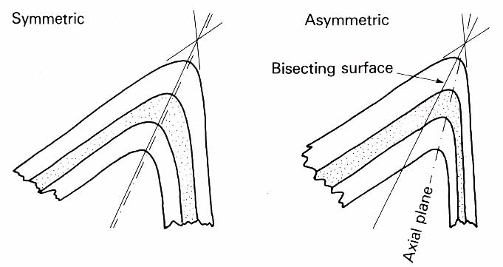
FOLD SYMMETRY
Symmetric fold: the axial surface bisects the angle made by the extension of the two limbs.
Asymmetric fold: the axial plane does not bisect the angle made by the extension of the two limbs.

Slide 38
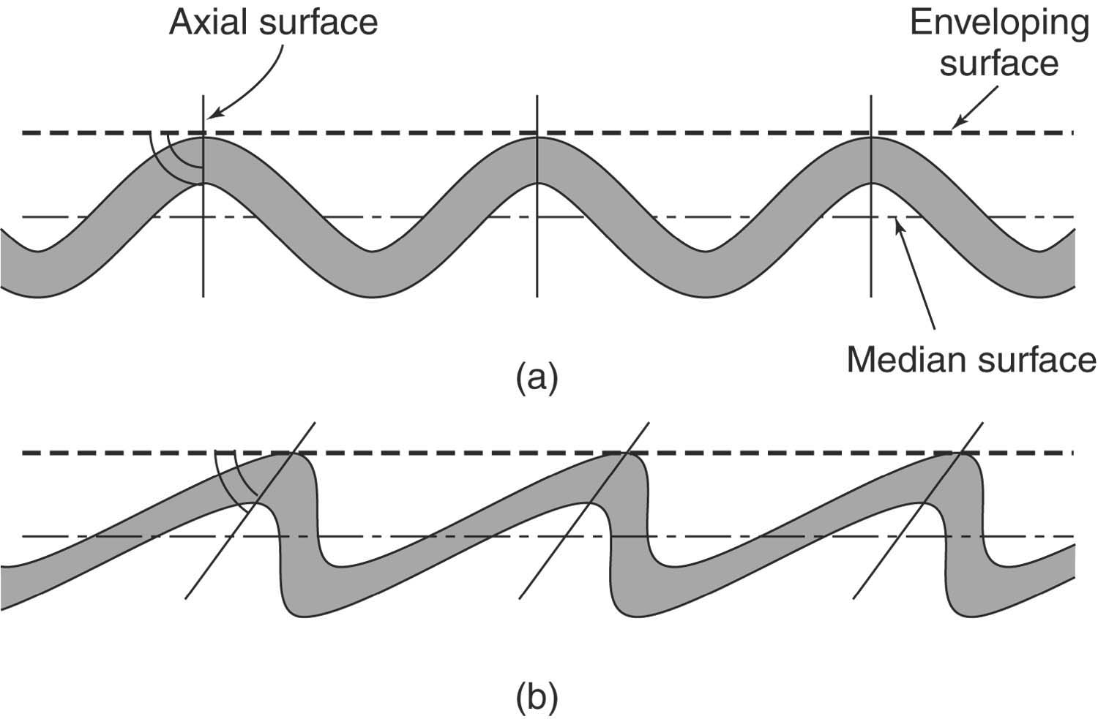

Slide 39
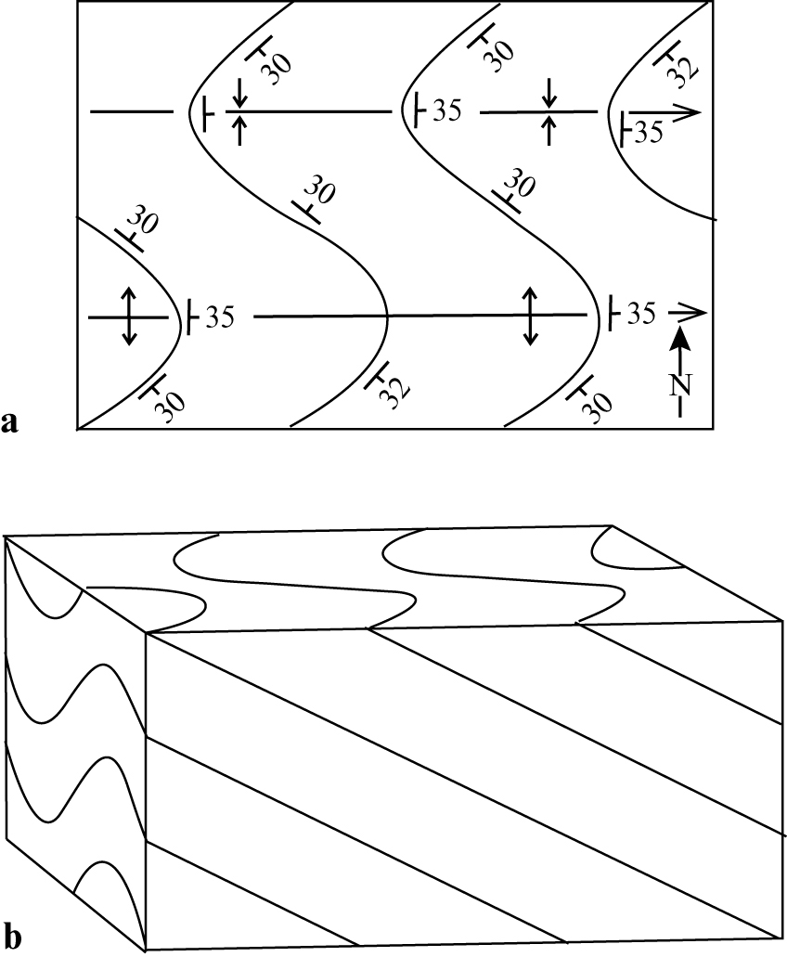

Slide 40
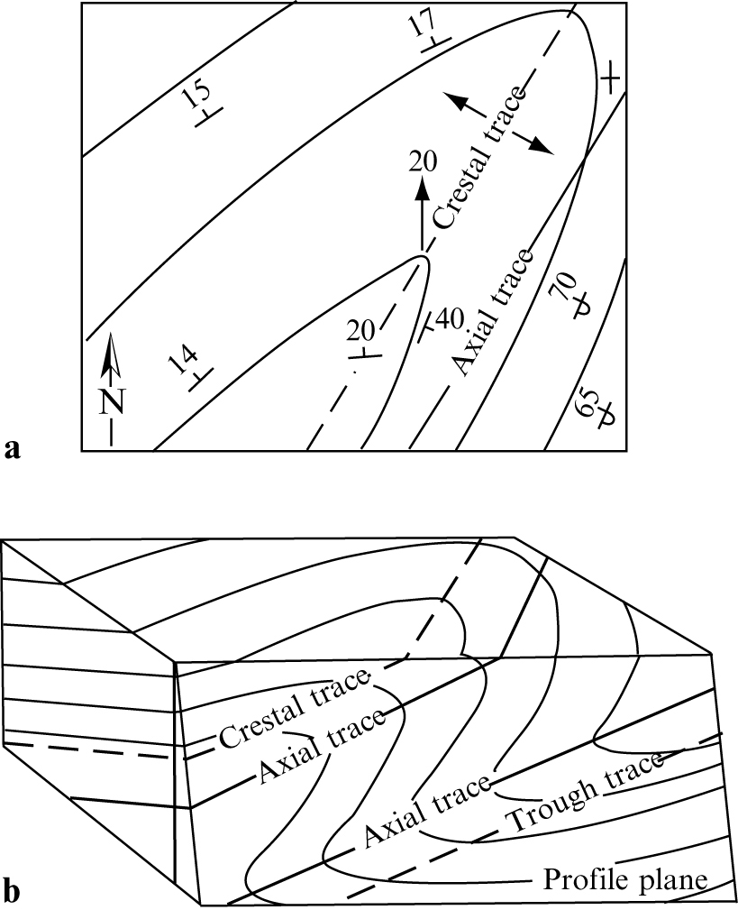

Slide 41
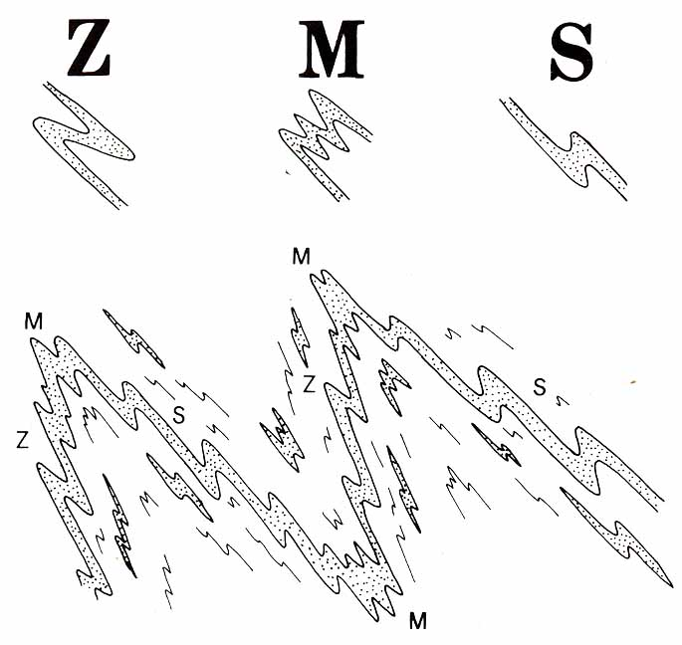
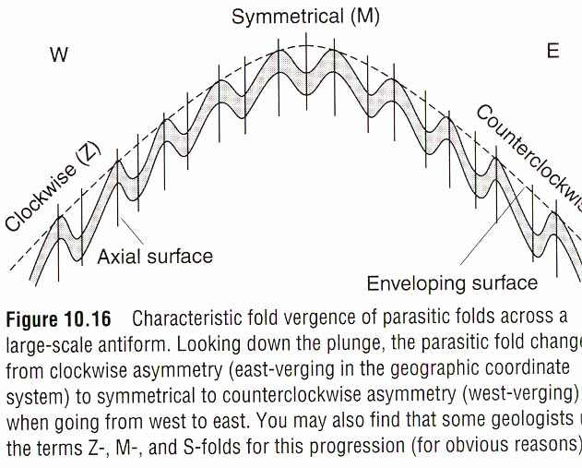
Fold vergence and parasitic folds
The form of a fold is determined by the relative lengths of the fold limbs and is described by using the letter S, Z, M.

Slide 42
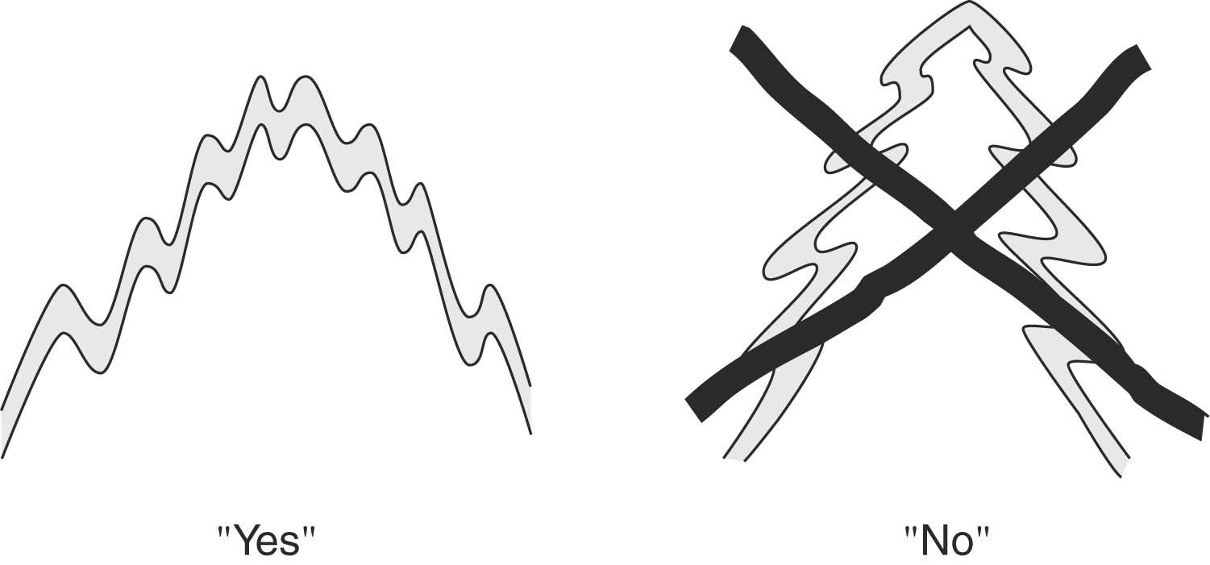
Pumpelly’s Rule
The orientation of the small-scale, high-order folds, is therefore representative of the large-scale, low-order folds.

Slide 43
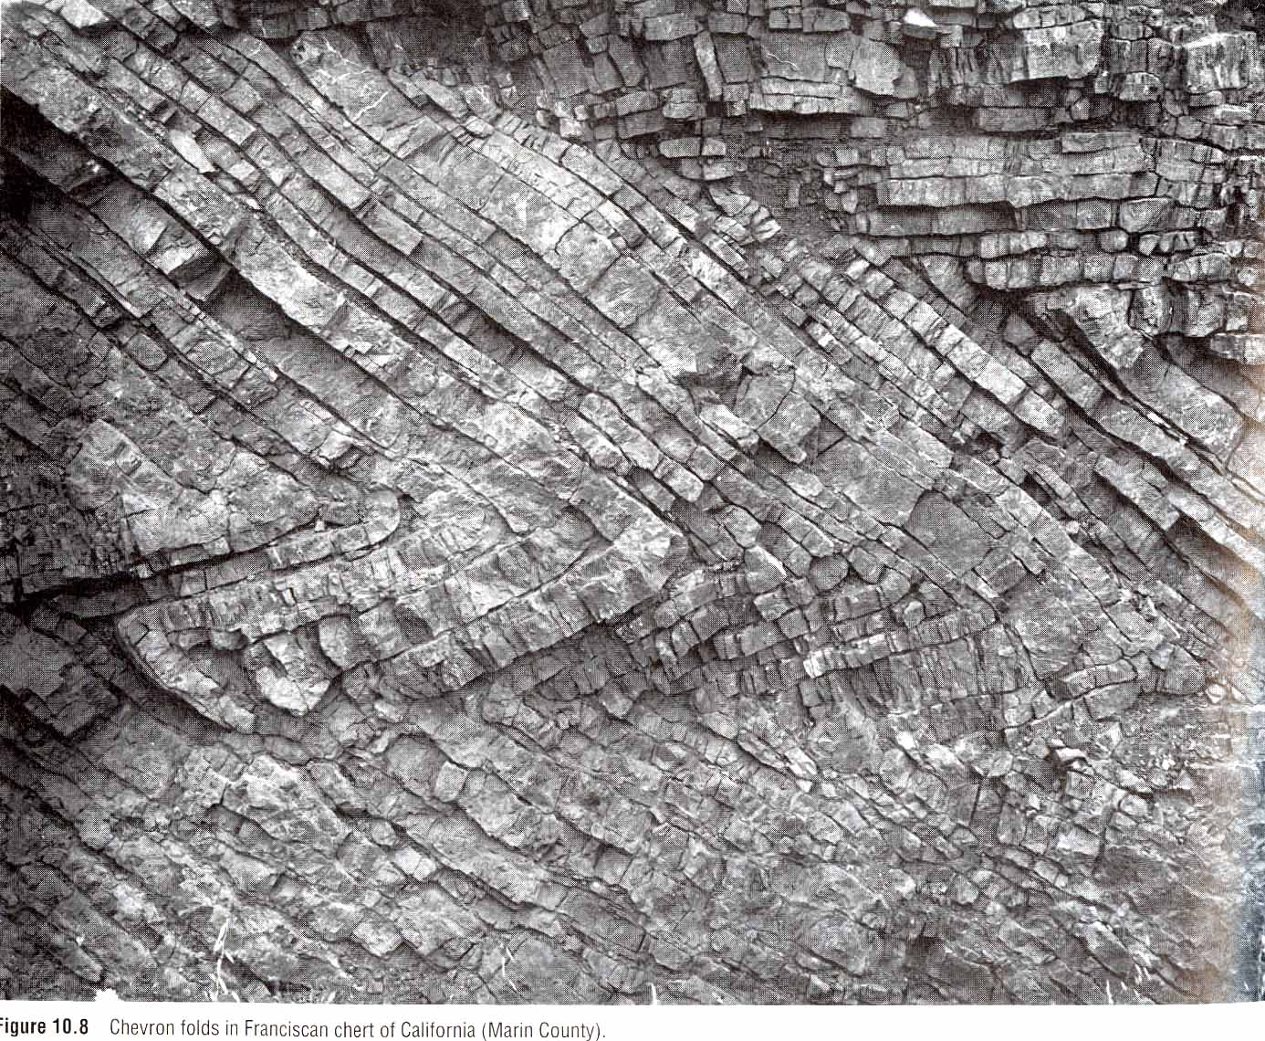
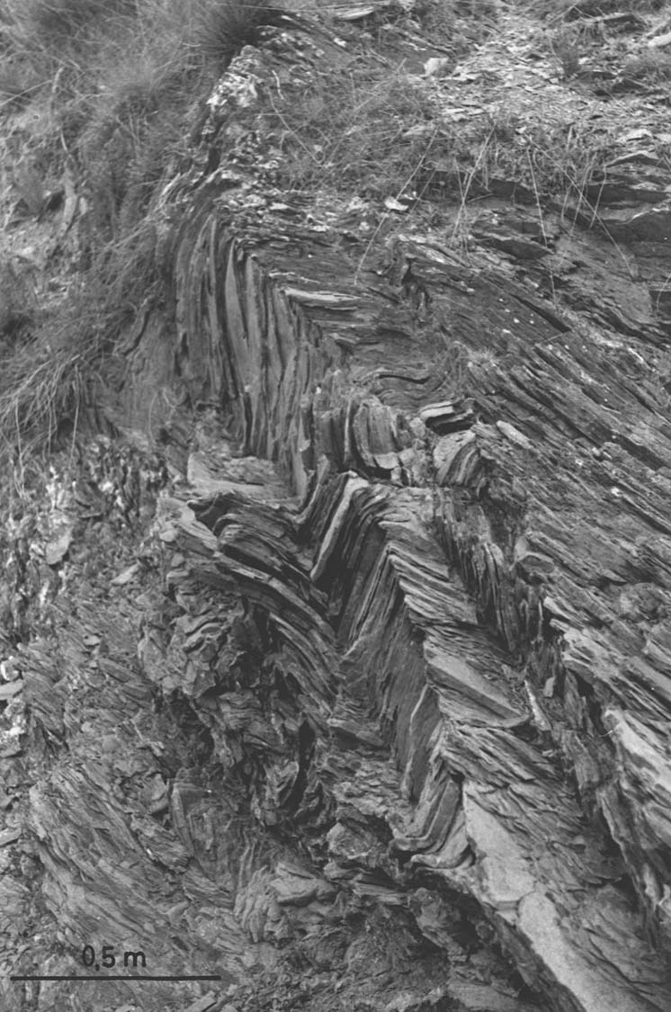
Special fold types
1. Chevron Folds (accordion) or Kink Fold
The limbs of chevron folds are approximately planar and the fold hinges are angular.

Slide 44
KINK FOLD
Kink folds are mesoscopic to microscopic folds, <1m, which are found in finely laminated, strongly anisotropic rocks like shale and slate
The fold it self has sharp hinges and straight limbs
Mica-rich portion of graywackes.

Slide 45
2. Monoclinal Fold
Monoclinal fold along the thrust faulted northern slope of the Colorado National Monument
Notes:
Photo: http://www.isgs.uiuc.edu/dinos/SIU-course/may12-02-siutripplan/indexfiles/P1010006.JPG.html

Slide 46
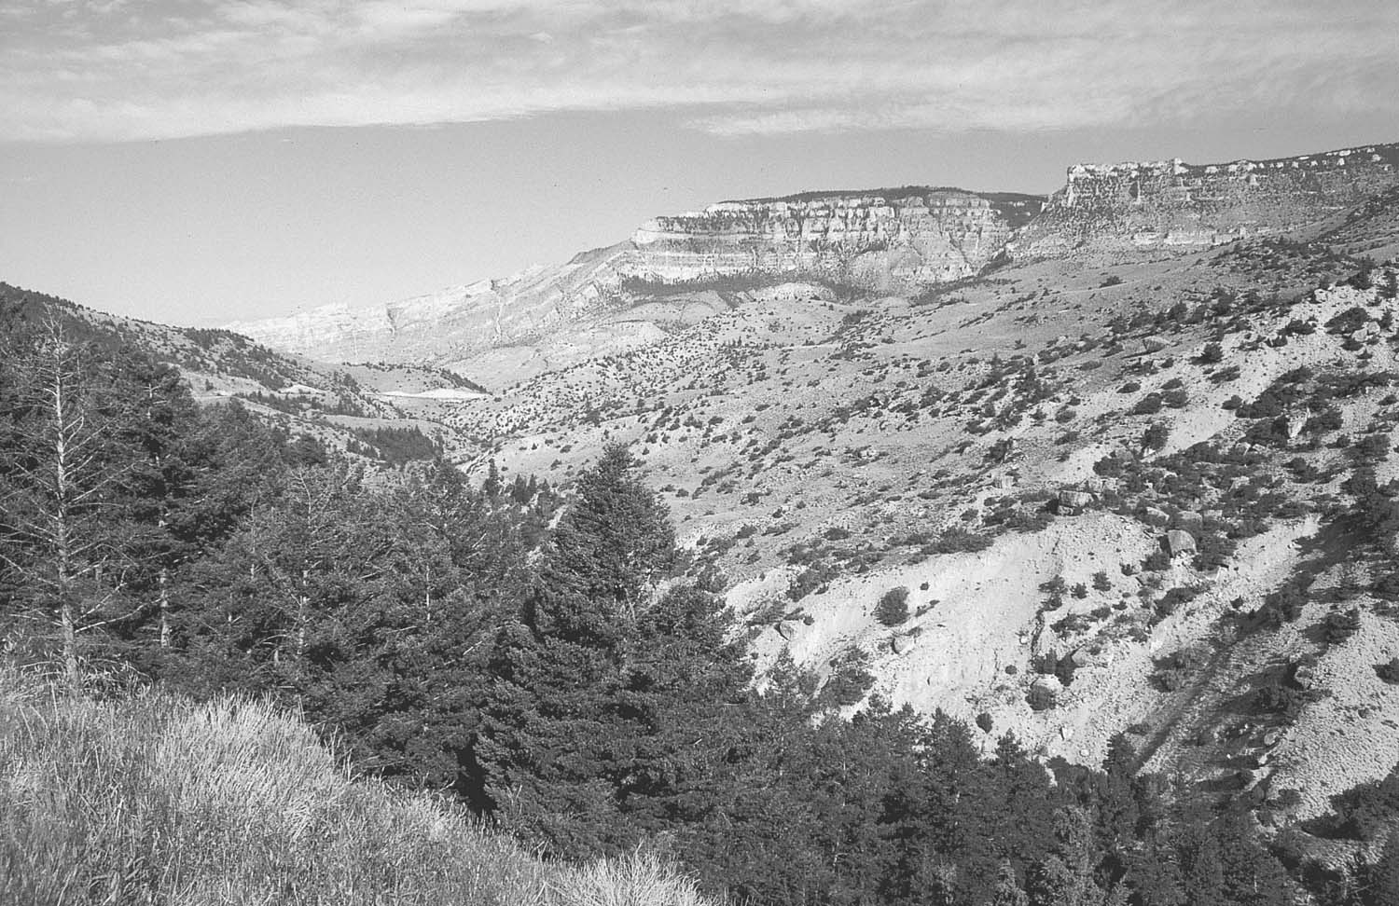

Slide 47
3. En echelon Fold

Slide 48
4. Box Fold

Slide 49
5. Ptygmatic Fold
6. Sheath Fold

Slide 50
An anticlinorium is a series of anticlinal folds on a regional-scale anticline.
A synclinorium is a series of synclinal folds on a regional-scale syncline.
* The highest point on a non cylindrical fold or a doubly plunging anticline is called the "culmination“.

Slide 51
Folds in 3-D
* Pericline: double plunging fold,
* Domes and Basins.

Slide 52
Interference Patterns and
Superimposed folds
First generation
Second generation

Slide 53
dome and basin pattern
Mushroom pattern
Refolded pattern

Slide 55
Fold Style Characteristics
Fold style characteristics are:
1. In profile plane, is the fold either parallel or similar?
2. In profile, what is the interlimb angle?
3. Is the fold cylindrical or
non-cylindrical?
4. Is there an associated axial plane
foliation or lineation present?

Slide 56
Dynamics of Folding Layering Shows Folding
Deformational forces are necessary to produce folding, but layering must be present in order to see the folding
The properties of the layers make a difference.

Slide 57
Passive folding (Bending)
Bending involves the application of force at an oblique angle to the layering
This can occur during the infilling of a basin, when ice accumulates on part of a lithospheric plate, or during the formation of a monoclinal fold.

Slide 58
Active folding (Buckling)
An applied force parallel to the mechanical anisotropy in the rock produces buckling
Collision between lithospheric plates of equal density can produce buckling.

Slide 60
Competency Effects
Figure illustrates the process of buckling with layers of different competency
A band of rubber is surrounded by foam in a transparent box.

Slide 61
Thickness Affect Competency
A plunger pushes down from the top, acting like a piston
A thicker rubber band is more competent than a thin band.

Slide 62
Changes in Fold Pattern
The observed pattern of folding varies significantly depending on the competency of the rubber band.

Slide 63
Arc length vs. Thickness
In performing this experiment, we see that the wavelength and arc length increase as the competency of the rubber band grows larger
This relation was observed early in the twentieth century in sandstone
Arc length was sometimes referred to as wavelength in older studies, and that is the case here.
Notes:
Note that arclength was sometimes referred to as wavelength in older studies, and that is the case in 10.30

Slide 64
Biot - Ramberg Equation
The Biot - Ramberg equation, first work out in the 1960's, relates the arclength(L)-thickness(t) relationship for a layer of viscosity η_{L} surrounded by matrix with viscosity η_{M}:
L = 2πt(η_{L}/6η_{M})^{(1/3)}
Arc length is directly proportional to the thickness, and to the cube root of the viscosity ratio

Slide 65
Viscosity Ratio
We can measure arclength, and thus obtain the viscosity ratio:
η_{L}/η_{M} = 0.024 (L/t)³
Viscosity is proportional to the cube of the (arclength to thickness) ratio.

Slide 66
Multilayers
In nature, we are not limited to a single layer, so the discussion needs to be extended to multilayer situations
Adding two layers of identical thickness results in a longer arclength
The two layers seem to act as a single, thicker layer.

Slide 67
Thick and Thin Layer
Combining a thick and thin layer results in the thick layer behaving similarly to a single thick layer, but the thin layer changing behavior radically
The thin layer mimics the behavior of the thicker layer

Slide 68
Single Layer vs. Multilayer Arclength
We can show that this is not equivalent to a single layer of thickness Nt
Dividing the single layer equation with thickness Nt by the multilayer equation gives:
L_{S}/L_{m} = N^{(2/3)}
Thus the arclength of N layers of thickness t is less than that of a single layer whose thickness is Nt

Slide 69
Kinematic Models of Folding
The models are:
Flexural folding
Neutral-surface folding
Shear folding

Slide 70
Flexural Folding Diagram

Slide 71
Characteristics of Flexural Folding
Three important characteristics associated with flexural folding are:
At each point in the profile plane the strain ratio and orientation differ
The 3-D strain state of the fold is plane strain - X > Y = 1 > Z, and Y is parallel to the hinge line
The fold is cylindrical, and belongs to class 1B (parallel) =bed thickness in flexural folds does not change

Slide 72
Neutral-Surface Folding Diagram
Figure shows the strain pattern for neutral-surface folding
The top of the folded layer is stretched, and the long axis of the strain ellipse is perpendicular to the hinge line.
The bottom layer is compressed,

Slide 73
Compression and Elongation
Clearly, somewhere in between the top and the bottom, there is a layer which is neither stretched not compressed

Slide 74
Shear Folding
Shear folding is a type of passive folding, where the layers have no mechanical significance
Material flows as a continuum, such as in a glacier
Rock, under certain circumstances, can also flow this way
Notes:
Source: Source: http://earthobservatory.nasa.gov/Newsroom/NewImages/images.php3?img_id=10307

Slide 75
Shear Folding Diagram
The fold shape will vary, depending on how each card is displaced relative to its neighbors
Overall strain is plane strain.

