Slide 1
Heating the Atmosphere Dr. Masdouq Al-Taj 2017

Slide 2
Weather and Climate
Weather
Over a short period of time
Constantly changing
Climate
Over a long period of time
Generalized, composite of weather

Slide 3
Weather and Climate
Elements of weather and climate
Properties that are measured regularly
Most important elements
Temperature
Humidity
Cloudiness
Precipitation
Air Pressure
Wind speed and direction

Slide 4
Composition of the atmosphere
Air is a mixture of discrete gases
Major components of clean, dry air
Nitrogen (N)—78 percent
Oxygen (O₂)—21 percent
Argon and other gases
Carbon dioxide (CO₂)—0.04 percent—absorbs heat energy from Earth

Slide 5
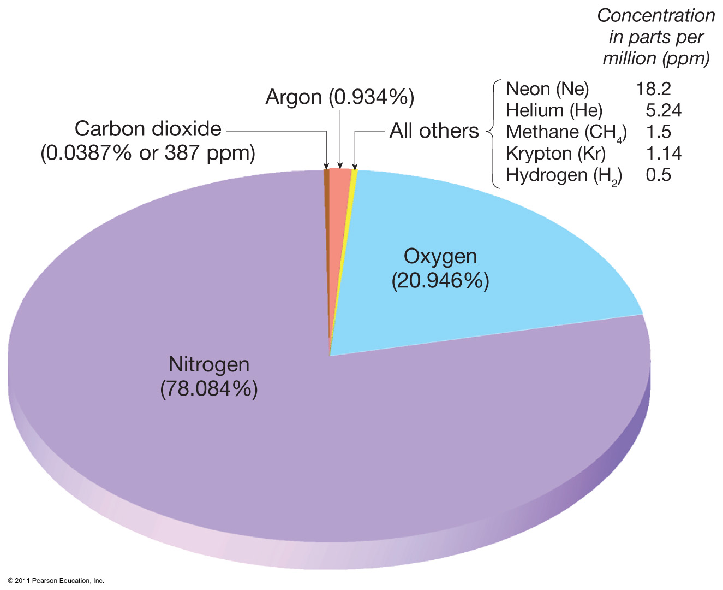
Composition of dry air

Slide 6
Composition of the atmosphere
Variable components of air
1. Water vapor
Up to about 4 percent of the air’s volume
Forms clouds and precipitation
Absorbs heat energy from Earth
2. Aerosols
Tiny solid and liquid particles
Water vapor can condense on solids
Reflect sunlight
Help color sunrise and sunset

Slide 7
Composition of the atmosphere
3. Ozone
Three atoms of oxygen (O₃)
Distribution not uniform
Concentrated between 10 to 50 kilometers above the surface
Absorbs harmful UV radiation
Human activity is depleting ozone by adding chlorofluorocarbons (CFCs)

Slide 8
Structure of the atmosphere
Pressure changes
Pressure is the weight of the air above.
Average sea level pressure
Slightly more than 1000 millibars
About 14.7 pounds per square inch
Pressure decreases with altitude
One half of the atmosphere is below 3.5 miles (5.6 kilometers)
Ninety percent of the atmosphere is below 10 miles (16 kilometers)

Slide 9
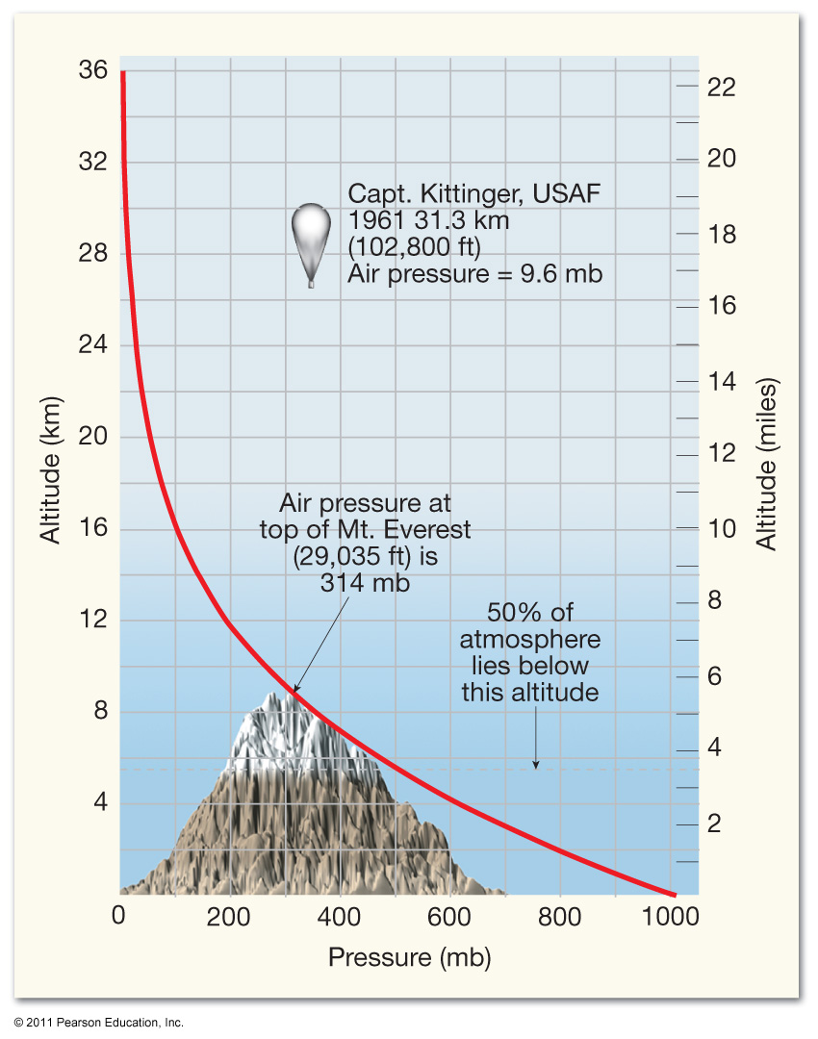
Atmospheric pressure variation with altitude

Slide 10
Structure of the atmosphere
Atmospheric layers based on temperature
1. Troposphere
Bottom layer
Temperature decreases with altitude—Called the environmental lapse rate
6.5˚C per kilometer (average)
3.5˚F per 1000 feet (average)
Thickness varies—Average height is about 12 kilometers
Outer boundary is named the tropopause

Slide 11
Structure of the atmosphere
2. Stratosphere
About 12 kilometers to 50 kilometers
Temperature increases at top
Outer boundary is named the stratopause
3. Mesosphere
About 50 kilometers to 80 kilometers
Temperature decreases
Outer boundary is named the mesopause

Slide 12
Structure of the atmosphere
4. Thermosphere (Ionosphere)
No well-defined upper limit
Fraction of atmosphere’s mass
Gases moving at high speeds

Slide 13
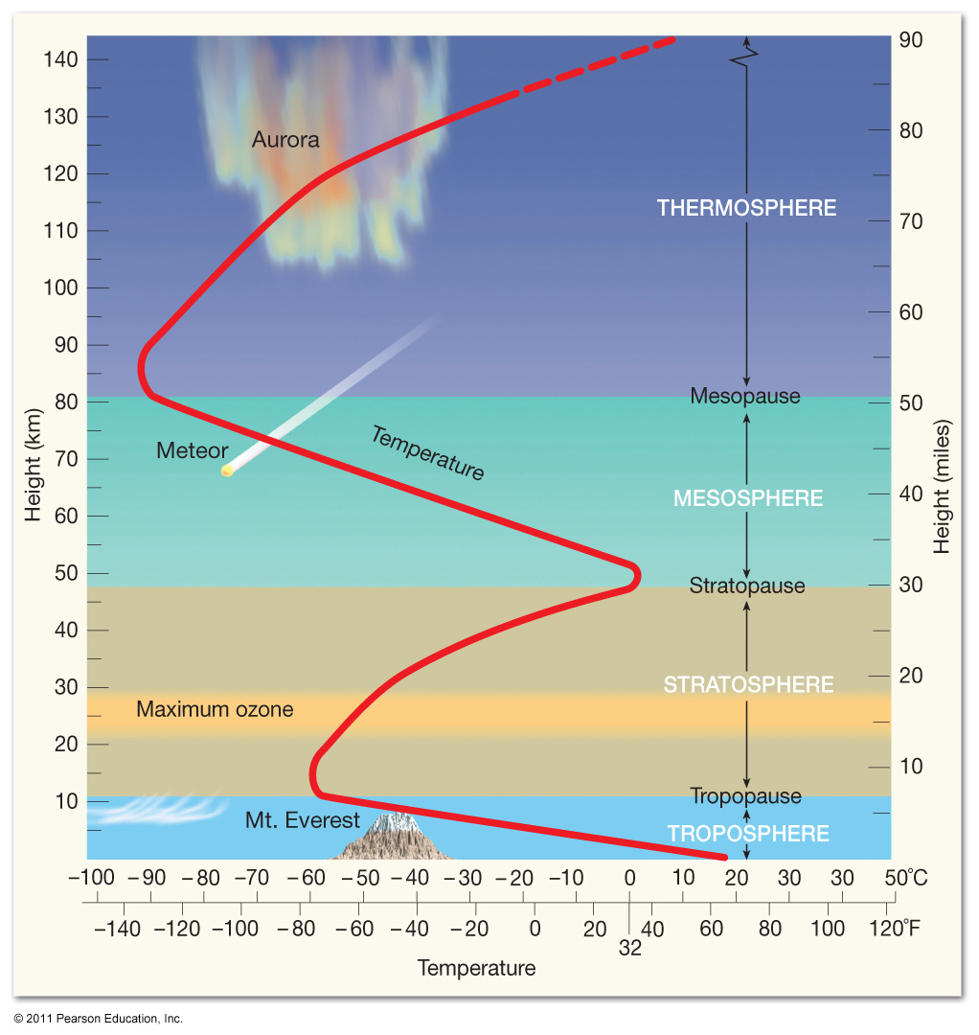
Thermal structure of the atmosphere

Slide 14
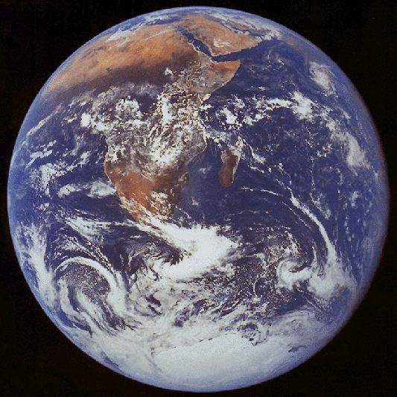
قال تعالى: ( قُلِ انظُرُواْ مَاذَا فِي السَّمَاوَاتِ وَالأَرْضِ). [ يونس : 101]

Slide 15
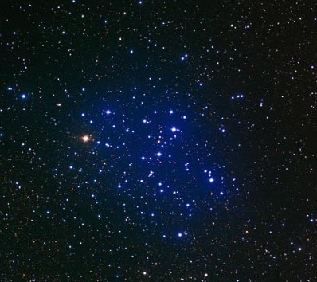
آل عمران: 190 ـ 191.
وقوله‏‏ سبحانه‏:‏ ]لخلق السماوات والأرض أكبر من خلق الناس ولكن أكثر الناس لا يعلمون[ ‏(‏غافر‏:57).‏

Slide 16
يحمينا من الاشعاعات الشمسية الضارة مثل الأمواج فوق البنفسجية وأشعة اكس وإشعاعات جاما

Slide 17
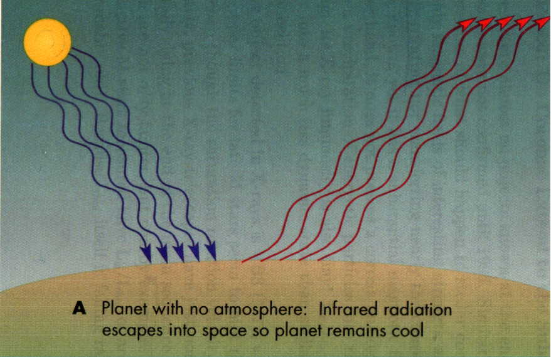
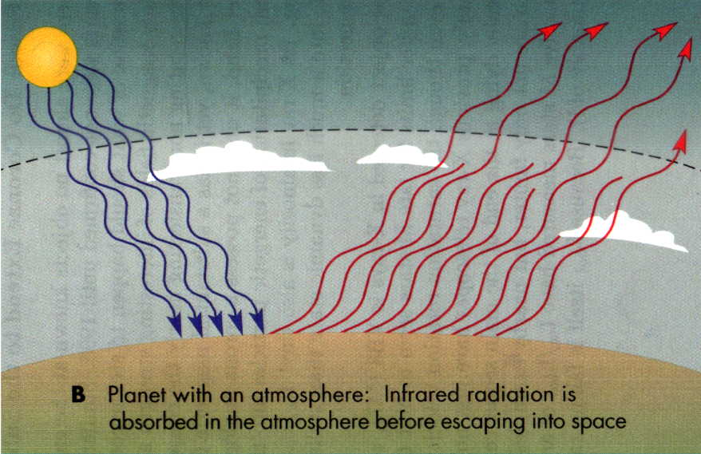
* يحفظ الكوكب من التغيرات
الكبيرة في درجات الحرارة
* يعمل كسقف يعكس الأمواج الراديوية.

Slide 18
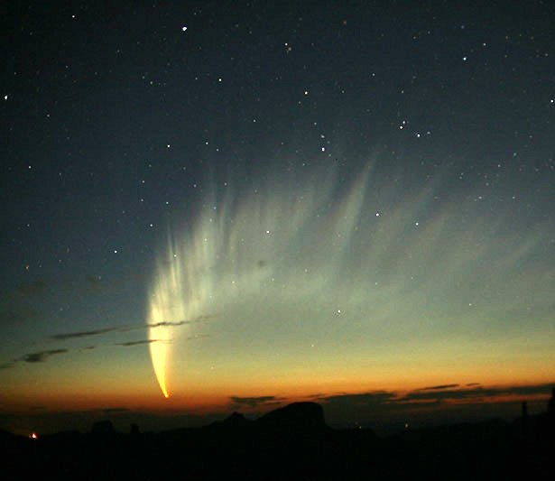
يحمي الأرض من الشهب، هو يمثل سقفاً يحفظ الأرض من زخات الشهب والنيازك

Slide 19
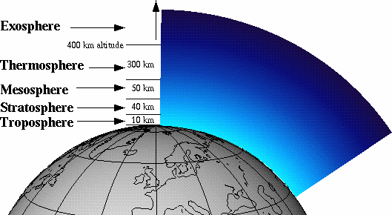
يقول جل وعلا: (وجعلنا السماء سقفا محفوظا وهم عن اياتها معرضون) الأنبياء 32

Slide 20
تأثيرات المجال الجوي:
الشهب ,الأشعة فوق البنفسجية ,أشعة إكس وجاما وأشعة كونية ورياح شمسية, اتصالات, بيت زجاجي .
(1 تشتت الضوء وعلاقته بلون السماء .
سبب التشتت: ذرات الأكسجين والنيتروجين في الغلاف الجوي
عند الظهر :أزرق؟
وجد أن التشتت يتناسب عكسيا مع القوة الرابعة للطول الموجي، وبالتالي فان اللون البنفسجي والأزرق هو الأكثر تشتتا. وبما أن الأزرق هو اللون الأكثر وفرة في الطيف المرئي لذلك تظهر السماء باللون الأزرق؟
* فكر لماذا تظهر السماء باللون الأحمر عند الشروق والغروب؟
(2 مواقع الأجرام السماوية النجوم:
* ترى في غير مواقعها :الشمس في حالة الغروب وفي حالة الشروق تبدو عالية تبدو أعلى من موقعها.
سبب ذلك إنكسار الضوء مع زيادة كثافة الغلاف الجوي من أعلى الى اسفل.

Slide 21
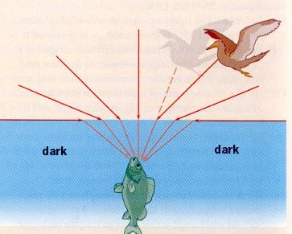

Slide 22
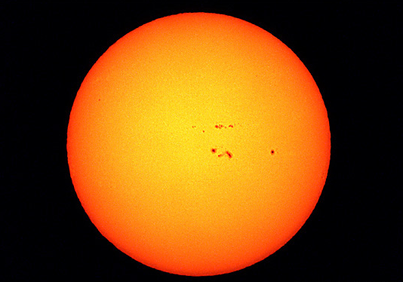
يقول تعالى: (فلا اقسم بمواقع النجوم وانه قسم لو تعلمون عظيم)
مستحيل أن نرى الشمس أو أي نجم اخر !!!

Slide 23
(3 الشفق: يؤثر الغلاف الجوي في الإشعاعات القادمة من الشمس بواسطة الإنعكاس عن ذرات الغبار والدخان خاصة عند الغروب أو الشروق فيوفر ضوءاً اضافياً للنهار ويدوم حتى تصبح الشمس تحت الأفق ب 18°
(4 الرياح على سطح الأرض:
نتيجة اختلاف التسخين على سطح الأرض من ضغط عالي إلى ضغط منخفض ودوران الأرض .
(5 الشفق القطبي: تعتبر من الظواهر المرصودة في مناطق خطوط العرض العليا ومن أجملها حيث ينتج الشفق القطبي نتيجة تحرك الجسيمات المشحونة الصادرة من التأججات الشمسية في المجالات المغناطيسية الموجودة حول الأرض حيث تتجمع هذه الجسيمات عند قطبي الكرة الأرضية الشمالي و الجنوبي حيث يحدث تفريغ كهربائي هائل يظهر أثره على شكل سحب من الشرار الكهربائي ذو ألوان مختلفة وجميلة.

Slide 24
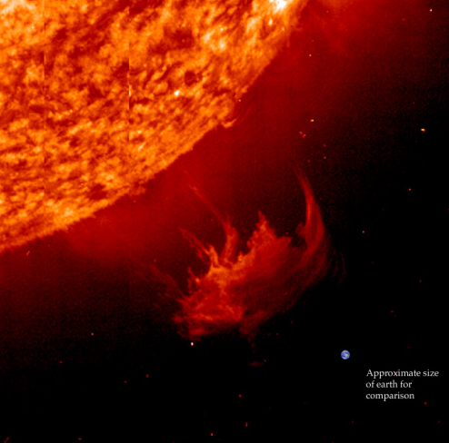
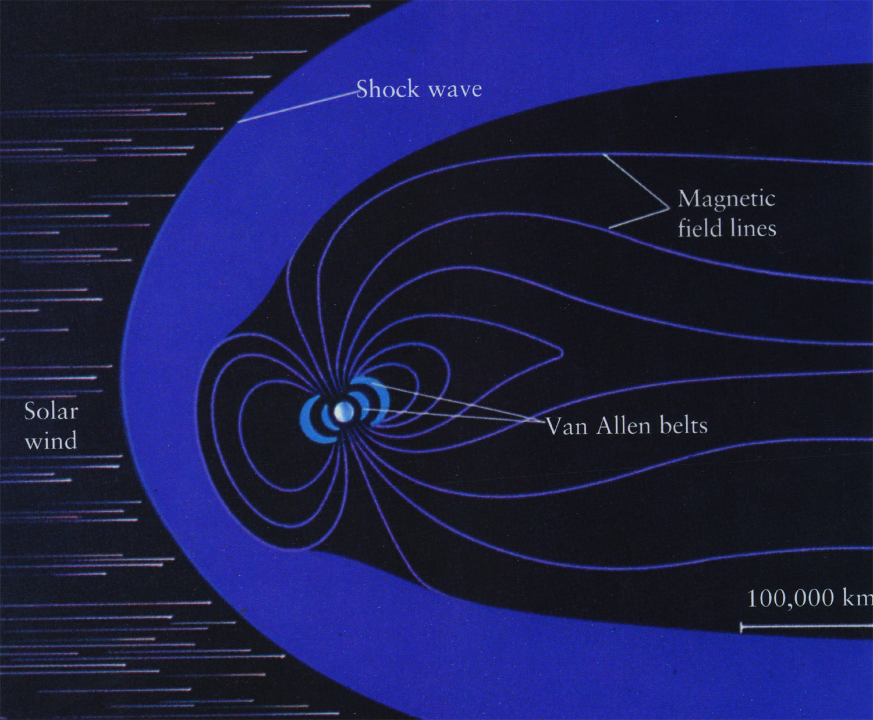

Slide 25
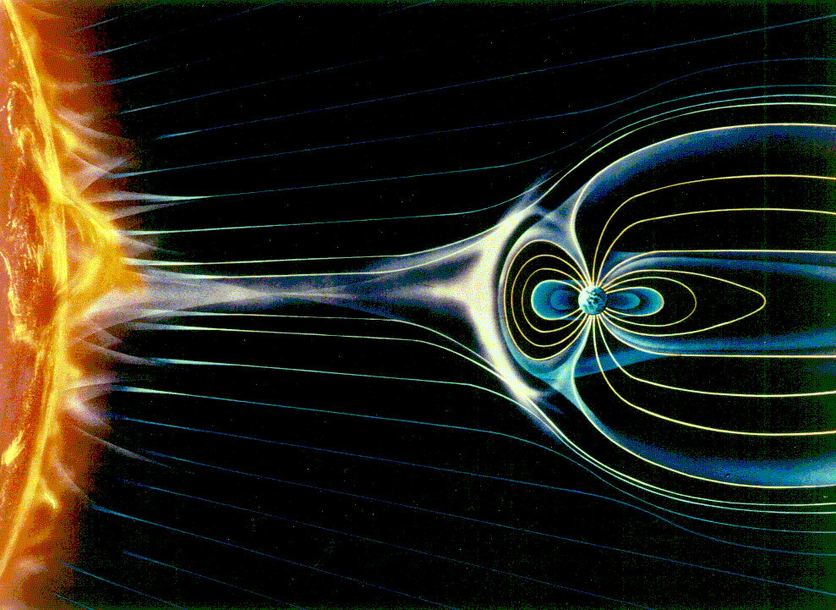

Slide 26
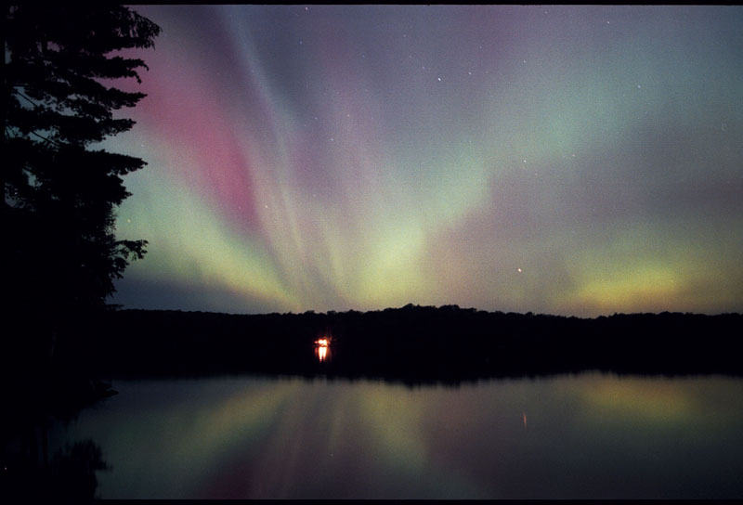

Slide 27
Earth–Sun relations
Earth motions
Rotates on its axis
Revolves around the Sun
Seasons
Result of
Changing Sun angle
Changing length of daylight

Slide 28
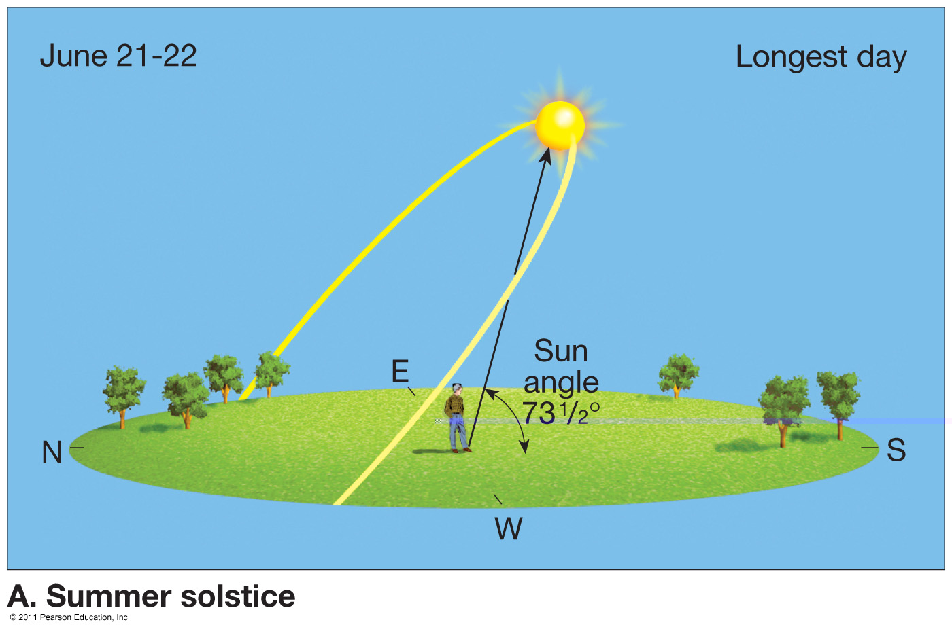
Daily paths of the Sun at 40° N latitude - June

Slide 29
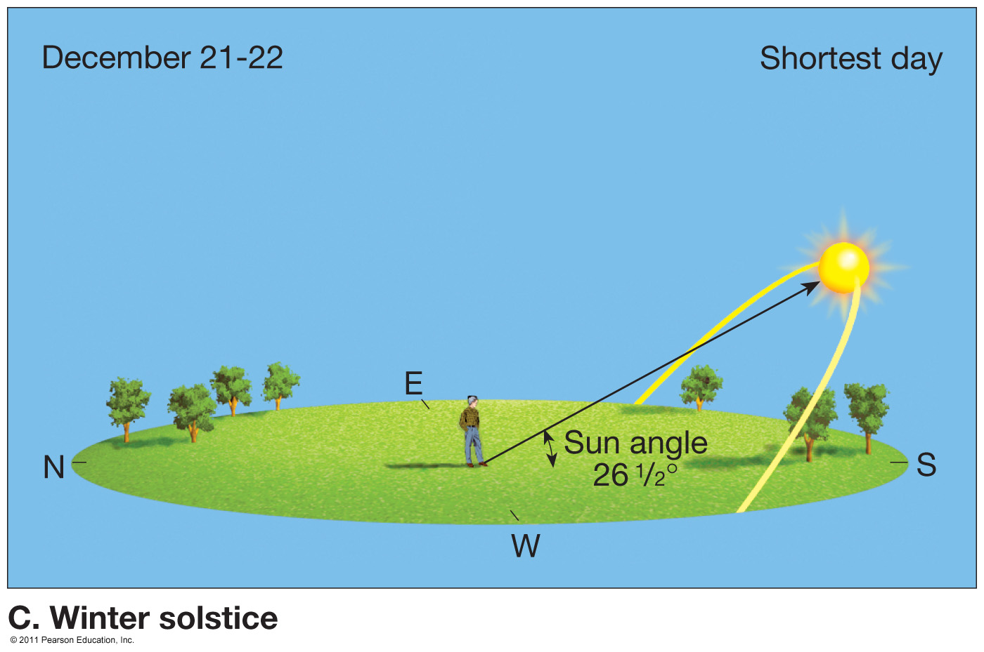
Daily paths of the Sun at 40° N latitude - December

Slide 30
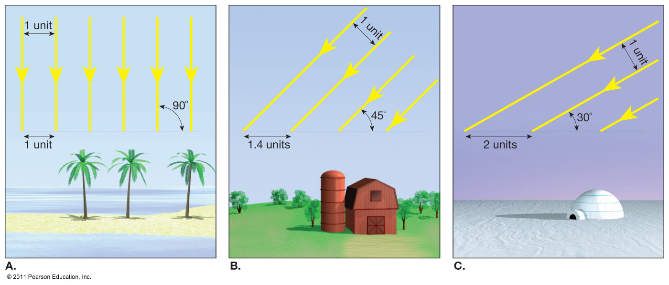
Relationship of sun angle and intensity of solar radiation

Slide 31
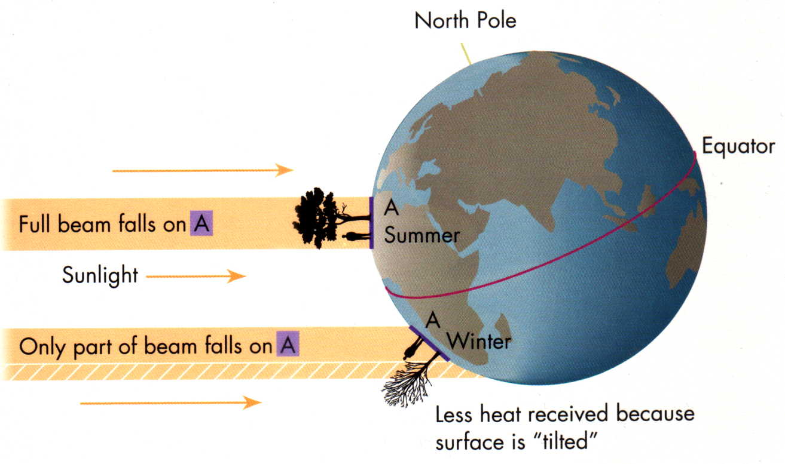

Slide 32
Earth–Sun relations
Seasons
Caused by Earth’s changing orientation to the Sun
Axis is inclined 23½ degrees
Axis is always pointed in the same direction
Special days (Northern Hemisphere)
A. Summer solstice
June 21
Sun’s vertical rays are located at the tropic of Cancer (23½ degrees north latitude)

Slide 33
Earth–Sun relations
B. Winter solstice
December 21
Sun’s vertical rays are located at the tropic of Capricorn (23½ degrees south latitude)
C. Autumnal equinox
September 23
Sun’s vertical rays are located at the equator (0 degrees latitude)

Slide 34
Earth–Sun relations
D. Spring equinox
March 21
Sun’s vertical rays are located at the equator (0 degrees latitude)

Slide 35
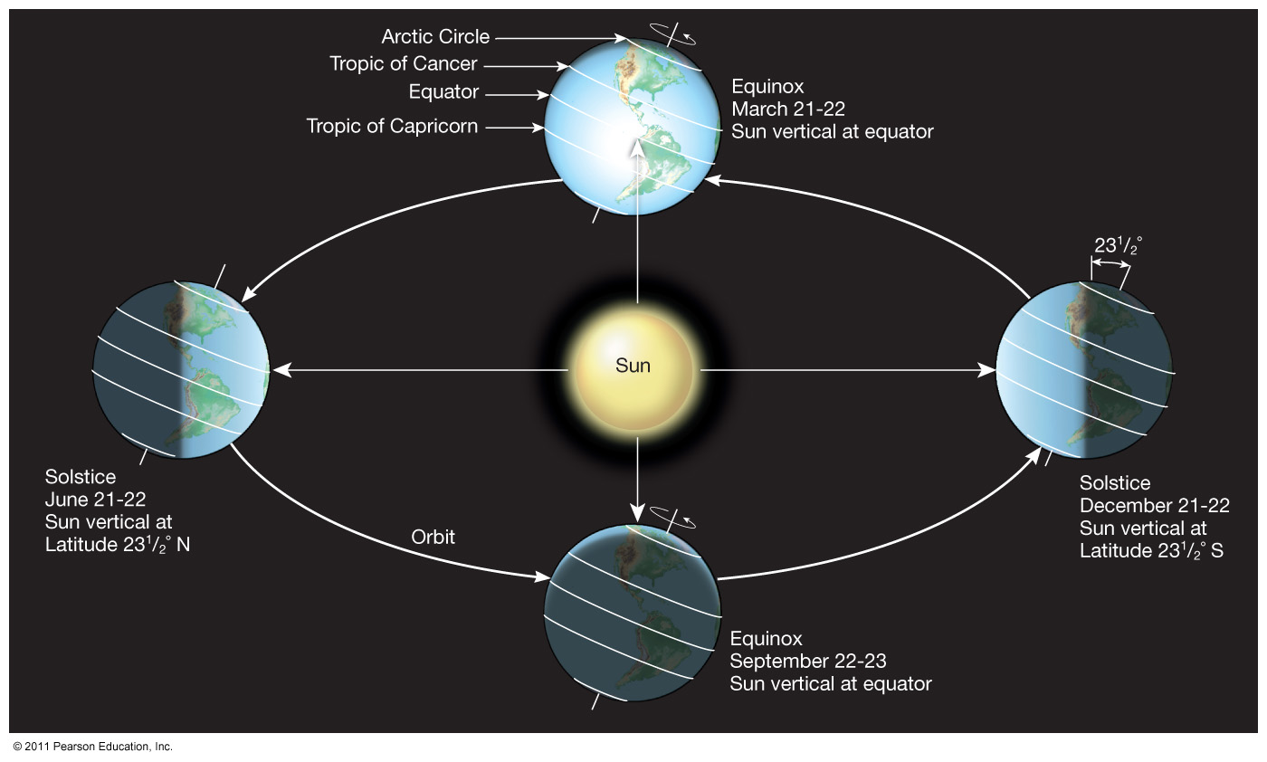
Earth–Sun relationships

Slide 36
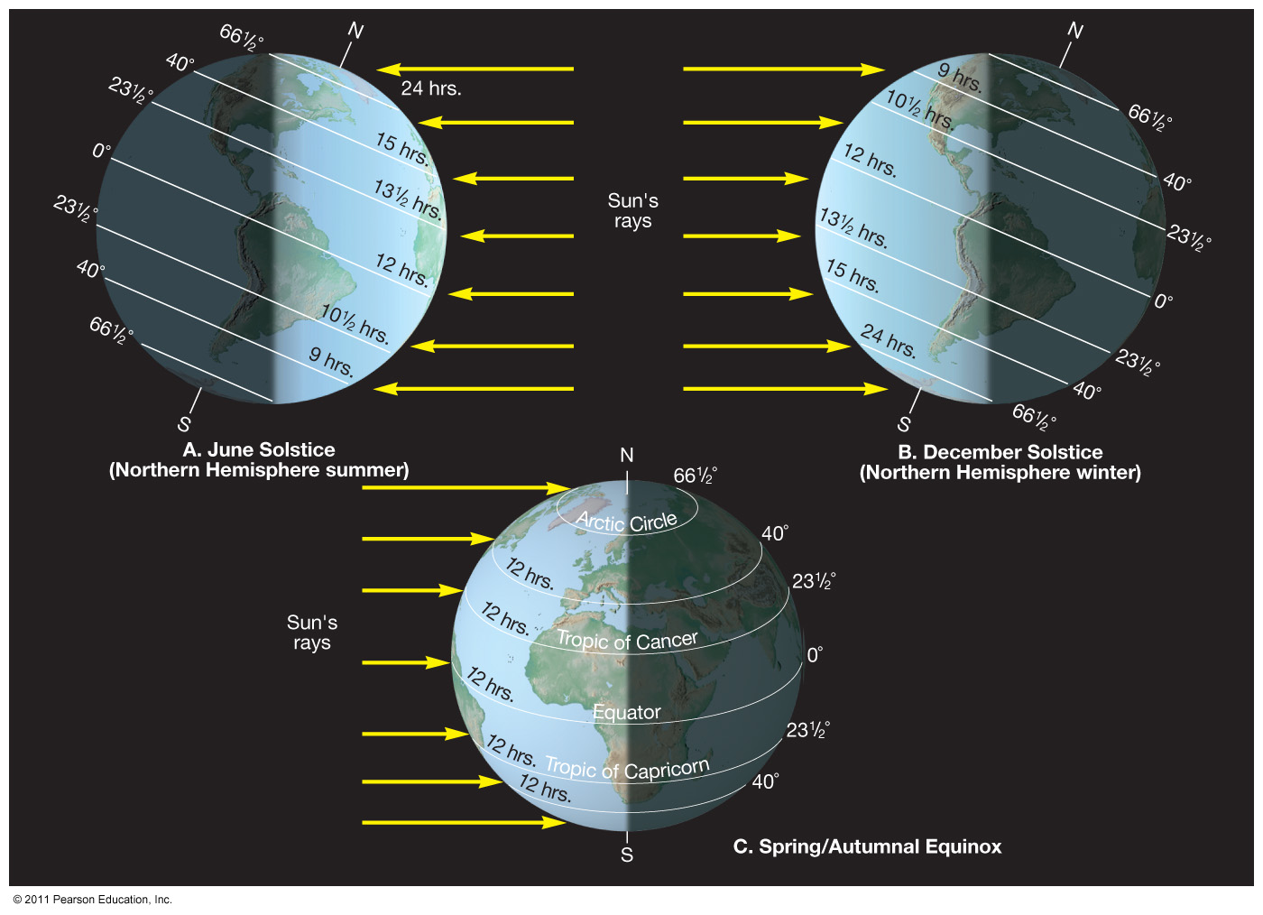
Characteristics of the solstices and equinoxes

Slide 37
Atmospheric heating
Heat is always transferred from warmer to cooler objects
Mechanisms of heat transfer
Conduction through molecular activity
Convection
Mass movement within a substance
Radiation (electromagnetic radiation)
Velocity: 300,000 kilometers (186,000 miles) per second in a vacuum

Slide 38
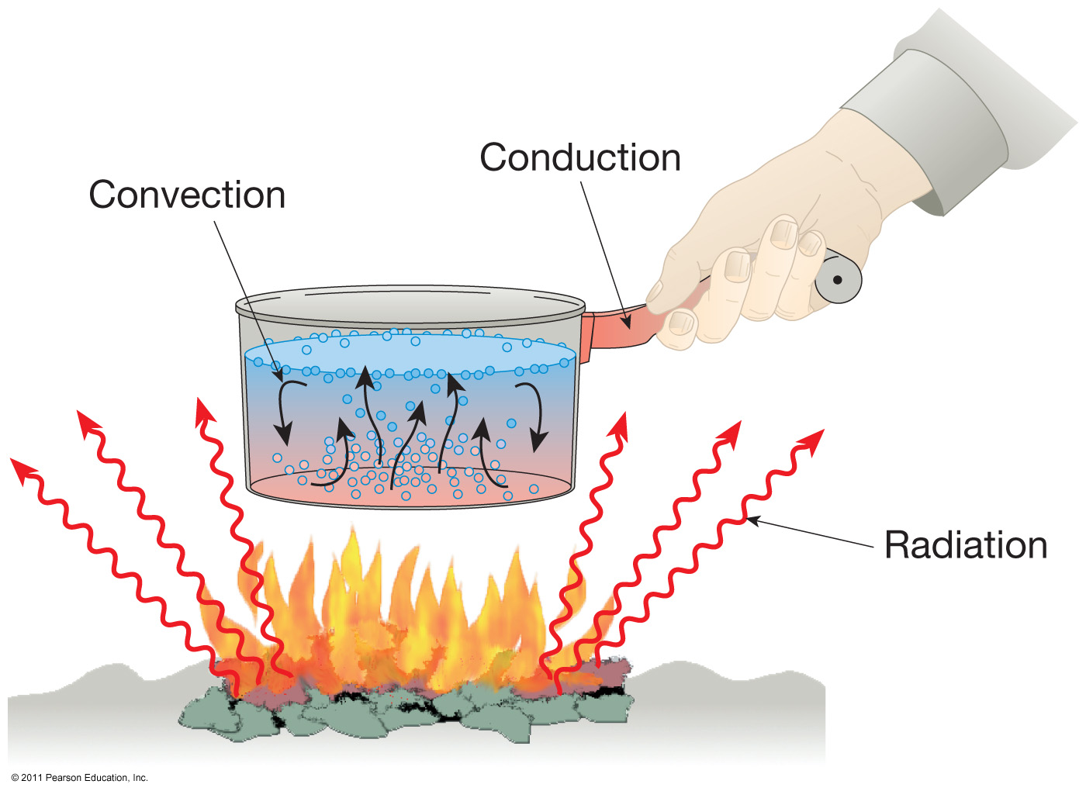
Mechanisms of heat transfer

Slide 39
Atmospheric heating
Radiation (electromagnetic radiation)
Consists of different wavelengths
Gamma (very short waves)
X-rays
Ultraviolet (UV)
Visible
Infrared
Microwaves and radio waves

Slide 40
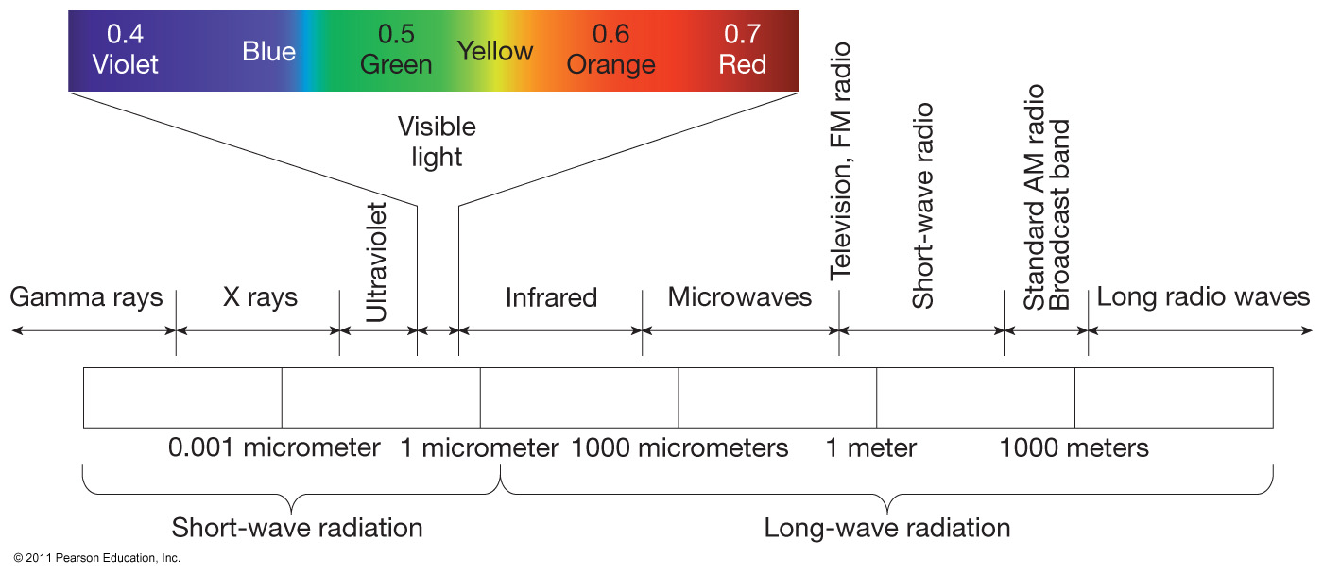
The electromagnetic spectrum

Slide 41
Atmospheric heating
Governed by basic laws
Hotter objects radiate more total energy per unit area than do cooler objects
The hotter the radiating body, the shorter the wavelength of maximum radiation
Objects that are good absorbers of radiation are good emitters as well

Slide 42
Atmospheric heating
Incoming solar radiation
Atmosphere is largely transparent to incoming solar radiation
Atmospheric effects
Reflection—Albedo (is the fraction of total radiation reflected by surface. It is about 30%.)
Scattering
Absorption
Most visible radiation reaches the surface
About 50 percent absorbed at Earth’s surface

Slide 43
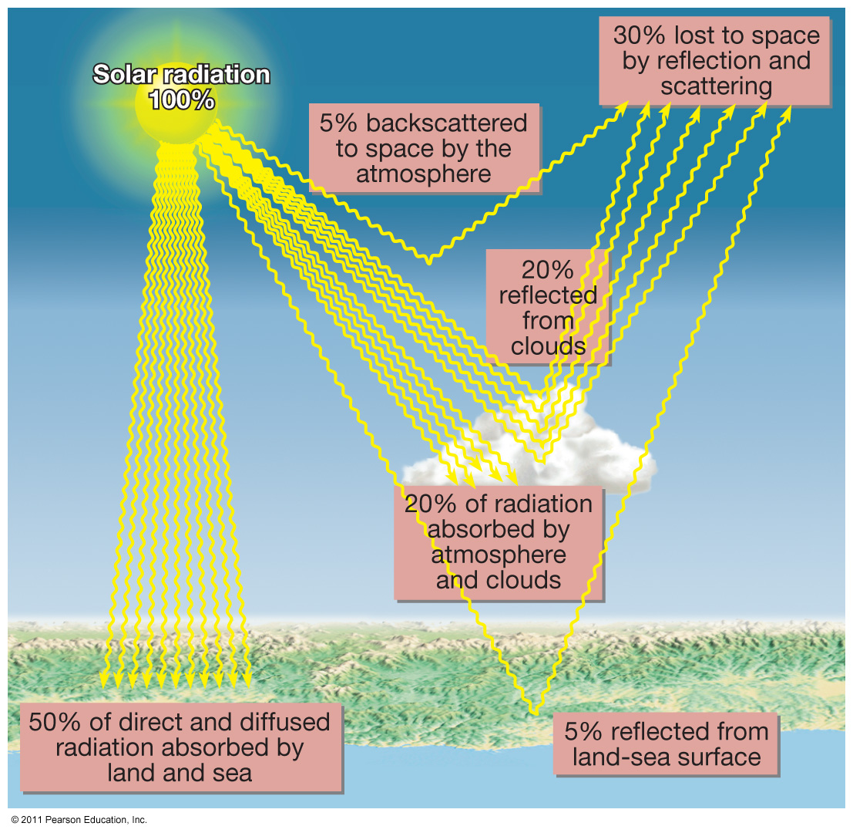
Average distribution of incoming solar radiation

Slide 44
Atmospheric Heating
Radiation from Earth’s surface
Earth re-radiates radiation (terrestrial radiation) at the longer wavelengths
Longer wavelength terrestrial radiation is absorbed by
Carbon dioxide and water vapor
Lower atmosphere is heated from Earth’s surface
Heating of the atmosphere is termed the greenhouse effect

Slide 45
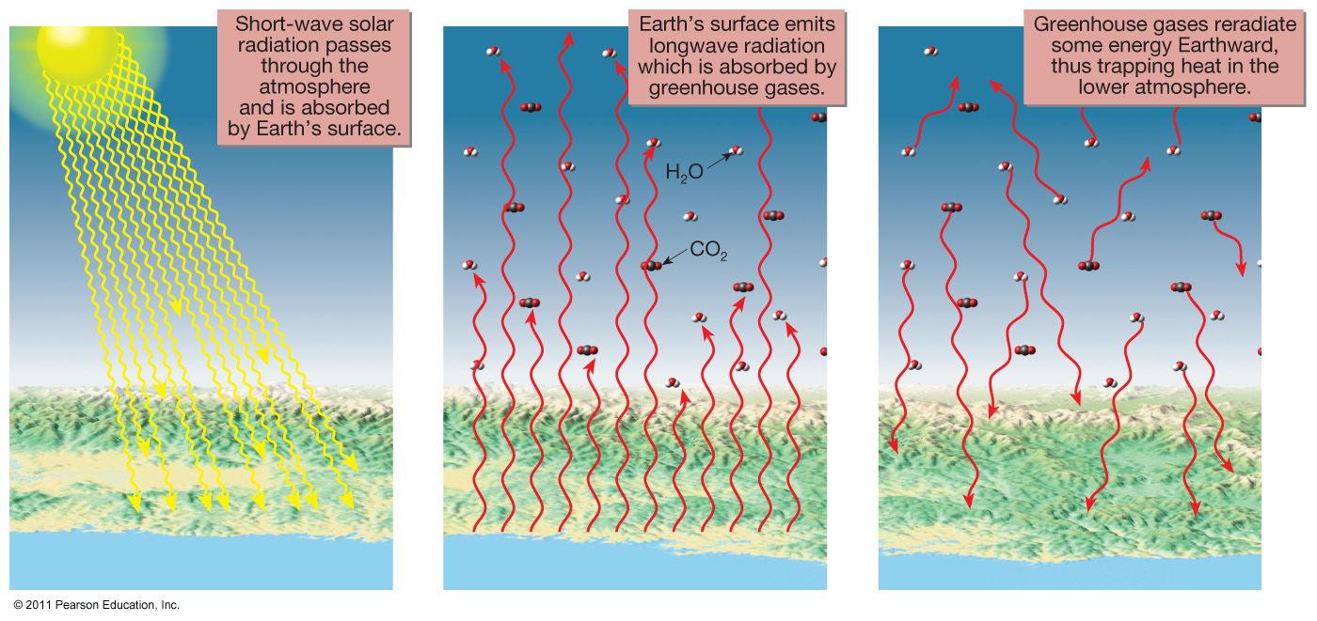
Heating of the atmosphere

Slide 46
Temperature measurement
Daily maximum and minimum
Other measurements
Daily mean temperature
Daily range
Monthly mean
Annual mean
Annual temperature range

Slide 47
Controls of temperature
Temperature variations
Receipt of solar radiation is the most important control
Other important controls
1. Differential heating of land and water
Land heats more rapidly than water
Land gets hotter than water
Land cools faster than water
Land gets cooler than water

Slide 48
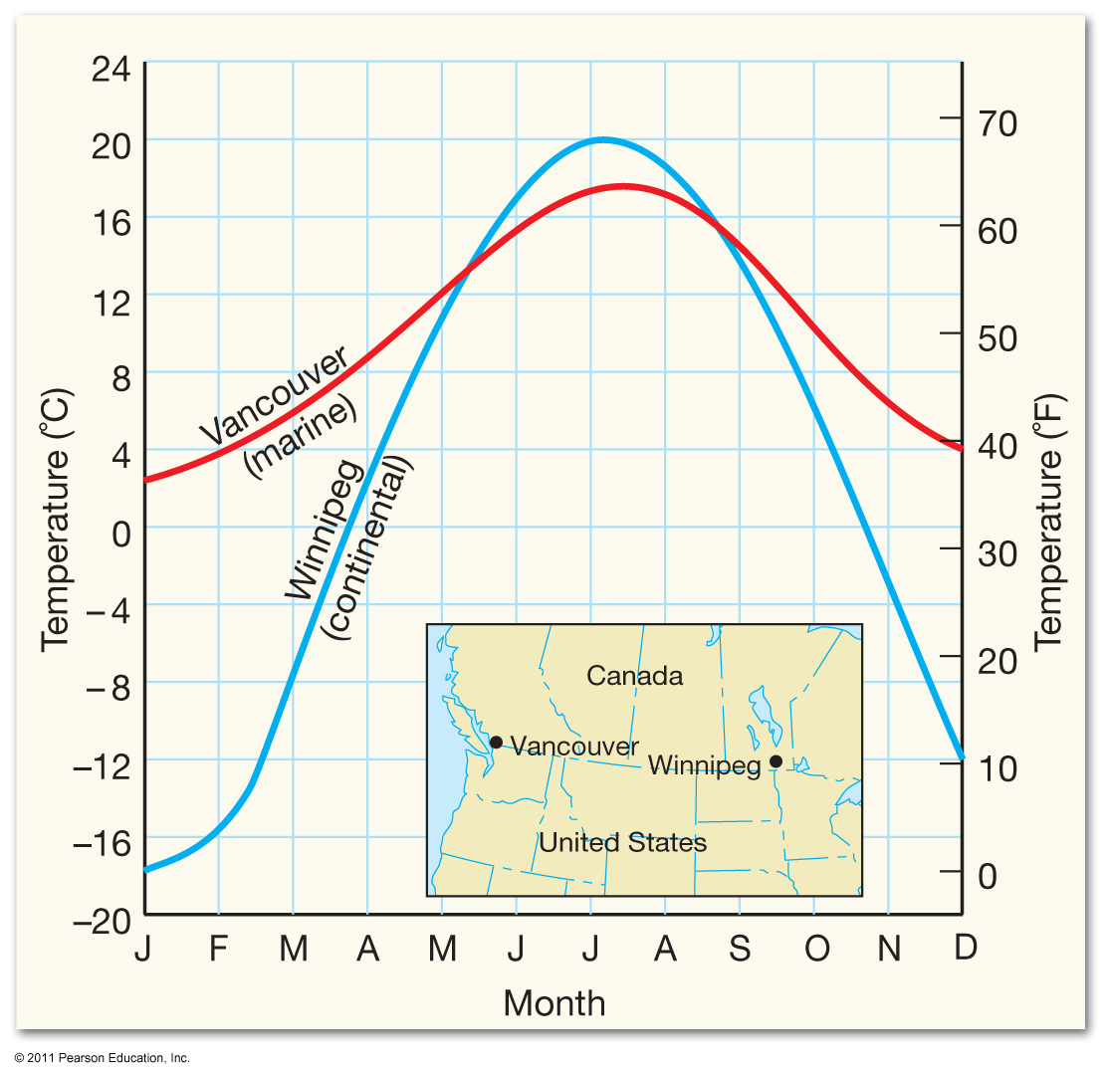
Maritime بحري Influence on temperature

Slide 49
Controls of temperature
2. Altitude
3. Geographic position
4. Cloud cover
5. Albedo

Slide 50
World Distribution of Temperature
Temperature maps
Isotherm—A line connecting places of equal temperature.
Temperatures are adjusted to sea level
January and July are used for analysis because they represent the temperature extremes

Slide 51
World Distribution of Temperature
Global temperature patterns
Temperature decreases poleward from the tropics
Isotherms exhibit a latitudinal shift with the seasons
Warmest and coldest temperatures occur over land

Slide 52
World Distribution of Temperature
Global temperature patterns
In the Southern Hemisphere
Isotherms are straighter
Isotherms are more stable
Isotherms show ocean currents
Annual temperature range
Small near equator
Increases with an increase in latitude
Greatest over continental locations

Slide 53
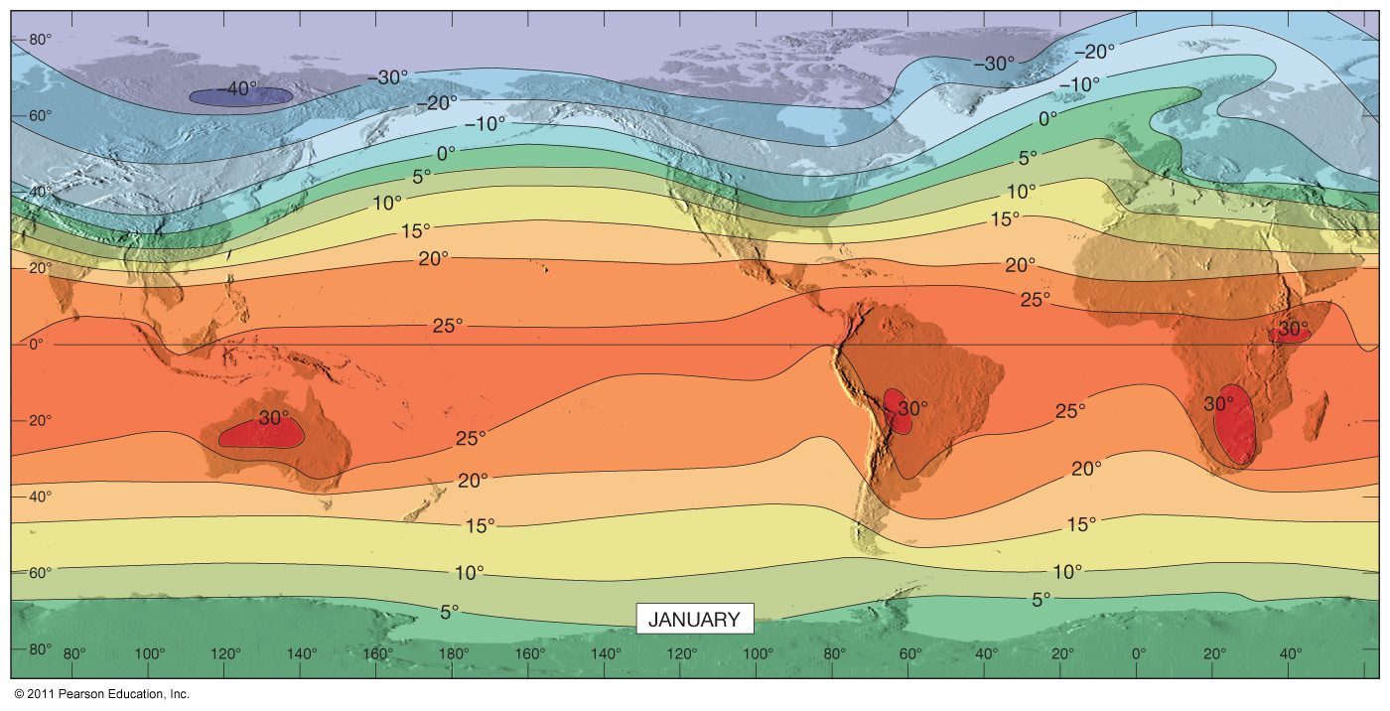
World mean sea-level temperatures in January

Slide 54
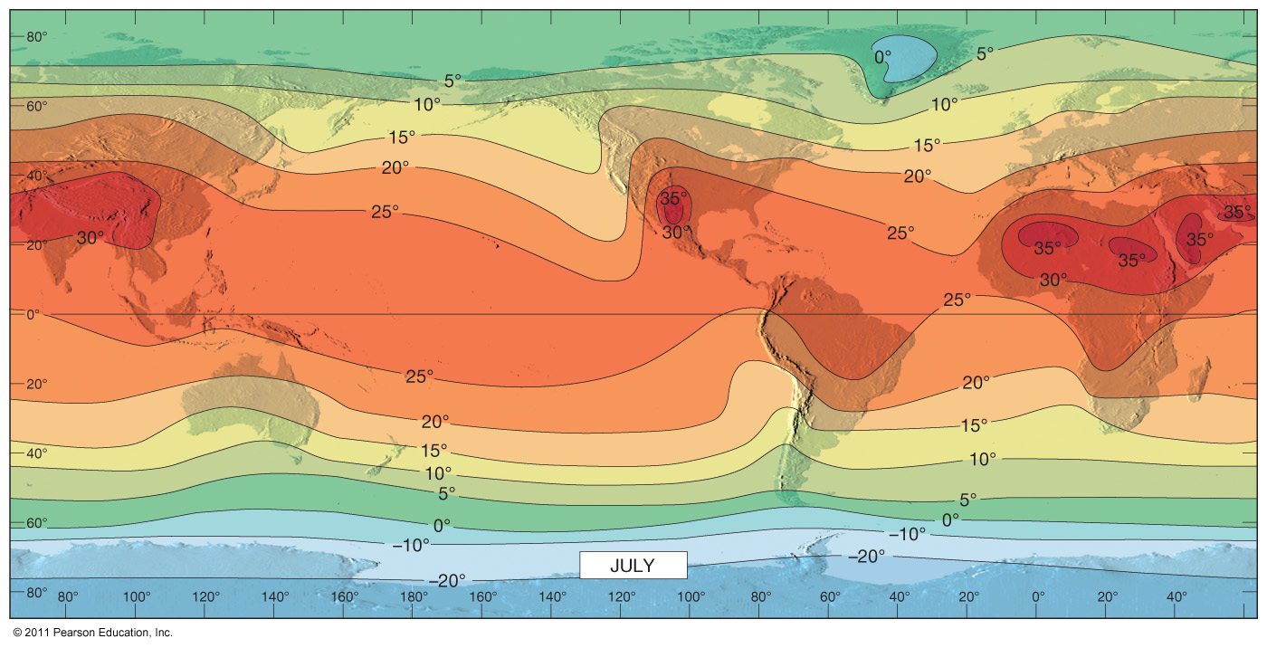
World mean sea-level temperatures in July

Slide 55
End of Chapter 11

