Slide 1
Chapter 20
Amines

Slide 2
1. Nomenclature
1º Amines
2º Amines

Slide 3
3º Amines

Slide 4
1A. Arylamines

Slide 5
1B. Heterocyclic Amines

Slide 6
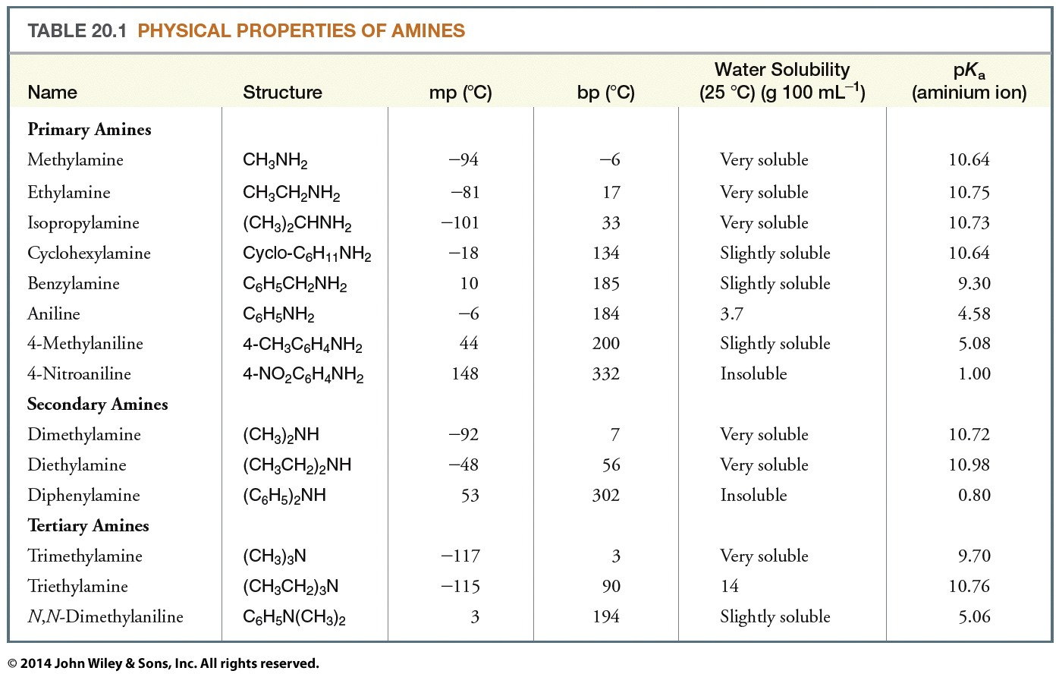
2. Physical Properties and Structure of Amines
2A. Physical Properties

Slide 7
2B. Structure of Amines
N: sp³ hybridized
Trigonal pyramidal
Bond angles close to 109.5º

Slide 8
3. Basicity of Amines: Amine Salts

Slide 9
The aminium ion of a more basic amine will have a larger pK_{a} than the aminium ion of a less basic amine

Slide 10
>
>
By releasing electrons, R— stabilizes the alkylaminium ion through dispersal of charge
>

Slide 12
3A. Basicity of Arylamines

Slide 13
Five resonance structures

Slide 14
Only two resonance structures

Slide 15
3C. Amines versus Amides
Amides are far less basic than amines (even less basic than arylamines). The pK_{a} of the conjugate acid of a typical amide is ~zero
Larger resonance stabilization
Smaller resonance stabilization

Slide 16
<
>

Slide 17
3D. Aminium Salts and Quaternary Ammonium Salts
Cannot act
as bases
However, R₄N⊕ ⊖OH are strong bases (as strong as NaOH)

Slide 18
3E. Solubility of Amines in Aqueous Acids

Slide 19
4. Preparation of Amines
4A. Through Nucleophilic Substitution Reactions
Alkylation of ammonia

Slide 21
Alkylation of azide ion and reduction

Slide 22
The Gabriel synthesis

Slide 23
Alkylation of 3º amines

Slide 24
4B. Preparation of Aromatic Amines through Reduction of Nitro Compounds

Slide 25
4C. Preparation of 1º, 2º, & 3º Amines through Reductive Amination

Slide 26
Mechanism

Slide 27
Examples

Slide 28
4D. Preparation of 1º, 2º, & 3º Amines through Reduction of Nitriles, Oximes, and Amides

Slide 29
Examples

Slide 30
Examples

Slide 31
4E. Preparation of Primary Amines
through the Hofmann and Curtius Rearrangements
Hofmann rearrangement

Slide 32
Examples

Slide 33
Mechanism

Slide 34
Curtius rearrangement

Slide 35
5. Reactions of Amines
Acid-base reactions
Alkylation

Slide 36
Acylation

Slide 37
Electrophilic aromatic substitution
NH₂: powerful activating group, ortho-para director

Slide 38
5A. Oxidation of Amines

Slide 39
6. Reactions of Amines with Nitrous Acid
Nitrous acid (HONO) is a weak, unstable acid

Slide 40
6A. Reactions of Primary Aliphatic
Amines with Nitrous Acid
1º aliphatic amine
(aliphatic diazonium salt)
(highly unstable)

Slide 41
6B. Reactions of Primary Arylamines
with Nitrous Acid
(arenediazonium salt)
(stable at <5ºC)

Slide 42
Mechanism

Slide 43
Mechanism (Cont'd)
diazonium ion

Slide 44
6C. Reactions of Secondary Amines with Nitrous Acid
N-Nitroso-
amines

Slide 45
6D. Reactions of Tertiary Amines with Nitrous Acid

Slide 46
7. Replacement Reactions of Arenediazonium Salts

Slide 47
7A. Syntheses Using Diazonium Salts

Slide 48
7B. The Sandmeyer Reaction: Replacement of the Diazonium Group by —Cl, —Br, or —CN

Slide 51
7C. Replacement by —I

Slide 52
7D. Replacement by —F

Slide 53
7E. Replacement by —OH

Slide 54
7F. Replacement by Hydrogen: Deamination by Diazotization

Slide 55
8. Coupling Reactions of Arenediazonium Salts

Slide 56
Examples

Slide 57
Examples

Slide 58
Examples

Slide 59
9. Reactions of Amines with Sulfonyl Chlorides

Slide 60
9A. The Hinsberg Test
Sulfonamide formation is the basis for a chemical test, called the Hinsberg test, that can be used to demonstrate whether an amine is primary, secondary, or tertiary

Slide 61
1º Amine

Slide 62
2º Amine

Slide 63
3º Amine

Slide 64
10. Synthesis of Sulfa Drugs

Slide 65
11. Analysis of Amines
11A. Chemical Analysis
Dissolve in dilute aqueous acid
Moist pH paper
⇒ basic
Hinsberg test
1º aromatic amines
⇒ azo dye formation with 2-naphthol

Slide 66
12. Eliminations Involving Ammonium Compounds
12A. The Hofmann Elimination

Slide 68
Although most eliminations involving neutral substrates tend to follow the Zaitsev rule, eliminations with charged substrates tend to follow what is called the Hofmann rule and yield mainly the least substituted alkene

Slide 70
12B. The Cope Elimination

Slide 71
13. Summary of Preparations and Reactions of Amines
Preparation of amines

Slide 73
Reactions of amines

