Slide 1
Principals of History Taking in Orthopaedics
DR. MONTHER GHARAIBEH

Slide 2
Aims
General history taking structure
Specific symptoms to think about in Orthopaedics
History in Trauma patients

Slide 3
Structure
Patient profile
Presenting complaints
Analysis of chief complaint
Past medical and surgical history
Social history
Family history

Slide 4
Symptoms in Orthopaedics
Pain
Swelling
Stiffness
Deformity
Weakness
Instability
Change in sensibility
Loss of function

Slide 5
Pain
Analysis: SOCRATES
Progression:
Neoplasia: Constant pain
Trauma: Increases up to 4-6 hours and then decreases
Acute Inflammation: Sudden increase and then subsides
Chronic inflammation: Remissions and exacerbation of disease
New origin pain in painless disease: Malignant change, Pathologic fracture
Quality:
Aching: Chronic arthritis
Stabbing: Ruptured tendon
Burning: Neuralgia
Throbbing: Abscess
Notes:
Constant? Worsened? Improved? On and off?

Slide 6
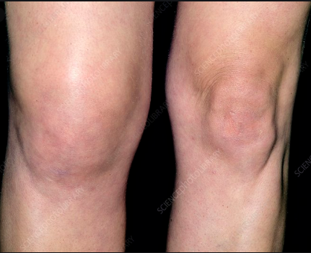
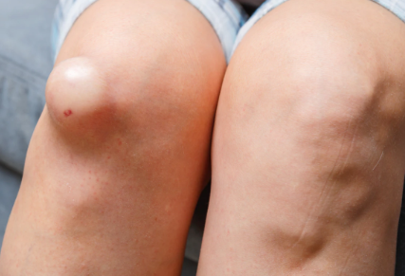
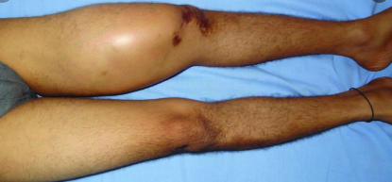
Swelling
Onset/first noticed:
rapid: hematoma, hemarthrosis
slow: inflammation, effusion, infection, tumor
Pain:
painful: acute inflammation, infection, malignancy
painless: benign growth, low grade malignancy
Progression:
constant or increasing size: neoplastic
remission: inflammatory
hardens in months: myositis ossificans

Slide 7
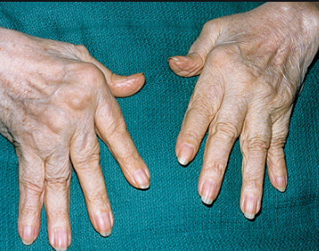
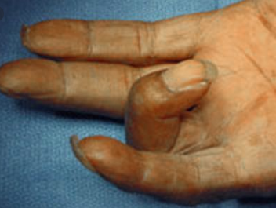
Stiffness
Location:
Generalized: RA, Ankylosing spondylitis
Localized: OA
Timing:
Early morning: RA
After a period of inactivity: OA
Stiffness vs Locking
Notes:
Locking: Sudden inability to complete a particular movement
Loose bodies
Torn meniscus
Unlocking: Offending body slips out of way

Slide 8
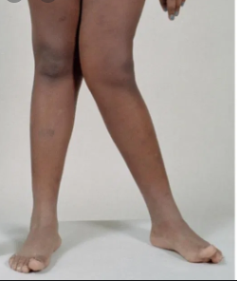
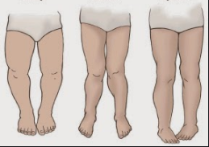
Deformity
Normal variant vs Pathological
Trauma: Dislocation, Fracture, Mal-union, Contracture
Disappear spontaneously: Pes Planus
Progressive

Slide 9
Instability
Ligamentous deficiency
Giving way
Weakness
No sensory loss: Myopathy, Motor neuropathy, Polio, Motor neuron disease
Sudden: Injury
Progressive: Neuropathy, Myopathy
Loss of function

Slide 10
Trauma History
S – Signs/Symptoms (Symptoms are important but they are subjective.)
A – Allergies
M – Medications
P – Past Pertinent medical history
L – Last Oral Intake (Sometimes also Last Menstrual Cycle.)
E – Events Leading Up To Present Illness / Injury

Slide 11
Mechanism of injury
Important in predicting the structural characteristics of the injury
Direct vs Indirect
Contact Point
Amount of force applied
Type of force transmitted
Notes:
Type:
Compression
Shear
Tensile

