Slide 1
Knee Joint Disorders
DR. MONTHER GHARAIBEH

Slide 2
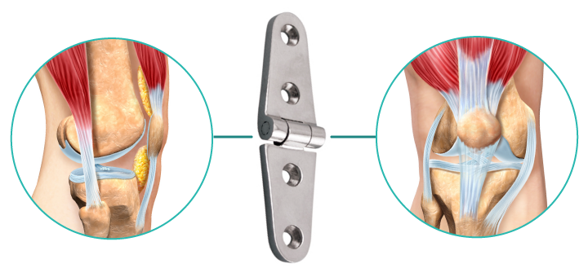
Anatomy
The knee joint is the largest and most complex joint of the body.
A modified hinge joint (it permits slight internal and external rotation at flexed knee).
It consists of three joints within a single synovial cavity:
Lateral tibiofemoral joint, between the lateral condyle of the femur, lateral meniscus, and lateral condyle of the tibia.
Medial tibiofemoral joint, between the medial condyle of the femur, medial meniscus, and medial condyle of the tibia. (carries about 90% of the load during weight bearing).
An intermediate patellofemoral joint is between the patella and the patellar surface of the femur.

Slide 3
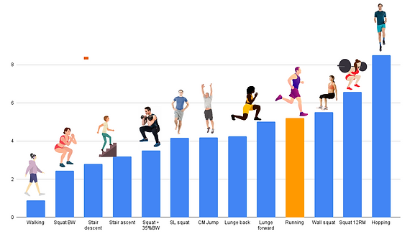
Joint function
Stability
Flexibility
Range of motion
Load transfer

Slide 4
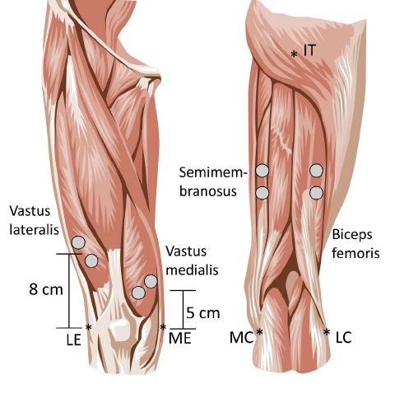
Knee Joint stability
Dynamic
All the muscle groups crossing and acting on the Joint
Ligaments
Joint Configuration

Slide 5
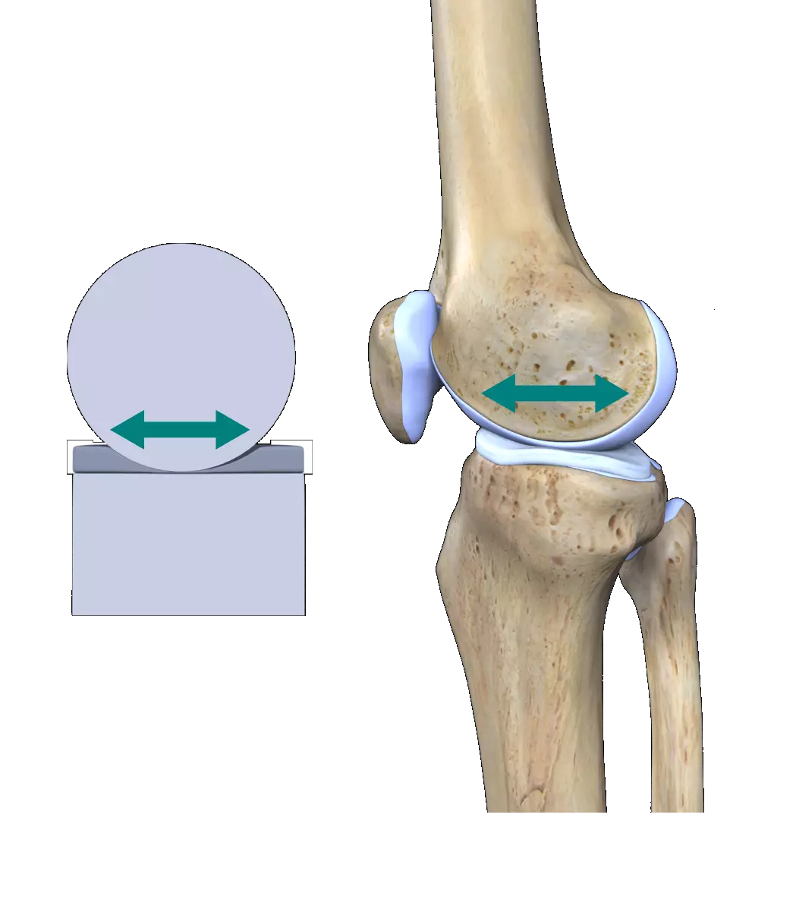
Knee Joint stability
Dynamic
Ligaments
Joint Configuration
- Tibio-femoral joint
-Patellofemoral joint

Slide 6
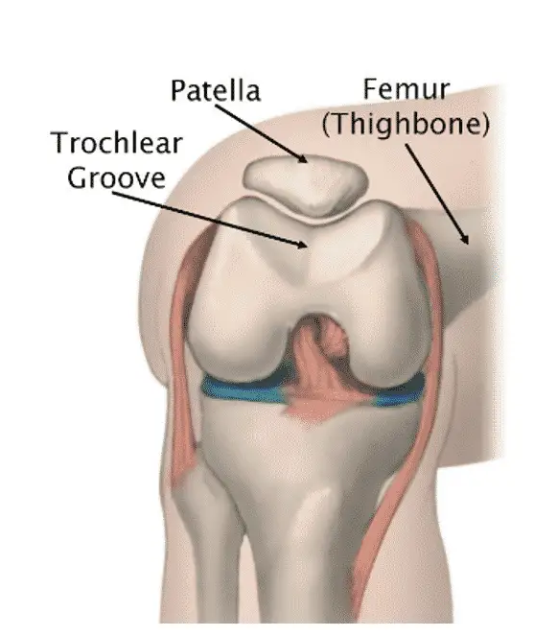
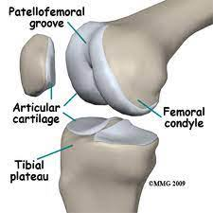
Knee Joint stability
Dynamic
Ligaments
Joint Configuration
- Tibio-femoral joint
-Patellofemoral joint

Slide 9
Anatomical components:
Patellar ligament: This continuation of the common tendon of insertion of the quadriceps femoris muscle extends from the patella to the tibial tuberosity. (anterior support).
Oblique popliteal ligament (posterior support).
Tibial (medial) collateral ligament: extends from the medial condyle of the femur to the medial condyle of the tibia (medial support).
Fibular (lateral) collateral ligament: extends from the lateral condyle of the femur to the lateral side of the head of the fibula(lateral support).
Medial and lateral patellar retinacula.(anterior support)
Arcuate popliteal ligament.(posterior support)
The tibial collateral ligament is firmly attached to the medial meniscus.

Slide 10
Intracapsular ligaments:
The anterior and posterior cruciate ligaments are named based on their origins relative to the intercondylar area of the tibia.
From their origins, they cross on their way to their destinations on the femur.
The ACL limits hyperextension of the knee and prevents the anterior sliding of the tibia on the femur.
The PCL prevents the posterior sliding of the tibia when the knee is flexed, a very important function when you walk down stairs or a steep incline.

Slide 11
Articular discs (medial and lateral menisci):
Increasing the stability of the knee.
Control the complex rolling and gliding actions of the joint.
Distributing load during movement.
Bursae:
Prepatellar bursa.
Infrapatellar bursa.
Suprapatellar bursa.

Slide 12
Symptoms of Knee Disorders
Pain (the most common symptom):
Diffuse: in inflammatory or degenerative disorders.
Gradual in onset with osteoarthritis.
Sudden and severe with gout or infection.
Localized: in mechanical disorders (meniscus or ligament).
Swelling (diffuse vs. localized // acute vs chronic)
Stiffness: pain on moving / lose of motion / loss of range of motion(sign)
Locking vs stiffness: one minute it moves perfectly and the next it can still flex as before but it cannot extend fully.
Pseudolocking: when movement suddenly stopped by pain the fear of impending pain.

Slide 13
Deformity. Mal-alignment
Giving way: A sudden loss of postural support. (Instability)
Loss of function:
Difficulty in standing up from a low chair.
Progressively diminishing walking distance.
Inability to run.
Difficulty going up and down steps.

Slide 14
Acute swilling of the entire joint
Traumatic synovitis
Post traumatic hemarthrosis
Non-traumatic hemarthrosis
Acute septic arthritis
Aseptic inflammatory arthritis
Chronic swelling of the entire joint
Non-infective arthritis
Chronic infective arthritis
Swellings in front of the knee
Prepatellar bursitis
Infrapatellar bursitis
Swellings at the back of the knee
Semimembranosus bursa enlargement
Popliteal cyst
Popliteal aneurysm
Swellings at the side of the joint
Meniscal cyst
Calcification of the collateral ligament
Bony swellings
Diffused
Localized

Slide 15
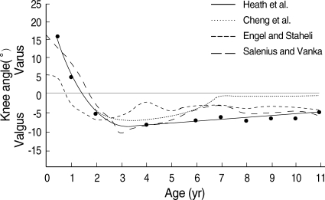
Deformities of the knee
Physiological Alignment of the knee:
Genu Varus (Bow-legs): A stages of normal development to the Age of 1.5 y.
Genu valgum (Knocked knee):
Develops at age of 2y.
Maximum physiological valgus at age of 3.5y.
Plateau to normal adulthood valgus at age of 7y.

Slide 16
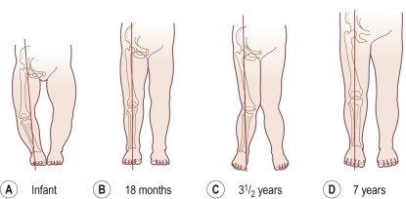
Bilateral bowlegged appearance can be recorded by measuring the distance between the knees with the child standing and the heels touching (Inter-condylar distance); it should be less than 6 cm.
Knock-knee can be estimated by measuring the distance between the medial malleoli when the knees are touching with the patellae facing forwards (Inter-malleolar distance); it is usually less than 8 cm.

Slide 17
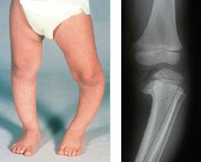
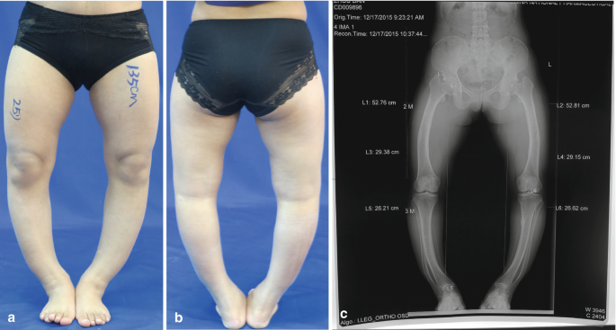
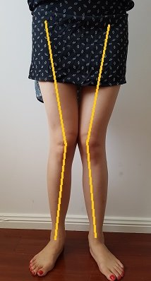
Abnormal Alignment
Unilateral deformity: usually caused by eccentric growth from the physis of the distal femur or proximal tibia; this may result from rickets, injury, infection, or an inherent growth disorder.
Severe bilateral deformity.
Progressive valgus deformity after the age of 7Y.

Slide 18
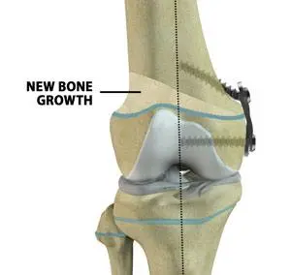
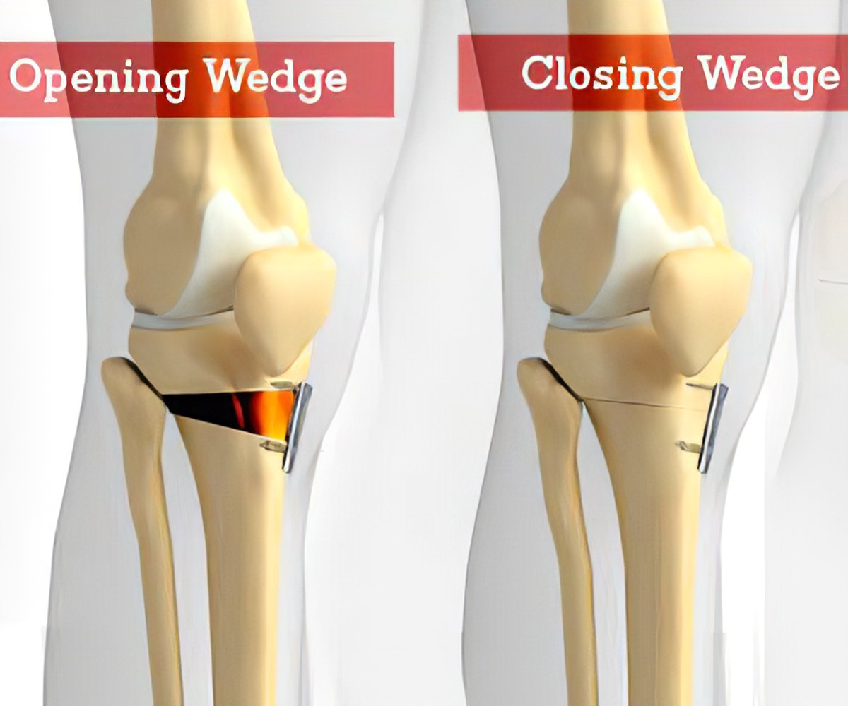
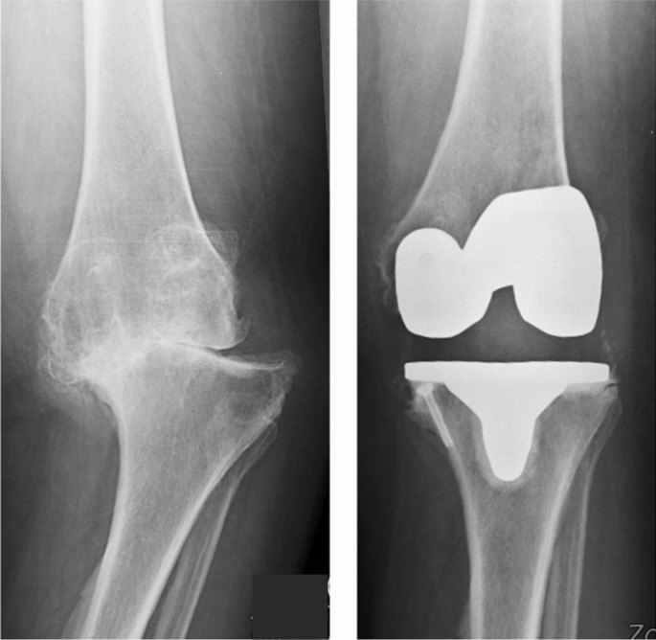
Management
Epiphysiodesis:
This is done by inserting a staple or small plate on the side of the physis that needs growth restriction (hemi-epiphyseodesis)
When the deformity has been corrected, the staple or plate is removed.
Corrective osteotomy
Joint Replacement

Slide 19
Menisci
Ligaments
Cartilage
Tendons
Soft tissue injuries

Slide 20
The knee joint is the joint most vulnerable to damage because:
It is a mobile, weight-bearing joint.
Its stability depends almost entirely on its associated ligaments and muscles.
The articular surfaces have only minimal contact throughout the range of motion.

Slide 21
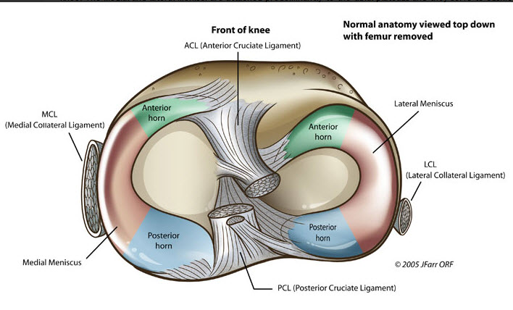
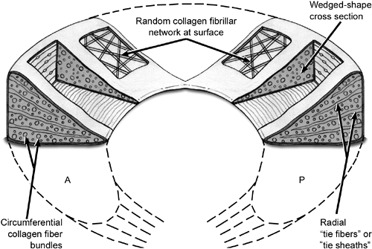
Menisci
Medial meniscus: C-shaped with triangular cross section
Lateral meniscus: more circular (the horns are closer together and approximate the ACL)
90% type I Collagen

Slide 22
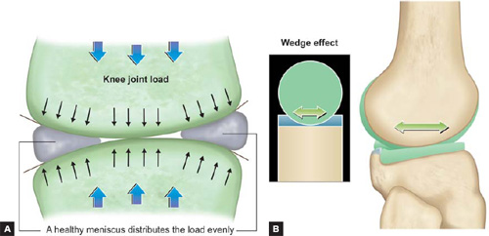
Function:
Force transmission
increasing congruency
increases contact area leads to decreased point loading
shock-absorption
transmits 50% weight-bearing load in extension, 85% in flexion
Stability

Slide 23
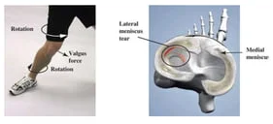
Meniscal tear
The medial meniscus is less mobile than the lateral and, the medial compartment of the knee carries about 90% of the load during weight bearing.
Accordingly, the meniscal lesions are more common on the medial side than the lateral.
It commonly affects football players when weight is being taken on the flexed knee and there is a twisting strain.
The firm attachment of the tibial collateral ligament to the medial meniscus is clinically significant, because tearing of the ligament also typically results in tearing of the meniscus.

Slide 24
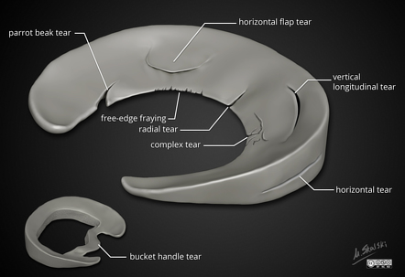
The torn portion sometimes displaces towards the center of the joint and, if trapped between femur and tibia, it can block the knee extending fully (‘locking’).

Slide 25
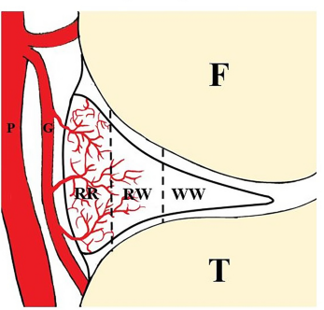
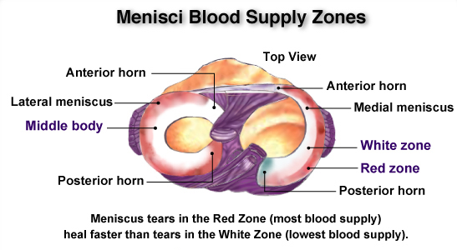
3 zones
- Red-Red
- Red-White
- White-white (avascular)

Slide 26
Symptoms
Pain localizing to medial or lateral side
mechanical symptoms (locking and clicking), especially with squatting
delayed or intermittent swelling
With rest the initial symptoms subside, only to recur periodically after trivial twists or strains.

Slide 27
On examination
The joint may be held slightly flexed and there is often an effusion.
In late presentations, the quadriceps will be wasted.
Tenderness is localized to the joint line, in the vast majority of cases on the medial side. (Most sensitive sign)
Special tests: McMurray’s test, Apley’s grinding test, Thessaly test.

Slide 28
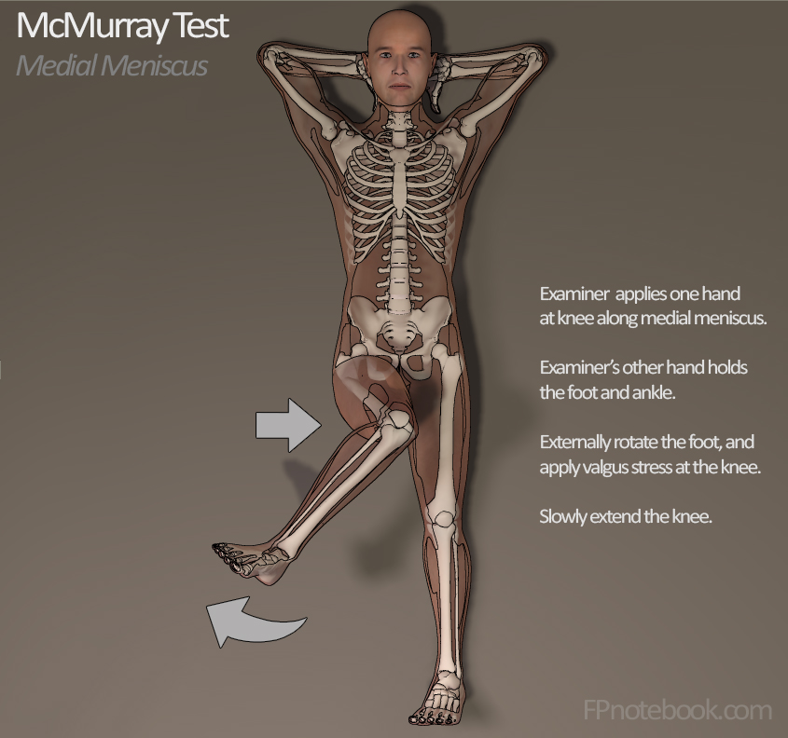
McMurray’s test is based on the fact that a loose meniscal tag can sometimes be trapped between the articular surfaces and then induced to snap free with a palpable and audible click.
A positive test is helpful but not pathognomonic and a negative test does not exclude a tear.

Slide 29
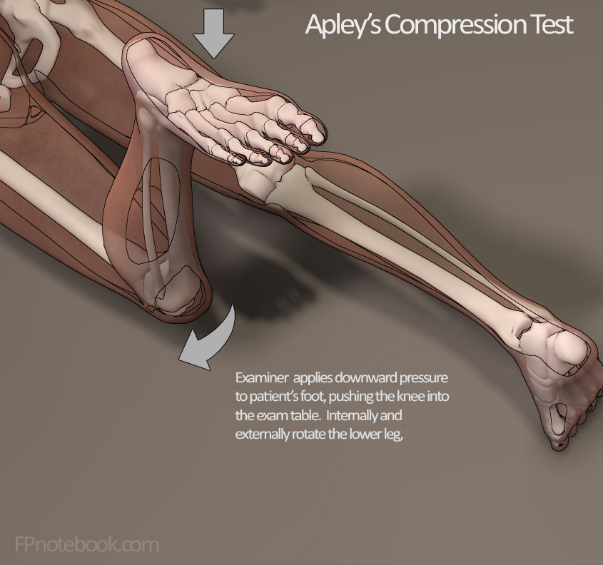
In Apley’s grinding test the meniscus is forcibly compressed and the leg is rotated from side to side between the articular surfaces; a painful response signifies the likelihood of a torn or degenerate meniscus.

Slide 30
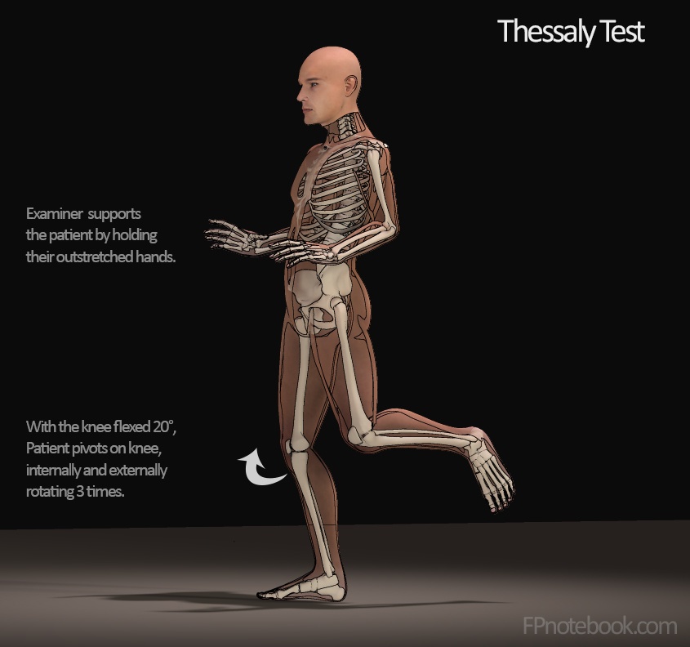
standing at 20 degrees of knee flexion on the affected limb, the patient twists with knee external and internal rotation with positive test being discomfort or clicking.

Slide 31
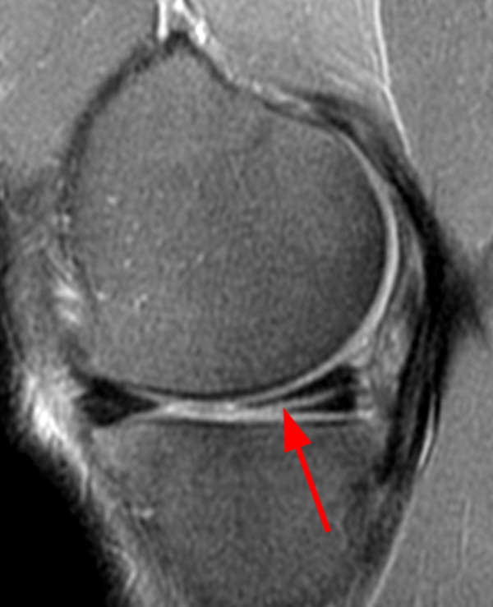
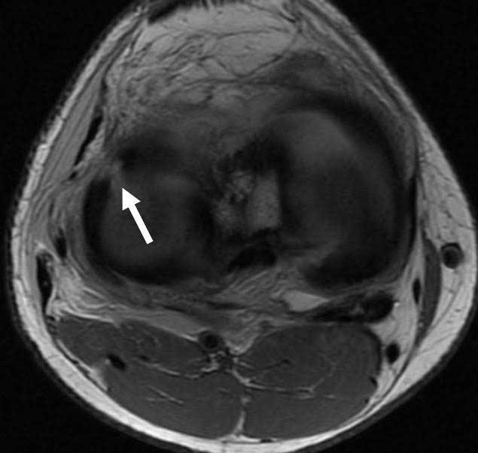
Imaging
Radiographs
Should be normal in young patients with an acute meniscal injury
MRI
MRI is most sensitive diagnostic test, but also has a high false positive rate
linear high signal that extends to either superior or inferior surface of the meniscus

Slide 32
Management
Treatment for a torn meniscus often begins conservatively:
Rest
Ice.
Analgesics.
Physiotherapy:
Physical therapy can strengthen the muscles around the knee and in legs to help stabilize and support the knee joint.
Arthroscopy:
Arthroscopy has the advantage that, if a lesion is identified, it can be treated at the same time. You have to be certain, though, that the lesion which you see is the one causing the patient’s symptoms!
If the knee remains painful despite rehabilitative therapy
If the knee cannot be unlocked.
It's sometimes possible to repair a torn meniscus
If the tear can't be repaired, the meniscus might be surgically trimmed (Partial meniscectomy)

Slide 33
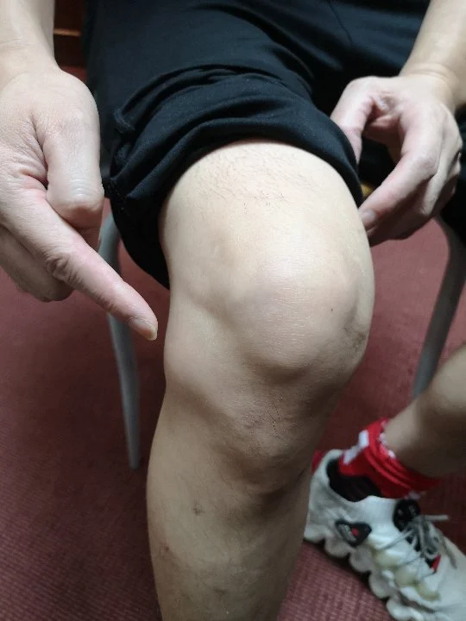
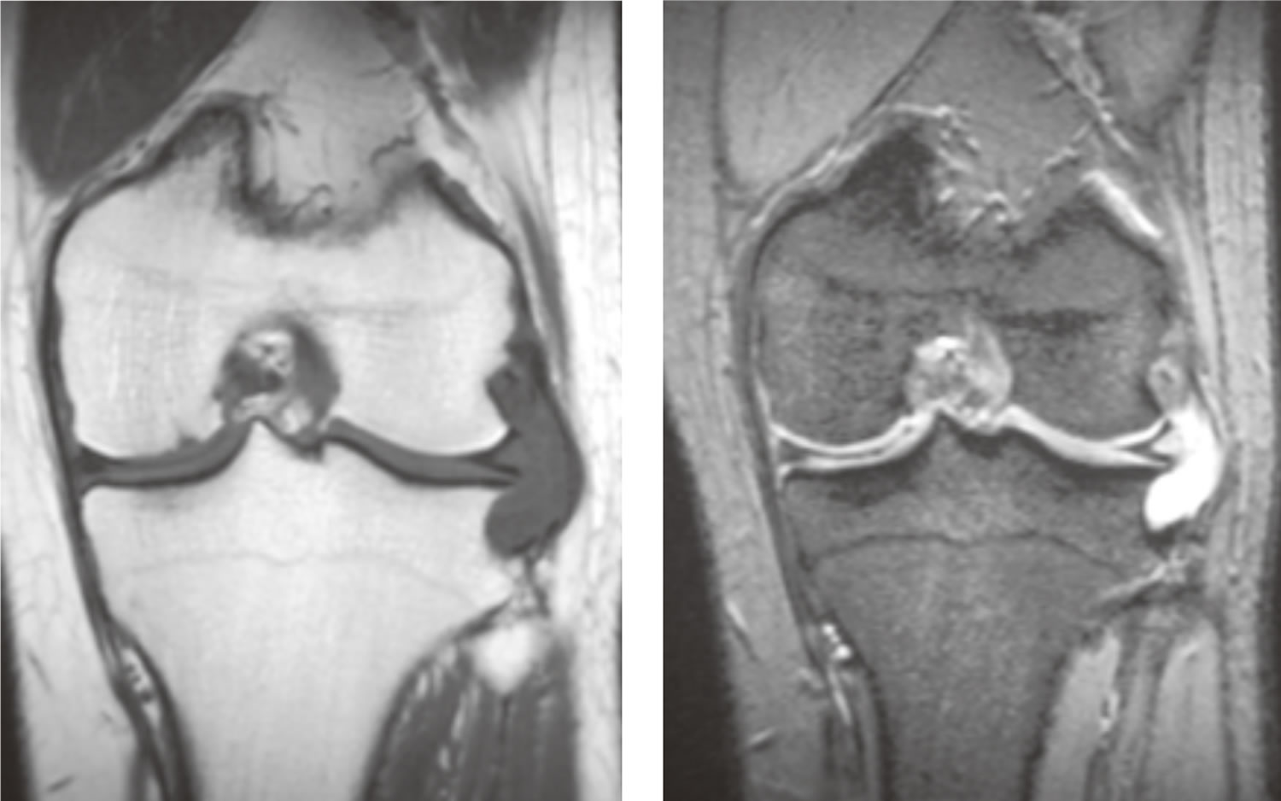
Meniscal cysts
Associated with meniscal tears (Lateral is more common)
It contains gelatinous fluid and is surrounded by fibrous tissue.
The patient presents with pain and a small lump can be seen and felt, usually on the lateral side of the joint; it may feel surprisingly firm (or tense), particularly when the knee is extended.
If the symptoms are sufficiently troublesome, the cyst can be decompressed or removed arthoscopically; any meniscal lesion can be dealt with at the same time.

Slide 34
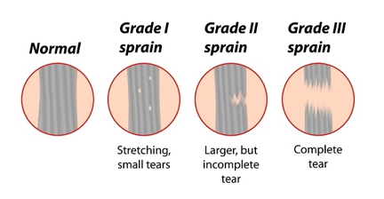

Slide 35
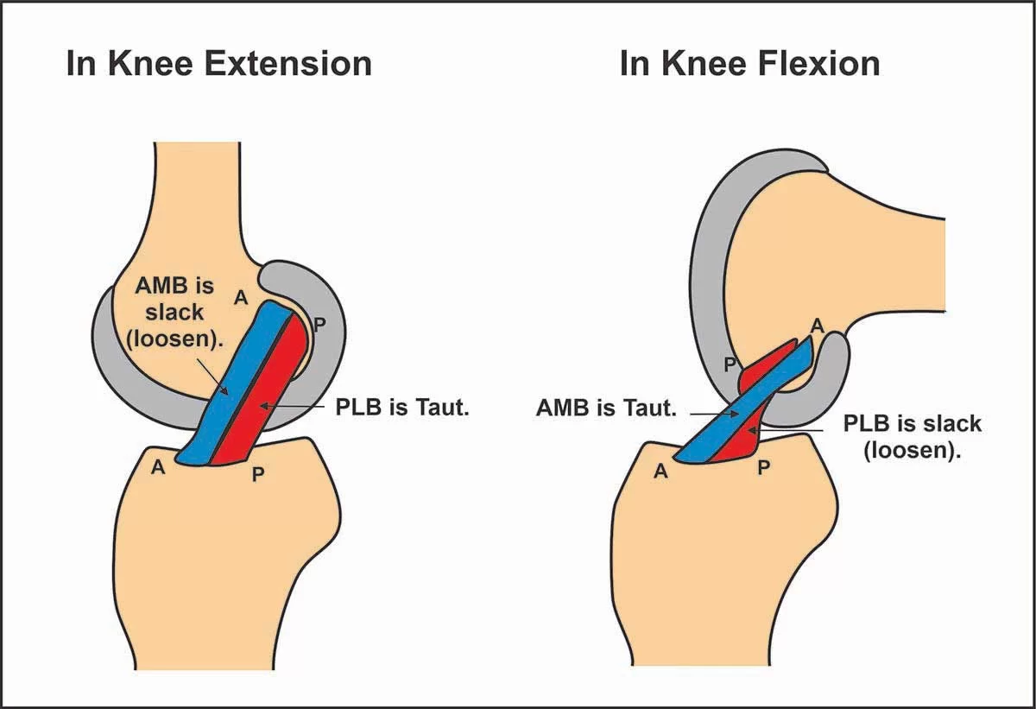
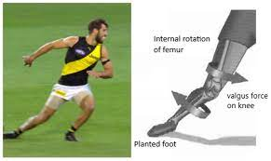
ACL injury
Most common knee ligament injury
M:F= 1:4 (among atheletes)
Non-contact pivoting: Tibia translates anteriorly while knee is in slight flexion and valgus
Presentation:
Sudden pop
Hemarthrosis
Deep knee pain

Slide 36
More sensitive is the Lachman test, but this is difficult if the patient has big thighs (or the examiner has small hands).
If the knee is stable, there should be no gliding.

Slide 37
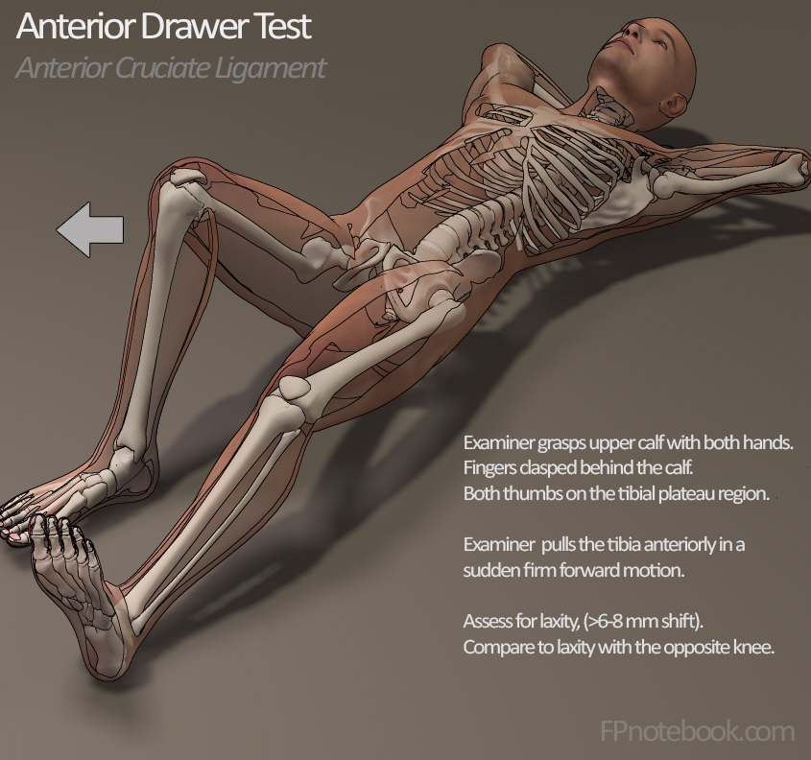
Excessive anterior movement (a positive anterior drawer sign) denotes anterior cruciate laxity; excessive posterior movement (a positive posterior drawer sign) signifies posterior cruciate laxity.

Slide 38
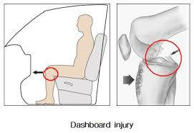
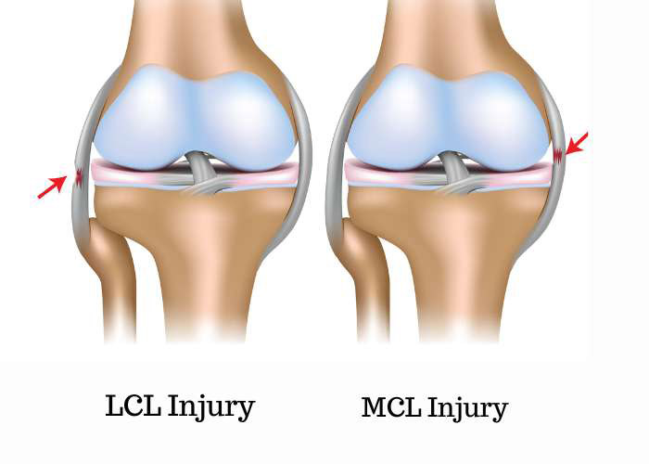
Other major ligaments
PCL
Primary restraint to posterior tibial translation
Injured due to direct blow to proximal tibia with a flexed knee (dashboard injury)
Presents with posterior knee pain and hemarthrosis
Collateral Ligaments
MCL prevents valgus instability, LCL prevents varus instability
Presented with medial or lateral knee pain with ecchymosis
Contact injury

Slide 39
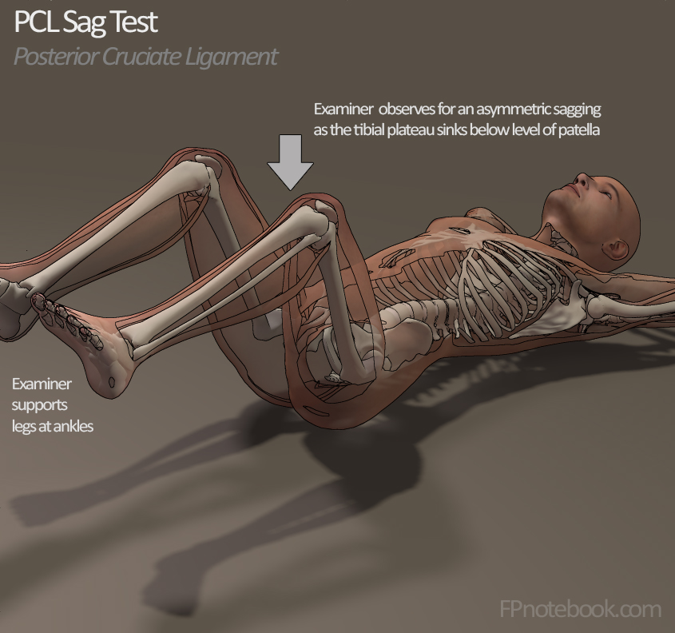

Slide 40
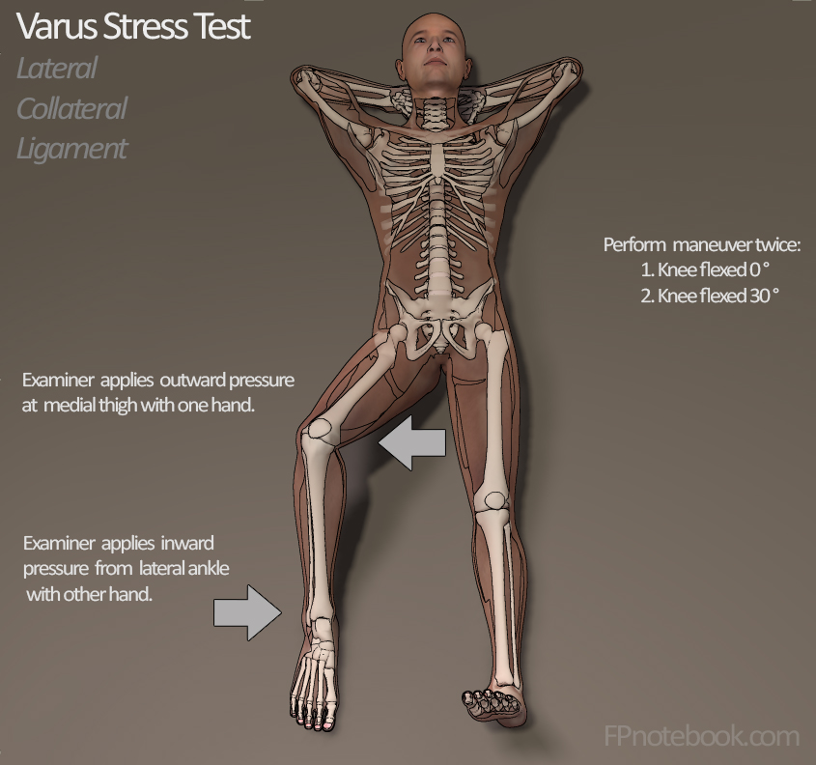
The test is performed at full extension and again at 30 degrees of flexion.
There is normally some mediolateral movement at 30 degrees, but if this is excessive (compared to the normal side) it suggests a torn or stretched collateral ligament.

Slide 41
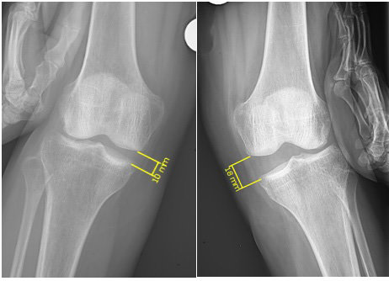
Imaging
Stress x-rays of the knee may provide visual evidence of instability.
Plain x-rays may show that the ligament has avulsed a small piece of bone:
The MCL usually from the femur.
The LCL from the fibula.
The ACL from the tibial spine.
The PCL from the back of the upper tibia.
Another sign is an avulsion fracture off the edge of the lateral tibial condyle (the so-called Segond fracture), indicating an ACL injury.
A magnetic resonance imaging (MRI) scan is usually requested. This is especially good at identifying ligament injuries.

Slide 42
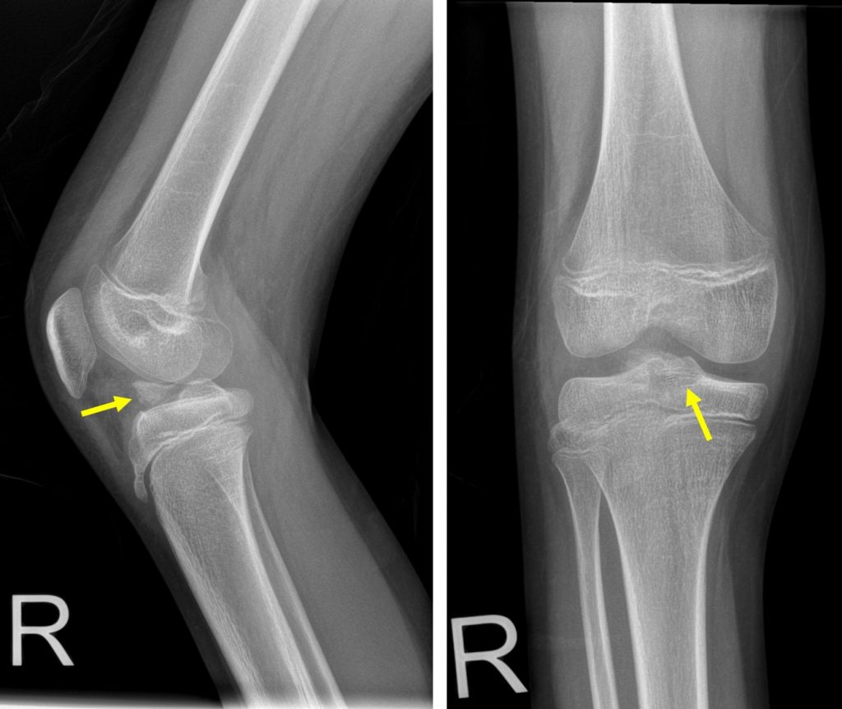
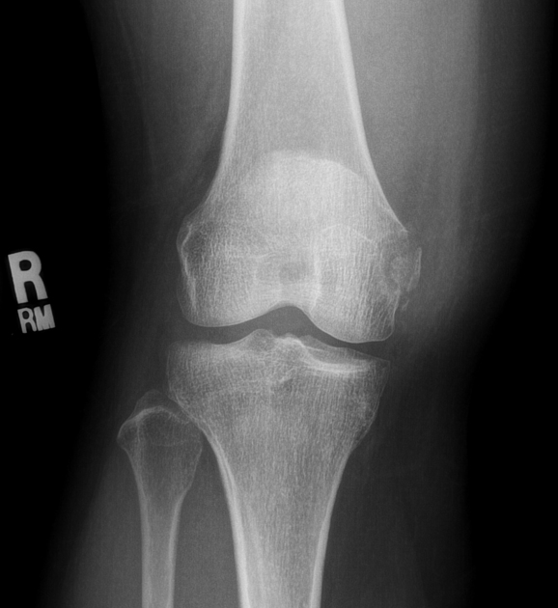
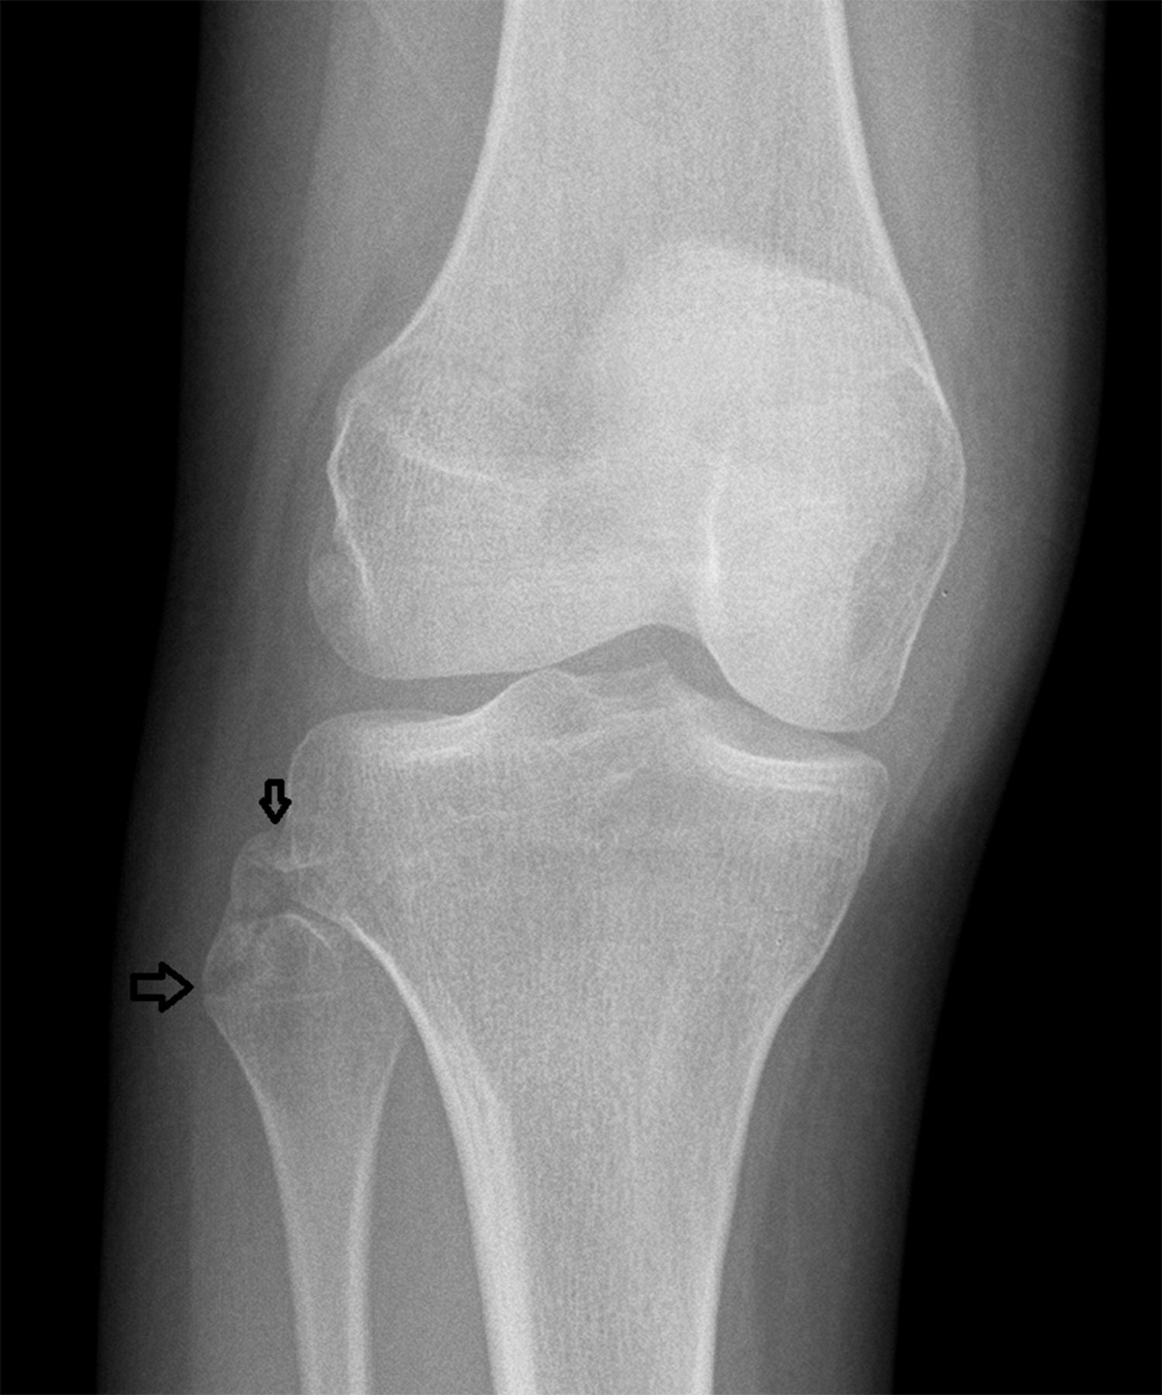
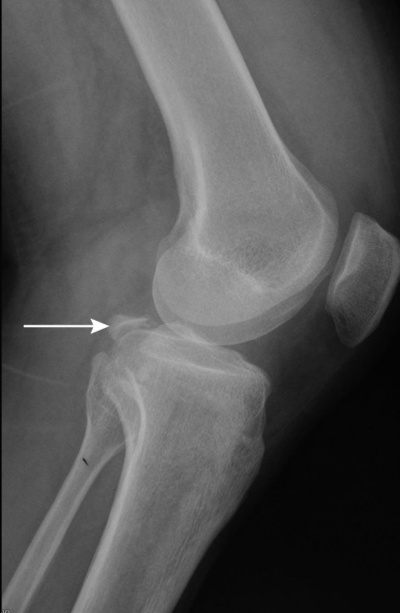
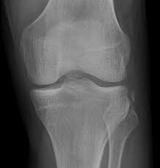
MCL avulsion
LCL avulsion
PCL avulsion
ACL avulsion
Segond fracture

Slide 43
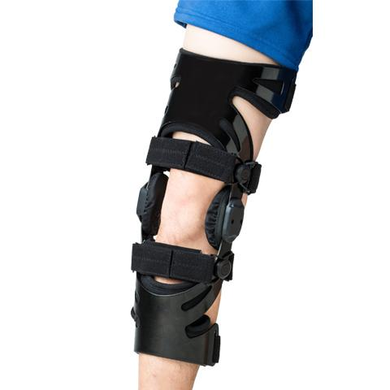
Treatment
Sprains and partial tears
The intact fibres splint the torn ones and spontaneous healing will occur.
The hazard is adhesions, so active exercise is prescribed from the start.
Aspirating the hemarthrosis controversial
Applying ice-packs intermittently also helps relieves pain.
Weightbearing is allowed, but the knee is protected from rotation or angulation strains by a heavily padded bandage or a functional brace.
A complete plaster cast is unnecessary and disadvantageous, as it inhibits movement.

Slide 44
Treatment
Complete tears
Isolated tears of the MCL or the LCL can be treated conservatively.
Isolated tears of the PCL are usually treated conservatively.
Isolated tears of the ACL may be treated by early operative reconstruction in young and athletes.
Whether the treatment involves surgery or not, rehabilitation plays a vital role in getting the patient back to his daily activities.
Avulsion fractures of the tibial intercondylar eminence
operative reduction and fixation with strong sutures (or with small screws if the physis has closed) will be needed
Combined injuries
With combined ACL and collateral ligament injury, it is wiser to start treatment with joint bracing and physiotherapy in order to restore a good range of movement before following on with ACL reconstruction.
The collateral ligament does not usually need reconstruction.
A similar approach is adopted for combined injuries involving the PCL, but here all damaged structures will need to be repaired.

Slide 45
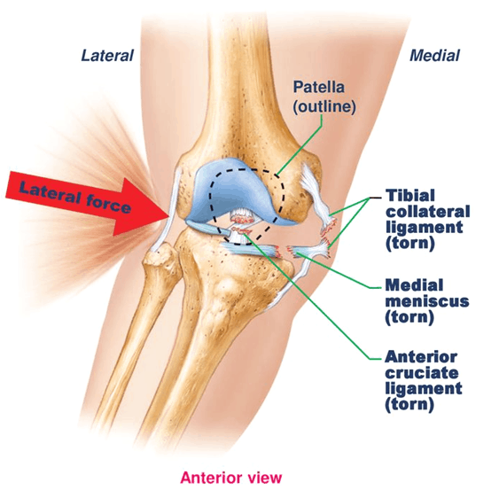
O'Donoghue's triad (unhappy triad):
The firm attachment of the tibial collateral ligament to the medial meniscus is clinically significant, because tearing of the ligament also typically results in tearing of the meniscus.
Such an injury may occur in sports such as football and rugby when the knee receives a blow from the lateral side while the foot is fixed on the ground.
The force of the blow may also tear the anterior cruciate ligament, which is also connected to the medial meniscus.
The term “unhappy triad” is applied to a knee injury that involves damage to three components of the knee joint at the same time: the tibial collateral ligament, medial meniscus, and anterior cruciate ligament.

Slide 46
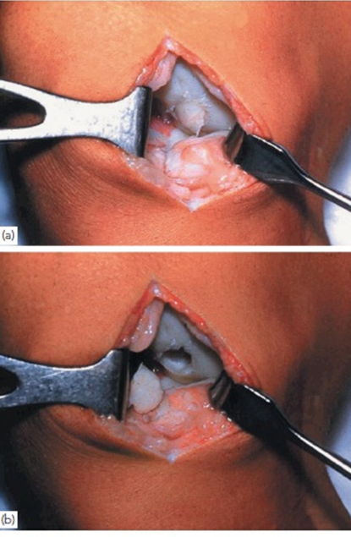
Osteochondritis dissecans
Osteochondritis Dissecans is a pathologic lesion affecting articular cartilage and subchondral bone with variable clinical patterns.
80% lateral aspect of the medial femoral condyle
25% bilateral
Symptoms
Pain: activity related pain that is vague and poorly localized
Locking
recurrent effusions of the knee
Physical exam
localized tenderness: to the medial femoral condyle
Wilson’s test
pain with internally rotating the tibia during extension of the knee between 90° and 30°, then relieving the pain with tibial external rotation

Slide 47
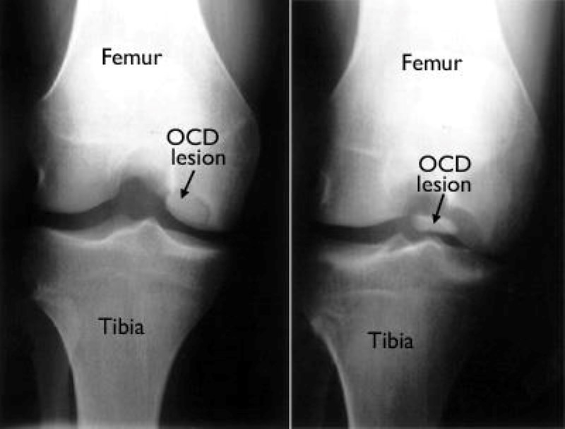
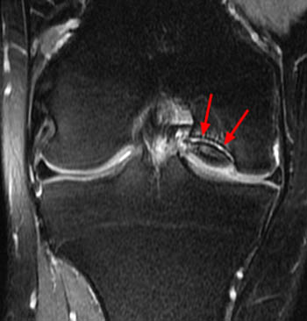
Imaging
Plain x-rays, especially intercondylar (tunnel) views, may show a line of demarcation around a lesion, usually in the lateral part of the medial femoral condyle.
Once the fragment has become detached, the empty hollow may be seen and possibly a loose body elsewhere in the joint.
Radionuclide scans show increased activity around the lesion, and MRI consistently shows an area of low signal intensity in the T1-weighted images.
Treatment:
Conservative
Operative: Fix, Remove, Implant

Slide 48
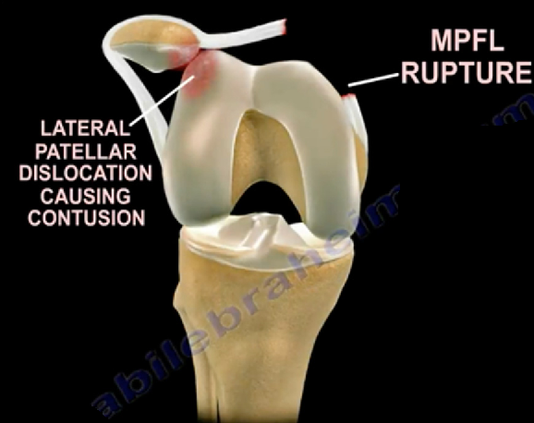
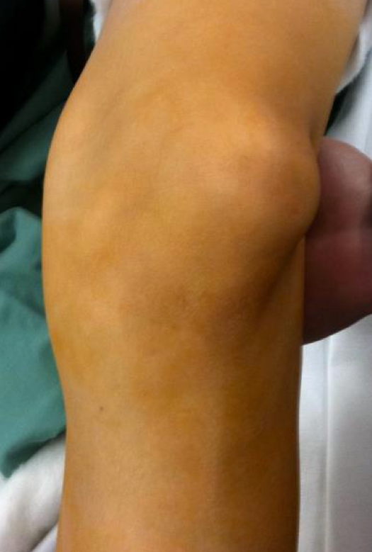
Patellar Instability
Almost always towards the lateral side
F>M
2nd and 3rd decade of life
Symptoms
The knee suddenly gives way and the patient falls; this may be accompanied by pain and sometimes the knee gets stuck in flexion.
Although the patella always dislocates laterally, the patient may think it has displaced medially because the uncovered medial femoral condyle stands out prominently.
Examination
Knee effusion
Medial facet tenderness
Apprehension test

Slide 49
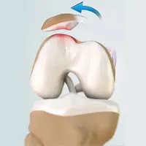
Risk factors
(1) generalized ligamentous laxity
(2) under-development of the lateral femoral condyle and flattening of the intercondylar groove
(3) mal-development of the patella (which may be unusually small or seated too high)
(4)Mal-alignment of the lower limb: increased Q angle, valgus knee, external tibial torsion, and excessive femoral anteversion valgus deformity of the knee
(6) a primary muscle defect.

Slide 50
Treatment
If the patella is still dislocated, it is pushed back into place while the knee is gently extended. A plaster cylinder or splint(for 2–3 weeks), isometric quadriceps strengthening exercises(at least 3 months specially vastus medialis muscle), walking with the aid of crutches.
In cases of repeated and distressing episodes of dislocation surgical reconstruction is indicated.

Slide 51
Chondromalacia of the patella
Softening’ of the patellar articular cartilage.
Repetitive mechanical overload of the patellofemoral joint:
(1) malcongruence of the patellofemoral surfaces.
(2) malalignment of the extensor mechanism, or relative weakness of the vastus medialis, which causes the patella to tilt, or subluxate, or bear more heavily on one facet than the other during flexion and extension of the knee.
Clinical features
Affects teenage girl or an athletic young adult.
Pain over the front of the knee or ‘under the knee-cap’.
Symptoms are aggravated by activity or stairs.
Quadriceps wasting.
Grinding and gliding positive

Slide 52
Tibial tubercle apophysitis
This condition (also called Osgood–Schlatter’s disease) is characterized by pain and swelling of the tibial tubercle.
Affects adolescents
Activity related pain
Tenderness over prominent tibial tubercle
X-rays show displacement or fragmentation of the tibial apophysis.
Management
Restrict activities
Resolves spontaneously after fusion of apophysis

Slide 53
Patellar tendinopathy
A patellar ligament strain or partial rupture may lead to a traction ‘tendinitis’ causing repeated episodes of pain and local tenderness – usually close to its attachment at the lower pole of the patella.
If persistent, it may lead to calcification within the ligament.
The condition is fairly common in adolescent athletes and has acquired the eponym Sinding-Larsen–Johansson syndrome.
It usually resolves spontaneously; if it does not, the painful area is carefully removed keeping the major part of the ligament in continuity.

